Slide 1
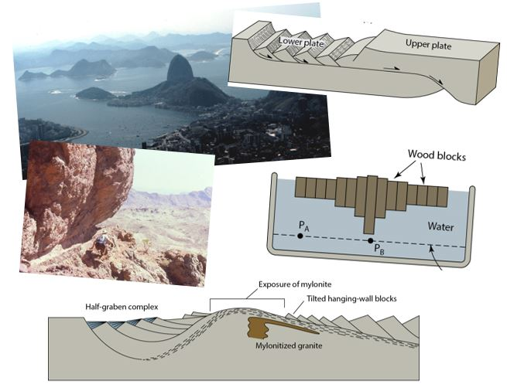
Extension Tectonics: Rifting and Divergence
Earth Structure (Processes in Structural Geology &Tectonics)
© Ben van der Pluijm
9/15/2023 3:43 PM

Slide 2
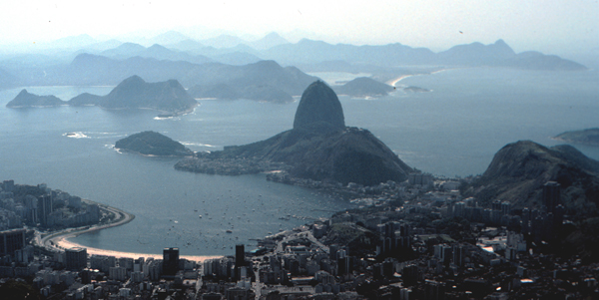
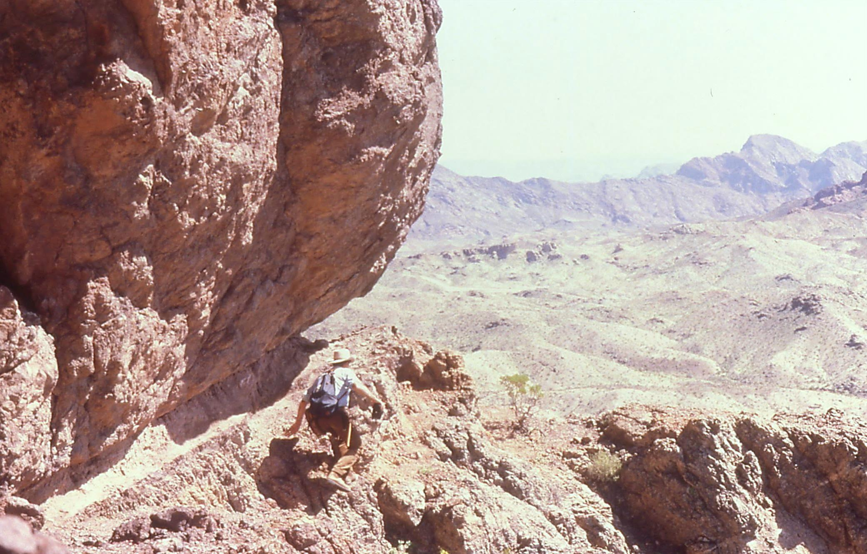
We Discuss …
Extension Tectonics
Today’s divergent plate boundaries
Ocean Ridges
Lithologies
Example: East African Rift
Failed Rifts (e.g., Midcontinent Rift)
Structural Styles
Pure shear systems
Simple shear systems
Stretching factor
Metamorphic core complexes
Isostasy
Rift evolution
Lithologies
Passive margins
Causes of rifting and regional extension
Notes:
F I G U R E 1 6 . 2 2 (a) Photo of the Serra do Mar, along the east coast of Brazil. Here, mountains exposing Precambrian granite and gneiss rise directly out of the ocean, along South America’s passive margin.
F I G U R E 1 6 . 2 0 . Photograph of a basalt flow on top of a rhyolitic ignimbrite, in the Basin and Range Rift of the western United States.

Slide 3
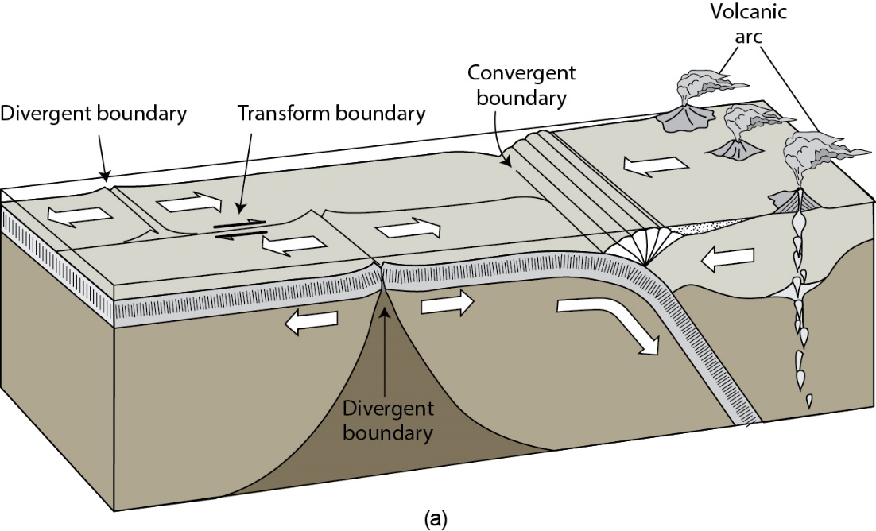
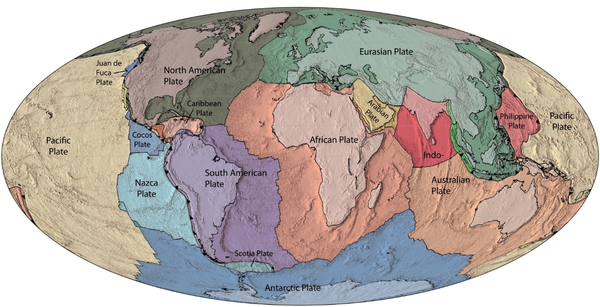
Today’s Plates and Divergent Boundaries
Lateral slip boundary
Divergent boundary +
Lateral slip boundary
Convergent boundary (points to upper plate)
Notes:
F I G U R E 1 4 . 1 4 The nature of plate boundaries.
(a) The basic kinds of plate boundaries. (b) Cross section of a divergent boundary. (c) Cross section of a convergent
boundary. (d) The seven major and several minor plates of the Earth. Ocean ridges (double lines), trenches (lines with
teeth on the overriding plate), and transform faults (single lines) mark the plate boundaries. In a few places, plate
boundaries are ill-defined. These boundaries are marked by dashed lines.

Slide 4
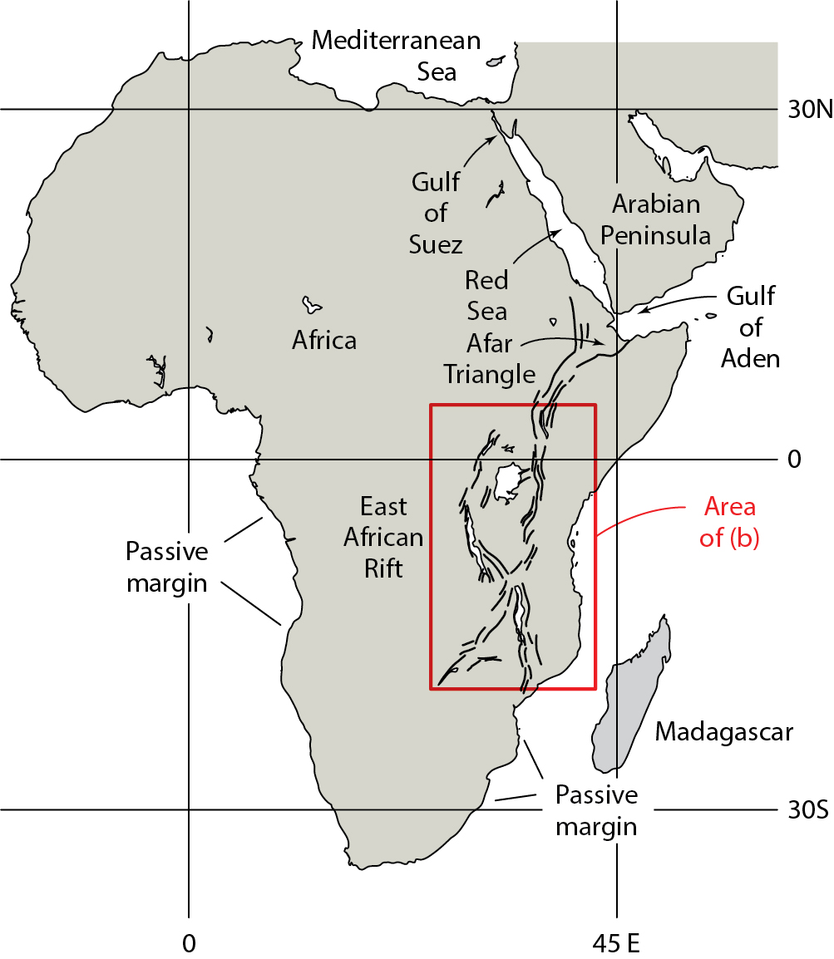
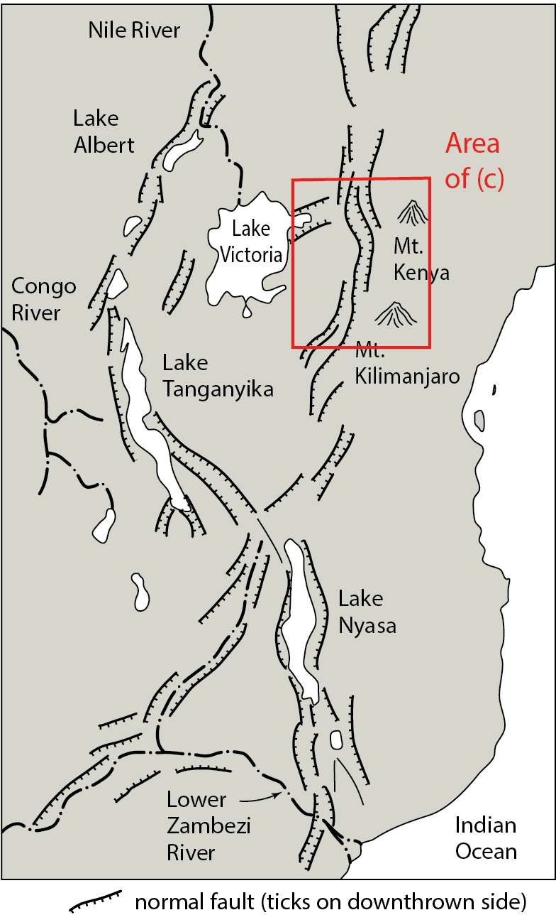
Continental Rift Systems: East African Rift
Gregory Rift
Notes:
F I G U R E 1 6 . 1 (a) Map of Africa, showing the East African Rift, the Red Sea, and the Gulf of
Aden. As we see in East Africa, a continental rift consists of a belt of normal faults, bounding deep
troughs. Some of the troughs may fill with water to become lakes. If the rift is “successful,” a
narrow ocean basin, like the Red Sea or Gulf of Aden, develops. The Afar Triangle lies at the triple
junction between the Red Sea, the Gulf of Aden, and the East African Rift. If seafloor spreading
continues for a long time, the narrow ocean could grow to become a large ocean, like the Atlantic.
The passive continental margins bordering the ocean basin are underlain by stretched continental
crust. (b) Detail of the East African Rift, illustrating the approximate fault pattern.

Slide 5
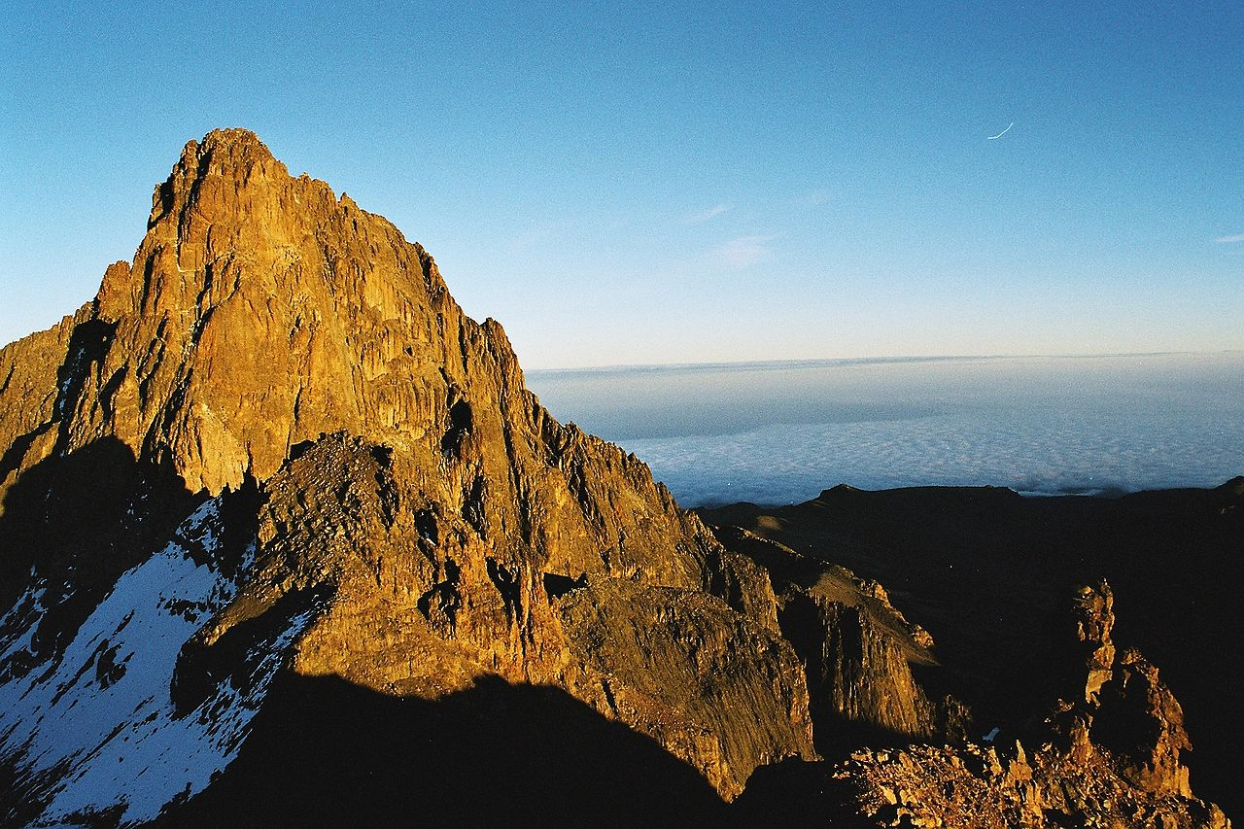
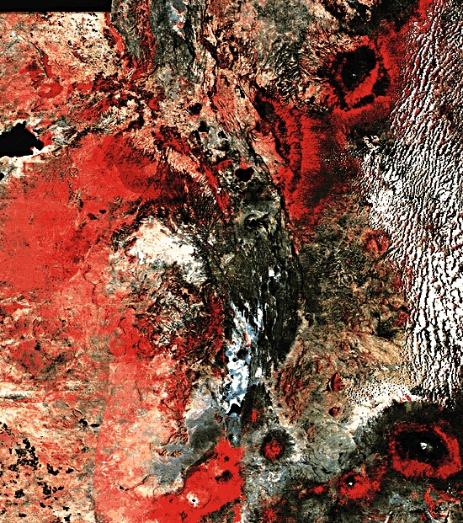
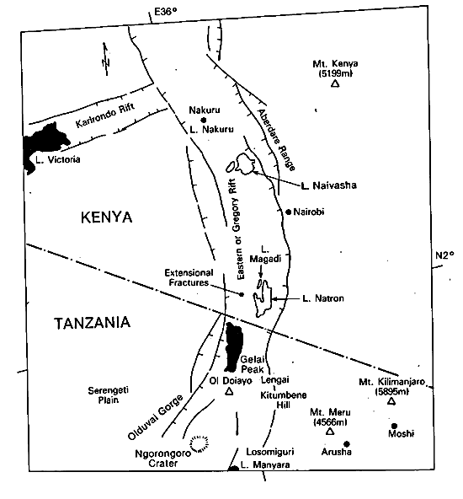
Africa’s Gregory Rift
Mt Kenya
Notes:
F I G U R E 1 6 . 2 Photo of the Gregory Rift in southwest Kenya. Note the escarpments. These are
the eroded footwalls of normal faults. Floods bring in sediment to bury the surface of the hangingwall
block. Magmatic activity associated with rifting has led to the growth of the volcano on the left.

Slide 6
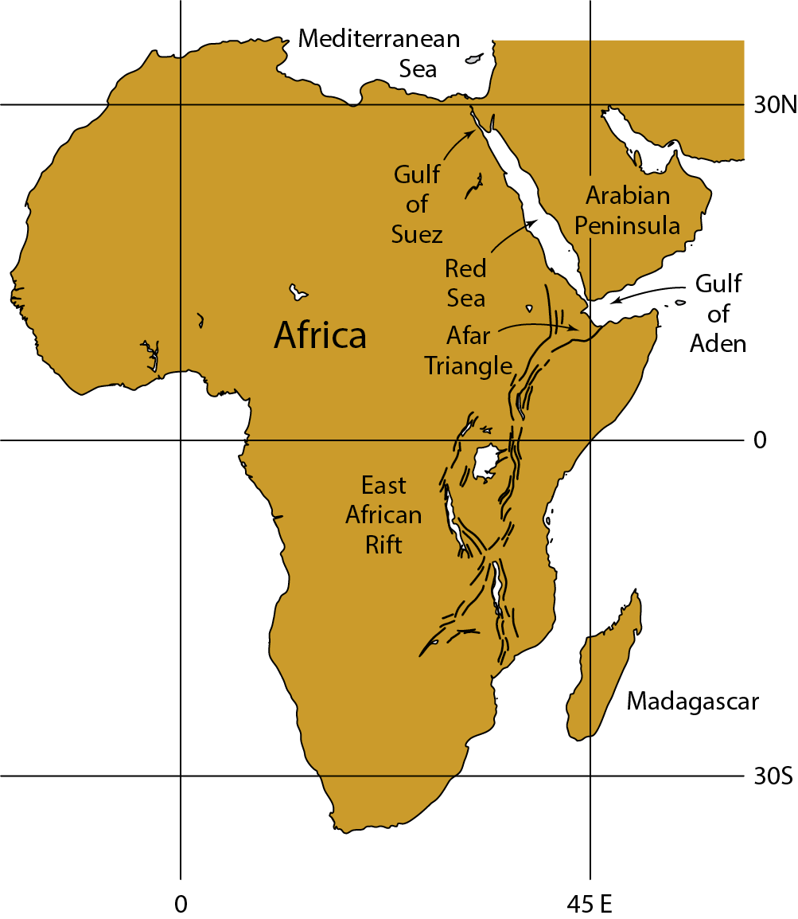
Tectonic Vignettes: Rifting
Map of Africa, showing East African Rift, Red Sea and Gulf of Aden. East African Rift consists of a belt of normal faults that bound deep troughs, some filled with water (lakes). Afar Triangle lies at triple junction between Red Sea, Gulf of Aden, and East African Rift. In Red Sea and Gulf of Aden the rift has evolved to form a narrow ocean basin.
Deconstructing Tectonics
Scotese & van der Pluijm

Slide 7
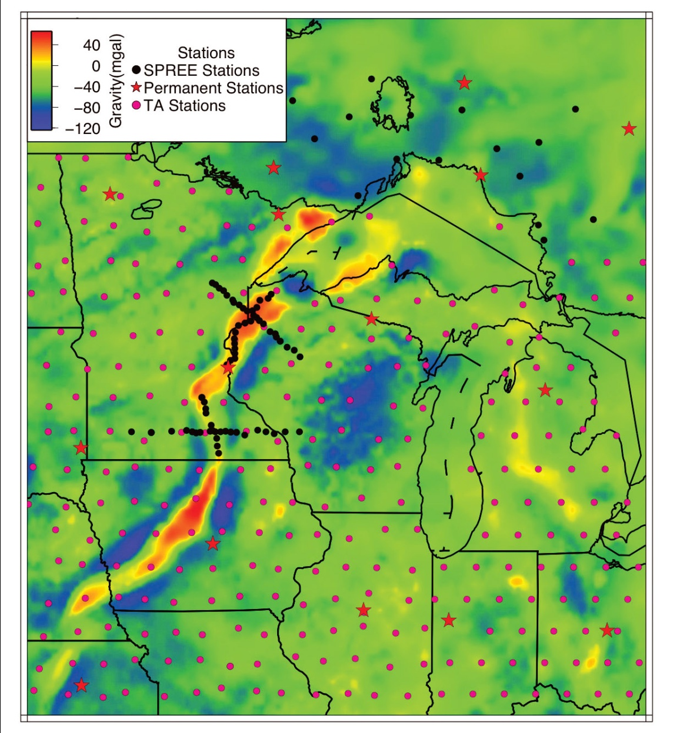
Failed Continental Rift Systems
Midcontinent Gravity High
Stein et al., 2011
Notes:
FIGURE 12.2. Map of the western two-thirds of the US showing inactive Proterozoic rifts that trend at a high angle to Phanerozoic orogens and continental margins. Because these rifts cut into the continent at a high angle, they are called aulacogens. They may be relicts of unsuccessful rifting events that occurred prior to successful rifting that generated the margins of North America at the beginning of the Phanerozoic. Late Proterozoic successful rifts of the western US trend north-northeast, forming a north-northeast trending, passive margin. Thus, Phanerozoic convergent-margin tectonism along this margin, generated orogens at high angles to the aulacogens. [16.3]

Slide 8
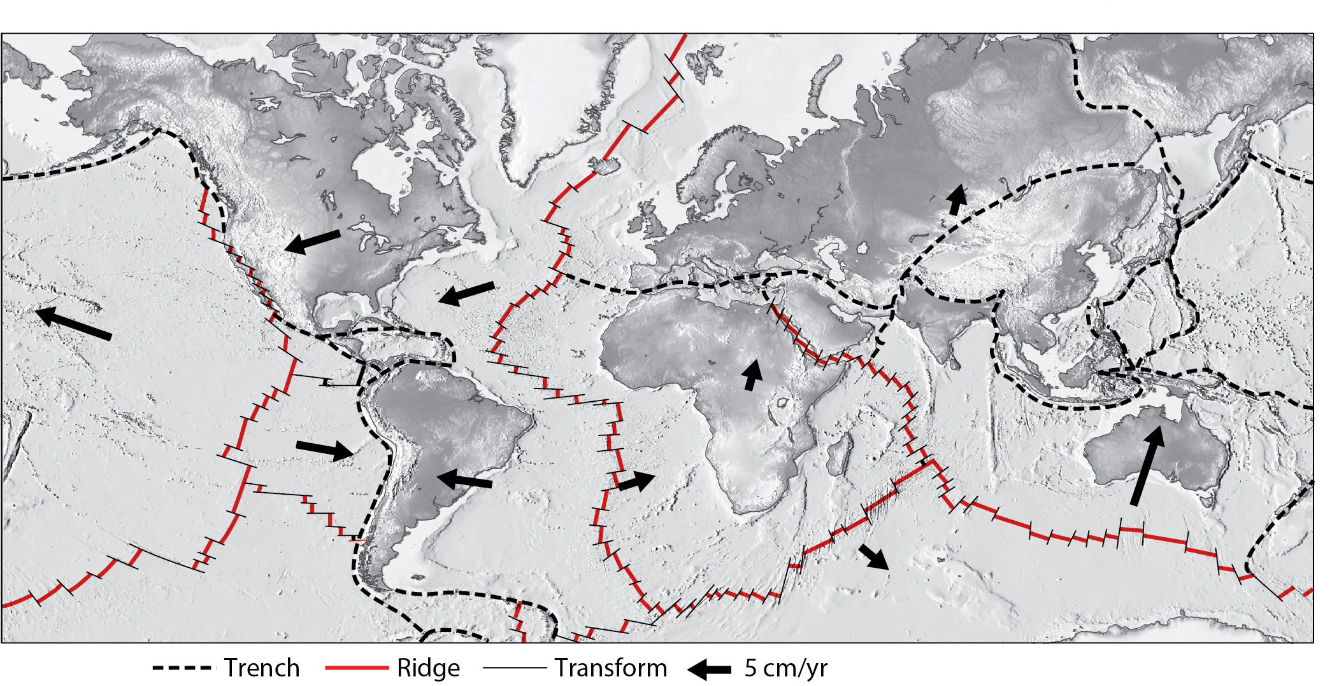
Rifting and Ocean Ridges
Notes:
FIGURE 12.3. The ocean ridges of Earth. Note that ridges, in map view, consist of short segments, linked by transform faults. The lengths of arrows are proportional to the plate velocity. [16.24]

Slide 9
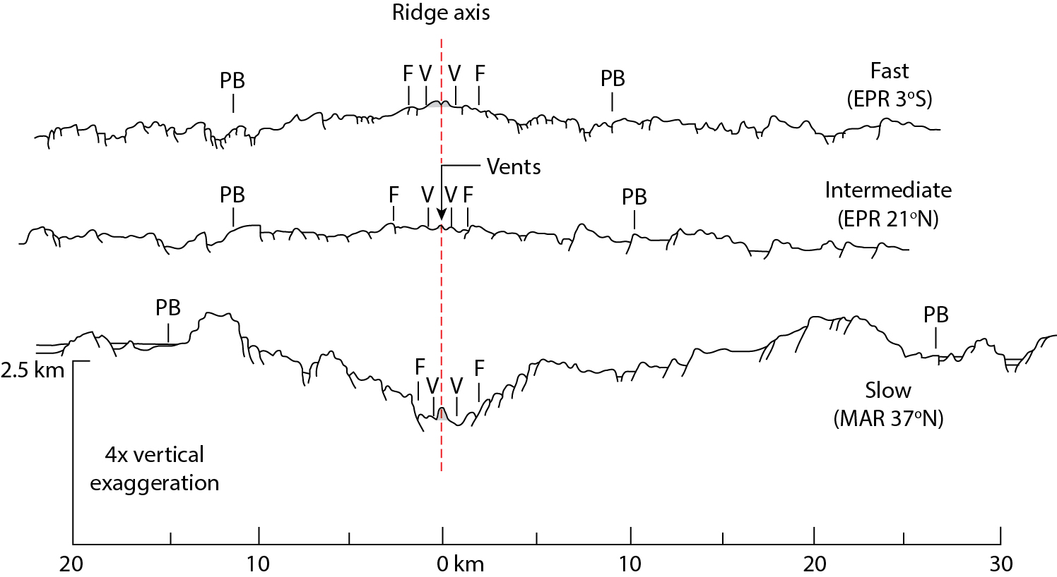
Morphology of Ocean Ridges and Spreading Rate
Fast: East Pacific Rise (EPR); 10+cm/y
Slow: Mid-Atlantic Ridge (MAR); few cm/y
Notes:
F I G U R E 1 6 . 2 6 Morphology of a midocean ridge axis. (a) Simplified profiles of a fast ridge versus a slow ridge. Notice that fast ridges are wider. That’s because the depth to which the seafloor sinks depends on its age. The slow plate at point A is the same age as the fast plate at point B, but both are at the same depth.
(b) Profiles contrasting fast and slow ridge axes. The top profile is across the East Pacific Rise (3° S latitude), while the lower profile is across the Mid-Atlantic Ridge (37° N latitude). Note that an axial trough only occurs at slow ridges, not at fast ridges. “V” marks the position of volcanic vents.

Slide 10
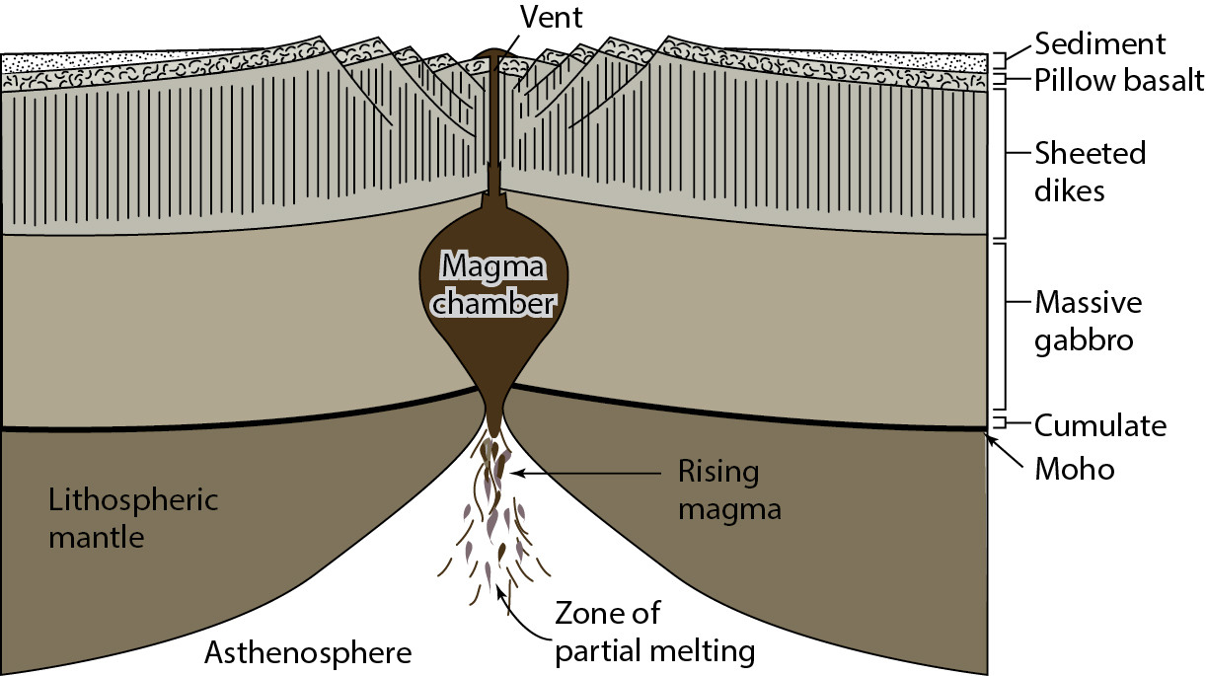
Petrology of Ocean Ridges (“ophiolite”)
Notes:
F I G U R E 1 6 . 2 5 Schematic cross section (not to scale) through the oceanic crust and upper
mantle at a fast-spreading ridge. This illustrates a model for the formation of the distinct layers of
oceanic crust.

Slide 11
Structural Styles of Rift Systems
Pure-shear model
Simple-shear (or detachment) model
Notes:
F I G U R E 1 6 . 5 Contrasting models of rift faulting. (a) Cross section illustrating the old concept
of symmetric horsts and grabens. (b) Cross section illustrating the contemporary image of tilted
fault blocks and half grabens, all above a detachment.
F I G U R E 1 6 . 9 Models of rifting at the crustal scale. (a) Pure-shear model; (b) simple-shear model; (c) delamination model; (d) hybrid model (simple shear plus broad zone of distributed shear at depth).

Slide 12
Examples of Rift Systems
Notes:
F I G U R E 1 6 . 1 1 (a) Cross section of the Viking Graben, in the North Sea Rift. Note that the cross section is at 5 × vertical exaggeration, so the faults look much steeper than they are in nature. Note the basement highs that separate the graben into sub-basins. (b) Cross section of the Gulf of Suez. Note the asymmetry of the rift, in that most faults dip to the northeast; also, note how the original breakaway was abandoned when a later one formed further to the southwest. (c) Location maps showing the North Sea and the Gulf of Suez.

Slide 13
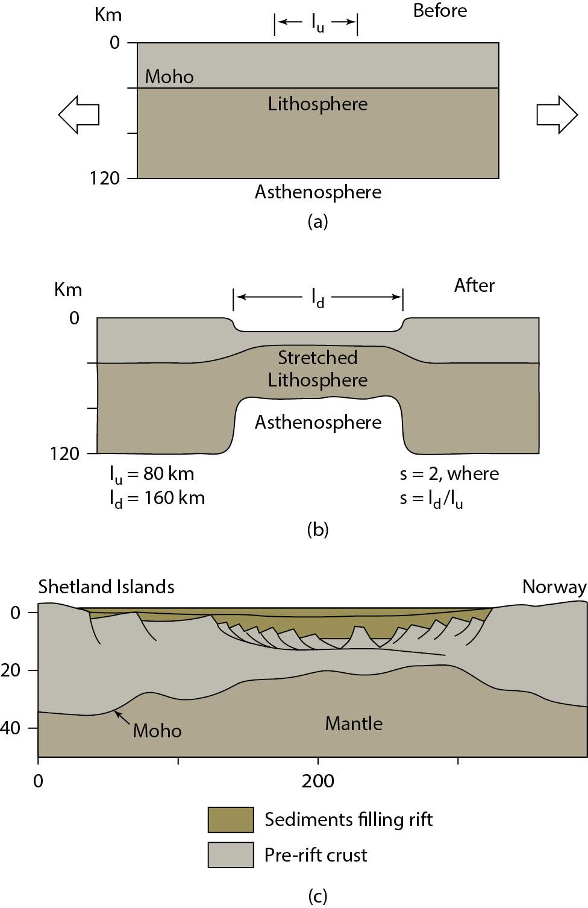
Extension and Stretching Factor
l_{o}
Stretch and extension:
s= l_{d}/l_{o} = 2
e = (l_{d}-l_{o})/l_{o} = 1 (=100% extension, so 50% thinning)
(recall: s = 1 + e)
e is typically 1-3
(s = 2-4)
100-400% extension, 50-75% thinning)
Notes:
F I G U R E 1 6 . 4 Illustration of the concept that rifting leads to stretching of the lithosphere. (a) This cross section shows that before rifting, the unstretched lithosphere is 120 km thick. The region that will evolve into the rift is 80 km wide. We call this the undeformed length (lu). (b) After rifting, the lithosphere in the rift has stretched and thinned, so its deformed length (ld) is 160 km, and it is 60 km thick. We can represent the strain that results from rifting by a number, β, called the stretching factor. In this example, β = ld/lu = 2. The larger the value of β, the greater the amount of stretching and thinning. A value of β = 2 means that the lithosphere has thinned by 50%. (c) In reality, the crust portion of the lithosphere stretches by developing normal faults.
F I G U R E 1 6 . 1 9 Thermal subsidence of a rift basin. (a) Just after rifting, the lithosphere is very thin, and the surface of the lithosphere has sunk to form a rift basin that rapidly fills with sediment. The details of the rift (faults) are not shown. (b) After time has passed, the lithosphere cools and thickens, and therefore sinks to maintain isostasy. The basin therefore gets deeper. The margins of the basin may warp down, so that sediments lap onto the unthinned lithosphere. This geometry is called a steerhead basin, because it resembles a head-on view of a bull with horns.
This simplified cross-sectional sketch through the Viking Graben (North Sea) shows the faulting in the
crust, and the thinning of the crust. (Note: The base of the lithosphere is not shown.) The depression formed by rifting has
filled with sediment.

Slide 14
Extension and Isostasy
Application of Law of Buoyancy to Earth (Archimedes’ Law):
“the mass of water displaced by a block is equal to the mass of the block”
So, surface thinning of “block” (lithosphere) results in subsidence.
l_{o}
P_{A} = P_{B} is called isostatic equilibrium
Notes:
F I G U R E 1 4 . 1 2 The concept of isostasy. (a) Blocks of wood of different thicknesses float at different elevations when placed in water. Therefore, the pressure at point A is the same as the pressure at point B. (b) In the Earth, isostasy requires that the mass of a column drilled down to the level of compensation at A equals the mass of a column drilled at B, if isostatic equilibrium exists at both locations.

Slide 15
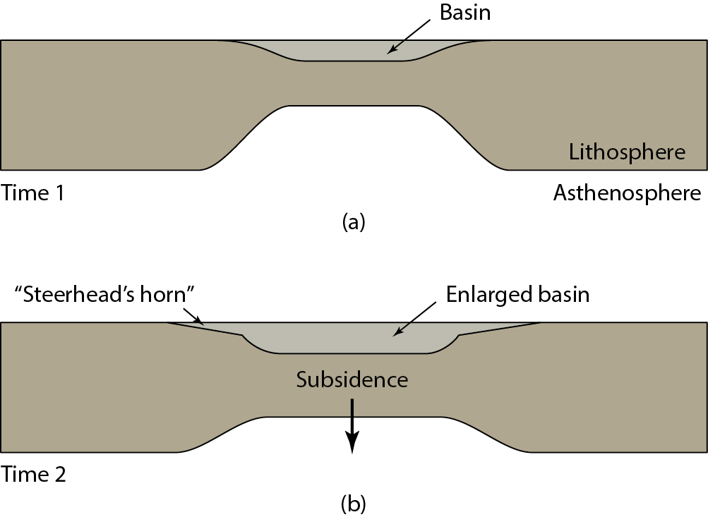
Extra: Extension and Sedimentation
Thinning and basin formation
Cooling and further subsidence, forming broad basin fill (“steerhead basin”)
Viking Graben (North Sea)
Notes:
F I G U R E 1 6 . 4 Illustration of the concept that rifting leads to stretching of the lithosphere. (a) This cross section shows that before rifting, the unstretched lithosphere is 120 km thick. The region that will evolve into the rift is 80 km wide. We call this the undeformed length (lu). (b) After rifting, the lithosphere in the rift has stretched and thinned, so its deformed length (ld) is 160 km, and it is 60 km thick. We can represent the strain that results from rifting by a number, β, called the stretching factor. In this example, β = ld/lu = 2. The larger the value of β, the greater the amount of stretching and thinning. A value of β = 2 means that the lithosphere has thinned by 50%. (c) In reality, the crust portion of the lithosphere stretches by developing normal faults.
F I G U R E 1 6 . 1 9 Thermal subsidence of a rift basin. (a) Just after rifting, the lithosphere is very thin, and the surface of the lithosphere has sunk to form a rift basin that rapidly fills with sediment. The details of the rift (faults) are not shown. (b) After time has passed, the lithosphere cools and thickens, and therefore sinks to maintain isostasy. The basin therefore gets deeper. The margins of the basin may warp down, so that sediments lap onto the unthinned lithosphere. This geometry is called a steerhead basin, because it resembles a head-on view of a bull with horns.
This simplified cross-sectional sketch through the Viking Graben (North Sea) shows the faulting in the
crust, and the thinning of the crust. (Note: The base of the lithosphere is not shown.) The depression formed by rifting has
filled with sediment.

Slide 16
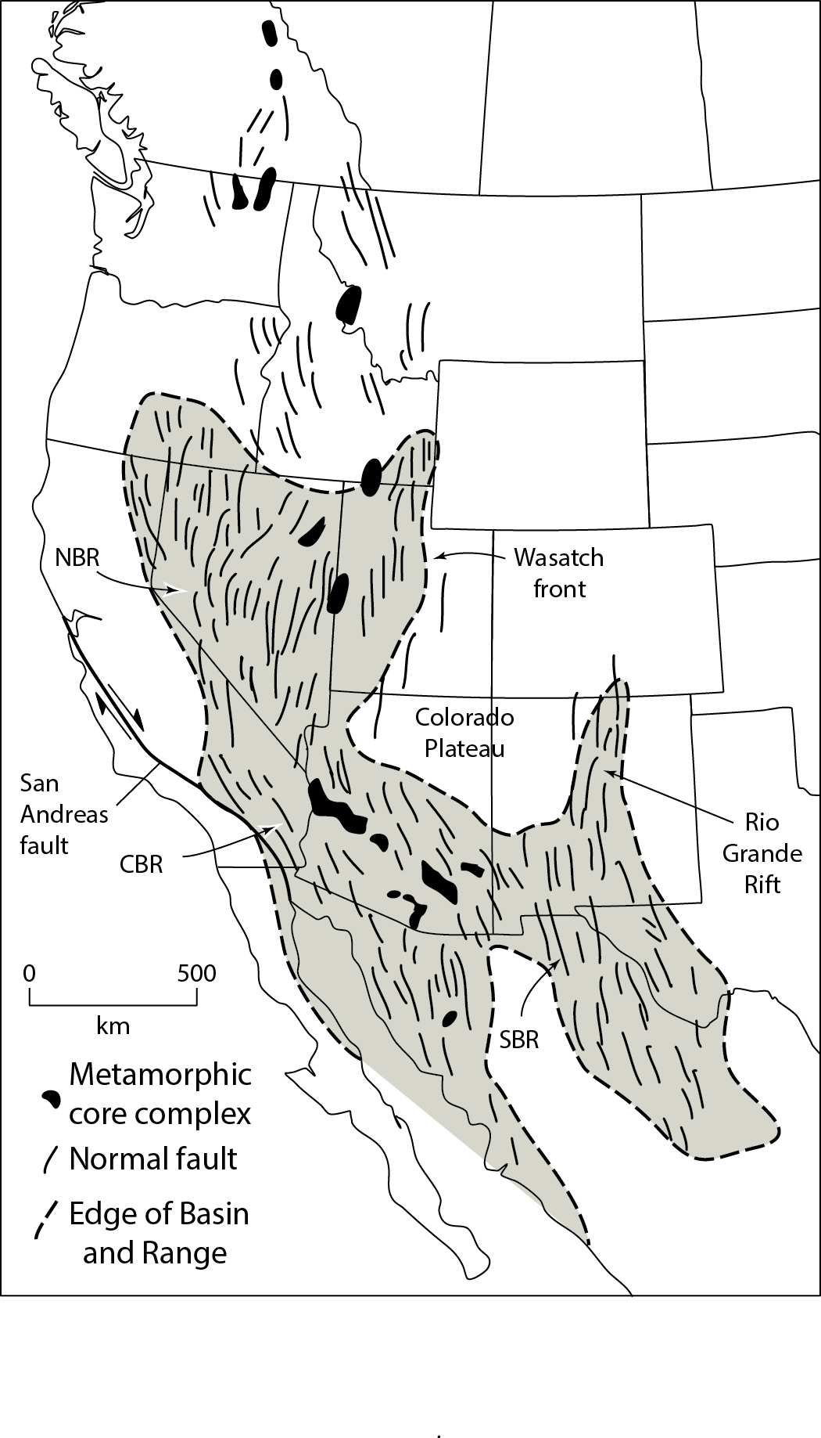
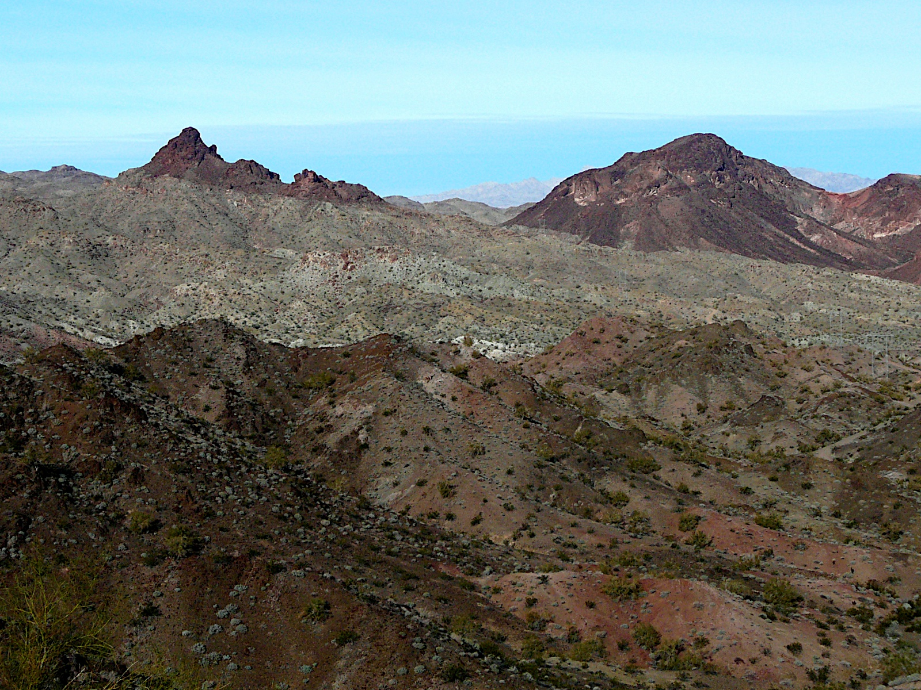
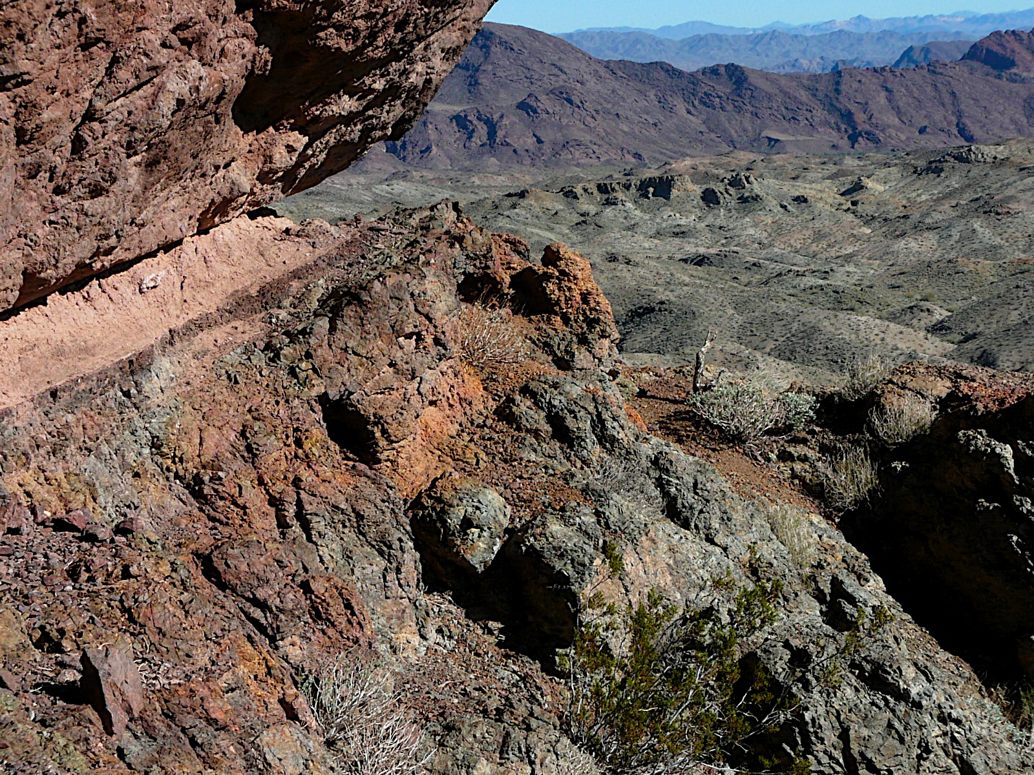
Continental Extension: Metamorphic Core Complexes (MCCs)
MCC: idealized cross section
Whipple Mnts, CA
Notes:
F I G U R E 1 6 . 1 2 Simplified geologic map of the Basin and Range Province of the North American Cordillera. The province can be subdivided into three parts: NBR = Northern Basin and Range, CBR = Central Basin and Range, and SBR = Southern Basin and Range. The Rio Grande Rift is an arm of extensional strain that defines the eastern edge of the Colorado Plateau. Metamorphic core complexes are shown in black.
F I G U R E 1 6 . 1 3 Idealized cross sections (a–d) showing stages in the development of a metamorphic core complex. (d) extreme thinning of the hanging wall exposes the “metamorphic core” (an exposure of the mylonitic shear zone of the detachment). Some of the hanging-wall blocks have rotated by 90°. (e) Photograph of the contact between tilted fault blocks composed of Tertiary volcanics of the hanging wall and mylonitized basement of the footwall. Whipple Mountains, California (USA).
Detachment surface in Whipple Mtns. Gneissic basement complex below. Young volcanic rocks and scraps of basement above.

Slide 17
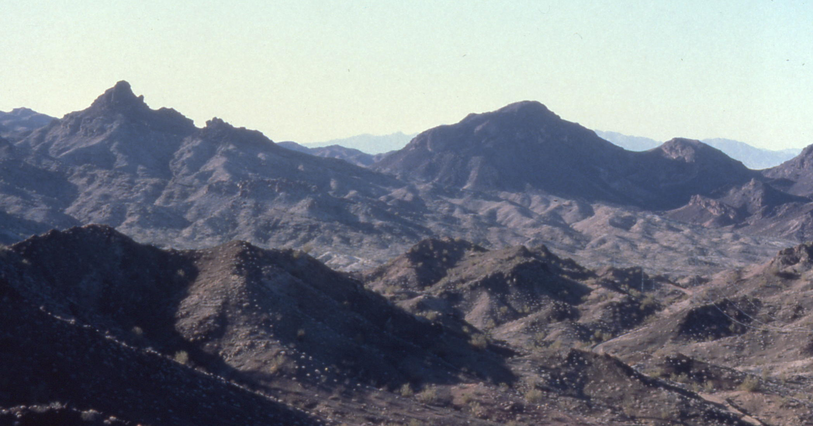
Evolution of Metamorphic Core Complexes
Whipple Mnts, CA
Notes:
F I G U R E 1 6 . 1 3 Idealized cross sections (a–d) showing stages in the development of a metamorphic core complex. (a) An initially subhorizontal, midcrustal ductile detachment zone is formed beneath an array of steeply dipping normal faults in the upper plate; (b) additional normal faults have formed, increasing the geometric complexity; (c) as a result of unloading and isostatic compensation, the lower plate bows upward; (d) extreme thinning of the hanging wall exposes the “metamorphic core” (an exposure of the mylonitic shear zone of the detachment). Some of the hanging-wall blocks have rotated by 90°. (e)
Photograph of the contact between tilted fault blocks composed of Tertiary volcanics of the hanging wall and mylonitized basement of the footwall. Whipple Mountains, California (USA).

Slide 18
Extension and Isostasy
Application of Law of Buoyancy:
“the mass of water displaced by a block is equal to the mass of the block”
So, surface thinning of “block” (upper crust) results in upward flow of “water” (lower crust).
In MCCs, thinning by normal faulting results in exhumation of deeper (mylonitic) detachment and basement rock.
P_{A} = P_{B} is called isostatic equilibrium
Notes:
F I G U R E 1 4 . 1 2 The concept of isostasy. (a) Blocks of wood of different thicknesses float at different elevations when placed in water. Therefore, the pressure at point A is the same as the pressure at point B. (b) In the Earth, isostasy requires that the mass of a column drilled down to the level of compensation at A equals the mass of a column drilled at B, if isostatic equilibrium exists at both locations.

Slide 19
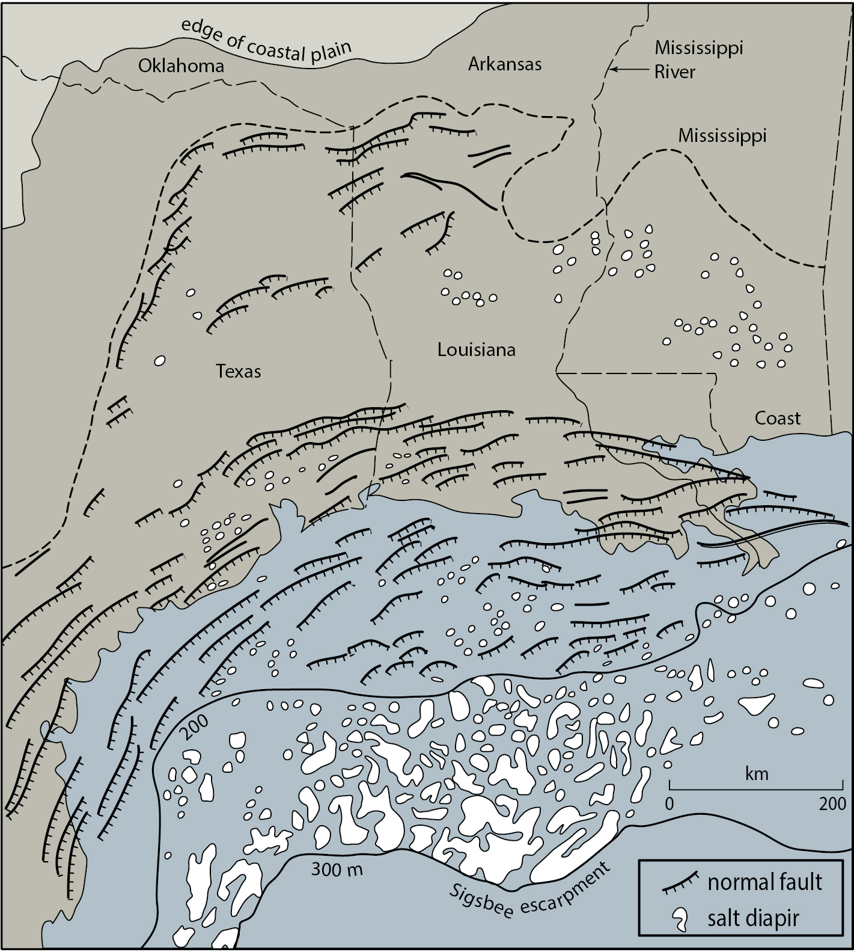
Extension at Passive Margins (US Gulf Coast)
Listric growth faults
US Gulf Coast region
Notes:
F I G U R E 1 6 . 2 7 Simplified map of the Gulf Coast region, off the coast of Louisiana and Texas
(USA), illustrating the normal faults that dip down to the Gulf of Mexico, and the abundant salt
diapirs. Part of the region lies within the Coastal Plain Province, a region submerged by the sea in
the Cretaceous and early Tertiary. The edge of the salt (zero isopach) is shown. Offshore, we show
the 200-m and 3000-m bathymetric contours. Thrusts at the toe of the passive-margin wedge
emerge at the Sigsbee Escarpment.
F I G U R E 1 6 . 2 8 Cross section of a passive-margin wedge. This cross section resembles that
of the Gulf Coast (USA), but has been simplified, and is not an exact representation. Note that there
are two levels of extensional faulting. The lower level formed during the original rifting of the
continental crust that led to the formation of this passive margin. The upper level developed within
the passive-margin wedge sediments and is due to seaward gravity-driven slip of the wedge. The
detachment for this upper level probably lies in the salt near the base of the section. The salt has
risen to form diapirs, especially in the footwalls of normal faults, due to buoyancy and to
differential vertical loads. A thrust belt has developed at the toe of the wedge. The inset shows a
detail of bedding in Cenozoic strata. Note that the faults are listric growth faults and that strata in
the hanging-wall blocks thicken toward the fault.

Slide 20
Rift Evolution (Rift-to-Drift) and Lithologic Assemblages
Rift stage with non-marine basins (continental sst)
Rift–drift transition with evaporate deposition
Drift stage, with seafloor spreading, passive-margin deposition, and marine basin deposition
Notes:
FIGURE 12.12. Evolution of a rift system into paired passive margins and sedimentary environment. (a) Rift stage with non-marine basins; (b) rift–drift transition with evaporate deposition; (c) drift stage, with seafloor spreading occurring and passive-margin basins evolving, and marine deposition in the basins. [16.18]

Slide 21
Main Causes of Regional Extension and Rifting
Rifting above thermal plume (‘mantle view’)
As plates move apart, continent is stretched and pulled apart (‘plate view’)
Backarc extension associated with subduction and slab roll-back
(a)
(b)
(c)

