Slide 1
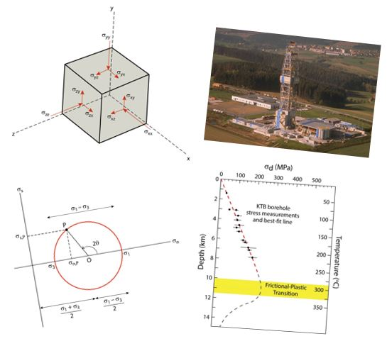
Force and Stress
Earth Structure (Processes in Structural Geology &Tectonics)
© Ben van der Pluijm
9/14/2023 3:47 PM
Notes:
cube, soft ball, hard ball (sphere), fault block, ellipsoid
2-2.5 hours, not 2 full 1.5hr classes

Slide 2
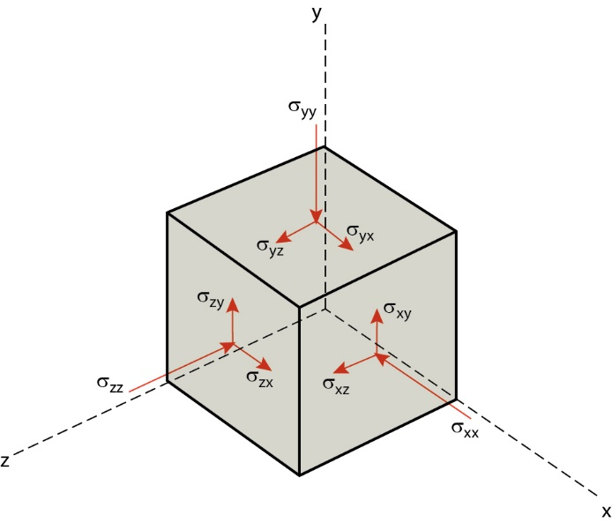
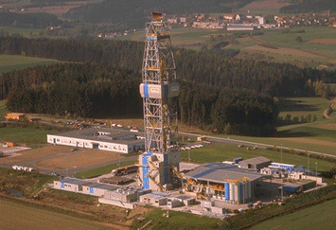
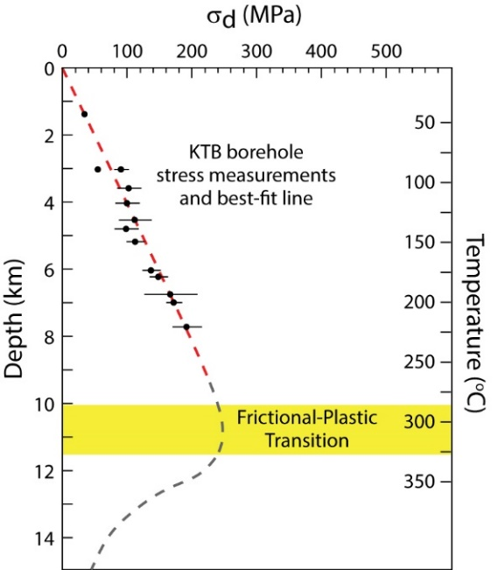
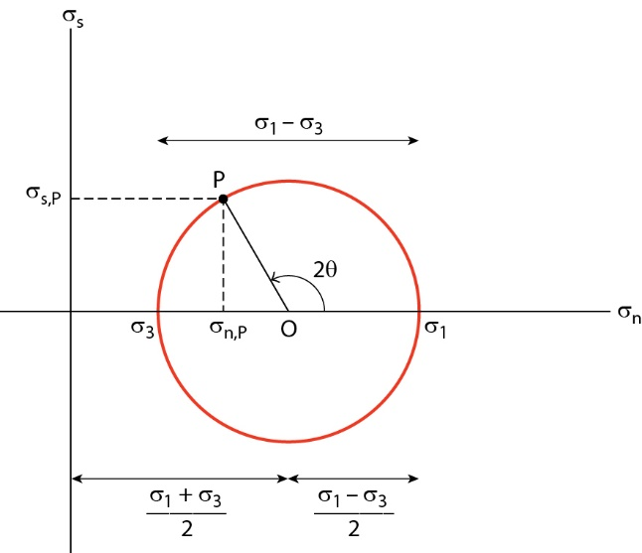
We Discuss …
Force and Stress
Force and Units
Newtonian and Continuum Mechanics
(Trigonometry)
2D and 3D Stress
Normal Stress and Shear Stress
Mohr Construction of Stress
Stress States
Measurement of Stress
At surface
At depth
Lithospheric Stress
Modern stress regimes
Geologic Provinces

Slide 3
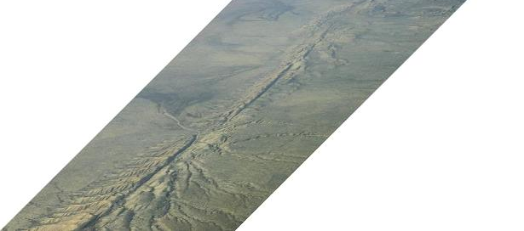
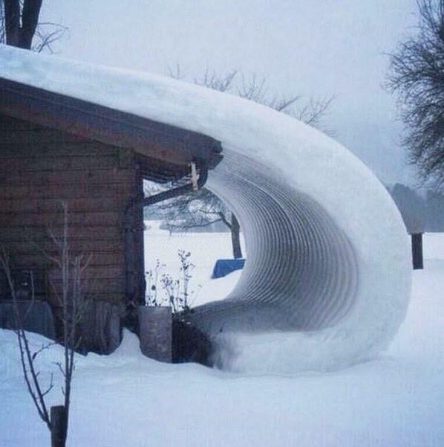
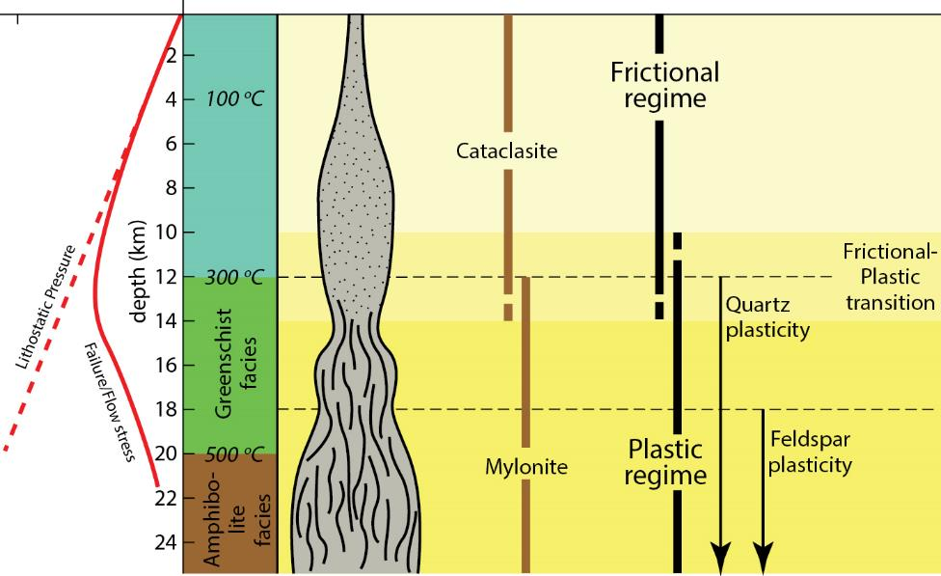
Frictional Deformation Regime and Brittle Structures
San Andreas Fault, Carrizo Plain
P_{l}/σ_{d} T(ºC) Rock Regime
frictional
Brittle Structures
plastic

Slide 4
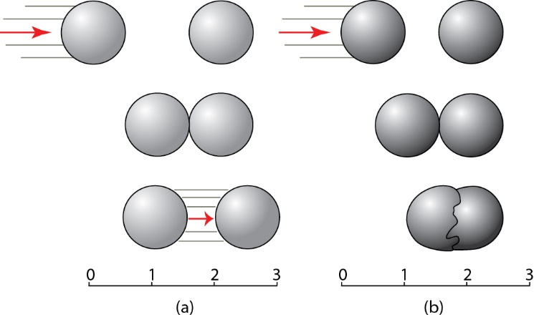
Mechanics: Force and Displacements
(a) Newtonian mechanics: displacements between bodies
1st Law: No force on object means constant velocity (inertia law)
2nd Law: F = m .a
3rd Law: F = -F
(b) Continuum mechanics: displacement between and within bodies
Notes:
Imagine the difference between playing pool with regular balls and balls made of jelly.
F I G U R E 3 . 2 The interaction of nondeformable bodies is described by Newtonian (or classical) mechanics (a) and that between deformable bodies by continuum mechanics (b).

Slide 5
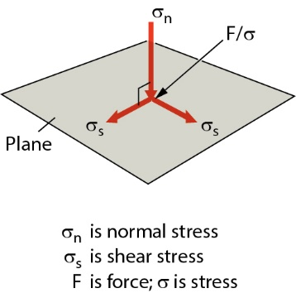
Stress and Tractions
Stress = Force/Area
(stress is “intensity of force”)
Stress on a plane in space is defined by
stress acting perpendicular to plane (normal stress, σ_{n})
stresses acting along plane (shear stress, σ_{s})
These resolved stresses are also called tractions
Notes:
Vector quantities
Body forces v surface forces
Stress = intensity of force. Hit rock with pointy or flat side of hammer, different result. Step on Lego piece.
F I G U R E 3 . 3 The stress on a two-dimensional plane is defined by a stress acting perpendicular to the plane (the
normal stress) and a stress acting along the plane (the shear stress). The normal stress and shear stress are perpendicular
to one another.

Slide 6
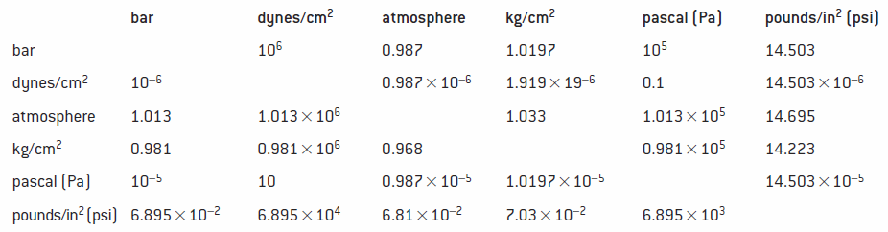
Units and Conversions
Stress (or Pressure) = Force/Area
= (m.a)/Area = kg.m.s⁻².m⁻² = N.m⁻² = Pa (Pascal)
1 bar (atmospheric conditions) = 1.10⁵ Pa (1E5 Pa) = 0.1 MPa
1000 bar = 1 kbar (geologic conditions) = 100 MPa
(Recall: Work(=Energy) = Force x Distance)
Notes:
Stress = intensity of force. Hit rock with pointy or flat side of hammer, different result.

Slide 7
Mechanical Foundations
Force =
mass x acceleration
kg.m.s⁻² = N (Newton)
Stress (Pressure) =
Force/Area =
mass x acceleration / area =
kg.m.s⁻².m⁻² (= kg.s⁻².m⁻¹) N/m² = Pa (Pascal)
Work (Energy) =
Force x distance =
mass x acceleration x distance
kg.m.s⁻².m (= kg.m².s⁻²)
N.m = J (Joule)
Power =
Force x distance / time =
kg.m.s⁻².m.s⁻¹ (= kg.m².s⁻³)
N.m.s⁻¹ = J/s = W (Watt)
Elastic Viscous

Slide 8
Relationship between Force and Stress (2D analysis)
F_{n} = F.cosθ
F_{s} =
σ = F/LengthAB; so, F= σ.AB
cosθ = AB/EF (adjacent/hypotenuse)
So, AB = EF. cosθ (F= σ. EF. cosθ)
Thus, corresponding stresses are:
σ_{n} = F_{n}/EF = F.cosθ/EF = (σ.AB).cosθ/EF
= (σ.EF.cosθ).cosθ/EF = σ cos² θ
σ_{s} =
Force and Stress on plane EF (2D section)
Notes:
Stress depends on reference system/orientation; tensor (not vector). Stress on surface is vector (traction).
F I G U R E 3 . 4 The relationship between force (F) and stress (σ) on a plane. Section through a cube showing face ABCD with ribs of length AB on which a force F is applied. This force is resolved into orientations parallel (Fs) and perpendicular (Fn) to a plane that makes an angle θ with the top and bottom surface (EF is the trace of this plane). The magnitudes of vectors Fs and Fn are a function of the angle θ: Fn = F ⋅ cos θ, Fs = F ⋅ sin θ. The magnitude of the normal (σn) and shear stress (σs) is a function of the angle θ and the area: σn=σcos2 θ, σs=σ1⁄2 (sin 2θ). (a) Force F on plane; (b) stress σ on plane; (c) normalized values of Fn and σn on plane with angle θ; (d) normalized values of Fs and σs on a plane with angle θ.
Sin = opposite/hypotenuse
Cos = adjacent/hypotenuse
Tan = sin/cos = opposite/adjacent

Slide 9
Relationship between Force and Stress (2D analysis)
F_{n} =
F_{s} = F.sinθ
σ = F/LengthAB; so, F= σ.AB
cosθ = AB/EF (adjacent/hypotenuse)
So, AB = EF. cosθ (F= σ. EF. cosθ)
Thus, corresponding stresses are:
σ_{n} =
σ_{s} = F_{s}/EF = F.sinθ/EF = (σ.AB).sinθ/EF
= (σ.EF.cosθ).sinθ/EF = σ.cosθ.sinθ = σ ½(sin2θ)
Force and Stress on plane EF (2D section)
Notes:
Stress depends on reference system/orientation; tensor (not vector). Stress on surface is vector (traction).
F I G U R E 3 . 4 The relationship between force (F) and stress (σ) on a plane. Section through a cube showing face ABCD with ribs of length AB on which a force F is applied. This force is resolved into orientations parallel (Fs) and perpendicular (Fn) to a plane that makes an angle θ with the top and bottom surface (EF is the trace of this plane). The magnitudes of vectors Fs and Fn are a function of the angle θ: Fn = F ⋅ cos θ, Fs = F ⋅ sin θ. The magnitude of the normal (σn) and shear stress (σs) is a function of the angle θ and the area: σn=σcos2 θ, σs=σ1⁄2 (sin 2θ). (a) Force F on plane; (b) stress σ on plane; (c) normalized values of Fn and σn on plane with angle θ; (d) normalized values of Fs and σs on a plane with angle θ.
Sin = opposite/hypotenuse
Cos = adjacent/hypotenuse
Tan = sin/cos = opposite/adjacent

Slide 10
Difference between Force and Stress: Effect of area
σ_{n} = σ cos² θ
y=cosθ (red)
y=cos²θ (blue); extremes (max, 0, min) at 90º
σ_{s} = σ ½(sin2θ)
y=sinθ (red)
y=1/2 sin2θ (blue); extremes (max, 0, min) at 45º
Recall π = 180º = 3.14
Notes:
Extremes at 90 vs 45 degrees

Slide 11
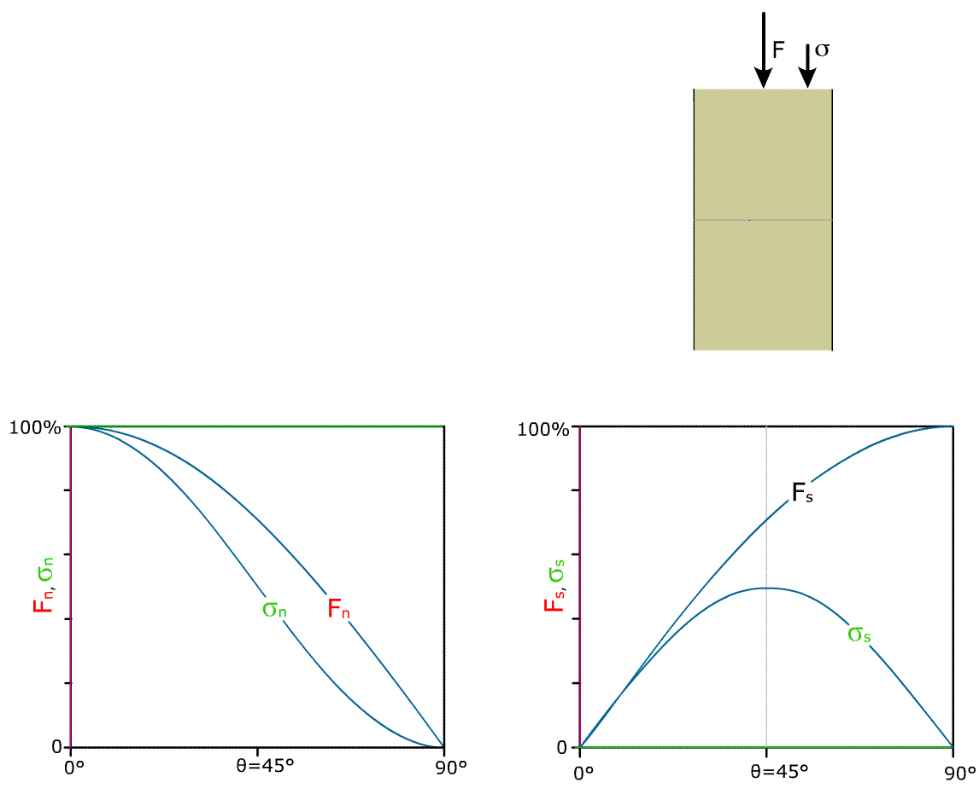
Relationship between Force and Stress (2D analysis)
F_{n} = F.cosθ
F_{s} = F.sinθ
σ_{n} = σ cos² θ
σ_{s} = σ ½(sin2θ)
Normalized values of F_{n} and F_{s} , and σ_{n} and σ_{s} on plane with angle θ reference (horizontal)
animation H Fossen)
Notes:
Stress depends on reference system/orientation; tensor (not vector). Stress on surface is vector (traction).
F I G U R E 3 . 4 The relationship between force (F) and stress (σ) on a plane. Section through a cube showing face ABCD with ribs of length AB on which a force F is applied. This force is resolved into orientations parallel (Fs) and perpendicular (Fn) to a plane that makes an angle θ with the top and bottom surface (EF is the trace of this plane). The magnitudes of vectors Fs and Fn are a function of the angle θ: Fn = F ⋅ cos θ, Fs = F ⋅ sin θ. The magnitude of the normal (σn) and shear stress (σs) is a function of the angle θ and the area: σn=σcos2 θ, σs=σ1⁄2 (sin 2θ). (a) Force F on plane; (b) stress σ on plane; (c) normalized values of Fn and σn on plane with angle θ; (d) normalized values of Fs and σs on a plane with angle θ.
Sin = opposite/hypotenuse
Cos = adjacent/hypotenuse
Tan = sin/cos = opposite/adjacent

Slide 12
3D stress
Cube is 3D object with least number of unique planes (2)
3rd Law: non-moving object, so, balancing tractions define six independent components:
Notes:
3rd law of motion for non moving, non-rotating object
F I G U R E 3 . 6 Resolution of stress into components perpendicular (three normal stresses, σn) and components
parallel (six shear stresses, σs) to the three faces of an infinitesimally small cube, relative to the reference system x, y, and z.

Slide 13
Infinitesimal Stress and Stress Ellipsoid (2D and 3D)
Point is intersection of infinite number of planes
Shrink cube to a point
two-dimensions: stress ellipse
three dimensions: stress ellipsoid
Ellipsoid axes are called principal stresses, with σ₁ ≥ σ₂ ≥ σ₃
Notes:
Shrink cube to point (point is infinite number of planes intersection)
F I G U R E 3 . 5 (a) A point represents the intersection of an infinite number of planes, and the stresses on these planes
describe an ellipse in the two-dimensional case. In three dimensions this stress envelope is an ellipsoid (b), defined by
three mutually perpendicular principal stress axes (σ1≥σ2≥σ3). These three axes are normal to the principal planes of stress.

Slide 14
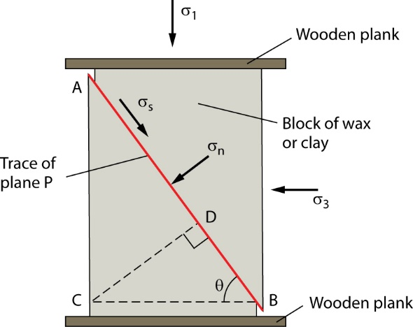
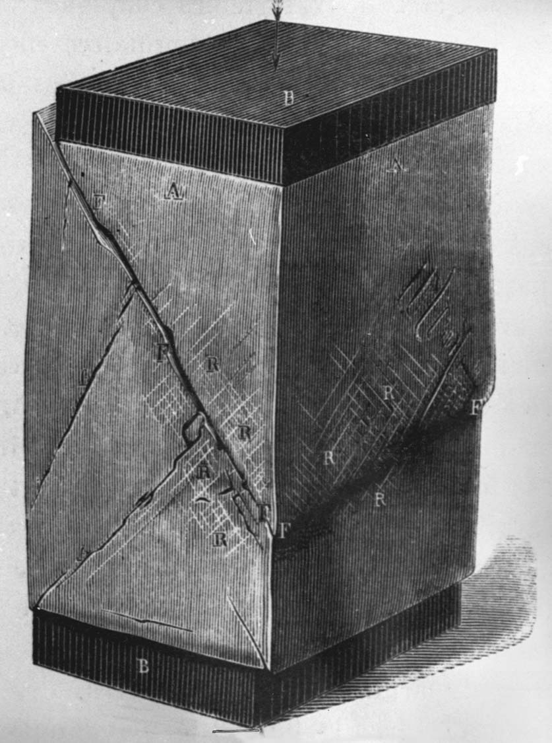
Normal and Shear Stress Relationships
ϴ (~60º) is angle with σ₃ is 90-ϴ (~30º) with σ₁
Notes:
F I G U R E 3 . 7 Determining the normal and shear stresses on a plane in a stressed body as a function of the principal stresses. (a) An illustration from the late nineteenth-century fracture experiments of Daubrée using wax. (b) For a classroom experiment, a block of clay is squeezed between two planks of wood. AB is the trace of fracture plane P in our body that makes an angle θ with σ3. The two-dimensional case shown is sufficient to describe the experiment, because σ2 equals σ3 (atmospheric pressure).

Slide 15
Deriving σ_{normal} and σ_{shear} from Principal Stresses σ₁, σ₂, σ₃
σ_{normal}
σ_{shear}
F = σ . Area
Here (2D): F = σ . Length
Notes:
CD parallel to sigmaN; AB parallel to sigmaS
Plane angles with max stress from equation

Slide 16
Graphical Solution: Mohr Diagram for Stress
Stress Solution space
σ_{d}
Plot 2 x ϴ (angle with σ₃)
Rearrange for (σ₁-σ₃), square and add:
Circle with radius r, centered on x-axis at distance a from origin
Diameter is (σ₁-σ₃) = σ_{d} = differential stress
Radius is 1/2(σ₁-σ₃) = σ_{s} = shear stress
So, shear stress is half of differential stress
Notes:
Plot twice theta angle (plane-sigma3) from sigma 1 side
F I G U R E 3 . 8 The Mohr diagram for stress. Point P
represents the plane in our clay experiment of Figure 3.7.

Slide 17
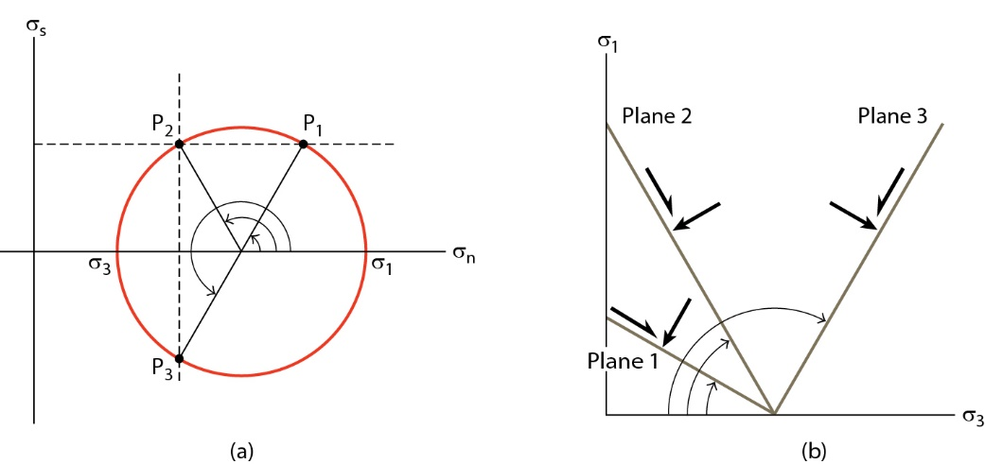
Planes in Stress and Real Space
Stress Solution Real Space
Space
For each value of shear stress and normal stress there are two corresponding planes, shown in Mohr diagram. Note this is stress solution (σ_{n} / σ_{s}) space, not real space.
Corresponding planes in (σ₁ / σ₃) space, which is real space.
Notes:
F I G U R E 3 . 9 For each value of the shear stress and the normal stress there are two corresponding planes, as shown in the Mohr diagram (a). The corresponding planes in σ1 – σ3 space are shown in (b).

Slide 18
Homework: Stress
Notes:
F I G U R E 3 . 1 0 Adventures with the Mohr circle. To estimate the normal and shear stresses on the the six planes in (a) apply the Mohr construction in (b). The principal stresses and angles θ are given in (a). You can check your estimates from the construction
in σn – σs space by using Equations 3.7 and 3.10.

Slide 19
3D Stress states
Mohr circle construction allows 3D stress ellipsoid solution in 2D plot space
General triaxial stress: σ₁ > σ₂ > σ₃ ≠ 0
Biaxial (or plane) stress: one axis = 0 (e.g., σ₁ > σ₂ > 0)
Uniaxial compression: σ₁ > 0; σ₂ = σ₃ = 0 (and Uniaxial tension: σ₁ = σ₂ = 0; σ₃ < 0)
Pressure (or Atmospheric/ Hydrostatic/ Lithostatic stress): σ₁ = σ₂ = σ₃ Note: σ_{s} is 0 because differential stress is 0
Notes:
F I G U R E 3 . 1 1 Mohr diagrams of some representative stress states: (a) triaxial stress, (b) biaxial (plane) stress, (c) uniaxial compression, and (d) isotropic stress or hydrostatic pressure, P (compression is shown).

Slide 20
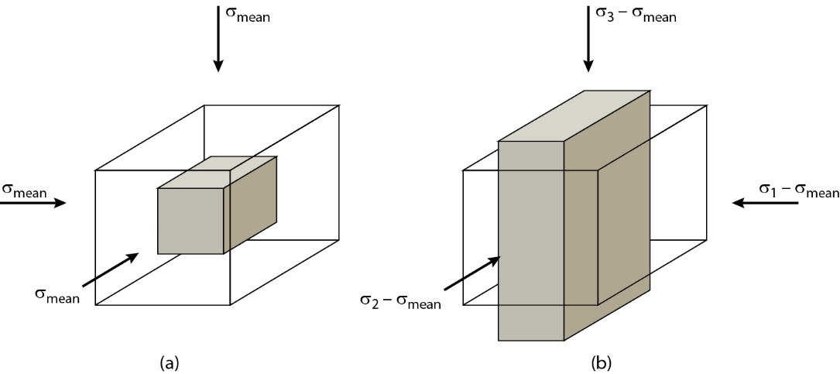
Isotropic and Non-isotropic Stress
volume change, reflects isotropic mean stress, σ_{m}
shape change, reflects non-isotropic stresses
Note: differential stress (=scalar) Is not same as deviatoric stress (=matrix/tensor)
…. Matrix algebra
σ_{m} + σ_{dev}
Notes:
F I G U R E 3 . 1 2 The mean (hydrostatic) and deviatoric components of the stress.
(a) Mean stress causes volume change and (b) deviatoric stress causes shape change.

Slide 21
Extra: Stress Tensor and Matrix Algebra
The transformation of point P defined by coordinates P(x, y, z) to point P′(x′, y′, z′). We describe the transformation of the three coordinates of P as a function of P′ by
The tensor that describes the transformation from P to
P′ is the matrix:
In matrix notation, the nine components of a stress tensor are:
with σ₁₁ oriented parallel to the 1-axis and acting on a plane perpendicular to the 1-axis, σ₁₂ oriented parallel to the 1-axis and acting on a plane perpendicular to the 2-axis, and so on.
Mean stress and deviatoric stresses:
Notes:
Stress is force vector (1x3 matrix) and orientation, so 3x3 matrix

Slide 22
Isotropic Stress: Lithostatic and Hydrostatic Pressure
Mean stress lithostatic (rock) pressure, P_{l}. Consider rock at depth of 1000 m,
lithostatic pressure is :
P_{l} = ρ ⋅ g ⋅ h
If ρ (density) is 2700 kg/m³, g (gravity) is 9.8 m/s², h (depth) is 1000 m, we get:
P_{l} = 2700 ⋅ 9.8 ⋅ 1000 = 26.5 ⋅ 10⁶ Pa ≈ 27 MPa (or 270 bars) per km
For every kilometer in Earth’s crust, lithostatic (rock column) pressure increases by ~27 MPa (and more with higher density rocks).
Corresponding hydrostatic (=water column) pressure is P_{h} = ρ ⋅ g ⋅ h = 1000 ⋅ 9.8 ⋅ 1000 ≈ 9.8 MPa (100 bars) per km
Note: plate tectonics stresses are much smaller than lithostatic pressure(as we’ll see later) !
mean stress

Slide 23
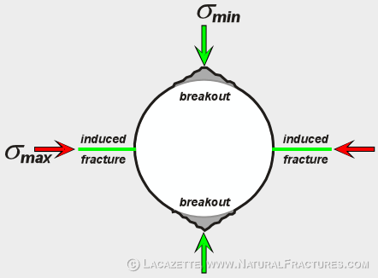
Stress Analysis
Borehole breakouts - Shape of borehole changes after drilling in response to stresses in host rock. Hole becomes elliptical with long axis of ellipse parallel to minimum horizontal principal stress (σ_{s} _{hor})
Hydrofracture - If water is pumped under sufficient pressure into sealed well, host rock will fracture. Fractures are parallel to maximum principal stress (σ₁), because water pressure necessary to open fractures is equal to minimum principal stress (σ₃)
Strain release - A strain gauge, consisting of tiny electrical resistors in a thin plastic sheet, is glued to bottom of borehole. The hole is drilled deeper with a hollow drill bit (called overcoring), separating core with strain gauge from wall of hole. Inner core expands (by elastic relaxation), which is measured by strain gauge. The direction of maximum elongation (e) is parallel to direction of maximum compressive stress and its magnitude is proportional to stress according to elasticity law (σ = E . e)

Slide 24
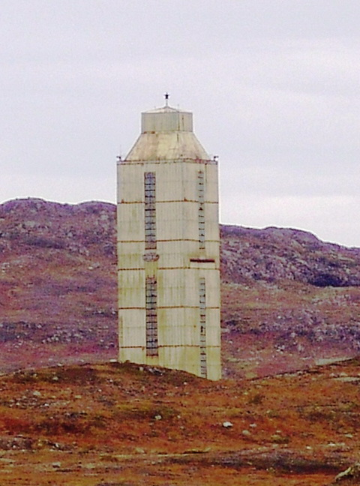
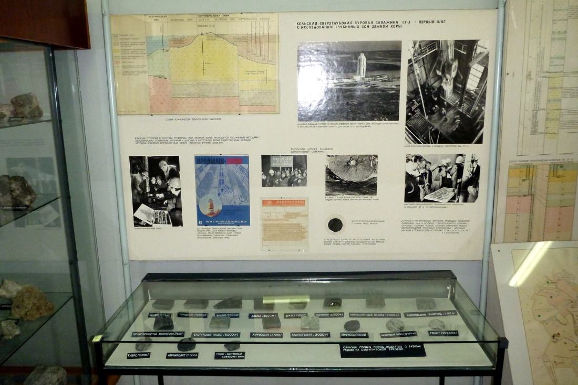
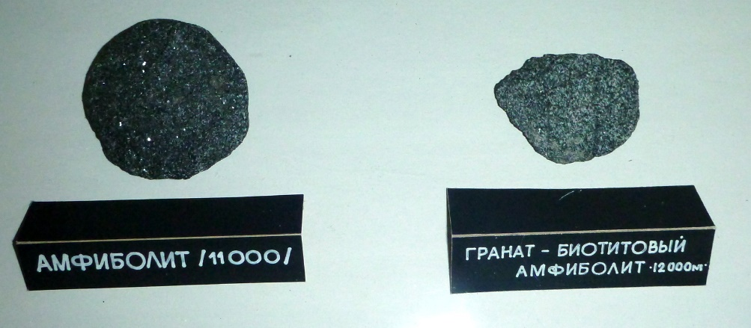
Deepest drill hole: Kola Peninsula, Russia
Kola Peninsula drill hole, Russia.
Reached 12,262 m (40,230ft) at 180°C (356°F) in 1989.
All granitic rock
Museum of Local Lore, Murmansk

Slide 25
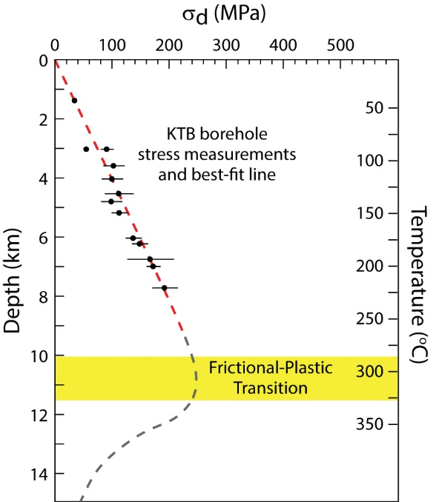
Stress Analysis from Drill Holes
KTB, Germany (9100m)
P(litho) = ρ ⋅ g ⋅ h
ρ (density) is 2700 kg/m³, g (gravity) is 9.8 m/s², and h (depth) is 1000 m, P(litho) ≈ 27 MPa (or 800 bars)
For every kilometer in Earth’s crust, isotropic lithostatic pressure increases by approximately 27MPa (or 100MPa=1kbar per ~3.3 km)
Instead, non-isotropic differential stress (σ_{d} = σ₁-σ₃) is smaller, increasing to a few hundred MPa until dropping at Frictional-Plastic Transition (see later)
P(litho)
KTB superdeep borehole in northern Bavaria to 9,101 m (29,859 ft) at temperatures >260°C (500 °F).
Notes:
F I G U R E 3 . 1 4 In situ borehole measurements of differential stress (σd) with depth, indicating a friction coefficient (μ) in the range of 0.6–0.7 for the upper crust.
KTB borehole: Kontinentales Tiefbohrprogramm de Bundesrepublik Deutschland (German Continental Deep Drilling Program); Bohemian Massif, southern Germany; main borehole KTB-HB started in 1990 (finished 1994), to a depth of 9101 m (29,859 ft).

Slide 26
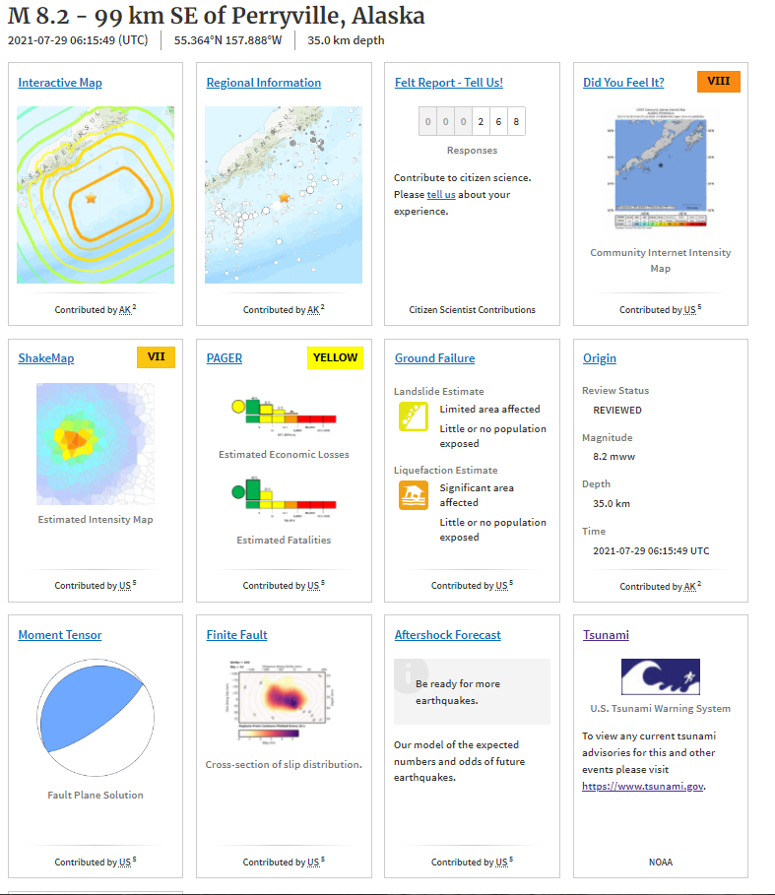
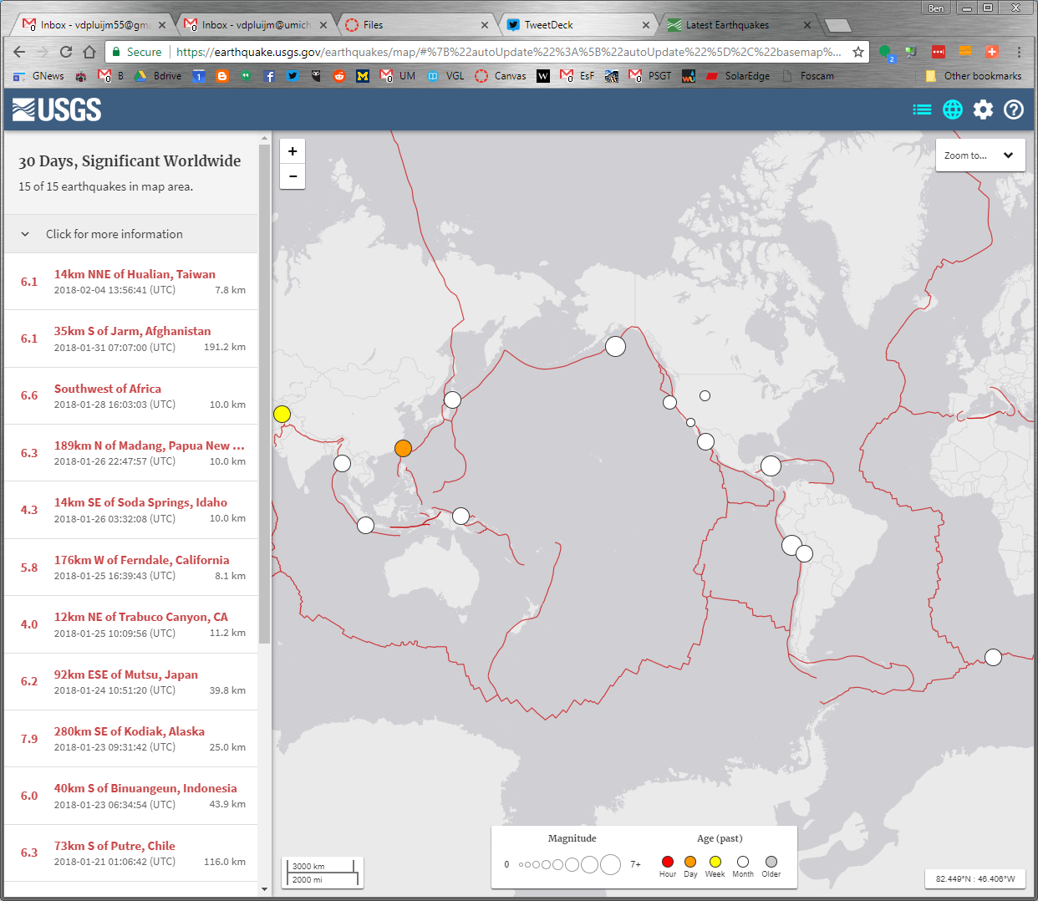
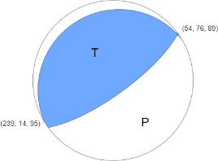
Near Real-time Earthquake Analysis: USGS
Go to: https://earthquake.usgs.gov/earthquakes/map/

Slide 27
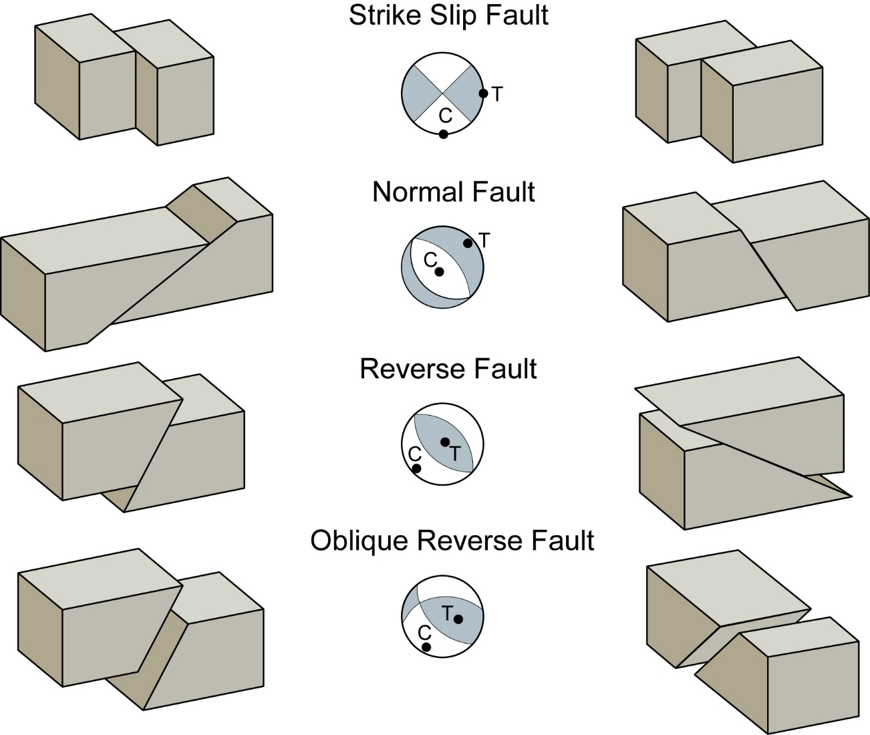
Stress Analysis from Earthquakes
Fault-plane solutions - When earthquake occurs, global seismometer records of first motion divide area into two sectors of compression (white) and two sectors of tension (gray), separated by two perpendicular planes.
One of these planes is fault plane on which earthquake occurred, and from distribution of compressive and tensile sectors, sense of slip on fault is determined.
C and T define regions of σ₁ and σ₃, but not exact orientation (not a fracture solution)!
USGS

Slide 28
North America Stress Map
Tension Compression
Black lines is maximum horizontal stress (S_{Hmax}) orientation; color is style of faulting.
Intraplate Stress: transition from reverse faulting (compression) in east to strike-slip faulting in central to normal faulting (extension) in west.
Lund Snee, Zoback (2020)
Notes:
From plate drag at base of lithosphere?
Lund Snee, JE., Zoback, M.D. Multiscale variations of the crustal stress field throughout North America. Nat Commun 11 (2020).

Slide 29
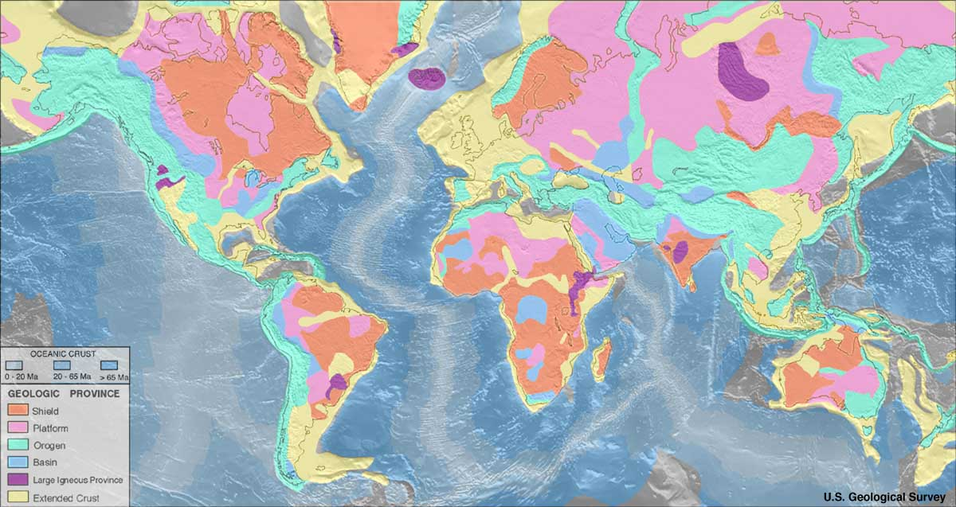
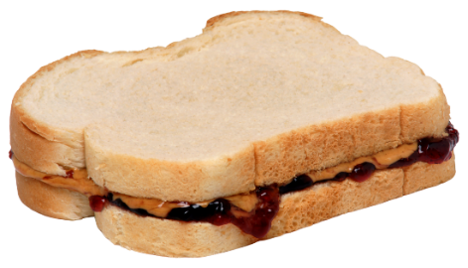
Stress and Geologic Provinces
Cold lithosphere is less deformable (cratons; Precambrian rocks)
Hot lithosphere is more deformable (orogens, ocean floor; Cenozoic rocks)
“PBJ Sandwich” model:
Strong (U Crust)
Weak (L Crust)
Strong (U Mantle)
(see later)
(σ₁-σ₃) = differential stress = 2 x σ_{s}
Notes:
Cold strong v warm weak. Large stresses
Peanut butter sandwich lithosphere
F I G U R E 3 . 1 6 Strength curves showing the variation in differential stress magnitude with depth in the Earth for (a) a region characterized by a low geothermal gradient (e.g., Precambrian shield areas) and (b) a region with a high geothermal gradient (e.g., areas of continental extension).
Differential stresses are largely based on experimental data for brittle failure and ductile flow, which change as a function of composition and temperature. In these diagrams the only compositional change occurs at the crust-mantle boundary (the Moho); in the case of additional compositional stratification, more drops and rises will be present in the strength curve. The bar at the right side of each diagram indicates where seismic activity may occur.

