Slide 1
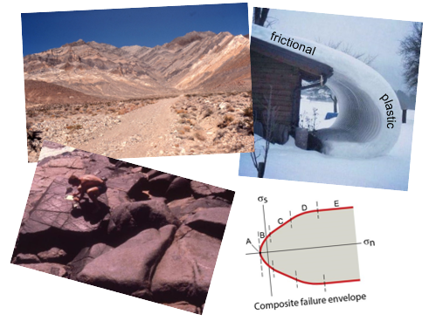
Frictional Regime and Elasticity
Earth Structure
(Processes in Structural Geology &Tectonics)
© Ben van der Pluijm
9/14/2023 3:52 PM
Notes:
Elastic band – tearing paper - envelope
Fault blocks
Block for sliding experiment

Slide 2
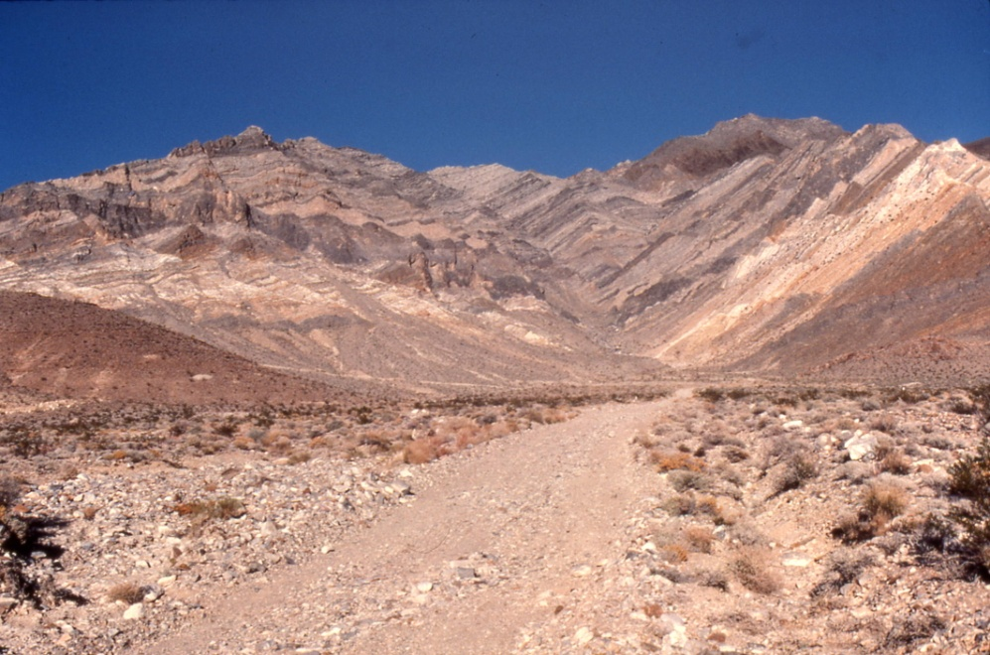
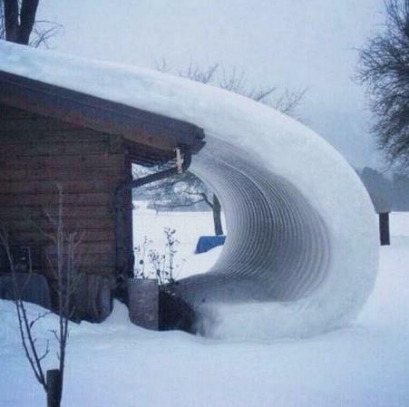
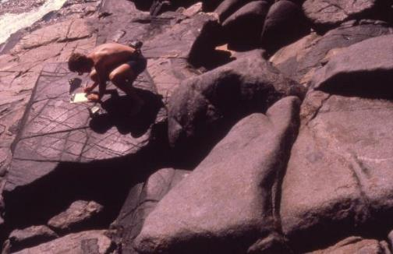
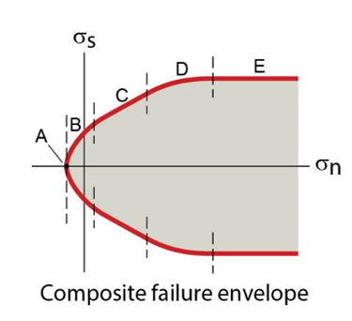
We Discuss …
The Frictional Regime
and Elasticity
Processes of Brittle Deformation
Elasticity
Uniaxial Experiments
Failure
  Tensile and Shear Fractures
  Failure Criteria
  Faults and Stress Orientations
  Composite Failure Envelope
Friction
  Frictional Sliding
  Sliding Criterion
  Stress and Sliding
Fluid Pressure
  Fracking
Structure and Society
  Earthquakes, Landslides, Resources
frictional
plastic
Notes:
BH = Permanent change due to fracturing and sliding

Slide 3
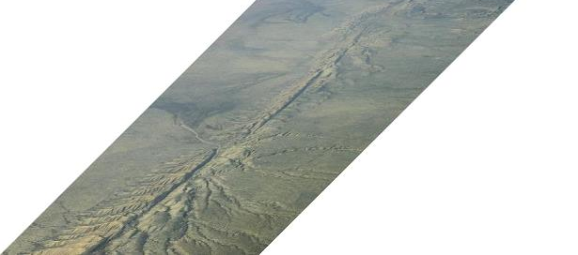

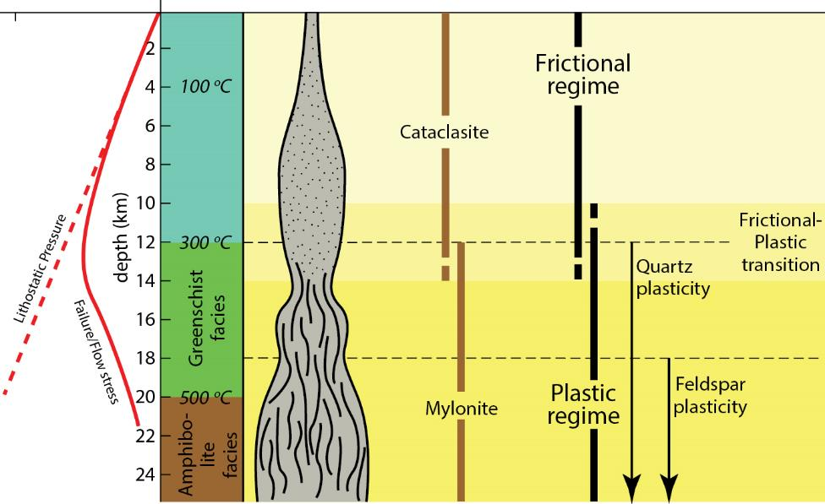
Deformation Regimes
San Andreas Fault, Carrizo Plain
P_{l}/σ_{d} T(ºC) Rock Regime
frictional
plastic

Slide 4
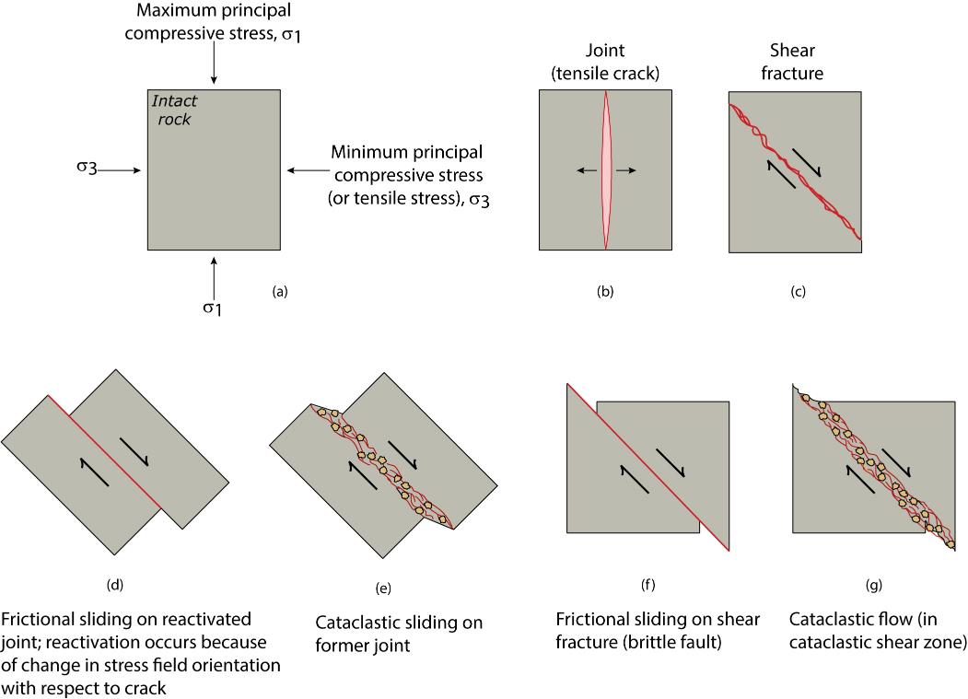
Brittle Structures
Tensile fracture
(joints)
Shear fracture
(faults)
Brittle failure is permanent change in a solid due to formation of cracks and/or to sliding on preexisting fractures
Brittle structures and deformation processes:
Tensile fracture (joints)
Shear fracture (faults)
Frictional sliding
Cataclastic flow
Notes:
F I G U R E 6 . 4 Types of brittle deformation. (a) Orientation of the remote principal stress directions with respect to an intact rock body. (b) A tensile crack, forming parallel to σ1 and perpendicular to σ3 (which may be tensile). (c) A shear fracture, forming at an angle of about 30° to the σ1 direction. (d) A tensile crack that has been reoriented with respect to the remote stresses and becomes a fault by undergoing frictional sliding. (e) A tensile crack which has been reactivated as a cataclastic shear zone. (f) A shear fracture that has evolved into a fault. (g) A shear fracture that has evolved into a cataclastic shear zone.

Slide 5
Categories of Brittle Deformation
Tensile cracking. This type of brittle deformation involves propagation of cracks into previously unfractured material when a rock is subjected to a tensile stress. If the stress field is homogeneous, tensile cracks propagate in their own plane and are perpendicular to the least principal stress (σ₃).
Shear failure (faulting). This type of brittle deformation results in the initiation of a macroscopic shear fracture (fault) at an acute angle to the maximum principal stress when a rock is subjected to a triaxial compressive stress. Shear failure involves growth and linkage of microcracks.
Frictional sliding. This process refers to the occurrence of sliding on a preexisting fracture surface, without the significant involvement of plastic deformation mechanisms.
Cataclastic flow. This type of brittle deformation refers to macroscopic ductile (=distributed) flow as a result of grain-scale fracturing and frictional sliding distributed over a band of some width.

Slide 6
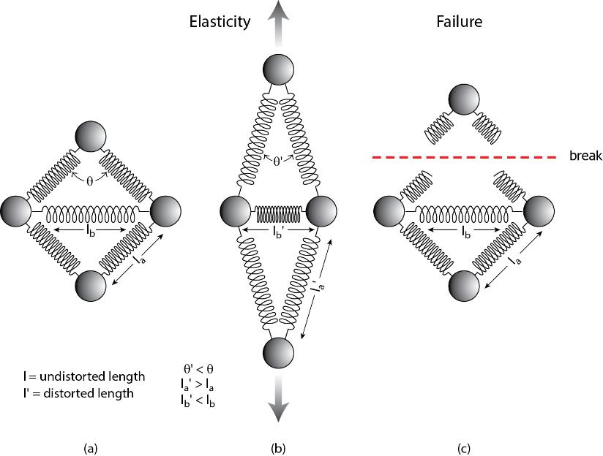
Elasticity and Brittle Failure: Atomistic View
Atomic bonds are elastic, like springs
Bonds:
Equilibrium
Stretched
Broken
Notes:
F I G U R E 6 . 3 A sketch illustrating what is meant by stretching and breaking of atomic bonds. The chemical bonds are represented by springs and the atoms by spheres. (a) Four atoms arranged in a lattice at equilibrium. (b) As a consequence of stretching of the lattice, some bonds stretch and some shorten, and the angle between pairs of bonds changes. (c) If the bonds are stretched too far, they break, and elastic strain is released.
F I G U R E 6 . 5 A cross-sectional sketch of a crystal lattice (balls are atoms and sticks are bonds) in which there is a crack. The crack is a plane of finite extent across which all atomic
bonds are broken.

Slide 7
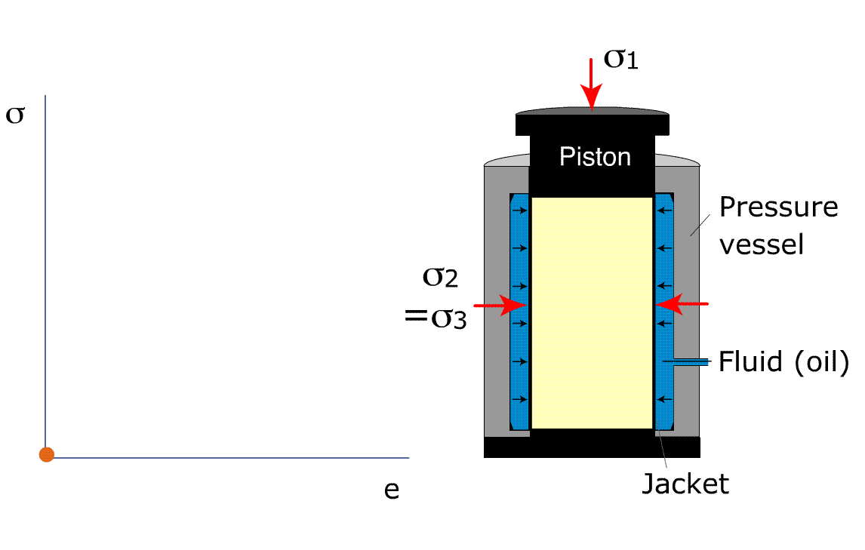
Elasticity
Elastic Behavior:
σ = E . e
  E = Young’s modulus
  e = strain = (l-l_{o})/l_{o}
  (rubber band)
Notes:
Elastic is reversible, immediate strain (stored elastic strain). <2%, but important for earthquakes
Viscous is permanent, progressive strain
Poisson: ratio of elongation perpendicular to compressive stress and elongation parallel to compressive stress; shortening without thickening. Sponge is 0
F I G U R E 5 . 3 Models of linear rheologies. Physical models consisting of strings and dash pots, and associated strain–time, stress–strain, or stress–strain rate curves are given for (a) elastic, (b) viscous, (c) viscoelastic, (d) elasticoviscous, and (e) general linear behavior. A useful way to examine these models is to draw your own strain–time curves by considering the behavior of the spring and the dash pot individually, and their interaction. Symbols used:
e = elongation, e˙ = strain rate, σ=stress, E = elasticity, η (eta)=viscosity, t = time, el denotes elastic component, vi denotes viscous component.

Slide 8
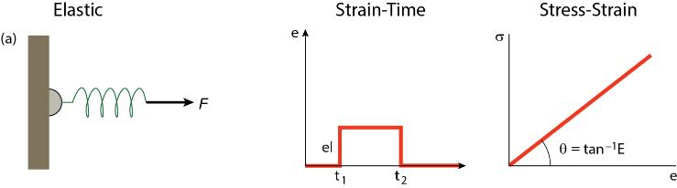
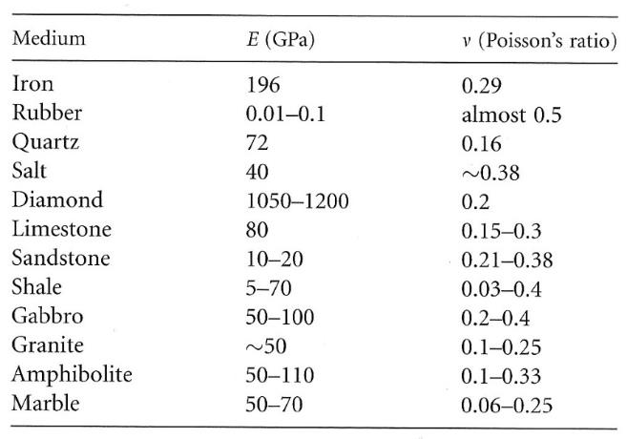
Elasticity
Elastic Behavior:
σ = E . e
  E = Young’s modulus (elasticity)
  e = strain (shape change)
  = (l-l_{o})/l_{o}
σ_{s} = G. γ
  G = shear modulus (rigidity)
  γ = shear strain
Other elastic parameters:
  Bulk Modulus (K): K = σ/ΔV;
  Poisson’s ratio: ν = e_{perpendicular to σ}/e_{parallel to σ}
Notes:
Elastic is reversible, immediate strain (stored elastic strain). <2%, but important for earthquakes
Viscous is permanent, progressive strain
Poisson: ratio of elongation perpendicular to compressive stress and elongation parallel to compressive stress; shortening without thickening. Sponge is 0
F I G U R E 5 . 3 Models of linear rheologies. Physical models consisting of strings and dash pots, and associated strain–time, stress–strain, or stress–strain rate curves are given for (a) elastic, (b) viscous, (c) viscoelastic, (d) elasticoviscous, and (e) general linear behavior. A useful way to examine these models is to draw your own strain–time curves by considering the behavior of the spring and the dash pot individually, and their interaction. Symbols used:
e = elongation, e˙ = strain rate, σ=stress, E = elasticity, η (eta)=viscosity, t = time, el denotes elastic component, vi denotes viscous component.

Slide 9
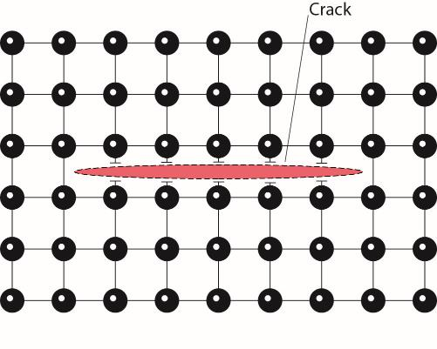
Rock Strength Paradox
Strength Paradox:
Rocks allow only few % elastic
strain (e) before permanent
deformation (failure), which occurs at low stresses.
= E . e Say, granite with e = 0.1 (= 10%)
= 5x10¹⁰ . 0.1 = 5x10⁹ Pa = 5x10³ MPa
Thus, theoretical strength of rock is 1000’s MPa, but observed tensile strength of rocks is only 10’s MPa.
Notes:
F I G U R E 6 . 3 A sketch illustrating what is meant by stretching and breaking of atomic bonds. The chemical bonds are represented by springs and the atoms by spheres. (a) Four atoms arranged in a lattice at equilibrium. (b) As a consequence of stretching of the lattice, some bonds stretch and some shorten, and the angle between pairs of bonds changes. (c) If the bonds are stretched too far, they break, and elastic strain is released.
F I G U R E 6 . 5 A cross-sectional sketch of a crystal lattice (balls are atoms and sticks are bonds) in which there is a crack. The crack is a plane of finite extent across which all atomic
bonds are broken.

Slide 10
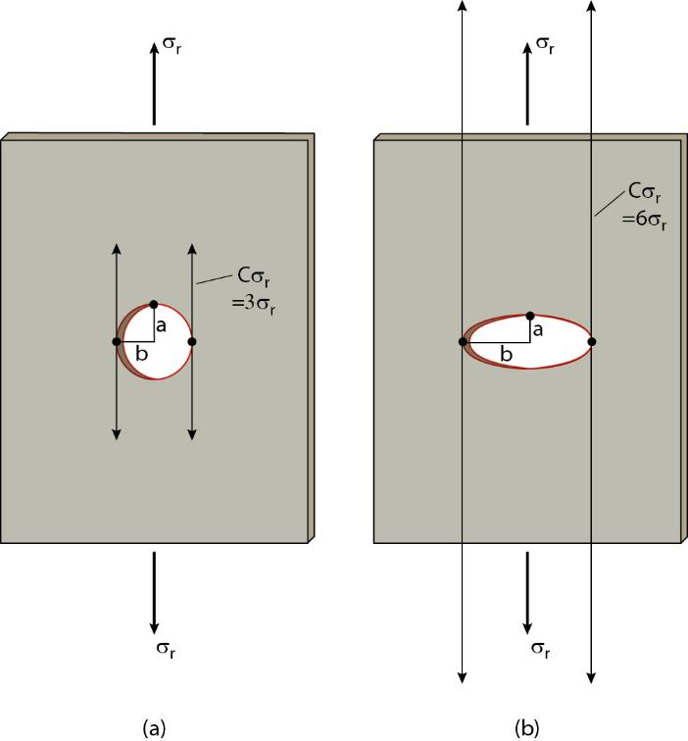
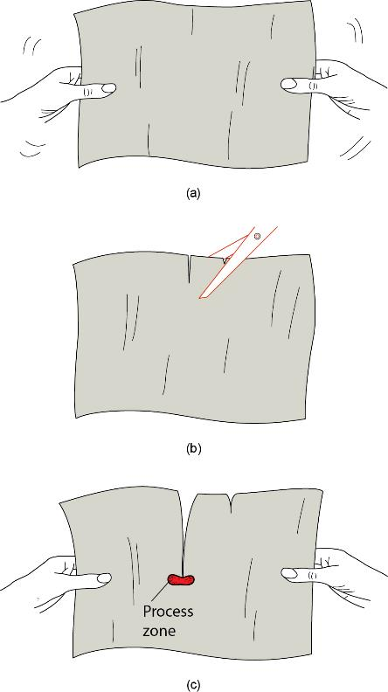
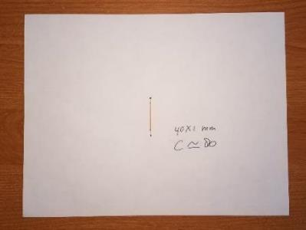
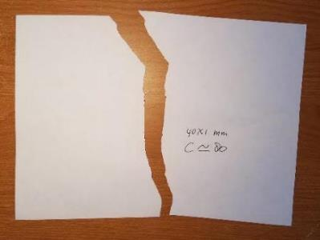
Tensile Failure and Stress Concentration
Remote v. local stress: stress concentration, C_{σ}, is: (2b/a) +1
Crack 1 x .02 μm: C_{σ} = 100 !
C_{σ} greater as crack grows longer.
Notes:
Paper with holes: longer cracks propagate easier than short cracks: runaway
F I G U R E 6 . 6 Stress concentration adjacent to a hole in an elastic sheet. If the sheet is subjected to a remote tensile stress at its ends (σr), then stress magnitudes at the sides of the holes are equal to Cσr, where C, the stress concentration factor, is (2b/a) + 1. (a) For a circular hole, C = 3. (b) For an elliptical hole, C > 3.
F I G U R E 6 . 7 Illustration of a home experiment to observe the importance of preexisting cracks in creating stress concentrations. (a) An intact piece of paper is difficult to pull apart. (b) Two cuts, a large one and a small one, are made in the paper. (c) The larger preexisting cut propagates. In the shaded area, a region called the process zone, the plastic strength of
the material is exceeded and deforms.

Slide 11
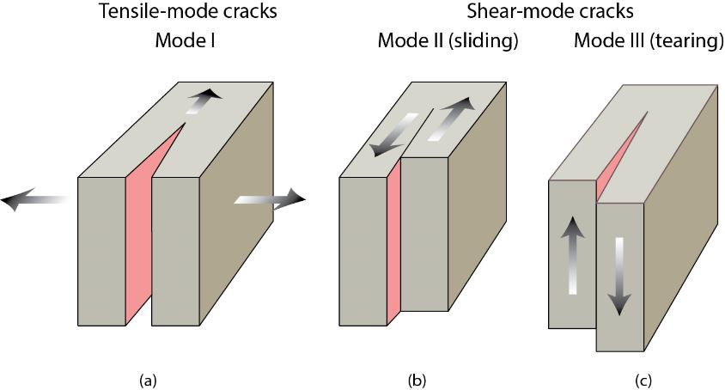
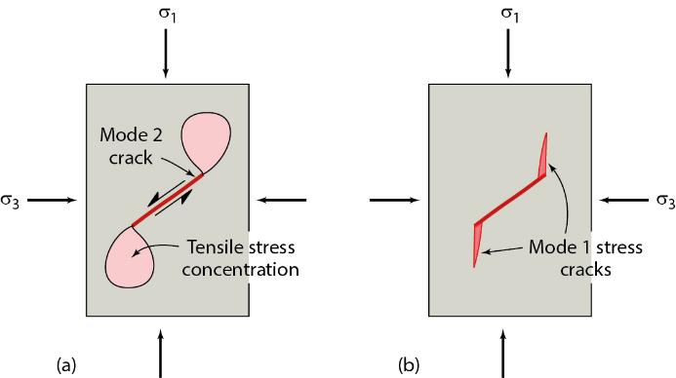
Tensile Fracture (Crack) Modes
Tensile cracks (Mode I)
Shear cracks (Mode II and III)
Shear-mode cracks are not faults. When they propagate, they rotate into Mode I orientation (“wing cracks”)
Notes:
F I G U R E 6 . 1 1 Block diagrams illustrating the three modes of crack surface displacement: (a) Mode I, (b) Mode II, (c) Mode III. Mode I is a tensile crack, and Mode II and Mode III are shear-mode cracks.
F I G U R E 6 . 1 2 Propagating shear-mode crack and the formation of wing cracks. (a) A tensile stress concentration occurs at the ends of a Mode II crack that is being loaded. (b) Mode I wing cracks form in the
zones of tensile-crack concentration.

Slide 12
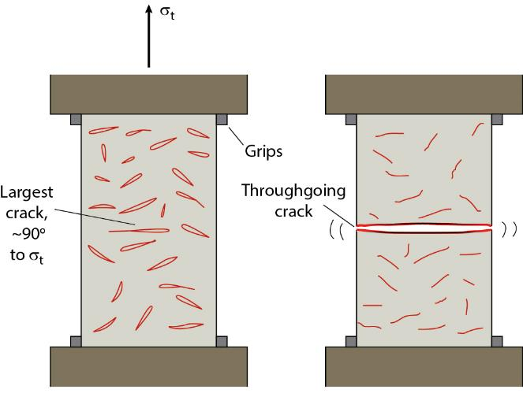
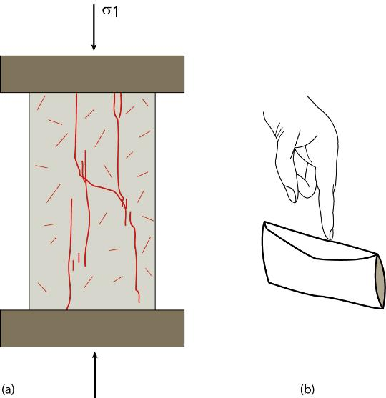
Uniaxial Experiments: Tensile Cracks
σ_{T}
σ_{C}
Extension Compression
Effect of preexisting (or Griffith) cracks: preferred activation, then longest cracks grow because of stress concentration.
Notes:
F I G U R E 6 . 8 Development of a throughgoing crack in a block under tension. (a) When tensile stress (σt) is applied, Griffith cracks open up. (b) The largest, properly oriented cracks propagate to form a through going crack.
F I G U R E 6 . 9 (a) A cross section showing a rock cylinder with mesoscopic cracks formed by the process of longitudinal splitting. (b) An “envelope” model of longitudinal splitting. If you push down on the top of an envelope (whose ends have been cut off), the sides of the envelope will move apart.

Slide 13
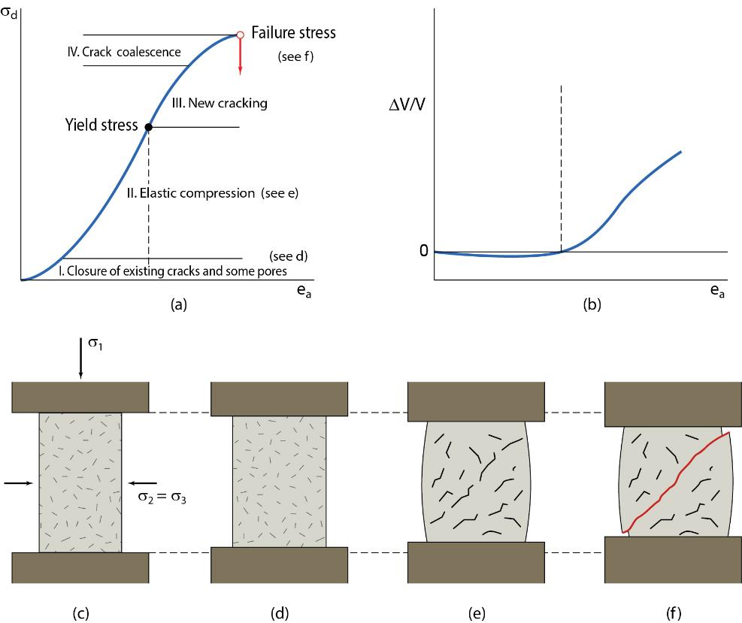
Formation of Shear Fractures
σ_{f}
Shear fracture (or fault) is surface across which rock loses continuity when shear stress parallel to surface is sufficiently large.
Faults are not large tensile cracks, as their eventual orientation shows.
Differential stress at failure is called failure stress (σ_{f}).
(I, II) (III)
dilatancy
Initial state I, II III IV
Notes:
F I G U R E 6 . 1 4 Fracture formation. (a) Stress–strain plot (differential stress versus axial shortening) showing the stages (I–IV) in a confined compression experiment. The labels indicate the process that accounts for the slope of the curve. (b) The changes in volume accompanying the axial shortening illustrate the phenomenon of dilatancy; left of the dashed line, the sample volume decreases, whereas to the right of the dashed line the sample volume increases. (c–f) Schematic cross sections showing the behavior of rock cylinders during the successive stages of a confined compression experiment and accompanying stress–strain plot, emphasizing the behavior of Griffith cracks (cracks shown are much larger than real dimensions).
(c) Pre-deformation state, showing open Griffith cracks. (d) Compression begins and volume decreases due to crack closure.
(e) Crack propagation and dilatancy (volume increase). (f) Merging of cracks along the future
throughgoing shear fracture, followed by loss of cohesion of the sample (mesoscopic failure).

Slide 14
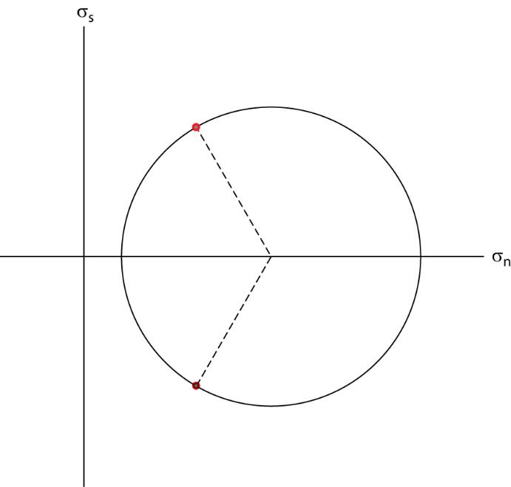
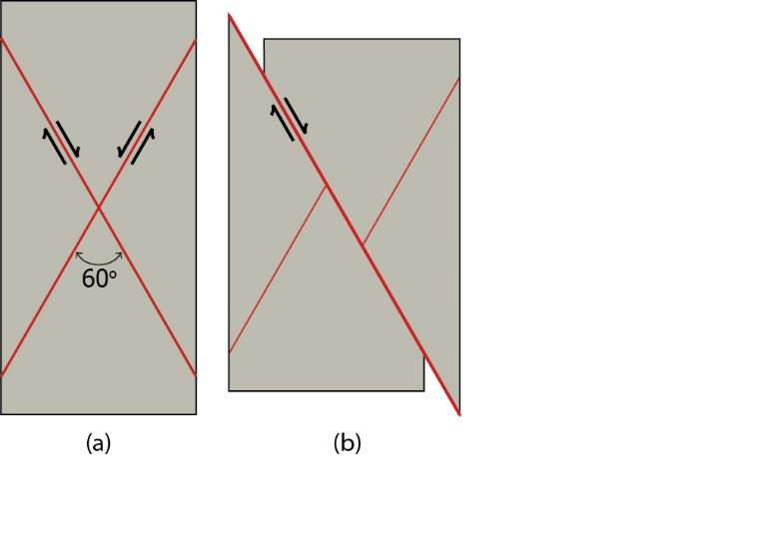
Shear Failure Criteria 1 – Compressional Failure
Two failure (conjugate) surfaces at ~30º to σ₁ (= ~60º to σ₃)
One becomes fault surface
Failure planes
σ₁
1
2
1
2
σ₃
σ₁
σ₃
Failure surfaces at ~30º to σ₁ (= ~60º to σ₃).
Yet, σ_{s} is maximum at 45º. Why?

Slide 15
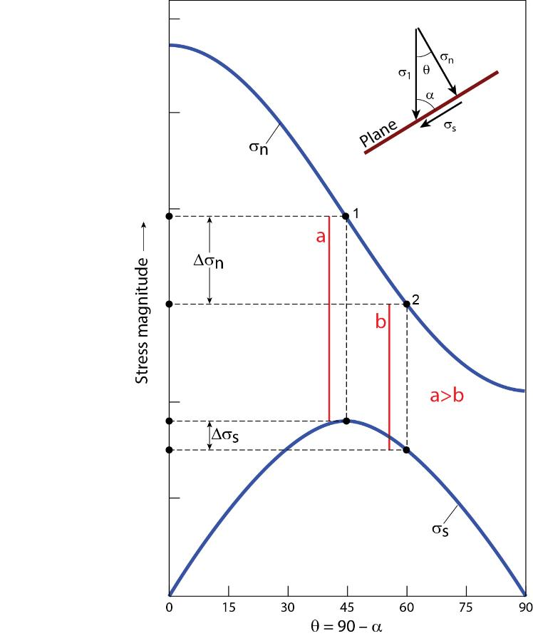
Why 30º instead of 45º Fracture Angle with σ₁?
Two failure (conjugate) surfaces at ~30º to σ₁ (= ~60º to σ₃)
Yet, σ_{s} is maximum at 45º. Why?
Reducing σ_{n} on plane
σ₁
σ_{s}
1
2
σ_{n}
σ₃
σ₁
σ₃

Slide 16
Why 30º instead of 45º Fracture Angle with σ₁?
Two failure (conjugate) surfaces at ~30º to σ₁ (= ~60º to σ₃)
Yet, σ_{s} is maximum at 45º. Why?
Reducing σ_{n} on plane
σ₁
σ₃
Notes:
45 degrees is maximum shear stress, yet 30 degrees from s1
F I G U R E 6 . 1 6 The change in magnitudes of the normal and shear components of stress acting on a plane as a function of the angle α between the plane and the σ1 direction; the angle θ = 90 – α is plotted for comparison with other diagrams.
At point 1 (α = θ = 45°), shear stress is a maximum, but the normal stress across the plane is quite large. At point 2 (θ = 60°, α=30°), the shear stress is still quite high, but the normal stress is much lower.
F I G U R E 6 . 1 7 Cross-sectional sketch showing how only one of a pair of conjugate shear fractures (a) evolves into a fault with measurable displacement (b).

Slide 17
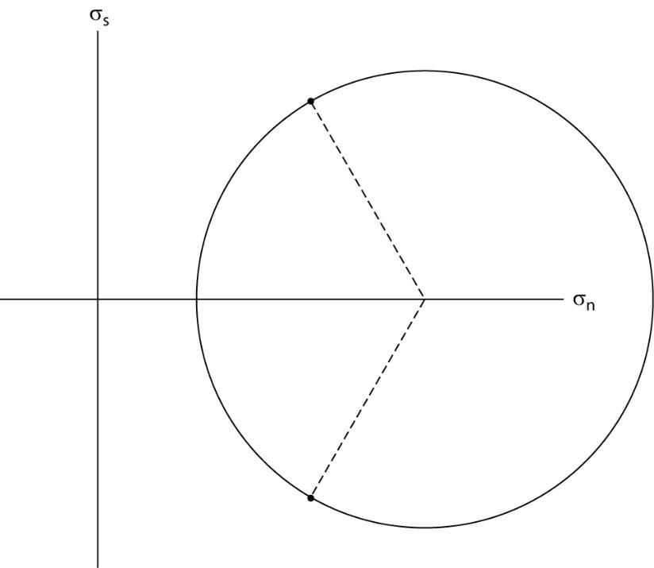
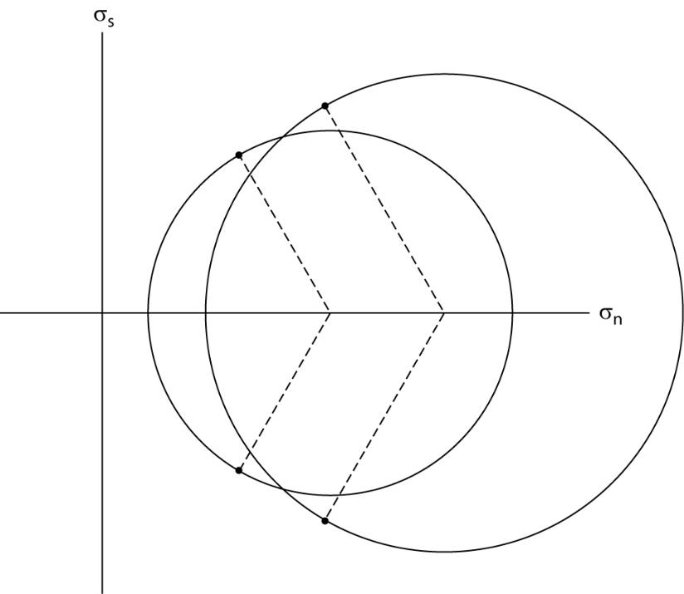
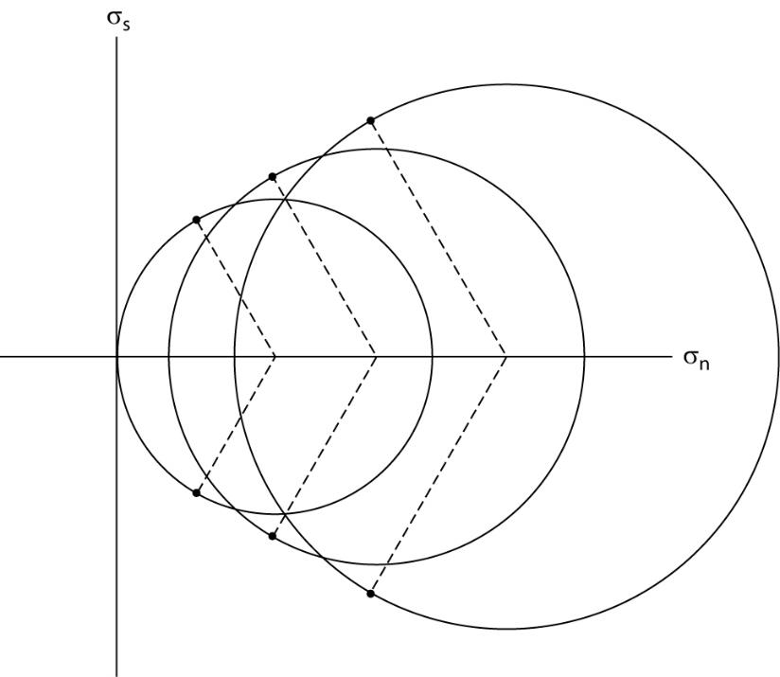
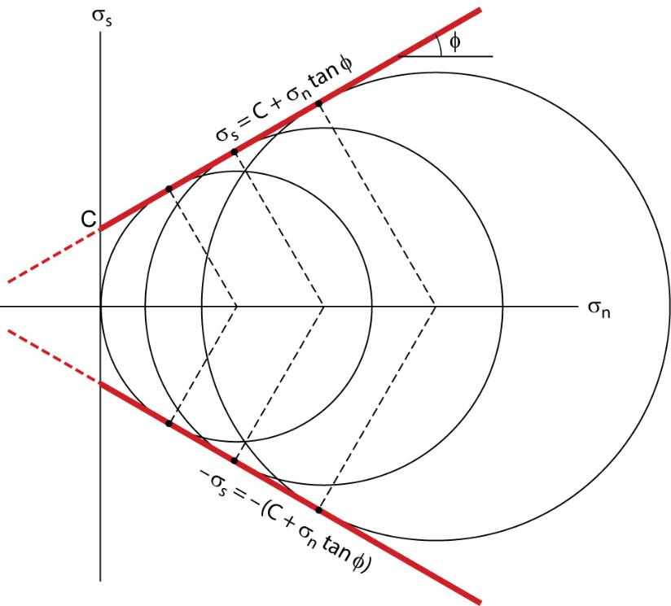
Shear Failure Criteria 1 – Compressional Failure
Shear Failure (Coulomb) criterion:
σ_{s} = C + σ_{n} tanᶲ = C + μσ_{n}
σ_{s} is shear stress parallel to fracture surface at failure
C is cohesion, a constant that specifies shear stress necessary to cause failure if normal stress across potential fracture plane equals zero
σ_{n} is normal stress across shear fracture at instant of failure
tan ᶲ (=slope) is constant: coefficient of internal friction: µ
failure envelope
Notes:
Experiments with increasing differential stresses until rock breaks
F I G U R E 6 . 1 5

Slide 18
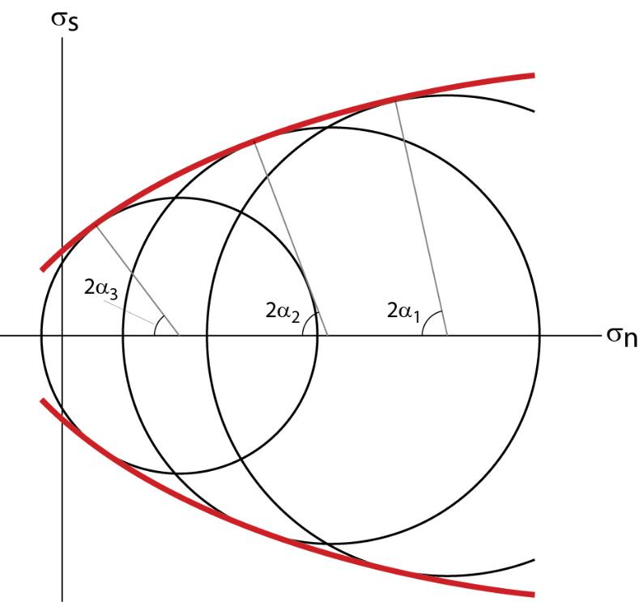
Shear Failure 2 – Tensile Stress
Parabolic failure envelope: steeper near tensile field (Mohr criterion) and shallower at high σ_{n} (plasticity)
Fractures toward 90º in tension, fractures around 30º in compression, relative to σ₁
(often called Mohr-Coulomb failure criterion)
failure envelope
Notes:
F I G U R E 6 . 1 8 Mohr failure envelope. Note that the slope of the envelope steepens toward the σs-axis. Therefore, the value of α (the angle between fault and σ1) is not constant (compare 2α1, 2α2, and 2α3).

Slide 19
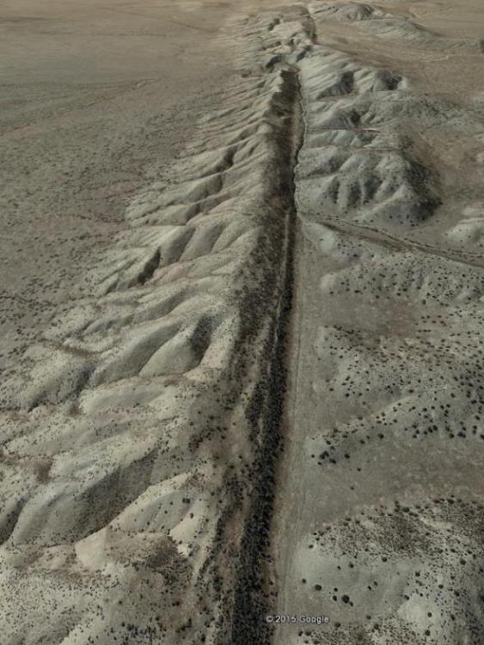
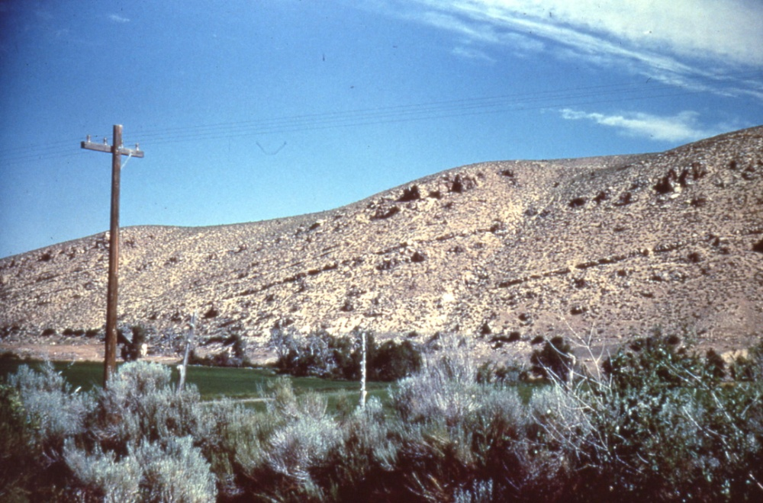
Fault Types
Dip-slip extension
(normal) fault
Strike-slip (lateral) fault
Dip-slip contraction (reverse) fault
Notes:
SAF: San Luis Opisbo; GE 35°07'23.75" N 119°39'25.26" W

Slide 20
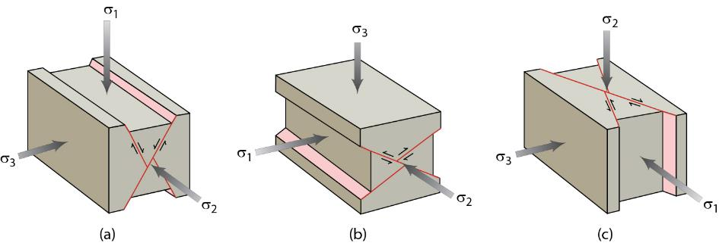
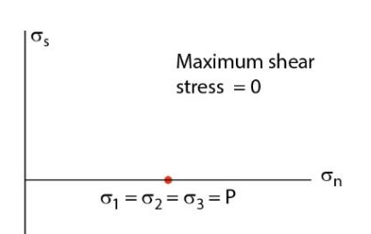
Predictions from Principal Stress Orientations (Anderson’s Theory)
σ1
Earth surface-atmosphere contact is ‘free surface’, meaning no shear stresses (air pressure is isotropic), so orthogonal principal stresses in shallow rock predict:
High-angle normal-slip faults
Strike-slip faults
Low-angle reverse-slip faults
Unexplained:
Low-angle normal-slip faults
Non-conjugate fault systems
Notes:
Earth solid-air contact is free surface, meaning no shear stresses.
F I G U R E 8 . 2 7 Anderson’s theory of faulting predicts (a) (high-angle) normal faults, (b) (low-angle) reverse faults (or thrusts),
and (c) (vertical) strike-slip faults.

Slide 21
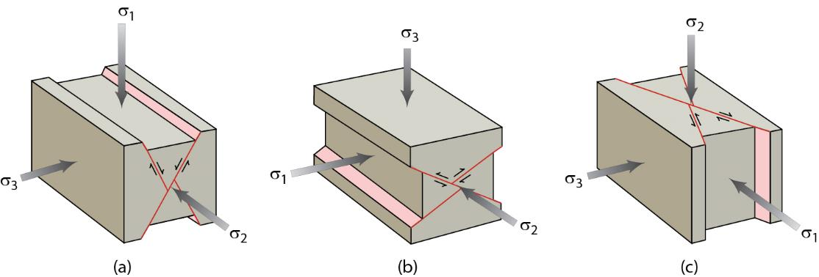
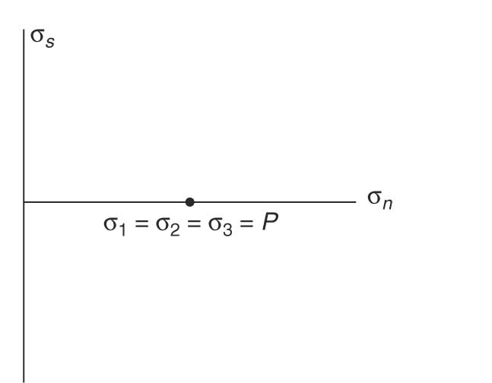
Principal Stresses and Fault Types
= ρ.g.h
= ρ.g.h
= ρ.g.h
Normal-Slip Fault Strike-Slip Fault Reverse-Slip Fault
Reverse
failure
σ_{s}
Vertical ρ⋅g⋅h is σ_{1,} σ₂ or σ₃, so shear stress (1/2(σ₁-σ₃)) for faulting increases from normal, to lateral slip to reverse faulting
Lateral
Normal
σ_{n}
σ_{vertical} = ρ⋅g⋅h

Slide 22
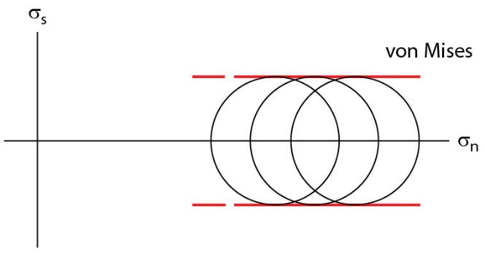
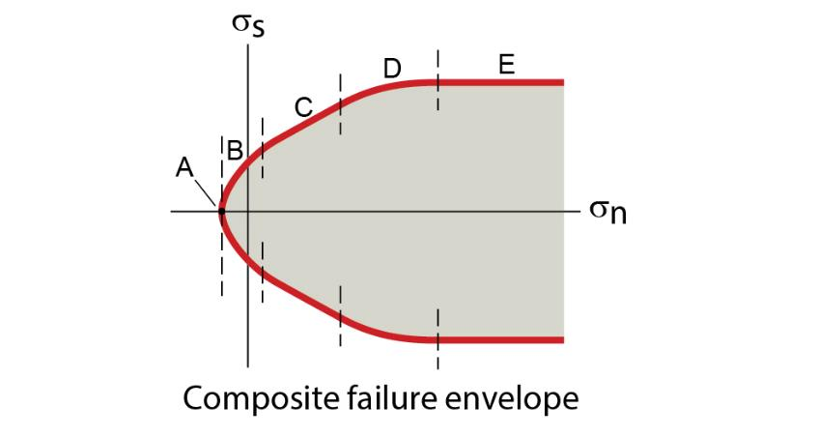
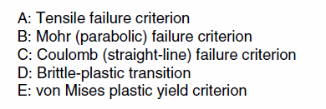
Shear Failure Criteria 3 – High Stress
At high stresses: Plastic ‘failure’ criterion (=non-frictional)
Plastic deformation at high (normal) stress is shear stress invariant, because corresponding high temperatures change deformation mechanisms
Composite failure envelope
A-C: Frictional Failure
  A: Tensile failure
  B: Mohr failure (parabolic)
  C: Coulomb failure (straight)
D: Frictional-Plastic transition
E: Plastic failure criterion
Notes:
Brittle deformation has high stress dependency; ductile behavior has low stress dependency. Hence the grouping of topics
F I G U R E 6 . 2 0 (a) Mohr diagram illustrating the Von Mises yield criterion. Note that the criterion is represented by two lines that parallel the σn-axis.

Slide 23
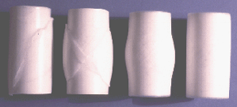
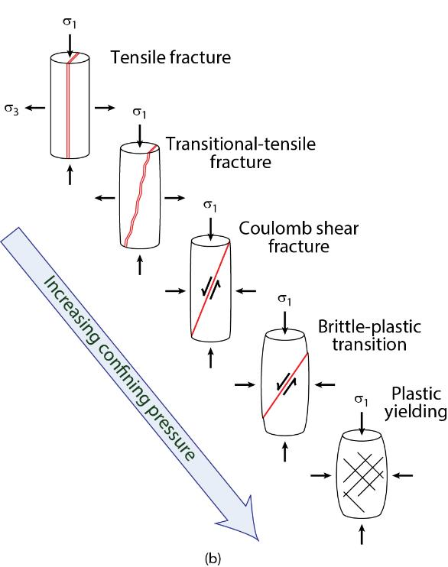

Composite Failure Envelope
A: Tensile failure criterion
B: Mohr failure criterion (parabolic)
C: Coulomb failure criterion (straight)
D: Frictional-Plastic transition
E: Plastic failure criterion
Note changing angle of rupture with respect to σ₁
Notes:
FIGURE 6.21 (a) A representative composite failure
envelope on a Mohr diagram. The different parts of the envelope are
labeled, and are discussed in the text. (b) Sketches of the fracture
geometries that form during failure. Note that the geometry
depends on the part of the failure envelope that represents failure
conditions, because the slope of the envelope is not constant.

Slide 24
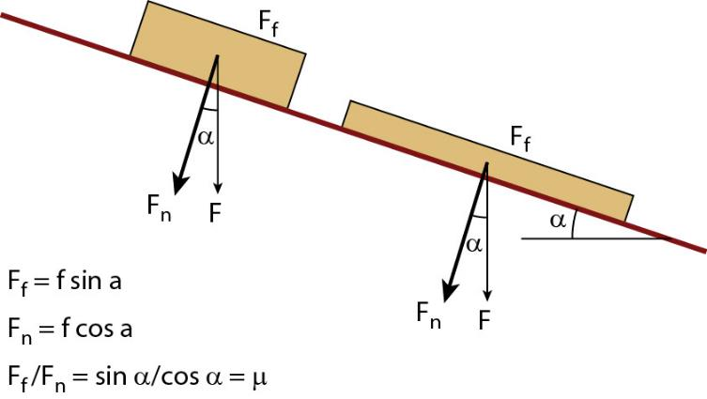
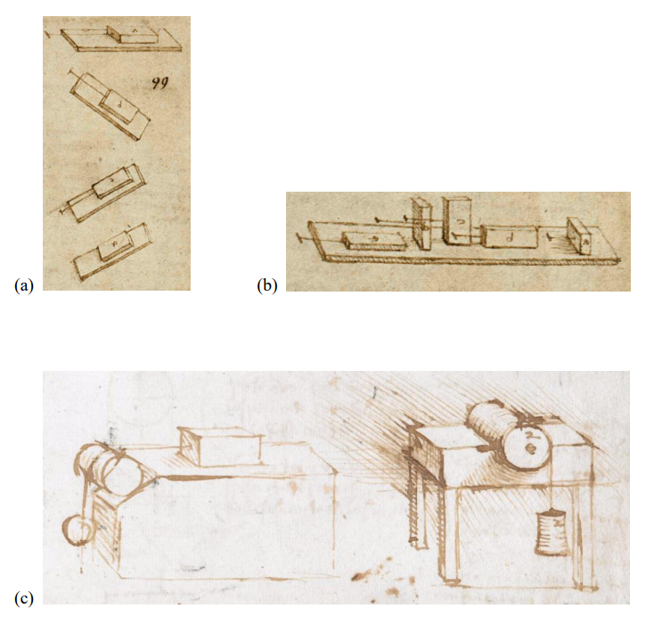
Friction: Sliding on a Surface
Frictional sliding refers to movement on a pre-existing surface when shear parallel to surface exceeds sliding resistance.
Observed Properties of Friction:
Frictional force is function of
normal force.
Frictional force is independent of
(apparent) area of contact.
Frictional force is (mostly)
independent of material used.
(Amonton 17thC)
(15thC da Vinci experiments)
Notes:
Friction, not faulting
Slide block on different sides
The friction coefficients and sliding forces (Ff) are equal for both objects, regardless of (apparent) contact area.

Slide 25
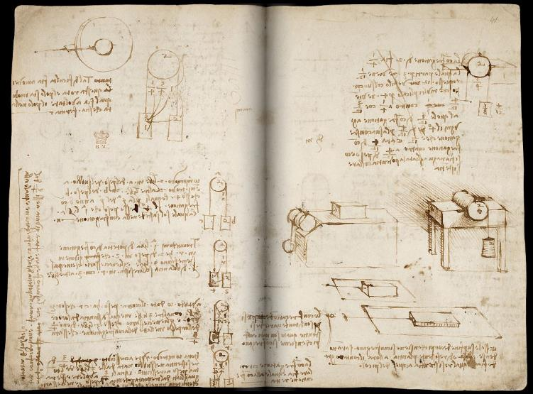
Extra: Leonardo Da Vinci and Friction
a), b) Codex Atlanticus, Biblioteca Ambrosiana, Milan (CA folio 532r ca. 1506-8)
c), d) Codex Arundel, British Library, London (Arundel folio 41r ca. 1500-05)
(d)

Slide 26
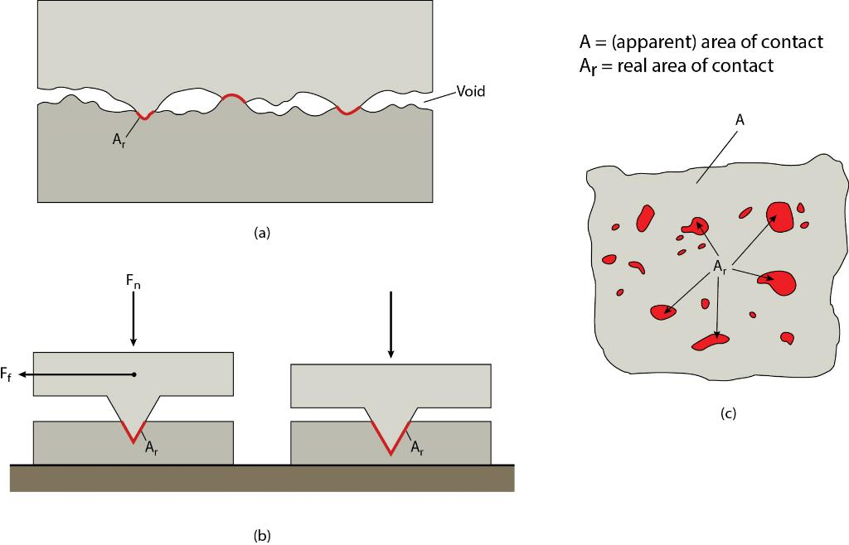
Surface Roughness (Asperities)
The bumps and irregularities (roughness) that protrude on natural surfaces are called asperities, which “anchor” surfaces.
Real v. Apparent
Area of Contact
Larger mass (larger F),
larger contact area
Notes:
asperities act like anchors; friction is breaking of anchors. Furniture imprint in carpet …..
F I G U R E 6 . 2 3 Concept of asperities and the real area of contact (Ar). (a) Schematic crosssectional
close-up showing the irregularity of a fracture surface and the presence of voids and asperities along the surface. (b) Idealized asperity showing the consequence of changing the load (normal force) on the real area of contact. (c) Map of a fracture surface; the shaded areas are real areas of contact.

Slide 27
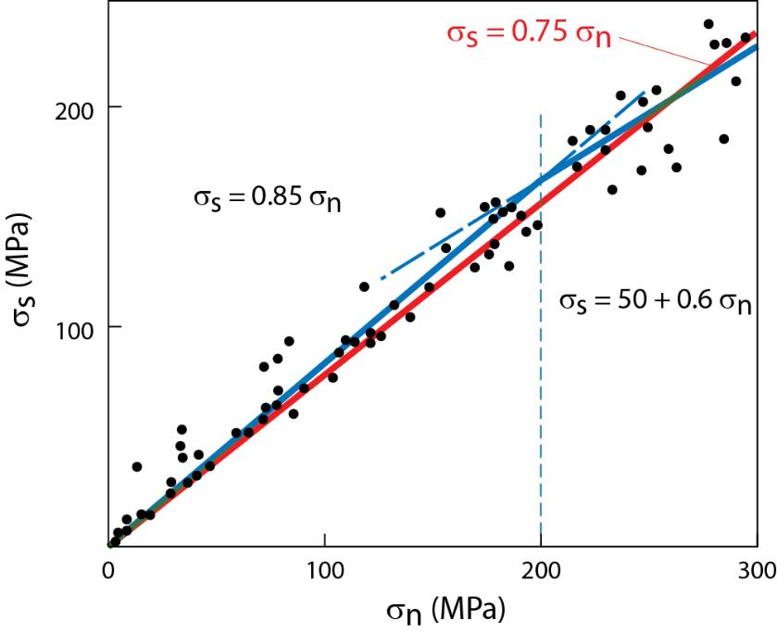
Sliding (Friction) Criterion (Byerlee’s Law)
σ_{s} = μ σ_{n}
σ_{s} / σ_{n} = constant = μ
= coefficient of friction
μ = 0.6-0.85, or ~0.75 (static friction)
Notes:
F I G U R E 6 . 2 4 Graph of shear stress and normal stress values at the initiation of sliding on preexisting fractures in a variety of rock types. The best-fit line defines Byerlee’s law, which is defined for two regimes.

Slide 28
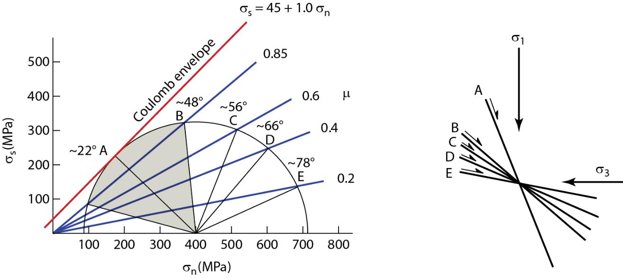
Sliding on Existing Fractures or Create New Fractures ?
σ_{s} = 0.75 σ_{n}
σ₃ σ₁
Instead of new failure surface (plane A), sliding on existing surfaces (gray area).
Preexisting surfaces from B to E will slide with decreasing friction coefficients.
(based on Blair Dolomite experiment)
Notes:
F I G U R E 6 . 2 5 (a) Mohr diagram based on experiments with Blair dolomite, showing how a
single stress state (Mohr circle) would contact the frictional sliding envelope before it would
contact the Coulomb envelope (heavy line). Surface A in (b) is the Coulomb shear fracture that
would form in an intact rock. However, sliding would occur on surfaces between intersections
with the friction envelope (marked by shaded area for friction envelope μ = 0.85) before new
fracture initiation. Preexisting surfaces B to E are surfaces that will slide with decreasing
friction coefficients. Consider the geologic relevance of decreasing friction coefficients for
stress state, failure, and fracture orientation.

Slide 29
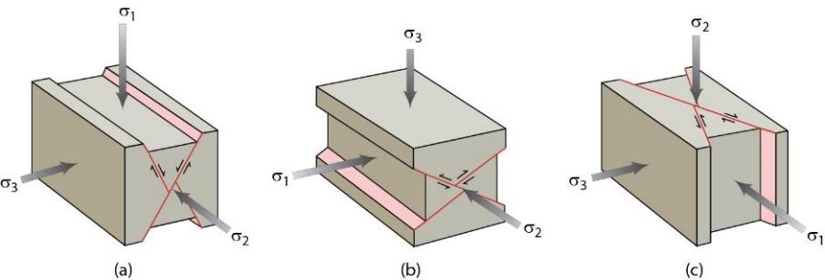
Differential Stress and Fault Types
Vertical ρ⋅g⋅h is σ_{1,} σ₂ or σ₃, so shear stress
(1/2(σ₁-σ₃)) for faulting (or sliding) increases
from normal-slip, to strike-slip
to reverse-slip faulting
Earthquake faulting is stress release,
so maximum earthquake magnitude (=energy)
by fault type:
normal-slip (M6-7) < strike-slip (M7-8) < reverse-slip (M8-9)
Reverse
friction
σ_{s}
Lateral
Normal
σ_{n}
σ_{vertical} = ρ⋅g⋅h

Slide 30
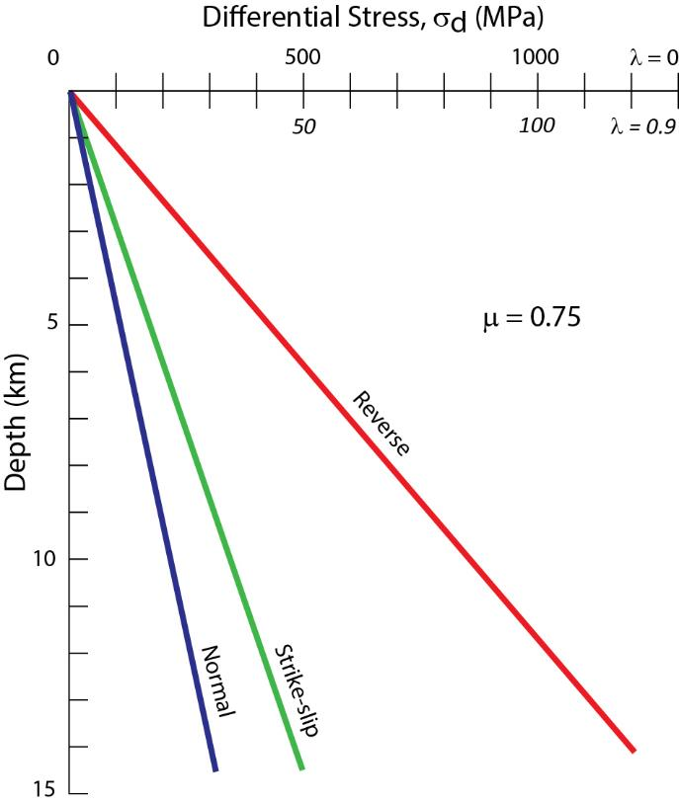
Limiting Stress Conditions for Sliding
(σ₁–σ₃)
μ = 0.75
σ_{d} ≥ β (ρ⋅g⋅h)
β is 3, 1.2, and 0.75 for reverse, strike-slip, and normal faulting
7km borehole σ_{d} measurement, sliding on strike-slip fault, but stable on reverse fault
7km borehole measurement
Reverse
friction
σ_{s}
Lateral
Normal
σ_{d}
σ_{n}
Notes:
F I G U R E 8 . 3 0 Graph showing variation in differential stress necessary to initiate sliding on reverse, strike-slip, and normal
faults, as a function of depth. The relationship is given by Equation 8.1, assuming a friction coefficient, μ=0.75, and a
fluid pressure parameter, λ=0 (no fluid present) and λ = 0.9 (fluid pressure is 90% of lithostatic pressure).

Slide 31


Extra: Derive Limiting Stress Conditions for Sliding
Consider μ = 0.75 (Friction Law)
σ₁ = σ₃ . 4
Normal fault:
  σ₁ = (ρ⋅g⋅h), so
  (ρ⋅g⋅h) = σ₃ x 4
  (σ₁–σ₃) = (ρ⋅g⋅h) – 0.25(ρ⋅g⋅h) = 0.75(ρ⋅g⋅h)
Reverse fault:
  σ₃ = (ρ⋅g⋅h)
  σ₁ = (ρ⋅g⋅h) x 4
  (σ₁–σ₃) = 4(ρ⋅g⋅h) - (ρ⋅g⋅h) = 3(ρ⋅g⋅h)
σ_{d} ≥ β (ρ⋅g⋅h)
β is 3, 1.2, and 0.75 for reverse, strike-slip, and normal faulting
σ_{s} = μ . σ_{n}
Substitute for principal stresses, given fracture angle and rearrange:
σ₁ = σ₃ . [μ²+1)^{1/2} + μ]²
Notes:
F I G U R E 8 . 3 0 Graph showing variation in differential stress necessary to initiate sliding on reverse, strike-slip, and normal
faults, as a function of depth. The relationship is given by Equation 8.1, assuming a friction coefficient, μ=0.75, and a
fluid pressure parameter, λ=0 (no fluid present) and λ = 0.9 (fluid pressure is 90% of lithostatic pressure).

Slide 32
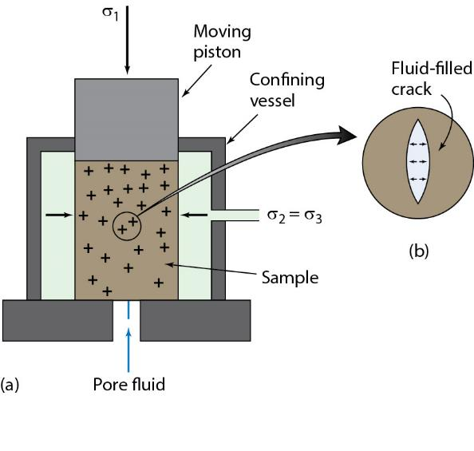

Fluids and Failure
Hydrostatic (fluid) pressure
P_{f} = ρ ⋅ g ⋅ h, ρ is density water (1000 kg/m³), g is gravitational constant (9.8 m/s²), h is depth
Lithostatic (load) pressure
P_{l} = ρ ⋅ g ⋅ h, weight of overlying column of rock (ρ ≈ 2700 kg/m³)
~
Notes:
FIGURE 6.26 Graph of lithostatic versus hydrostatic pressure as a function of depth in the Earth’s crust.
Figure 6.10

Slide 33


Fluid Pressure and Effective Stress
“outward push”
σ_{s} = C + μ.(σ_{n} – P_{f}) [fracturing]
σ_{s} = μ.(σ_{n} – P_{f}) [sliding]
(σ_{n} – P_{f}) is commonly labeled σ_{n}*, effective stress
So, μ_{effective} < μ (for P_{f} > 0)
(e.g., hydraulic fracturing or “fracking”)
Notes:
Hydraulic fracturing
F I G U R E 6 . 1 0 (a) Cross-sectional sketch illustrating a rock cylinder in a triaxial loading experiment. Fluid has access to the
rock cylinder and fills the cracks. (b) A fluid-filled crack that is being pushed apart from within by pore-fluid pressure.
F I G U R E 6 . 2 7 A Mohr diagram showing how an increase in pore pressure moves the Mohr circle toward the origin. The increase in pore pressure decreases the mean stress (σmean), but does not change the magnitude of differential stress (σ1 – σ3). In other words, the diameter of the Mohr circle remains constant, but its center moves to the left.

Slide 34


Structure and Society: Fluid-induced Landslides
Dry and Stable
High friction
Wet and Unstable
Low effective friction
μ = σ_{s} / σ_{n}
μ_{effective} = μ (1 – P_{f}/σ_{n})
            Increasing P_{f}/P_{l} increases failure potential
2014 West Salt Creek landslide, Mesa County, Colorado (CGS).

Slide 35



Structure and Society: Hydraulic Fracturing (Fracking) and
Waste Injection
Prague, OK;
M5.7, 2011 (USGS)
OK “Earthquake Alley”
Biggest so far: M5.8 on 9/9/2016 (~surface atom bomb)
https://goo.gl/FIm01i

Slide 36




Structure and Society: Earthquakes
Nearly all earthquakes are reactivations of existing fractures
Later lecture ….

