Slide 1
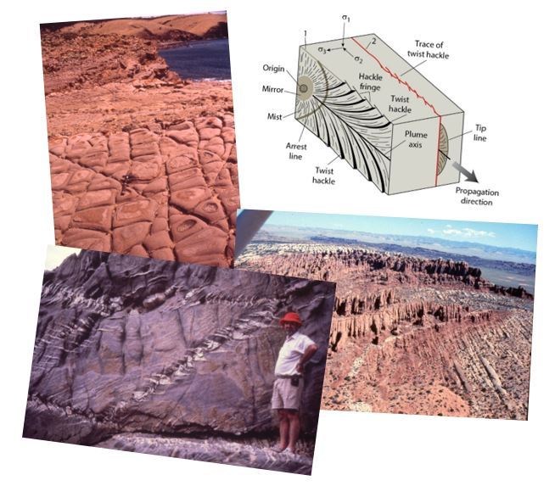
Joints and Veins
Earth Structure (Processes in Structural Geology &Tectonics)
© Ben van der Pluijm
9/14/2023 3:55 PM
Notes:
Societal relevance: groundwater, gas, petroleum
Introduce elasticity

Slide 2
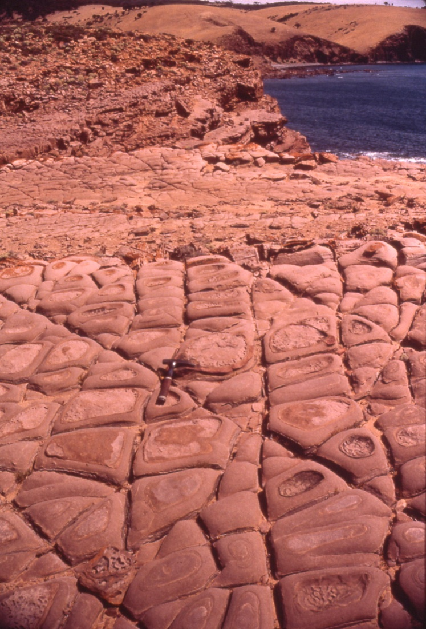
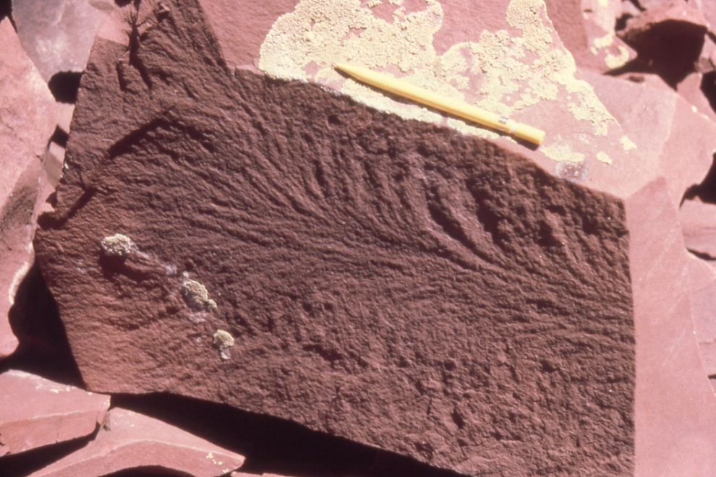
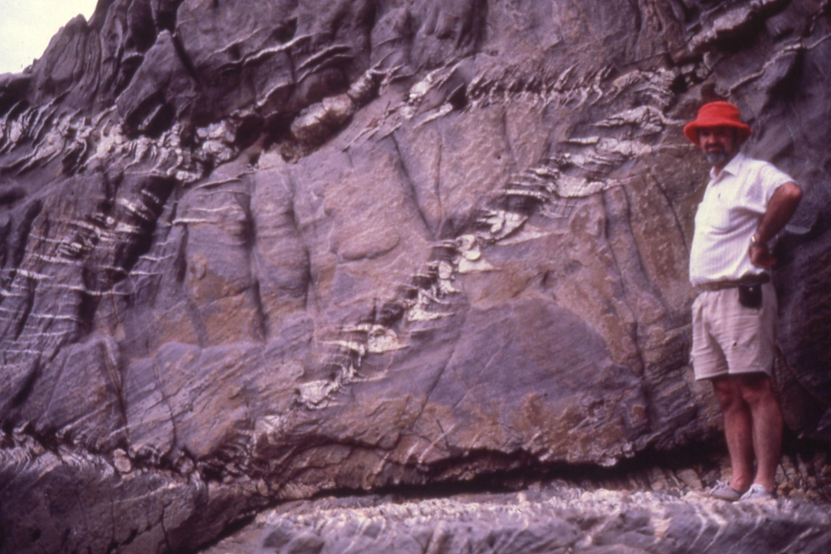
We Discuss …
Joints and Veins
Crack Modes
Surface Features
Formation and Propagation
Elasticity
Joint Arrays
Joint Spacing
Origin of Joints
Veins
Opening and Filling
Syntaxial and Antitaxial Veins
En-echelon Veins
Structure and Society
Groundwater
Mineralization
Notes:
Three sets of systematic joints controlling erosion in Cambrian sandstone (Kangaroo Island, Australia).

Slide 3
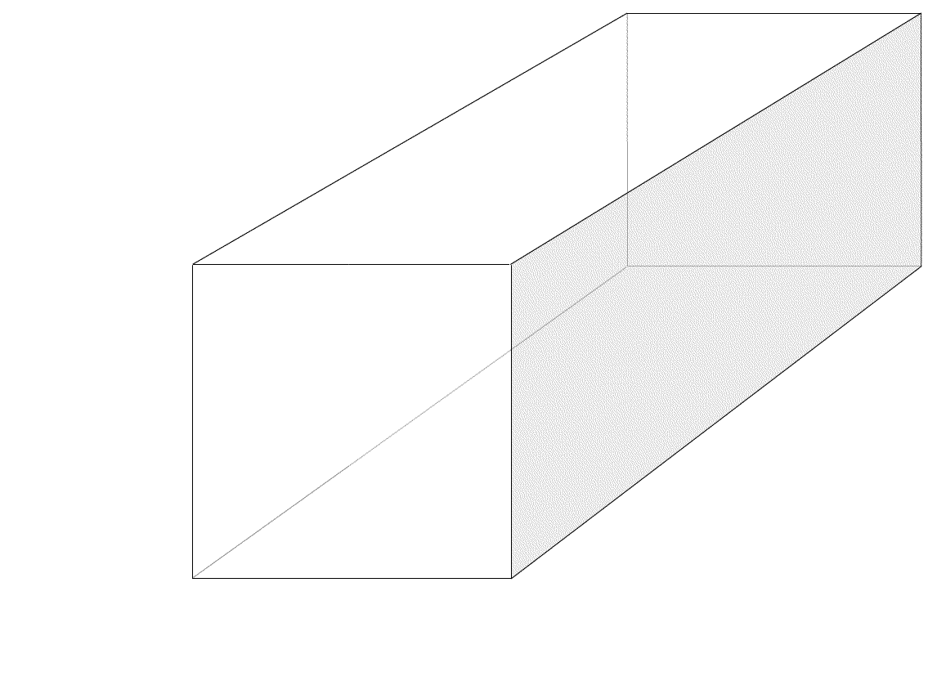
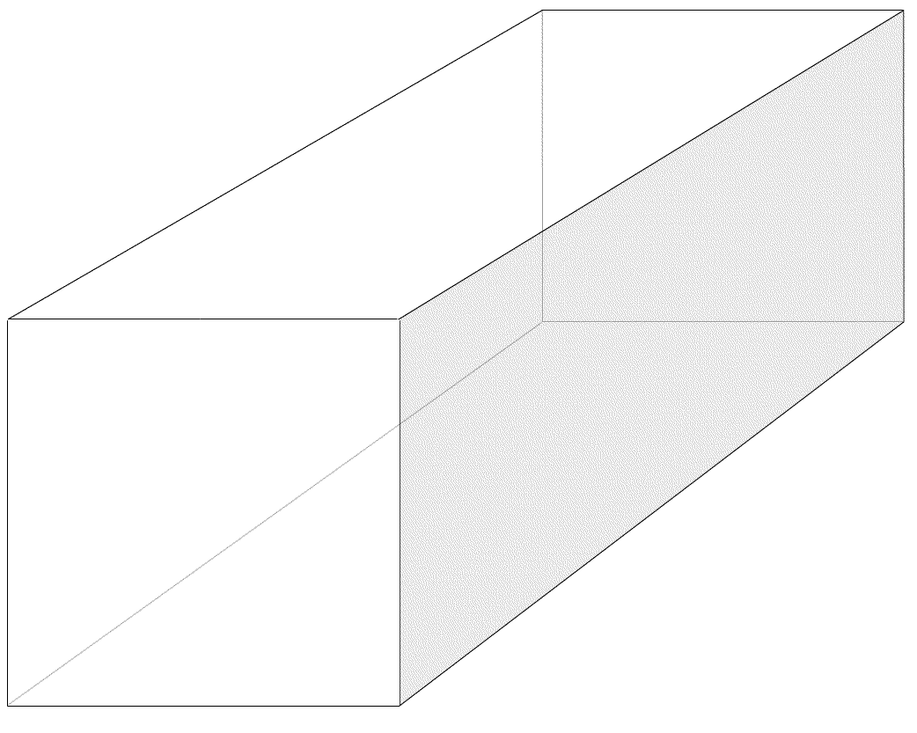
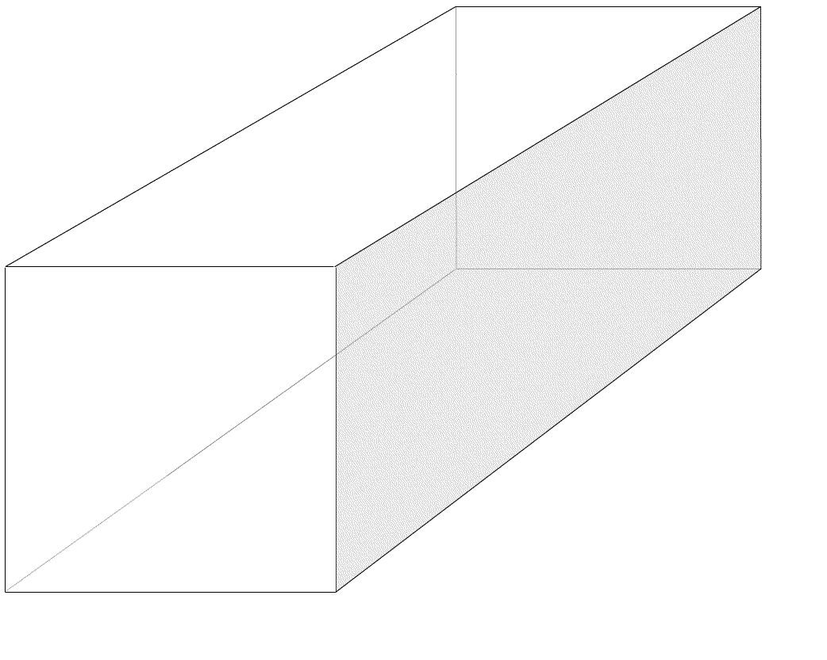
Crack Modes
Tensile Mode Shear Mode
Recall, shear-mode crack do not become faults; they propagate as tensile-mode cracks
Fossen 2016

Slide 4
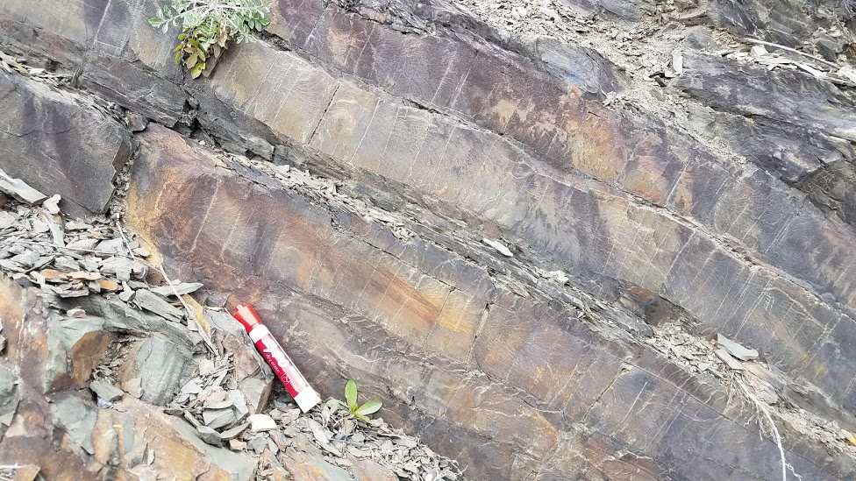
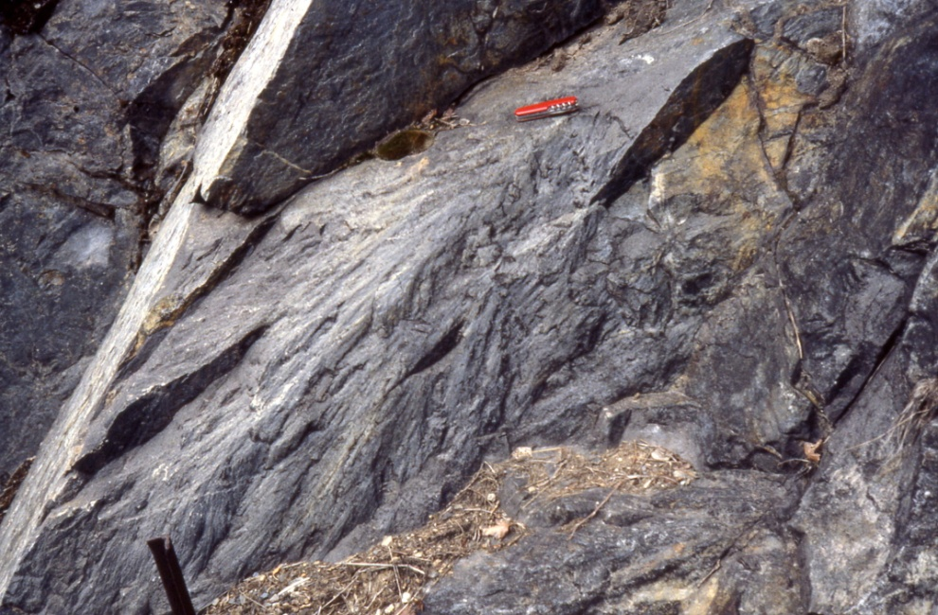
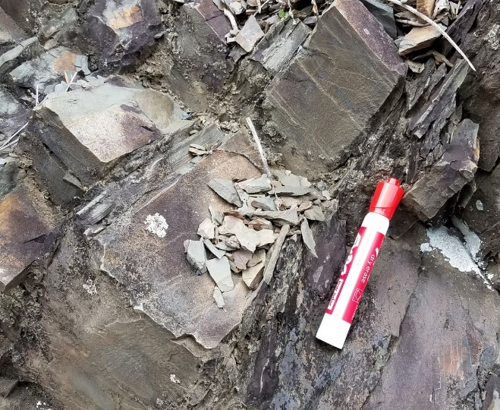
Joint Surfaces
(a)
(b)
Shatter cones (Sudbury); impacts
Plumes (MD); joint propagation
Notes:
F I G U R E 7 . 2 Photographs of plumose structure on joint surfaces (New York
State, USA). (a) Wavy plumose structure on a joint in siltstone. (b) Plumose
structure in thin bedded siltstone; pencil points to the point of origin.

Slide 5
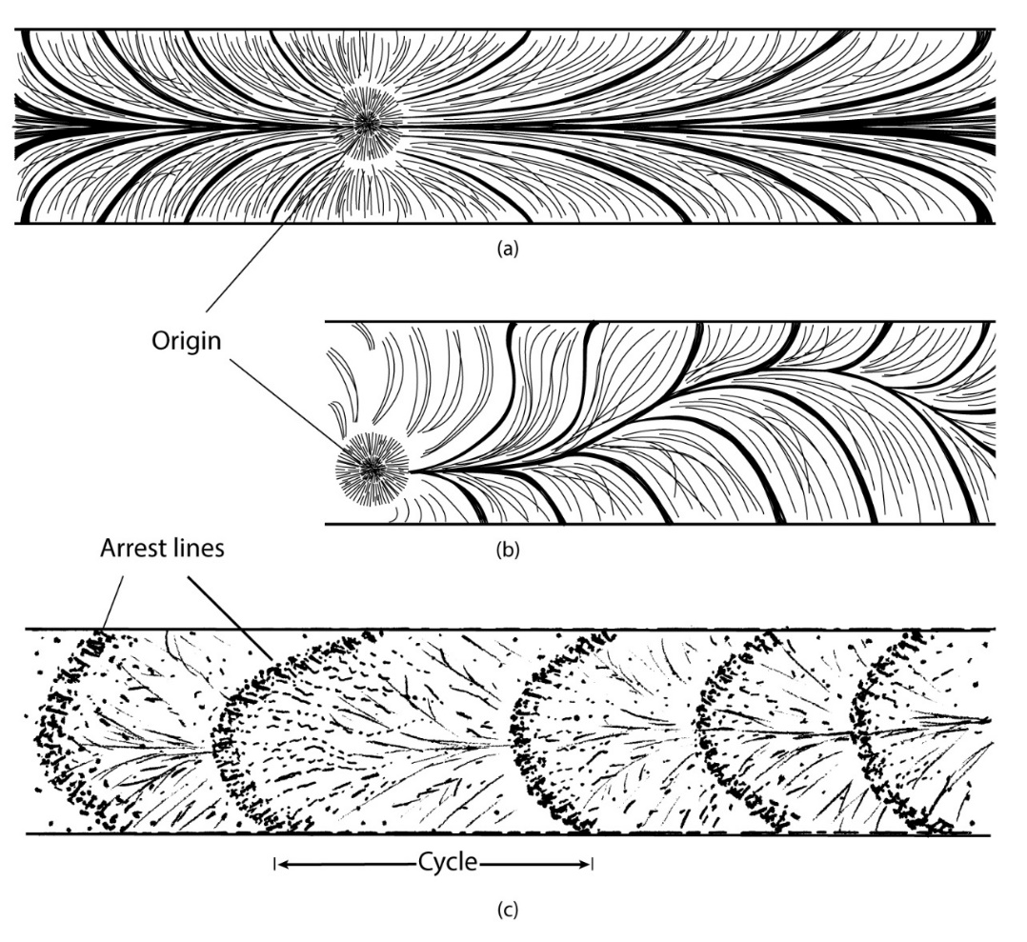
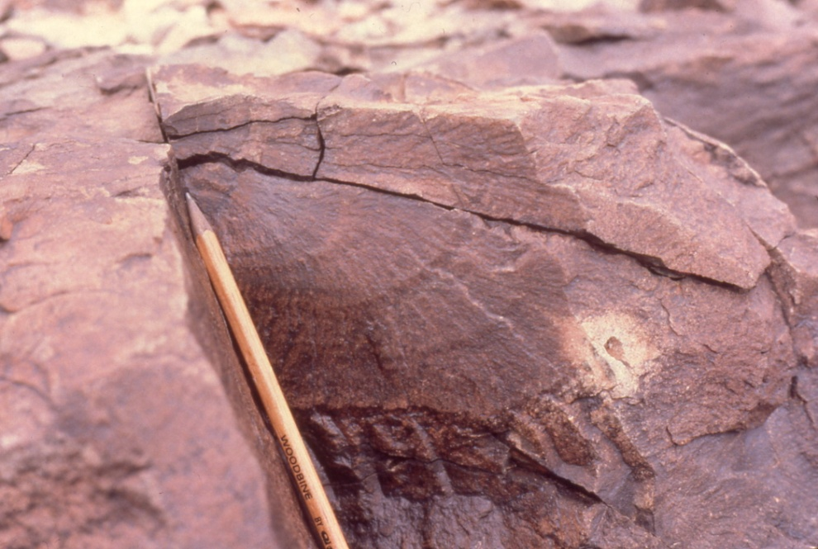
Plumose Structures
(a) Straight plume; (b) Curvy plume;
(c) Plume with arrest lines, indicating repeated opening
T. Engelder
Notes:
F I G U R E 7 . 2 Photographs of plumose structure on joint surfaces (New York
State, USA). (a) Wavy plumose structure on a joint in siltstone. (b) Plumose
structure in thin bedded siltstone; pencil points to the point of origin.
F I G U R E 7 . 4 Types of plumose structure. (a) Straight plume. (b) Curvy plume. (c) Plume with many arrest lines, suggesting that it opened repeatedly.

Slide 6
Joint Structure
Components of ideal plumose structure on joint. Face of joint 1 is exposed; joint 2 is within rock.
Cross sectional sketch showing dimple at joint origin, controlled by inclusion.
Notes:
F I G U R E 7 . 3 (a) Block diagram showing the various components of an ideal plumose structure on a joint. The face of
joint 1 is exposed; joint 2 is within the rock. (b) Simple crosssectional sketch showing the dimple of a joint origin, controlled by an inclusion.

Slide 7
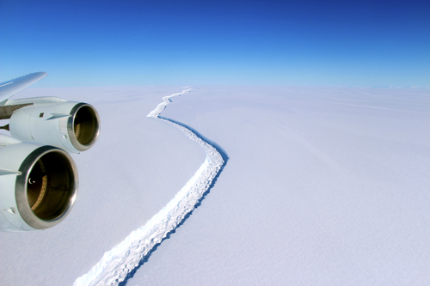
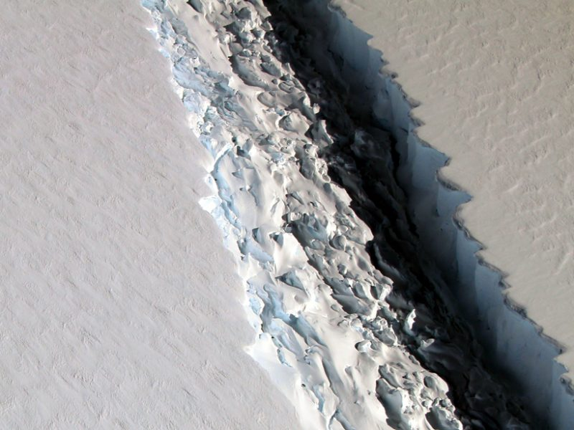
Extra: Larsen Ice Shelf, Antarctica
https://goo.gl/Tb2RPz
Joint propagation occurs on all scales in space and time. Video shows stops in ice crack propagation found as arrest lines on joint surfaces.
Larsen ice shelf's leading edge collapse is natural icecap-and-shelf evolution.
Larsen C iceberg calving, 2016 (NASA)

Slide 8
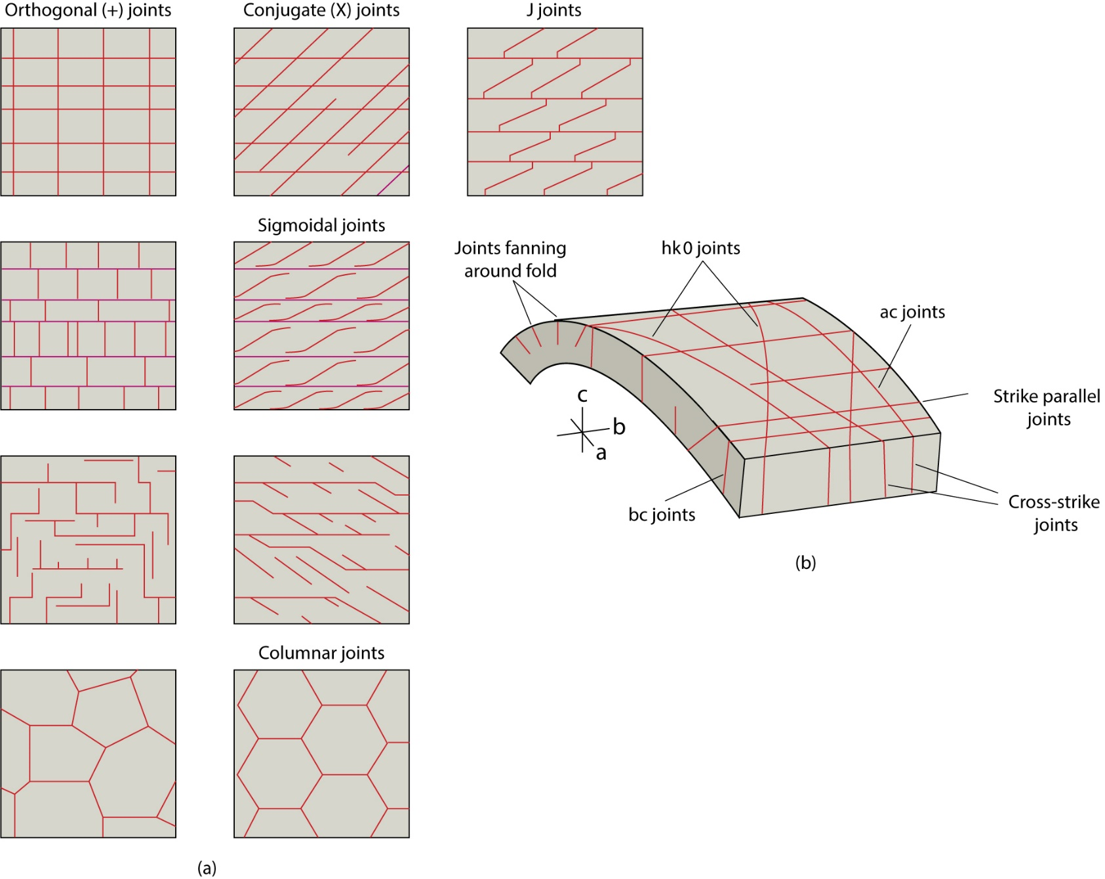
Systematic Joint Arrays
Traces of types of joint arrays on a bedding surface.
Arrangement of joint arrays with respect to fold geometrical axes.
Notes:
F I G U R E 7 . 6 (a) Traces of various types of joint arrays on a bedding surface. (b) Idealized
arrangement of joint arrays with respect to fold symmetry axes. The “hk0” label for joints that cut
diagonally across the fold-hinge is based on the Miller indices from mineralogy; they refer to the
intersections of the joints with the symmetry axes of the fold.

Slide 9
Joint Development
Sequence of joint development
Time 1 refers to time before first joint forms, and time 7 is last.
Scenario shows that joints form in random sequence, but result in regular spacing (d_{m}).
Why?
Notes:
F I G U R E 7 . 8 A model of the sequence of development of
joints. Time 1 refers to the time before the first joint forms, and
time 7 is the present day. This scenario suggests that joints
form in a random sequence, but with regular spacing.

Slide 10
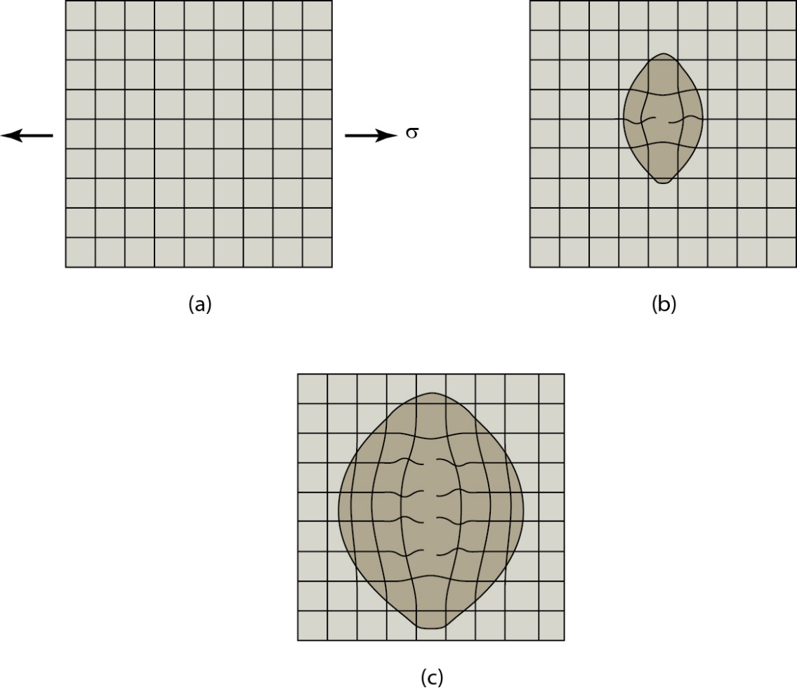
Stress Shadows and Joints
Joint stress shadows
A grid of springs
Cutting one spring causes a few springs to relax around cut, so only relatively small area affected
Cutting many springs in a row causes a wider band of springs to relax, so larger area affected
Notes:
F I G U R E 7 . 1 0 Illustration of why joint stress shadows exist. (a) A grid
of springs. (b) Cutting one spring causes only a few springs to relax around
the cut, so only a relatively small area is affected, as indicated. (c) Cutting
many springs in a row causes a wider band of springs to relax; thus, a
larger area is affected.

Slide 11
Stress Shadows and Joint Spacing
Thins beds have shorter joints, meaning smaller shadows.
Thus, closer spacing.
Stress shadow (shaded area) exists around each joint.
Note how stress is transmitted across regions that are unfractured in 3D.
Notes:
F I G U R E 7 . 9 The concept of stress shadows around joints. The heavy vertical lines are joints;
dm refers to the average spacing between joints. (a) Block diagram illustrating stress shadow
(shaded area) around each joint. Note how stress is transmitted across regions that are
unfractured in the third dimension. Stresses are also exerted by tractions at bedding contacts.
(b) Thin bedded sequence, containing joints with narrow stress shadows, so that the joints are
closely spaced. (c) Thick bedded sequence, containing joints with wide stress shadows, so that
the joints are widely spaced.

Slide 12
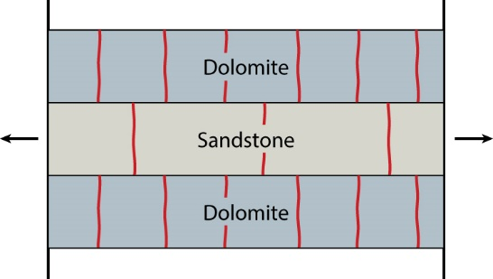
Joints and Lithology (and Elasticity)
Multilayer with different elasticities
Stiffer layers (dolomite) develop more closely spaced joints.
Why?
Notes:
F I G U R E 7 . 1 1 Cross-sectional sketch illustrating a
multilayer that is composed of rocks with different values of
Young’s modulus. The stiffer layers (dolomite) develop more
closely spaced joints.

Slide 13
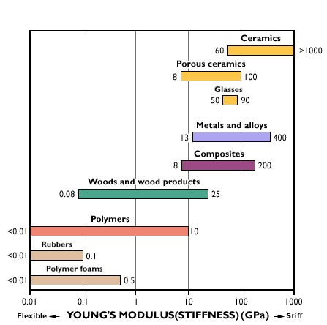
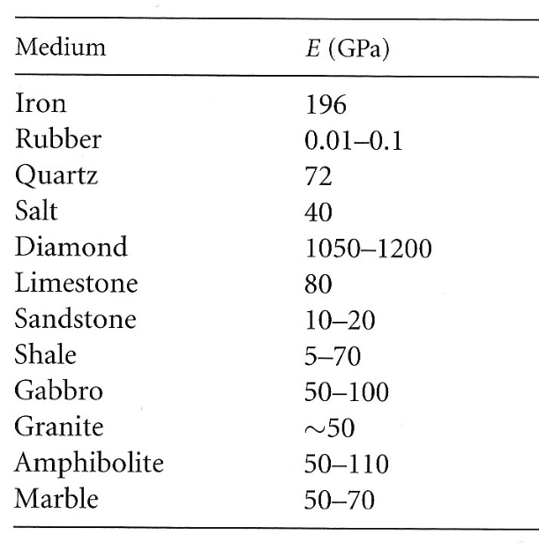
Elasticity
Elastic (or Hookean) Behavior:
σ = E . e
E = Young’s Modulus
Notes:
Hand-out for class annotation
Elastic is reversible, immediate strain (stored elastic strain). <2%, but important for earthquakes
Viscous is permanent, progressive strain
F I G U R E 5 . 3 Models of linear rheologies. Physical models consisting of strings and dash pots, and associated strain–time, stress–strain, or stress–strain rate curves are given for (a) elastic, (b) viscous, (c) viscoelastic, (d) elasticoviscous, and (e) general linear behavior. A useful way to examine these models is to draw your own strain–time curves by considering the behavior of the spring and the dash pot individually, and their interaction. Symbols used:
e = elongation, e˙ = strain rate, σ=stress, E = elasticity, η (eta)=viscosity, t = time, el denotes elastic component, vi denotes viscous component.

Slide 14
Joints and Lithology (and Elasticity)
Multilayer with different elasticities
Stiffer layers (dolomite) develop more closely spaced joints.
Why?
Young’s modulus E (elasticity, measure of stiffness) and stress.
σ = E . e (Hooke’s Law).
For same extension (e):
Large E (80GPa, stiffer) means large σ, so more fractures (and earlier).
Small E (20GPa) means small σ, so fewer fractures.
Notes:
F I G U R E 7 . 1 1 Cross-sectional sketch illustrating a
multilayer that is composed of rocks with different values of
Young’s modulus. The stiffer layers (dolomite) develop more
closely spaced joints.

Slide 15
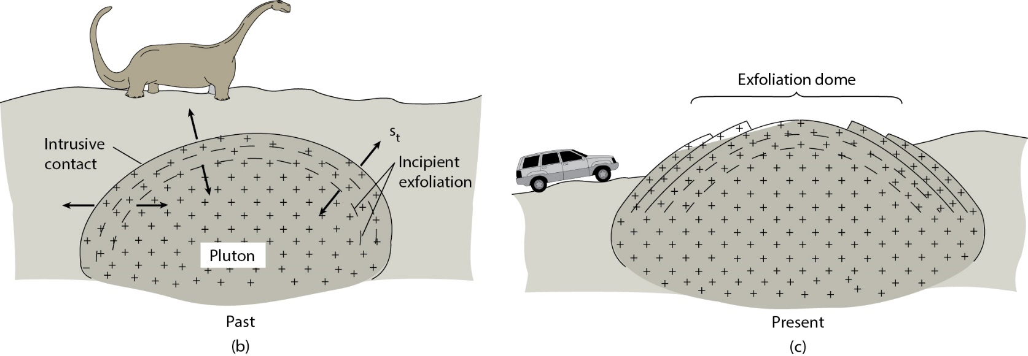
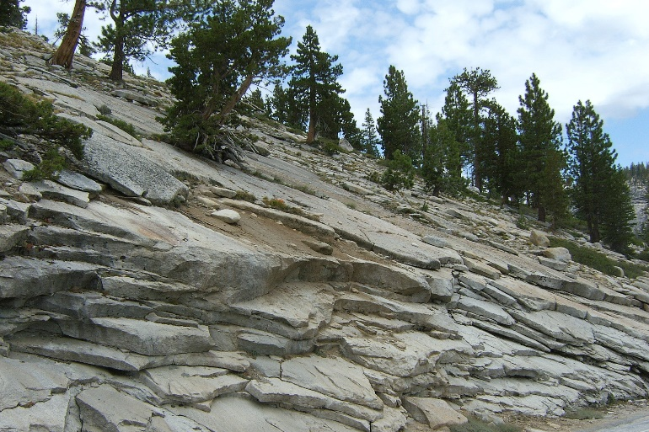
Other Joints: Sheeting (or Unroofing) Joints
Unloading (relaxing):
Vertical extension, horizontal contraction (‘Poisson effect’) as rock expands from removal of overburden

Slide 16
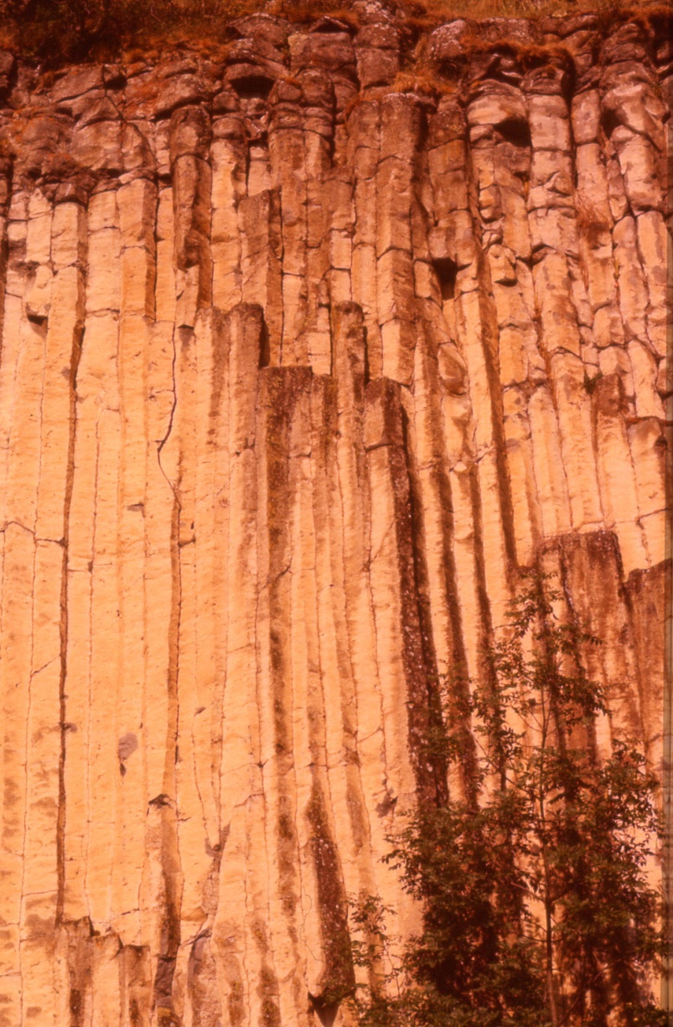
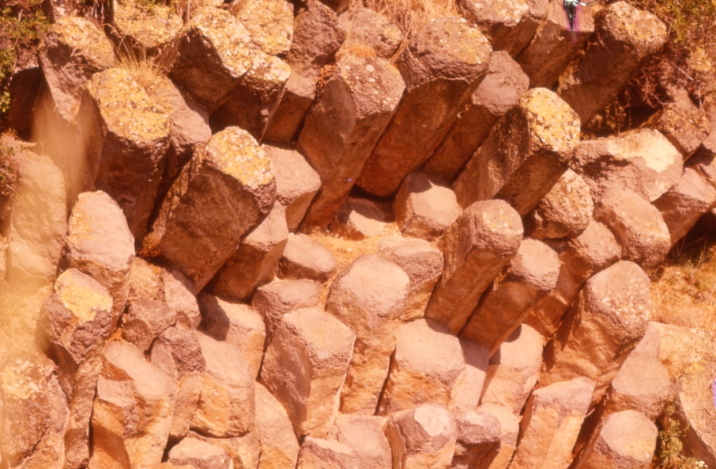
Other Joints: Columnar (or Cooling) Joints
Cooling:
Horizontal stress as rock contracts vertically from cooling
Notes:
F I G U R E 7 . 1 4 Joint formation during unroofing. As the block of rock approaches the ground
surface, subsequent to the erosional removal of overburden, it expands in the vertical direction and
contracts in the horizontal direction. It also cools (vertical axis shows approximate isotherms).

Slide 17
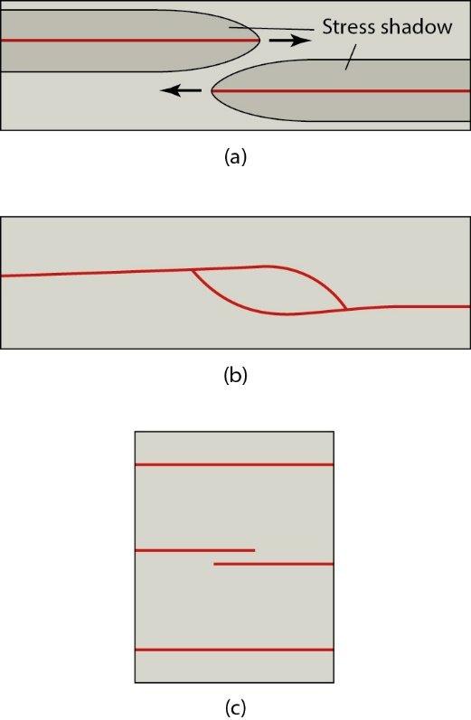
Joint terminations
Joints terminate without curving when they approach one another.
Joints curving into each other and linking.
Joint spacing is fairly constant because joints that grow too close together cannot pass each other.
Notes:
F I G U R E 7 . 2 1 Joint terminations. (a) Joints terminating
without curving when they approach one another. (b) Joints
curving into each other and linking. (c) Map view sketch
illustrating how joint spacing is fairly constant because joints
that grow too close together cannot pass each other.

Slide 18
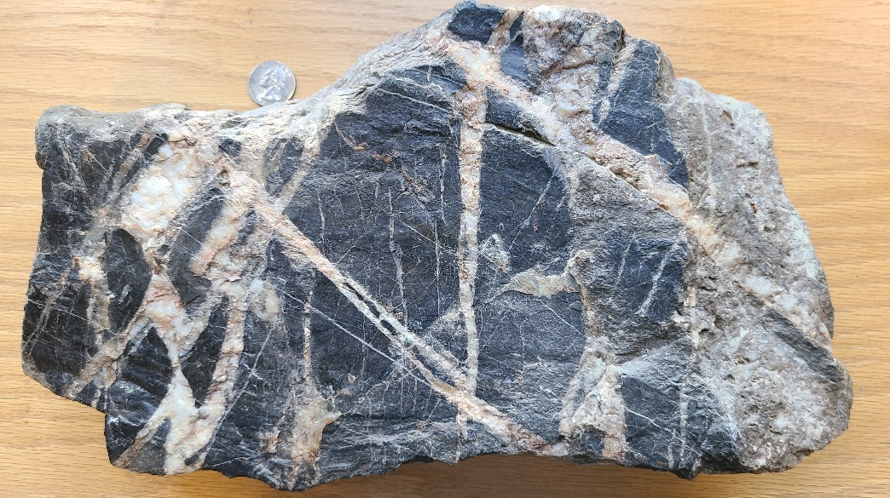
Veins

Slide 19
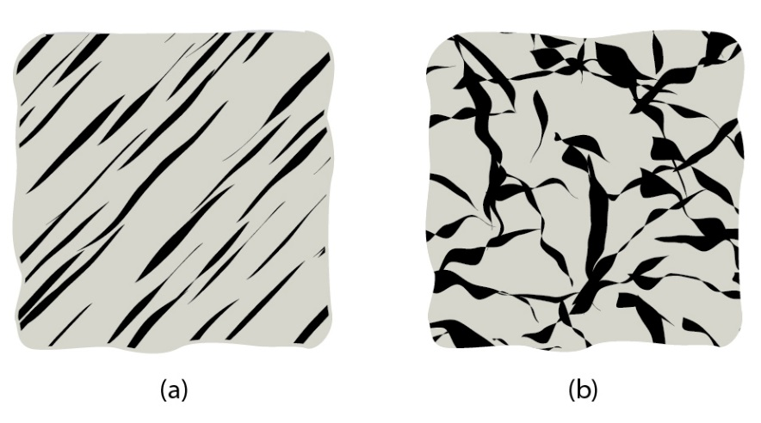
Veins (=filled joints and fractures) and Vein Arrays
Planar array of veins.
Stockwork array of veins.
(Vein fill is dark)

Slide 20
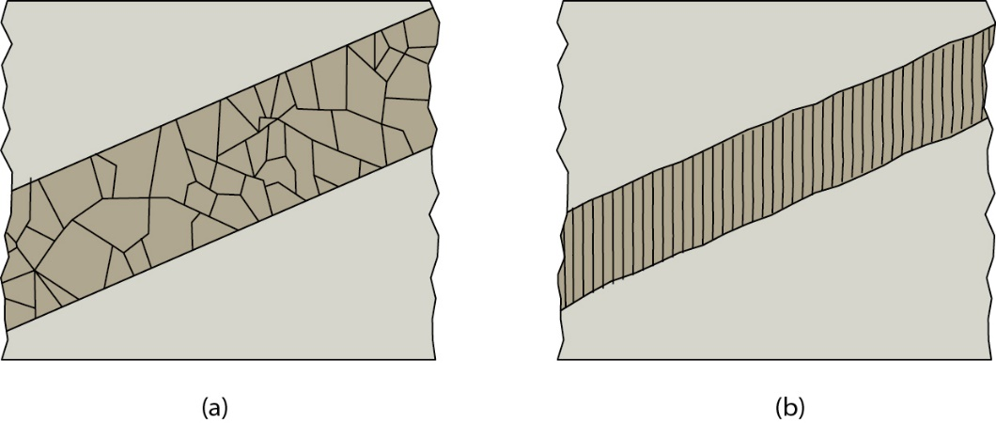
Vein Morphology
Blocky vein Fibrous vein
Notes:
F I G U R E 7 . 2 4 Vein fill types.
Blocky vein means open void
Fibrous vein means crack-seal opening

Slide 21
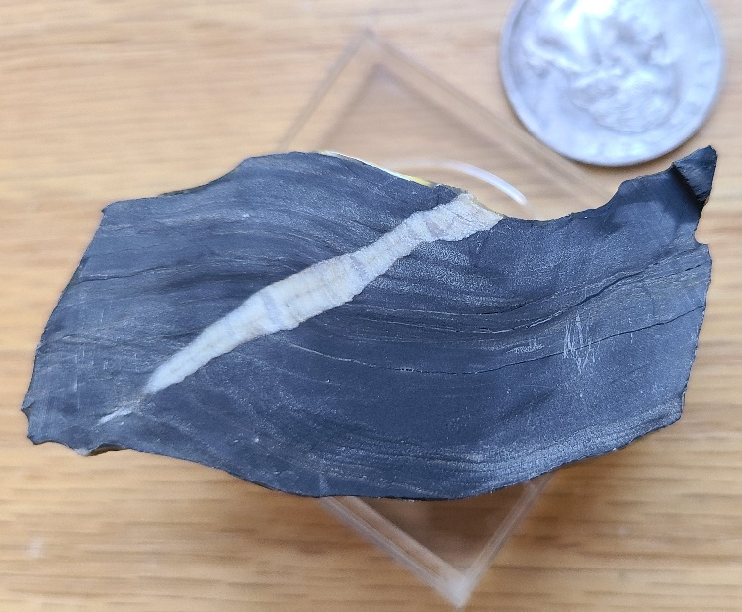
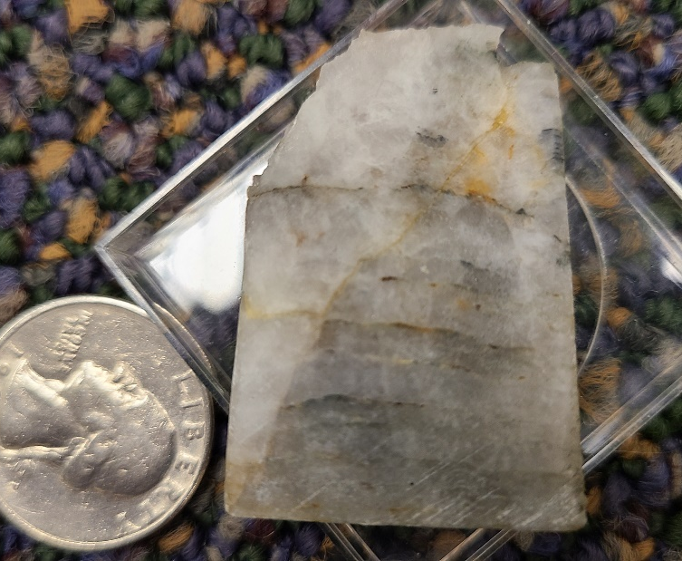
Vein Fibers

Slide 22
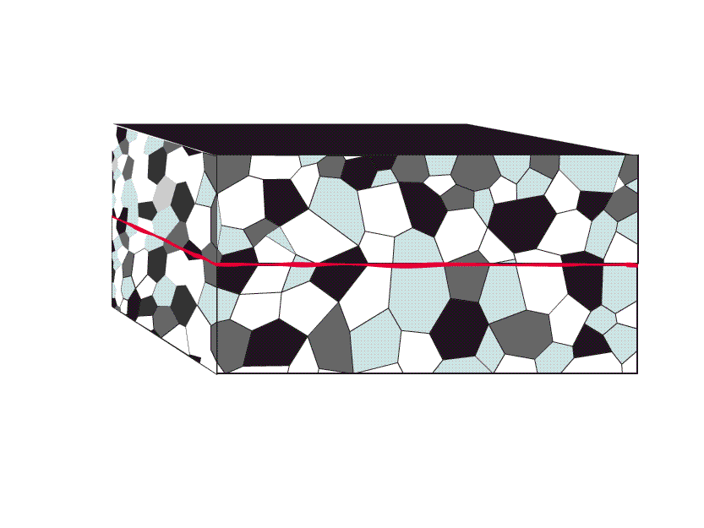
Antitaxial Veins
Antitaxial veins where fill and wall contrast (“weak weld”); e.g., carbonate vein in sandstone or a pyrite inclusion.
Notes:
F I G U R E 7 . 2 6 Cross-sectional sketches, at the scale of individual grains, showing the contrast in the stages of crack-seal deformation leading to antitaxial veins and syntaxial veins. (a) Formation of antitaxial veins. The increments of cracking form along
the margins of the vein, and the vein composition differs from the wall rock (i.e., the fibers are not in optical continuity with the
grains of the wall). During increments of cracking, tiny slices of the wall rock spall off. The slices bound the growth increments in a fiber. (b) Syntaxial vein formation. During each increment, the cracking is in the center of the vein. The composition of the fibers is the same
as that of the grains in the wall rock (that is, the fibers are in optical continuity with the grains of the wall rock). Optical continuity between fiber and grain means that the crystal lattice of the grain has the same orientation as the crystal fiber of the fiber. Optically
continuous fibers and grains go extinct at the same time, when viewed with a petrographic microscope.
Host rock in antitaxial should be different

Slide 23
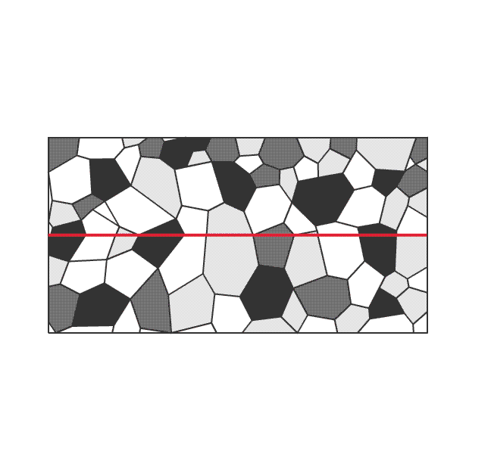
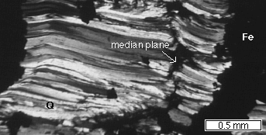
Syntaxial Veins
Syntaxial veins where vein fill same material as wall rock (“strong weld”); e.g., quartz vein in quartzite.
Notes:
F I G U R E 7 . 2 6 Cross-sectional sketches, at the scale of individual grains, showing the contrast in the stages of crack-seal deformation leading to antitaxial veins and syntaxial veins. (a) Formation of antitaxial veins. The increments of cracking form along
the margins of the vein, and the vein composition differs from the wall rock (i.e., the fibers are not in optical continuity with the
grains of the wall). During increments of cracking, tiny slices of the wall rock spall off. The slices bound the growth increments in a fiber. (b) Syntaxial vein formation. During each increment, the cracking is in the center of the vein. The composition of the fibers is the same
as that of the grains in the wall rock (that is, the fibers are in optical continuity with the grains of the wall rock). Optical continuity between fiber and grain means that the crystal lattice of the grain has the same orientation as the crystal fiber of the fiber. Optically
continuous fibers and grains go extinct at the same time, when viewed with a petrographic microscope.
Host rock in antitaxial should be different

Slide 24
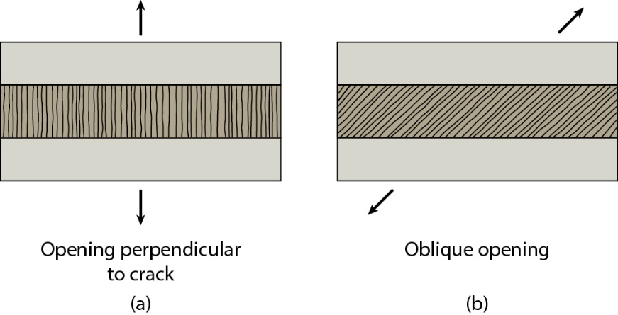
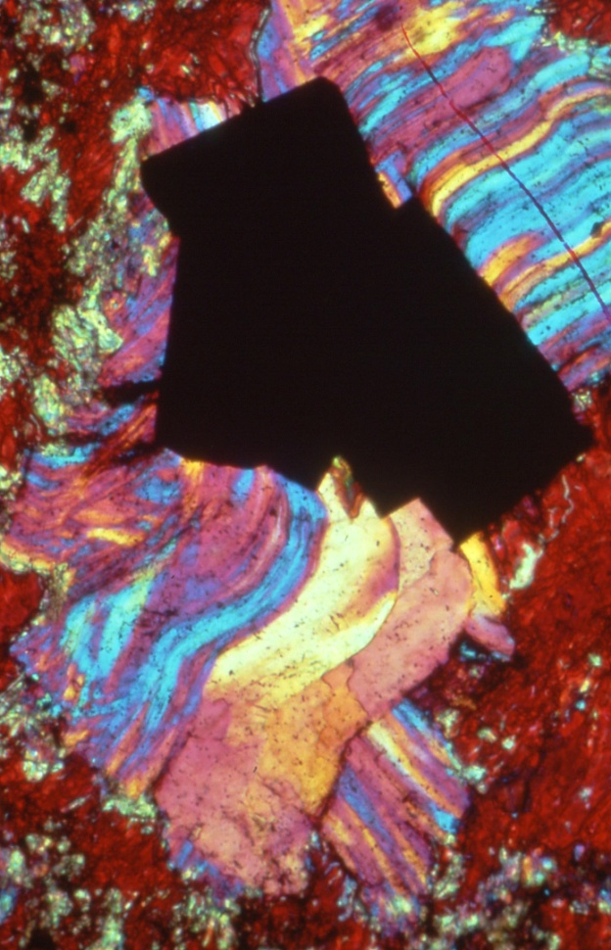
Crack Opening and Fibers
Long axis of vein fibers tracks direction of extension, and change in extension direction leads to curved fibers.
Antitaxial veins where fill and wall contrast (“weak weld”); e.g., calcite vein in quartzite, pyrite inclusion.
Syntaxial veins where vein material fill same as wall rock (“strong weld”); e.g., quartz vein in quartzite.
+
Antitaxial Syntaxial
Notes:
Syntaxial veins in rocks where vein fill same as wall rock: Q vein in quartzite
Antitaxial veins in rock where fill and wall contrast
Antitaxial veinsF I G U R E 7 . 2 7 Cross sectional sketches showing that the long axis of fibers in a vein tracks the direction of extension,
and how a change in extension direction leads to the formation of sigmoidal fibers. (a) If the extension direction is
perpendicular to the vein wall then the fibers are perpendicular to the grain. (b) If the extension direction is oblique to the vein
wall, then the fibers are oblique to the vein wall. If the extension direction is effectively parallel to the vein surface (i.e., the vein is
a fault surface), then the fibers are almost parallel to the vein wall, and on exposed surface would form slip lineations. (c, d)
A change in extension direction leads to the formation of sigmoidal fibers. In this example, the opening is first perpendicular
to the vein wall, and then is oblique to the vein. Because of the locus of vein fiber precipitation, (c) antitaxial veins and (d) syntaxial veins have different shapes.

Slide 25
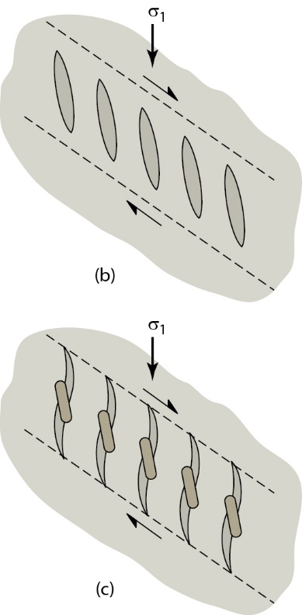
En-echelon and Sigmoidal Veins
Formation of en-echelon array.
Formation of sigmoidal en echelon veins, due to rotation of older, central part of veins, and growth of new vein material at original angle to shear surface.
Rotated, filled crack
New, filled crack
Fossen, 2016
Notes:
../Animations/enEchelon2.swf
F I G U R E 7 . 2 3 (b) Formation of a simple en echelon array. (c) Formation of sigmoidal en echelon veins, due to
rotation of the older, central part of the veins, and the growth of new vein material at ∼45° to the shear surface.

Slide 26
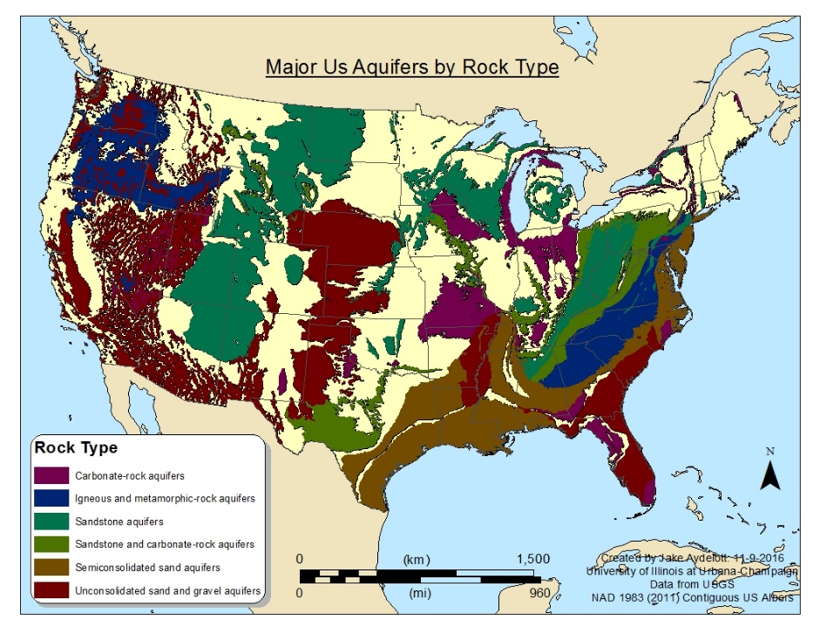
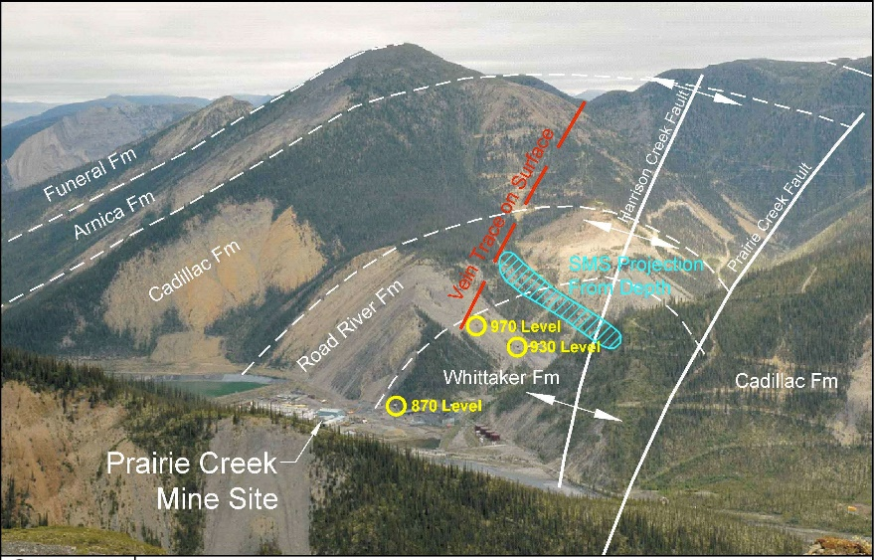
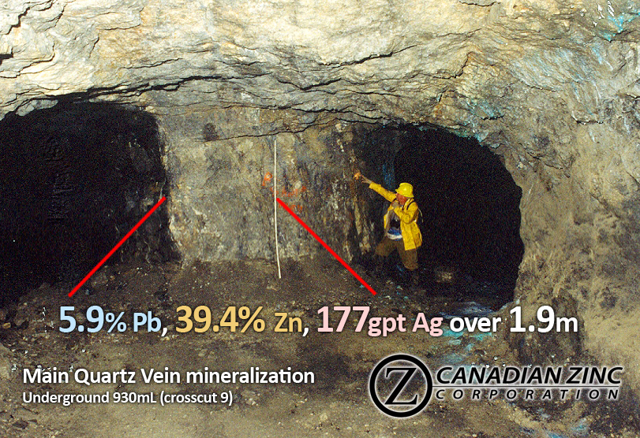
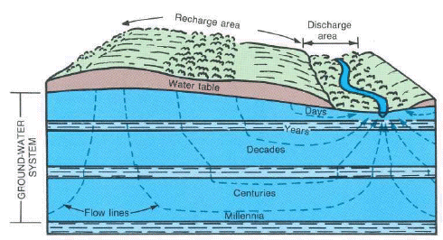
Structure and Society: Fractures and Veins
Fractures: Aquifers and Groundwater Veins: Mineralization
Mississippian Aquifer
Ogallala Aquifer
All USGS

Slide 27
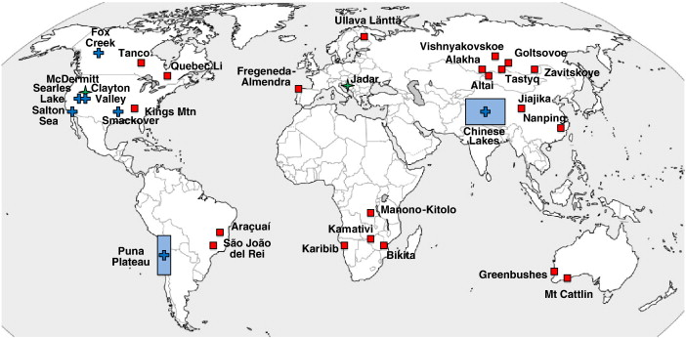
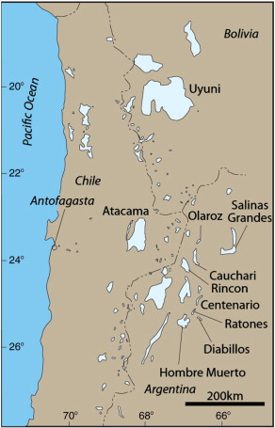
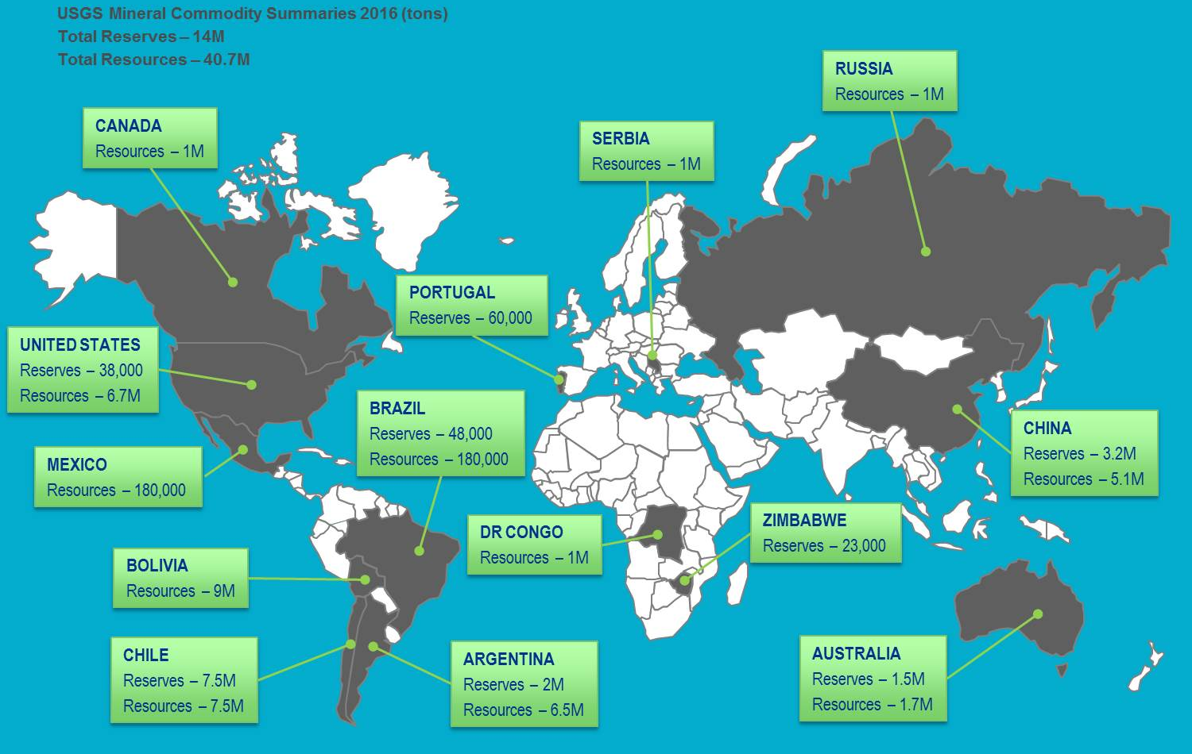
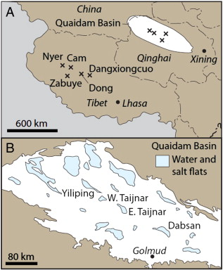
Lithium Reserves and Resources
Major lithium pegmatite (square) and brine (cross) deposits;
Kesler et al, 2012
Lithium Reserves and Resources
USGS, 2016

