Slide 1
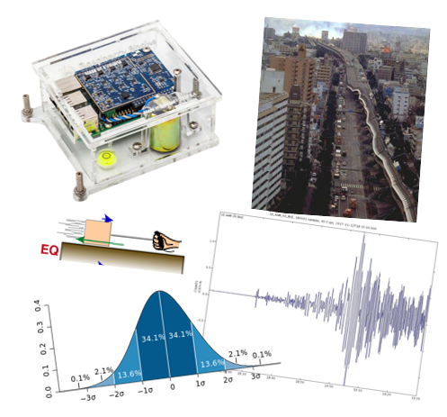
About Earthquakes
Earth Structure (Processes in Structural Geology &Tectonics)
© Ben van der Pluijm
9/14/2023 4:00 PM
Notes:
Societal relevance: groundwater, gas/petroleum, mineralization; surface stability

Slide 2
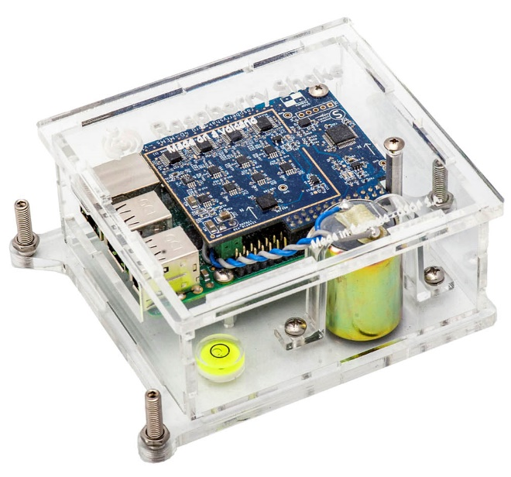
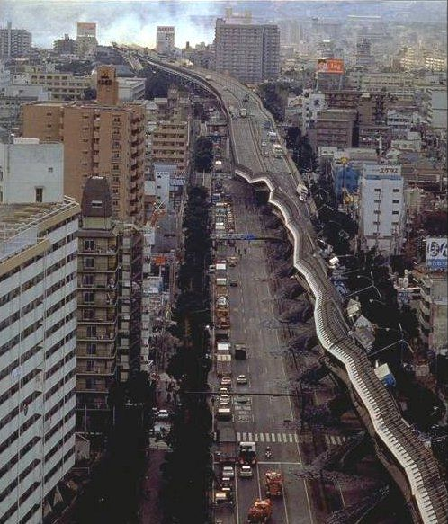
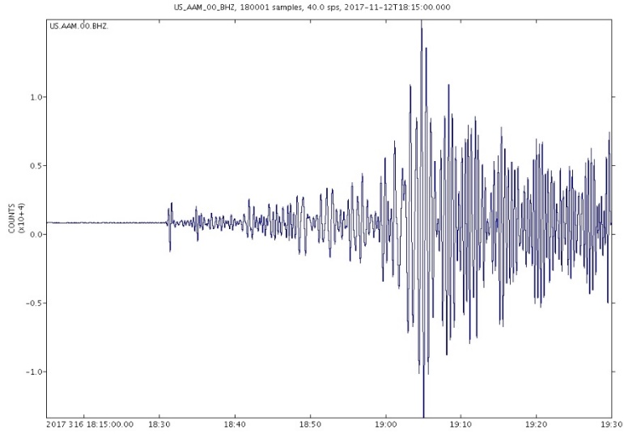
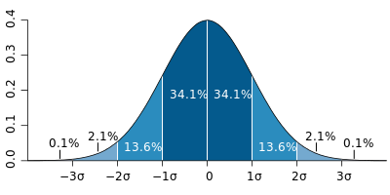
We Discuss …
Earthquakes
Global earthquakes and geology
Basic mechanics of earthquakes
Earthquake waves
Seismograms and Magnitudes
Fault plane solutions
Probability
Time-independent
Time-dependent
Order and Recurrence
Groundshaking and Impact
Beyond plate boundaries
Eastern US (intraplate)
Central US (industrial)

Slide 3
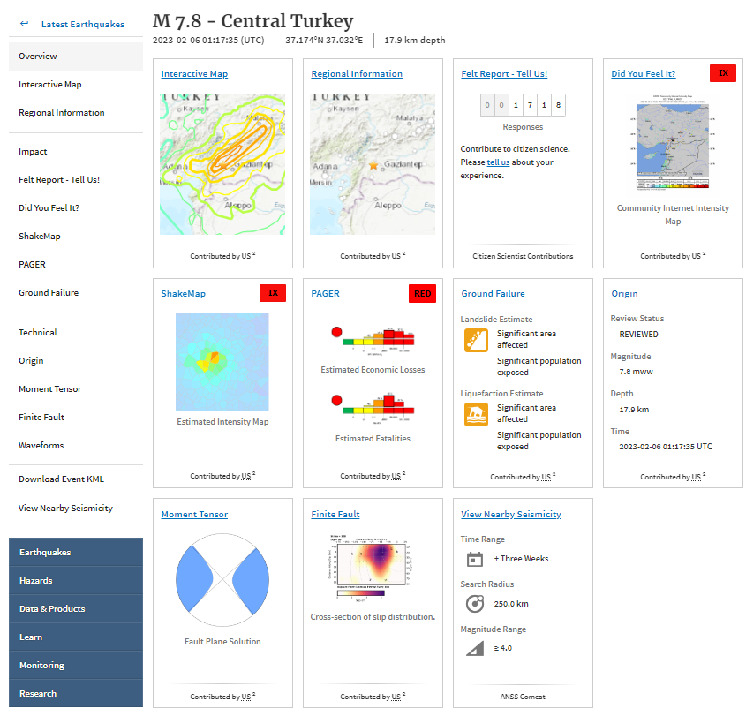
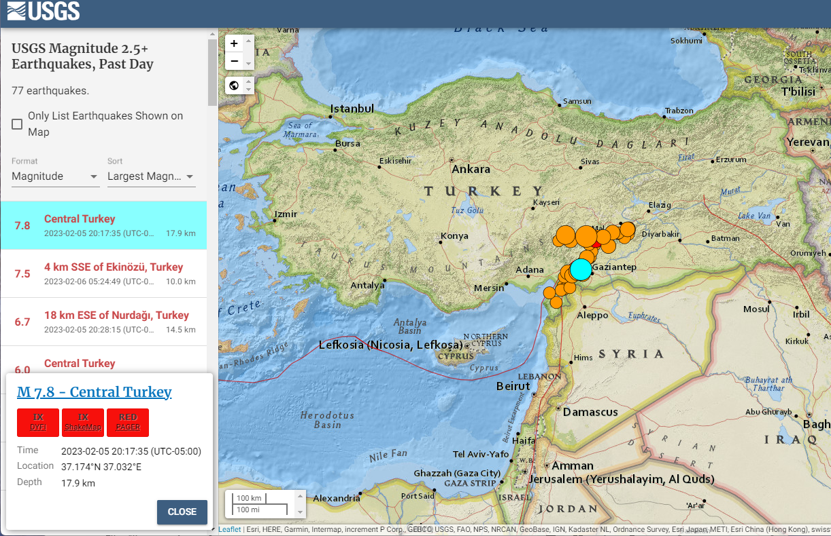
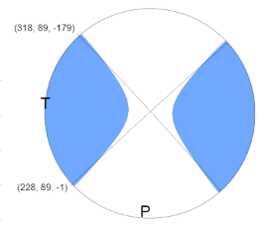
Near Real-time Earthquake Analysis: USGS
Go to: https://earthquake.usgs.gov/earthquakes/map/

Slide 4
Elastic Release and Seismic Waves
P – Compressive waves (fast)
S – Shear waves (slower)
Surface waves (slowest)
P-S is EQ distance measure
Notes:
FIGURE 4.2 (a–d) The cycle of elastic-strain buildup and release for a right-lateral strike-slip fault according to Reid’s elastic rebound theory of earthquakes. At the instant of rupture, (c), energy is released in the form of earthquake waves that radiate out in all directions. (e) Right-lateral offset of a fence by 2.5 meters (8 ft) by displacement on the San Andreas fault in 1906; Marin County, California.

Slide 5
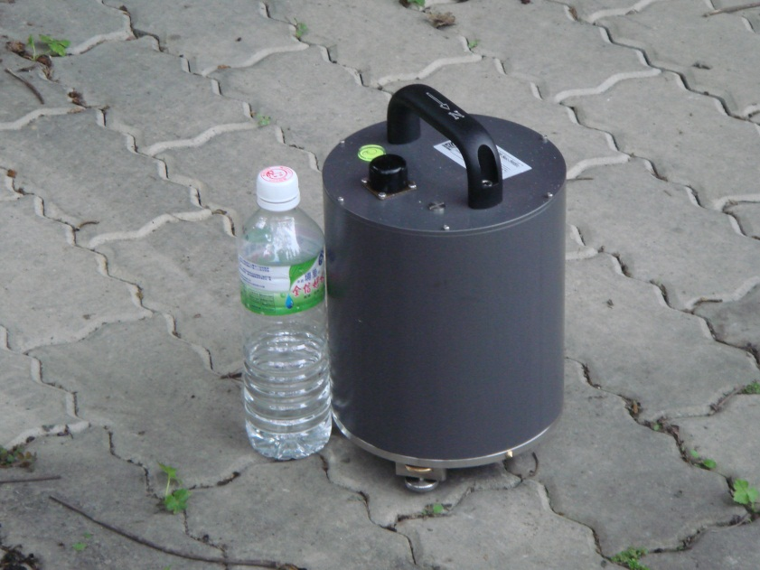
Seismometers Then and Now
20th century
Ancient (China)
21st century
Notes:
FIGURE 4.5 Seismometer (left) and seismogram (right) used to demonstrate method of detecting and recording earthquakes. The record on the seismogram is not an earthquake, but represents the seismometer’s detection of vibrations from students’ footsteps amplified about 2,000 times.
FIGURE 4.6 The first earthquake detector, invented about A.D. 130 by Chinese scholar Chang Heng. Balls held in the dragons’ mouths were aligned with a pendulum inside the vase. When an earthquake occurred the pendulum swung and pushed balls into the mouths of the frogs aligned with the pendulum’s swing. If the frogs facing north and south contained balls, for example, Chang Heng could say that the earthquake epicenter was north or south of the instrument.

Slide 6
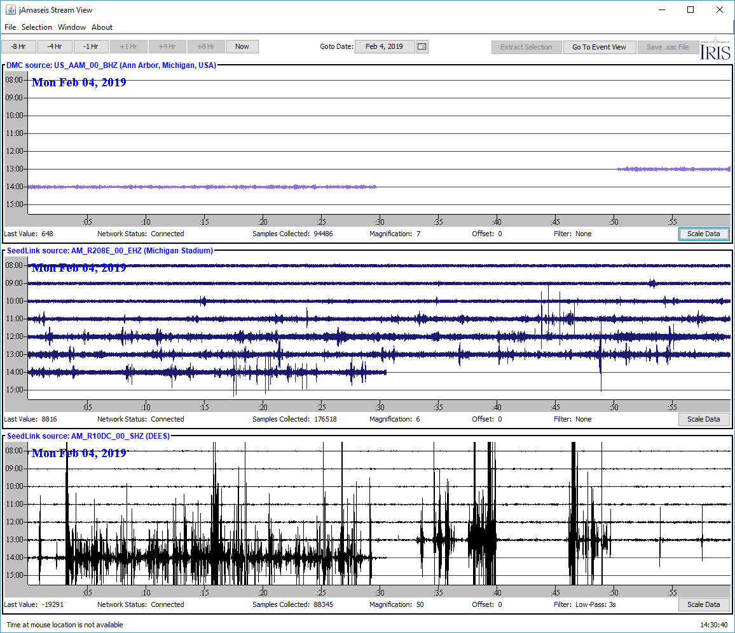
Citizen Seismometer: RaspberryShake

Slide 7
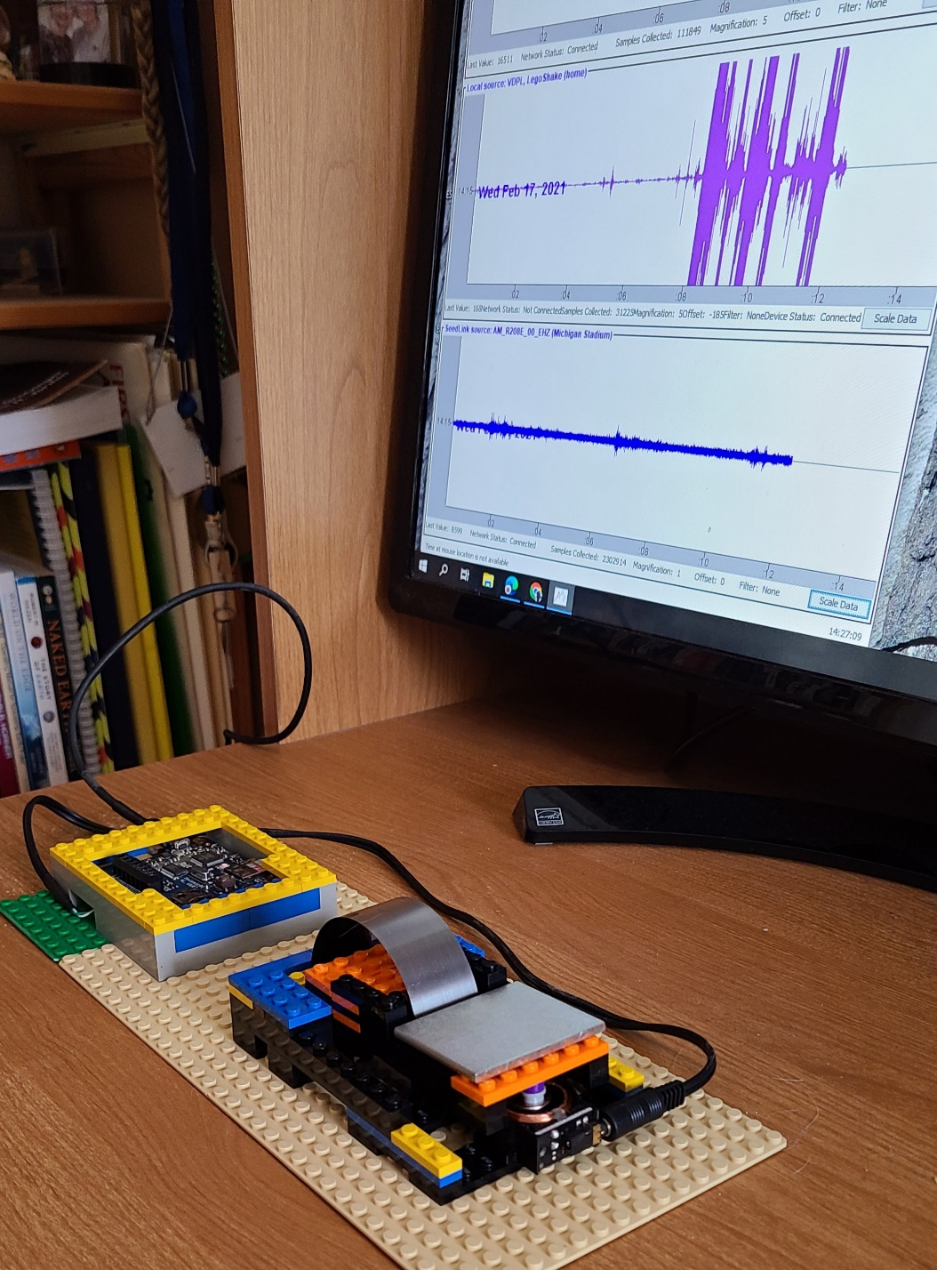
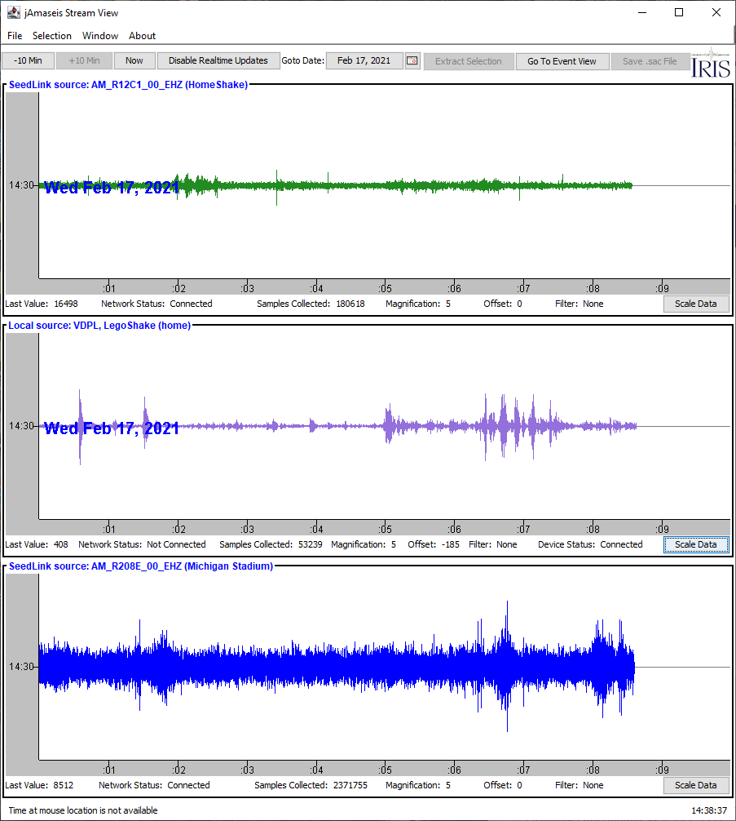
Lego Seismometer

Slide 8
Elastic Strain and Frictional Slip 1
“Stick-slip” earthquake model using wood block, sandpaper and rubber band. Sandpaper represents contact zone and friction, and rubber band is elastic component of deformation.
Elastic energy accumulates when rubber back stretches, and is rapidly released when block jerks during slip event (=earthquake).
On graph, yellow line is steady pull over time; blue line is movement of block during slip events, so repeating jumps over time.

Slide 9
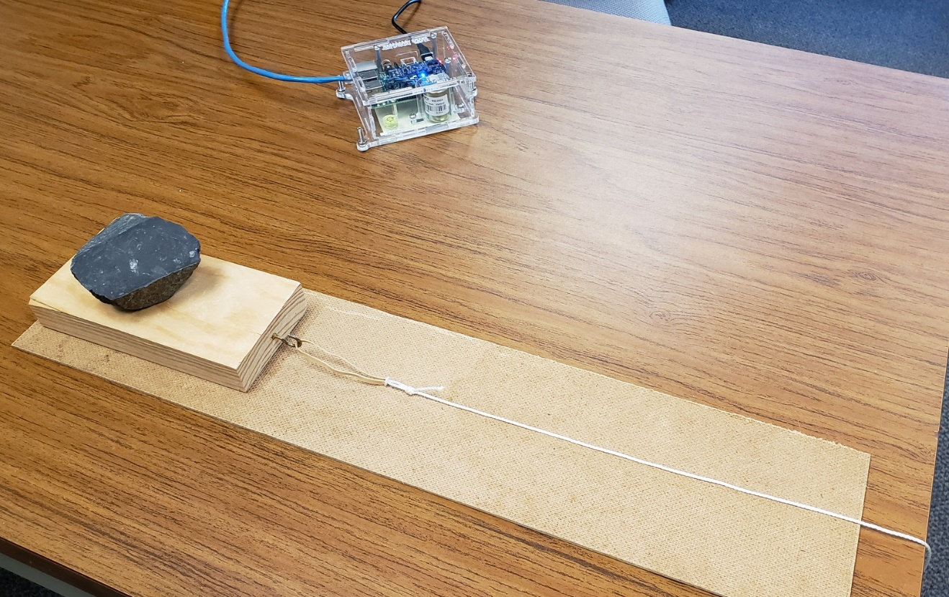
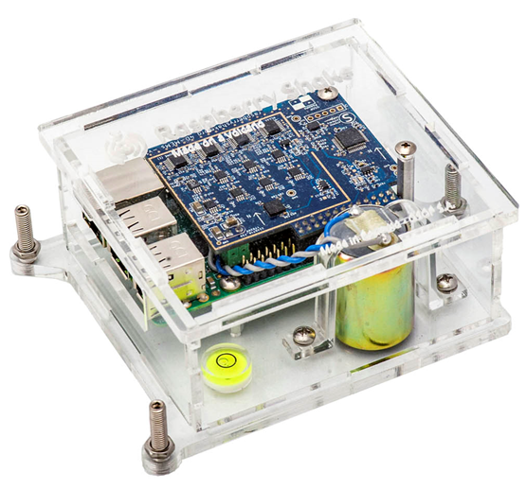
Stick-slip and Earthquakes
Weighted block (appropriately, pseudotachylite) with elastic band and rope on rough board illustrates elasticity and stick-slip faulting (= earthquake) behavior.
Nearby seismometer (raspberryshake) records stick-slip pulses on Swarm software.

Slide 10
Earthquake waves
IRIS: http://ds.iris.edu/seismon/swaves/

Slide 11
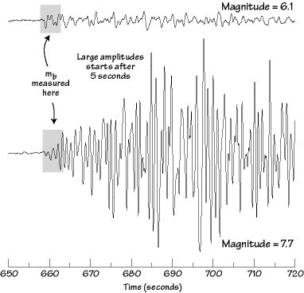
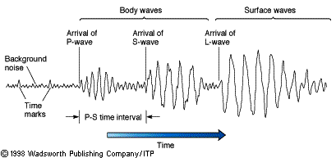
Seismic Moment and Moment Magnitude
Original Richter scale used body waves, so underestimates total energy of earthquakes
Energy defines societal impact
Energy is linearly related to Seismic Moment
Seismic Moment (M_{o}) =
= elastic parameter (rigidity) of rock X fault displacement X fault displacement area SI unit is dyne.cm or erg

Slide 12
Seismic Moment and Moment Magnitude
Seismic Moment, M_{o}:
= rigidity of rock x displacement on fault x fault displacement area (dyne.cm or erg)
Earthquake | Richter | Moment
Chile, 1960 | 8.3 | 9.5
Alaska, 1964 | 8.4 | 9.2
Mexico, 1985 | 8.1 | 8.1
Loma Prieta, 1989 | 7.1 | 7.0
Northridge, 1994 | 6.4 | 6.7
Kobe, 1995 | 7.2 | 6.9
Moment magnitude, M_{w}:
2/3 log M_{o} – 16.1
(Up to M ≈ 7 equivalent to old Richter scale)

Slide 13
Earthquake Magnitude and Energy
Each M_{w} step is ~30x energy
(slope of line)
For example: M_{W}=7 has ~1000x more energy than M_{W}=5
Notes:
FIGURE 4.11 Earthquake magnitude and energy. (a) Richter magnitudes of nine selected earthquakes, 1906–1994. (b) Equivalent moment magnitudes of energetic human-caused events (squares), natural events (triangles), and large earthquakes (circles). The erg is a unit of energy, or work, in the metric (cgs) system. To lift a one-pound weight one foot requires 1.4 x 107 ergs.

Slide 14
Societal Impact: Intensity (or Mercalli) Scale
I. | Not felt except by a very few under especially favorable conditions.
II. | Felt only by a few persons at rest, especially on upper floors of buildings.
III. | Felt quite noticeably by persons indoors, especially on upper floors of buildings. Many people do not recognize it as an earthquake. Standing motor cars may rock slightly. Vibrations similar to the passing of a truck. Duration estimated.
IV. | Felt indoors by many, outdoors by few during the day. At night, some awakened. Dishes, windows, doors disturbed; walls make cracking sound. Sensation like heavy truck striking building. Standing motor cars rocked noticeably.
V. | Felt by nearly everyone; many awakened. Some dishes, windows broken. Unstable objects overturned. Pendulum clocks may stop.
VI. | Felt by all, many frightened. Some heavy furniture moved; a few instances of fallen plaster. Damage slight.
VII. | Damage negligible in buildings of good design and construction; slight to moderate in well-built ordinary structures; considerable damage in poorly built or badly designed structures; some chimneys broken.
VIII. | Damage slight in specially designed structures; considerable damage in ordinary substantial buildings with partial collapse. Damage great in poorly built structures. Fall of chimneys, factory stacks, columns, monuments, walls. Heavy furniture overturned.
IX. | Damage considerable in specially designed structures; well-designed frame structures thrown out of plumb. Damage great in substantial buildings, with partial collapse. Buildings shifted off foundations.
X. | Some well-built wooden structures destroyed; most masonry and frame structures destroyed with foundations. Rails bent.
XI. | Few, if any (masonry) structures remain standing. Bridges destroyed. Rails bent greatly.
XII. | Damage total. Lines of sight and level are distorted. Objects thrown into the air.
DAMAGE

Slide 15
Example: 1994 Northridge (CA) EQ
Mercalli intensities of 1994 Northridge (CA) earthquake.
M_{w}6.7; PGA >1g
January 17, 1994 at 4:30:55am PST
thrust fault
57 deaths, >8,700 injured
$15-40B property damage)
Notes:
FIGURE 4.10 (a) Isoseismal map of the near-field (close to the epicenter) modified Mercalli scale intensities of the 1994 Northridge, California, earthquake. Intensity-IX values are assigned where there are spectacular partial collapses of modern buildings, destroyed wood-frame buildings, and collapses of elevated freeways (see Appendix 4). (b) Community Internet Intensity Map (CIIM) for the same earthquake. The main difference in appearance is due to the fact that the intensities were not contoured but assigned to ZIP code areas of the respondents. (a) SCEC data (b) USGS

Slide 16
Earthquake Shaking and Subsurface: Sand vs Sandstone
Same magnitude + different subsurface
= different impact
New Madrid EQ (1895) vs. Northridge EQ (1994)
strong rock vs. weak soil
Notes:
FIGURE 4.29 Mid-continent earthquakes. (a) Comparison of the effects of two earthquakes of similar magnitude. The 1895 Charleston, Missouri, earthquake impacted a relatively huge area in the central United States, whereas the 1994 Northridge earthquake’s effects were limited to Southern California. Red indicates areas of minor-to-major damage to buildings and their contents. Yellow indicates areas where shaking was felt but there was little or no damage to objects, such as dishes. (b) Damage from the 1886 earthquake along East Bay Street in Charleston, South Carolina.
FIGURE 4.30 The New Madrid seismic zone covers parts of four states and consists of an ancient, fault-bounded depression (rift) buried below 1.5 kilometers (almost a mile) of sedimentary rocks. An area of major seismic hazard, it is studied intensively. USGS DATA

Slide 17
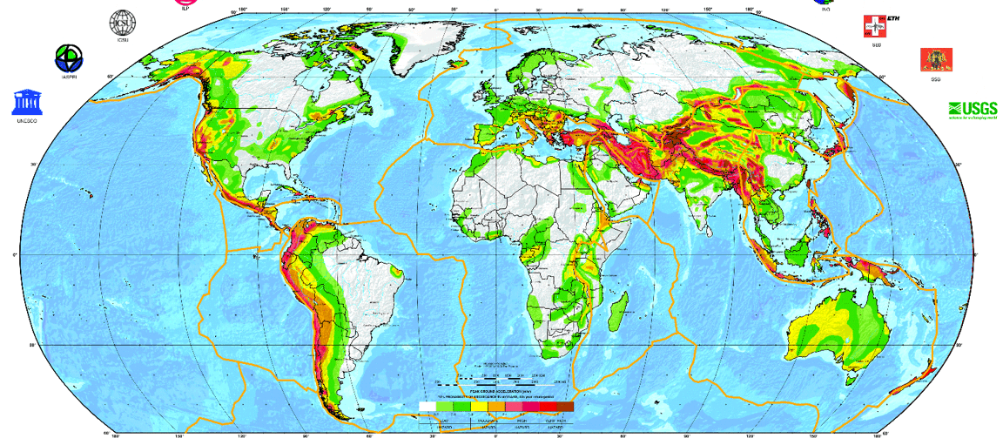
Global Seismic Hazard
https://www.gfz-potsdam.de/en/GSHAP/
Expected Peak Ground Acceleration (PGA) with 10% chance of exceedance in 50 years.
Serious structural damage starts at >10% of g (1g = 9.8m/s² = 100%). Acceleration of 2.4m/s² is 2.4/9.8 = 24% of g.

Slide 18
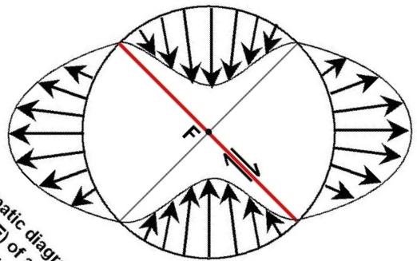
Earthquakes and Fault-plane Solutions
When EQ occurs, global seismometers record first motion (toward station vs away from station), dividing area into two sectors of compression (usually white) and two sectors of tension (usually shaded), separated by two planes.
One of these planes is fault plane on which EQ occurred, From distribution of compressive and tensile sectors, sense of slip on fault is constrained.
C
T
T
C

Slide 19
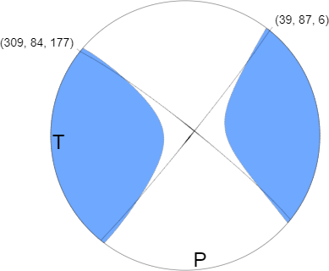
Fault-plane (Moment Tensor) Solutions
M 6.3 - 77km NNE of Loreto, Mexico 2018-01-19 16:17:42 UTC; 26.680°N 111.107°W; 10 km depth
Two fault planes = two solutions
Add geology = one solution
C
Notes:
Sign form first P wave arrivals

Slide 20
Earthquakes and Fault-plane Solutions
When EQ occurs, global seismometers record first motion (toward vs away), dividing area into two sectors of compression (white) and two sectors of tension (shaded), separated by two planes.
One of these planes is fault plane on which EQ occurred, From distribution of compressive and tensile sectors, sense of slip on fault is constrained.
C and T define regions for σ₁ and σ₃, but not exact orientation (frictional behavior, not failure condition)!

Slide 21
EQ Statistics: Magnitude
Logarithmic EQ frequency-EQ magnitude relationship (self-similar or “fractal” property)

Slide 22
Earthquake Probability and Recurrence
“70% chance of >6.7 earthquake in San Francisco Area for 2000-2030”
Meaning what?
Notes:
FIGURE 4.33 Probabilities that one or more magnitude-6.7 or greater earthquakes will strike on specific faults in the San Francisco Bay region between 2000 and 2030. The San Andreas, Rogers Creek, and Hayward faults have the highest probabilities. Total probability for the region is computed as 70% (or 10%).
FIGURE 4.34 A graphing of 463 earthquakes of magnitude 4 or greater in a small area near a nuclear reactor in Southern California over a period of 44 years. Statistically, the graph shows that 600 magnitude-4 earthquakes can be expected in 100 years, or 6 per year on average. The probability of a magnitude-8 earthquake in 100 years is 0.1, which would be 1 in 1,000 years. Such plots can be constructed for a region or for the world. The graphs are all similar in shape; only the numbers differ.

Slide 23
Geohazards and Time-dependency
Time independent: future event is equally likely immediately after an event or much later.
Time-dependent: events follow cycle in which conditions build up after an event before causing next one. Recurrence times are distributed according to "normal" (or "bell“) curve, with average value most likely and values farther away from average less likely.
Hazards Group | Time Dependency | Main Types
Geological | Time-dependent | Earthquake, Volcano, Landslide (dry)
Hydrological | Time-independent | Flood, Tsunami, Landslide (wet)
Atmospheric-Weather | Time-independent | Storm, Tornado, Hurricane
Atmospheric-Climate | Time-dependent | Extreme Temperature, Drought, Wildfire

Slide 24
Earthquake Probability and Recurrence
70% of M>6.7 earthquake in San Francisco Area for 2000-2030
Recurrence prediction based on ~45 years of earthquakes in S California
Predicts: one M6.7 per ~95 years
Magnitude
Notes:
FIGURE 4.33 Probabilities that one or more magnitude-6.7 or greater earthquakes will strike on specific faults in the San Francisco Bay region between 2000 and 2030. The San Andreas, Rogers Creek, and Hayward faults have the highest probabilities. Total probability for the region is computed as 70% (or 10%).
FIGURE 4.34 A graphing of 463 earthquakes of magnitude 4 or greater in a small area near a nuclear reactor in Southern California over a period of 44 years. Statistically, the graph shows that 600 magnitude-4 earthquakes can be expected in 100 years, or 6 per year on average. The probability of a magnitude-8 earthquake in 100 years is 0.1, which would be 1 in 1,000 years. Such plots can be constructed for a region or for the world. The graphs are all similar in shape; only the numbers differ.

Slide 25
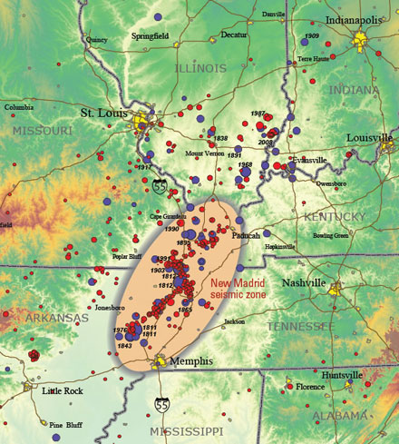
What about Eastern US? Intraplate Earthquakes
Notes:
(b) Damage from the 1886 earthquake along East Bay Street in Charleston, South Carolina.

Slide 26
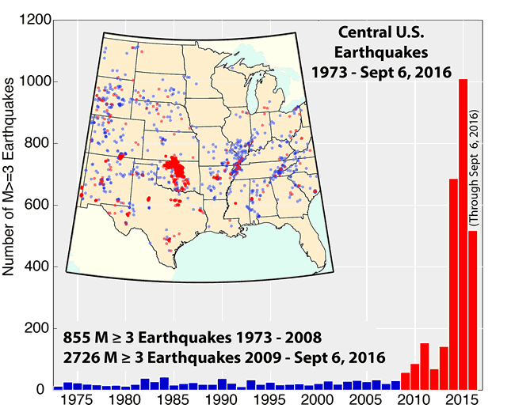
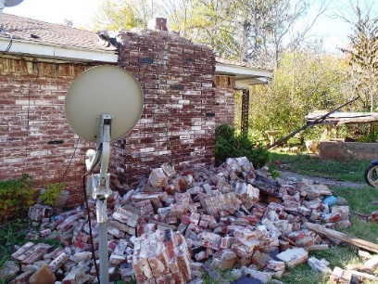
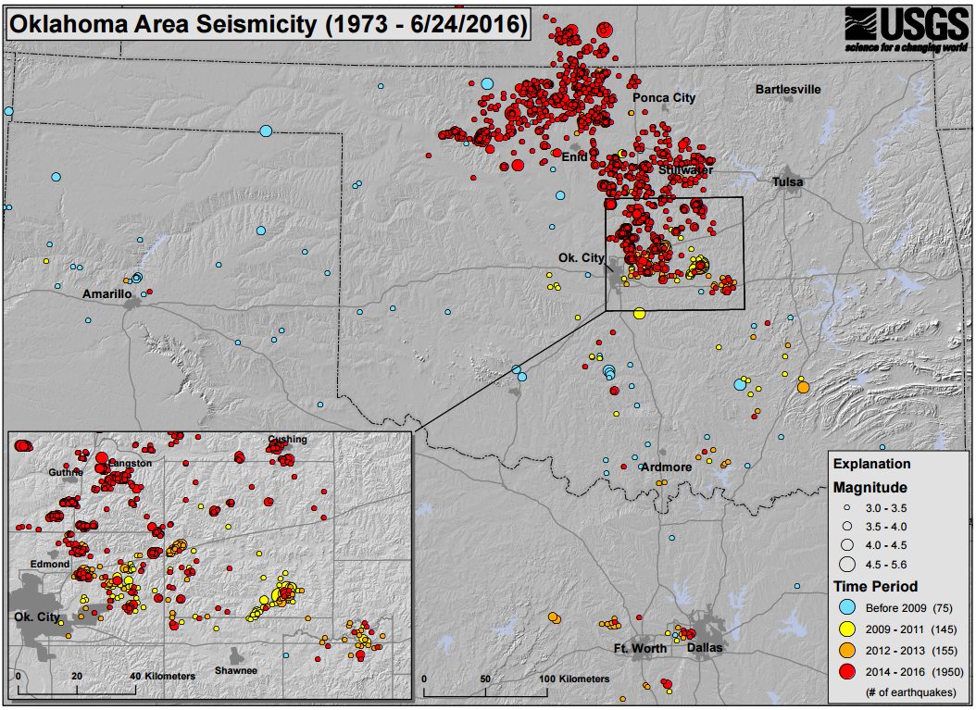
What about Anthropogenic EQs in US Continental Interior?
Wastewater disposal (not fracking) is primary cause of anthropogenic earthquakes in central US
OK “Earthquake Alley”
https://goo.gl/FIm01i
Shallow M3+: 304 (2017), 623 (2016), 903 (2015), 579 (2014), 110 (2013), 35 (2012)
Biggest, so far: M5.8; September 3, 2016; ~1945 Hiroshima atom bomb, ~15M kg (=15,000 kilotons) of TNT

Slide 27
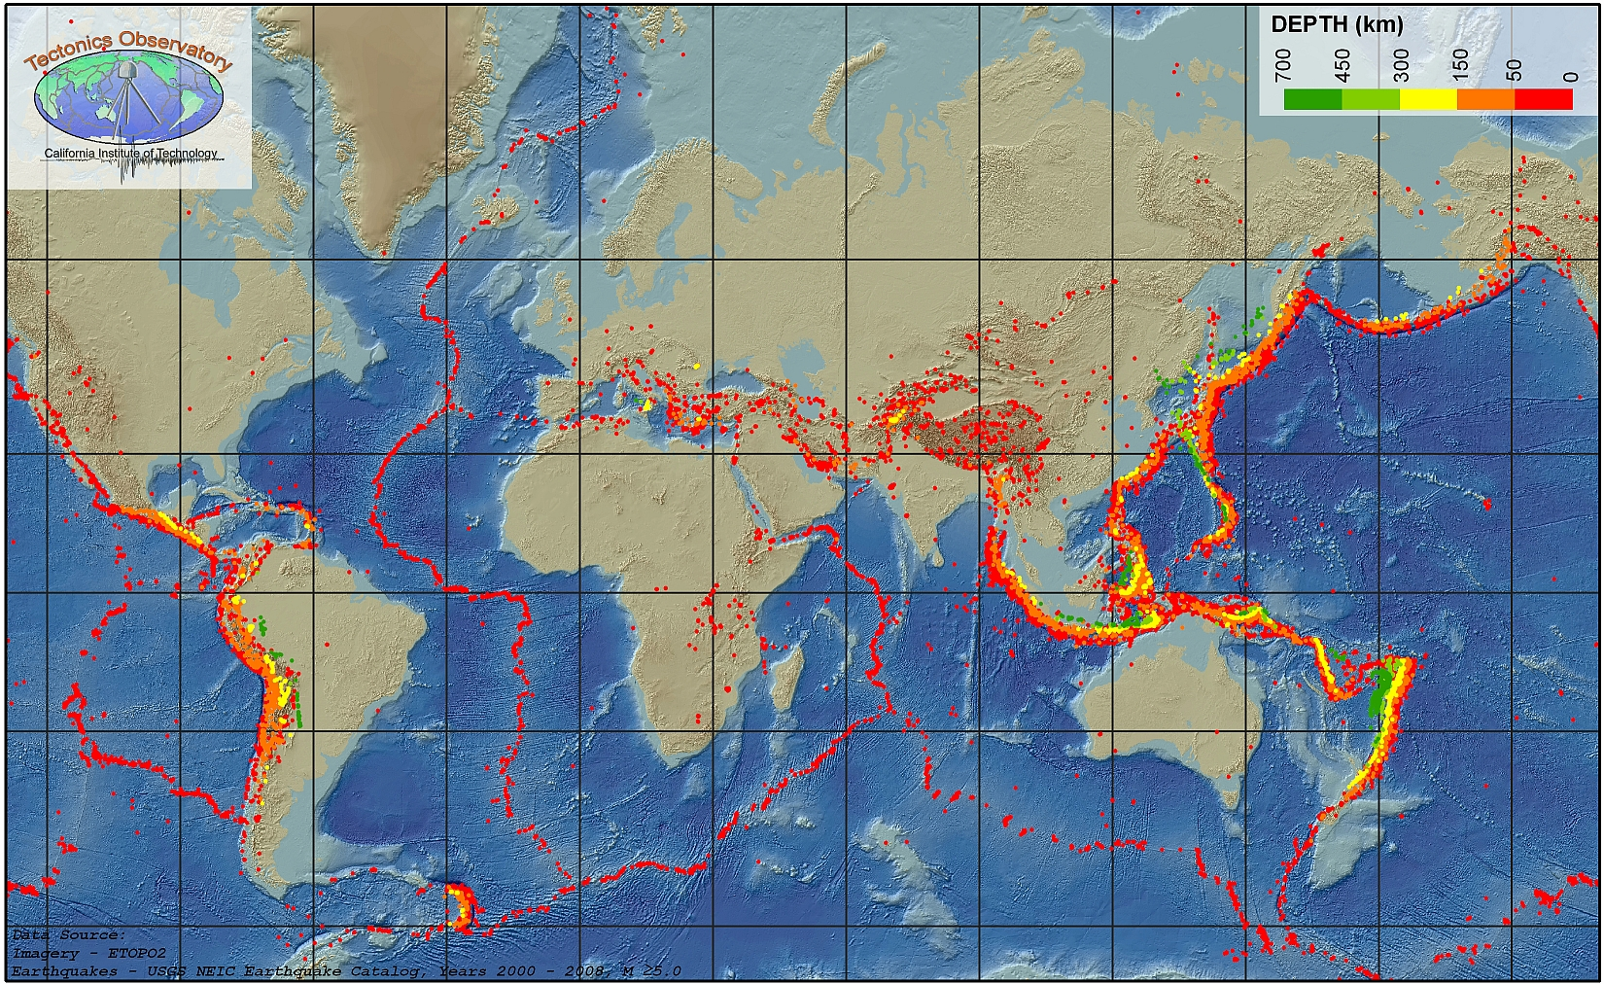
Global Earthquakes and Plate Tectonics
Plate Boundaries
Divergent boundaries
Convergent boundaries
Lateral boundaries
Plate Interiors

