Slide 1
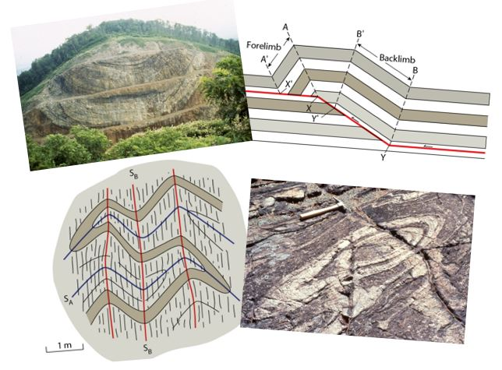
Folds and Folding
Earth Structure
(Processes in Structural Geology &Tectonics)
© Ben van der Pluijm
9/15/2023 3:33 PM
Notes:
Cards to flex (fold); paper for interference patterns (hand-out)

Slide 2
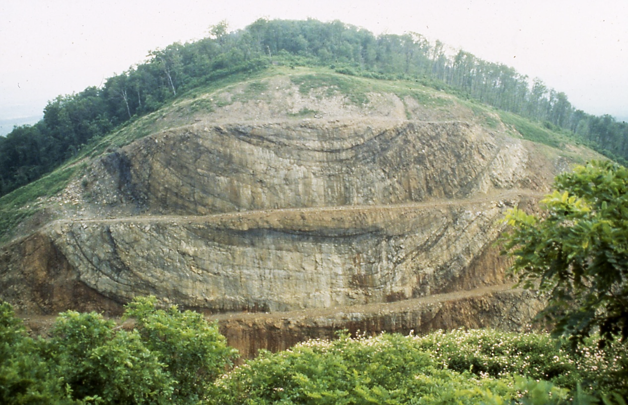
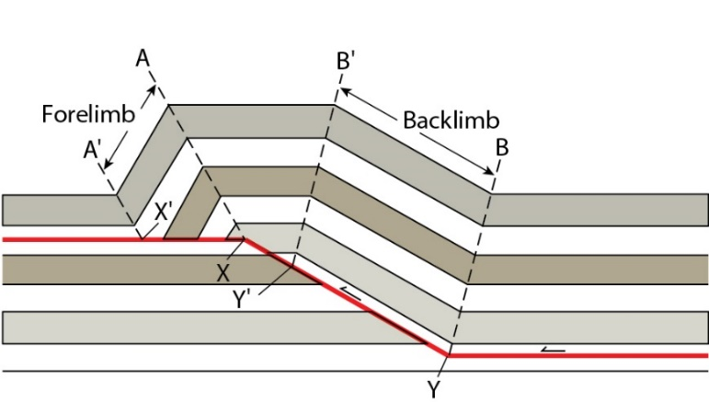
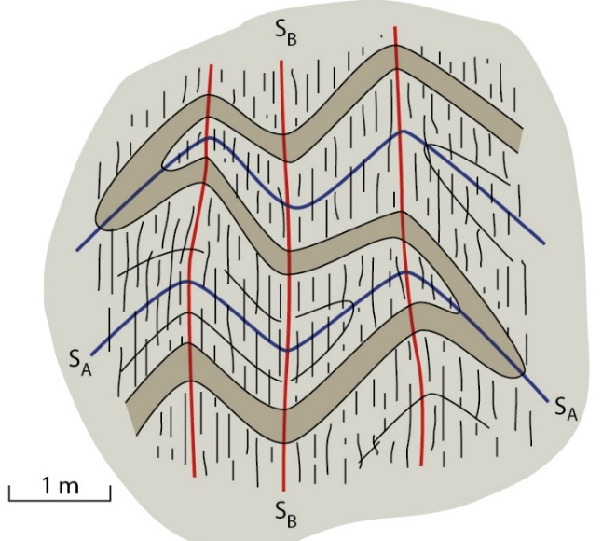
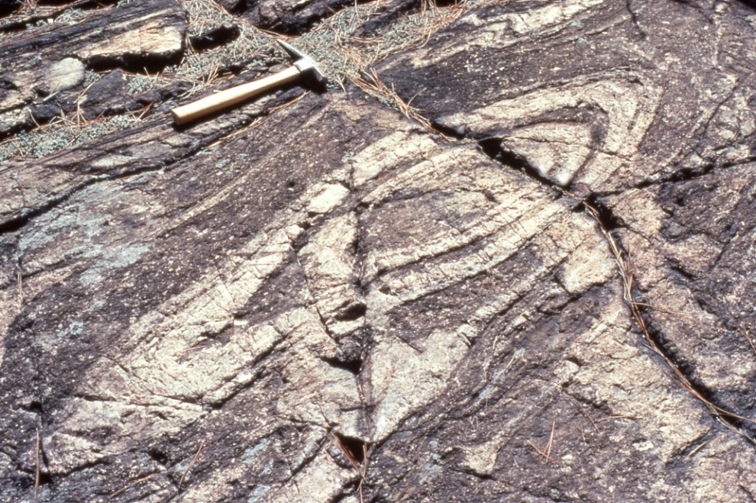
We Discuss …
Folds and Folding
Fold Description
Fold Classification
Fold Systems
  (A)symmetry and Vergence
Fault-related Folds
  Fault-propagation folds
  Fault-bend folds
  Detachment folds
Elements of Fold Style
Superposed Folding
Fold Mechanics and Kinematics
  Bending and Buckling
  Basic fold math
  Fold Strain
Structure and Society
Notes:
Open syncline in Maryland Appalachians
Inclined folds in Canadian Rockies

Slide 3
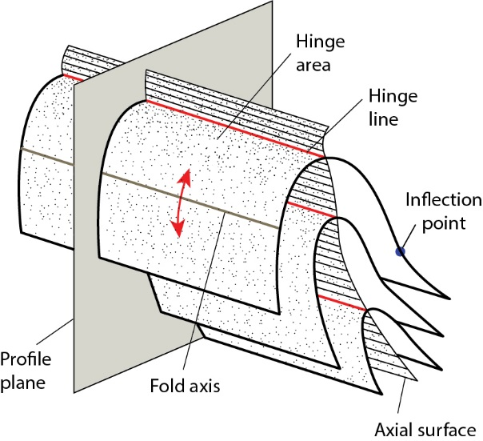
Elements of Fold Classification
fold shape in profile
interlimb angle
similar/parallel
symmetry/vergence
fold size
amplitude
wavelength
fold facing
upward/downward
fold orientation
fold axis/hinge line
axial surface
fold in 3D
cylindrical/non-cylindrical
presence of secondary features
foliation
lineation
Notes:
..\Animations\foldprofiles.swf

Slide 4
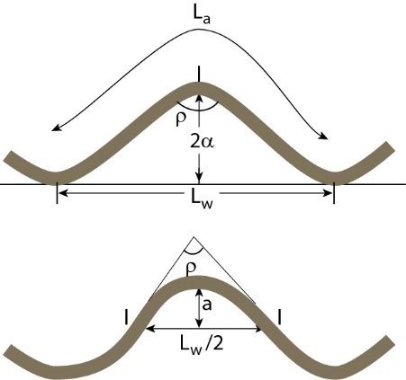
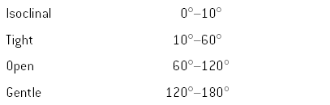
Fold Terminology and Measures
2a
L_{w}(or W) = Wavelength
L_{a} = Arc length
a = Amplitude
Interlimb angle:
Notes:
F I G U R E 1 0 . 2 The terminology of a fold.

Slide 5
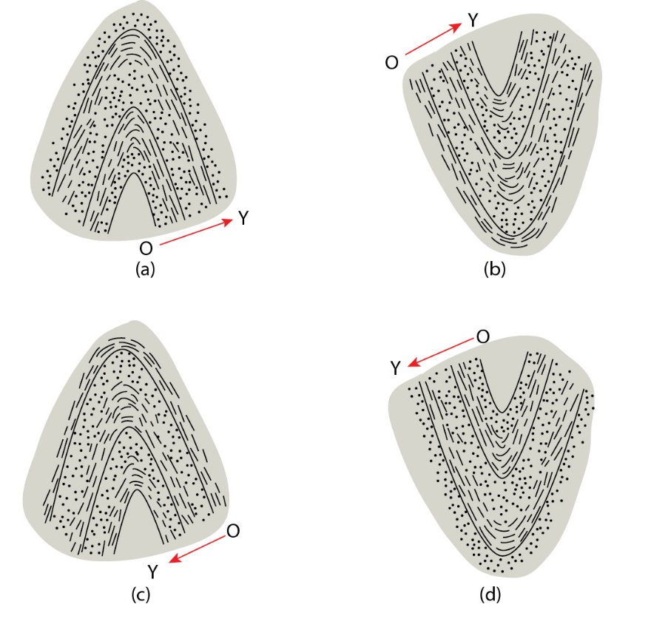
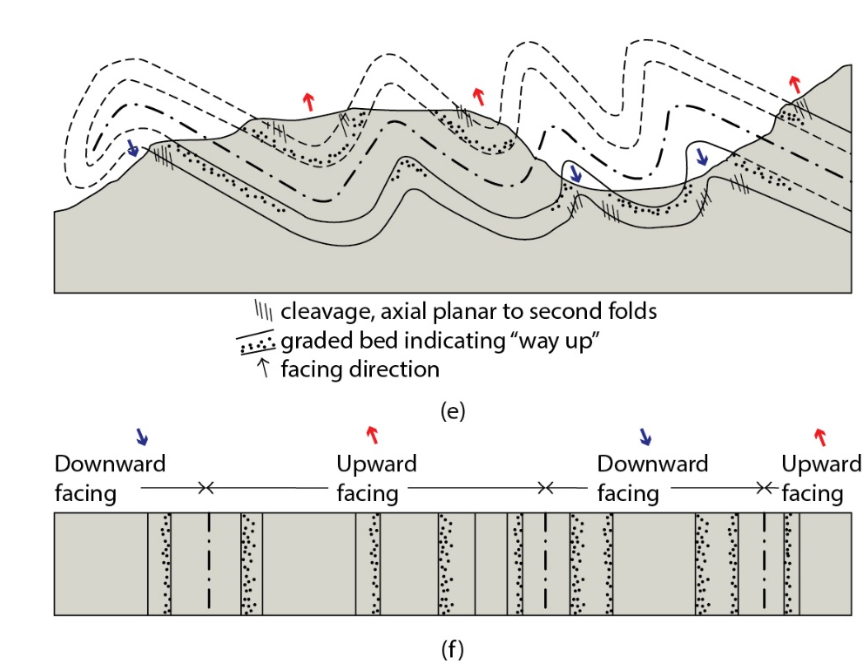
Anticline, Syncline and Fold Facing
(a) Anticline (upward-facing antiform)
(b) Syncline (upward-facing synform)
(c) Downward-facing anticline (downward-facing antiform)
(d) Downward-facing syncline (downward-facing synform)
(e) profile view; (f) map view
Notes:
F I G U R E 1 0 . 6 Antiforms, synforms, and fold facing. An upward facing antiform (a) is also called an anticline and an upward-facing synform (b) is called a syncline. Downward-facing antiforms (c) and downward-facing synforms reflect an early history that placed the beds upside down prior to folding. These forms may occur in a region containing two generations of folding (e). The corresponding facing in map view across this area is shown in (f). Younging direction is indicated by O→Y arrow.

Slide 6
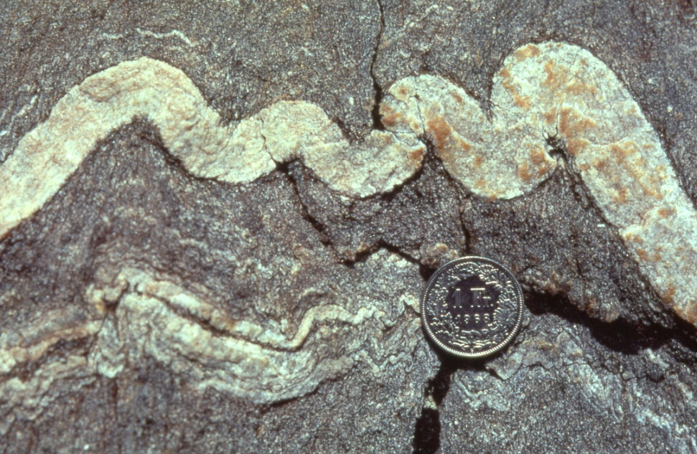
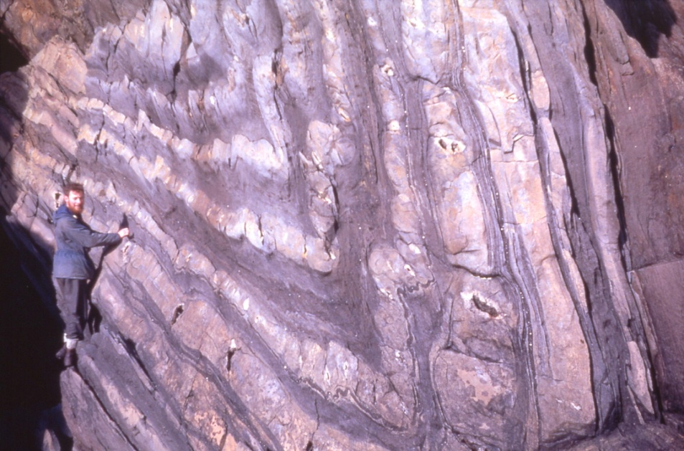
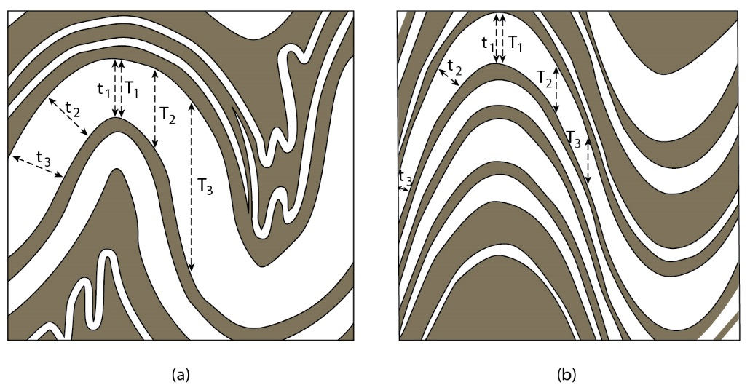
Fold Shape in 2D: Profile View
parallel fold
similar fold
t is layer-perpendicular thickness
T is axial trace-parallel thickness
Notes:
F I G U R E 1 0 . 1 1 Parallel folds (a) maintain a constant layer thickness
across the folded surface, meaning, t1 = t2 = t3, but the layer thickness
parallel to the axial surface varies (T1 < T2 < T3). Note that parallelism must
eventually break down in the cores of folds because of space limitation, which
is illustrated by the small disharmonic folds in (a). In similar folds (b), the layer
thickness parallel to the axial surface remains constant, so, T1 = T2 = T3, but the
thickness across the folded surface varies (t1 > t2 > t3). Similar folds do not
produce the space problem inherent in parallel folds.

Slide 7
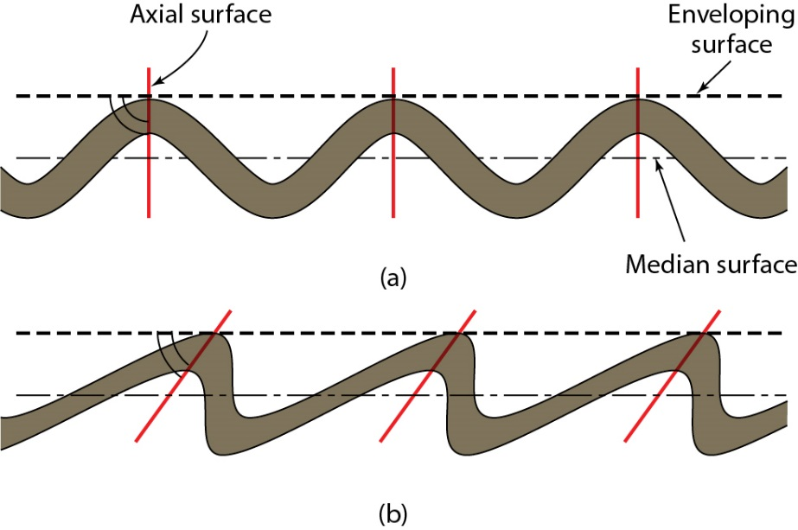
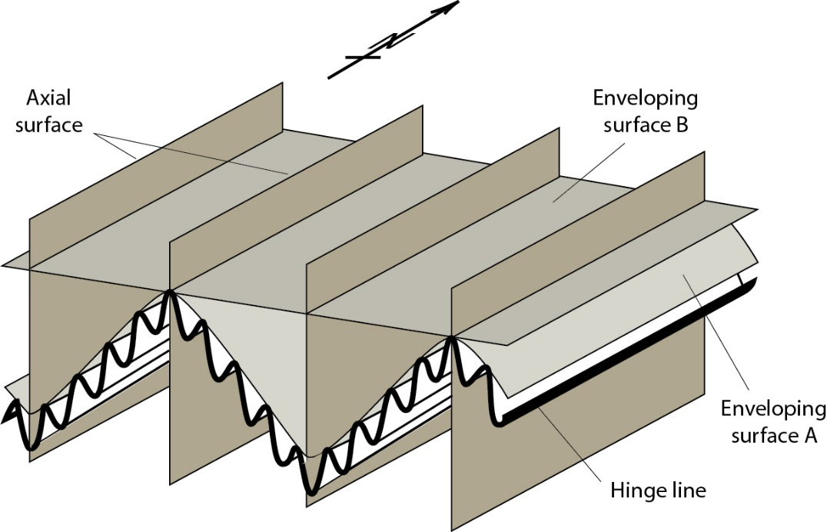
Fold Systems: Enveloping surface and Fold (a)symmetry
W-vergence
E-vergence
Fold enveloping surface
Fold Symmetry:
symmetric, ~90º, asymmetric, < 90º
Notes:
F I G U R E 1 0 . 1 3 The enveloping surface connects the antiform (or synform) hinges of consecutive folds (surface A). If this imaginary surface appears to be folded itself, we may construct yet a higher-order enveloping surface (surface B). Note that the orientations (hinge line and axial surface) of the small folds and the large-scale folds are very similar.

Slide 8
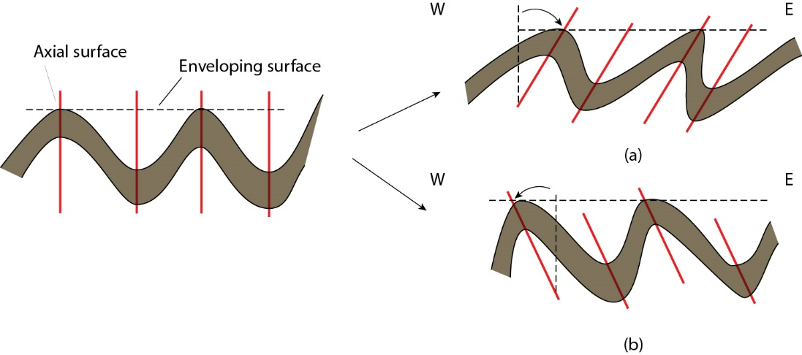
Fold Asymmetry and Fold Vergence
E-vergence
W-vergence
Vergence is rotation of axial surface from symmetrical into asymmetrical fold (relative to enveloping surface)
Notes:
F I G U R E 1 0 . 1 5 Fold vergence, clockwise (a) and counterclockwise (b), is defined by the
apparent rotation of the axial surface from a hypothetical symmetric fold into the observed
asymmetric fold, without changing the orientation of the enveloping surface. In a given
geographic coordinate system we may also say east-verging (a) and west-verging (b) folds for
clockwise and counterclockwise folds, respectively (for this example). In all descriptions we are
looking down the plunge of the fold.

Slide 9
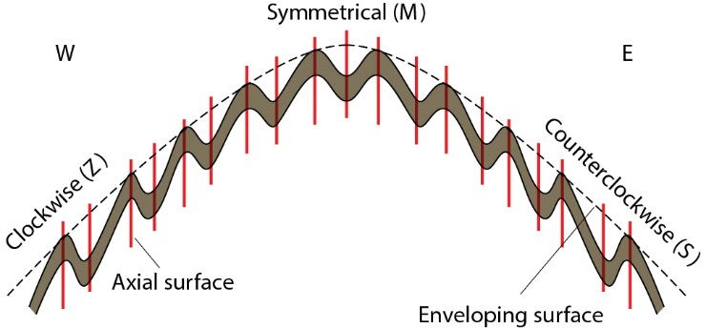
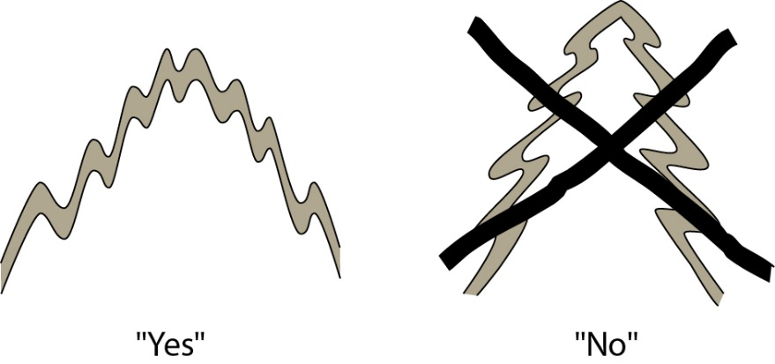
Fold Vergence - Anticlinorium
E-vergence (Z)
W-vergence (S)
No Xmas tree !
Notes:
F I G U R E 1 0 . 1 6 Characteristic fold vergence of parasitic folds across a large-scale antiform. Looking down the plunge, the parasitic fold changes from clockwise asymmetry (eastverging in the geographic coordinate system) to symmetric to counterclockwise asymmetry (west-verging) when going from W to E. You may also find that some geologists use the terms Z-, M-, and S-folds for this progression (for obvious reasons).

Slide 10
Fold Vergence - Synclinorium
Enveloping Surface
Axial Surface
Notes:
F I G U R E 1 0 . 1 6 Characteristic fold vergence of parasitic folds across a large-scale antiform. Looking down the plunge, the parasitic fold changes from clockwise asymmetry (eastverging in the geographic coordinate system) to symmetric to counterclockwise asymmetry (west-verging) when going from W to E. You may also find that some geologists use the terms Z-, M-, and S-folds for this progression (for obvious reasons).

Slide 11
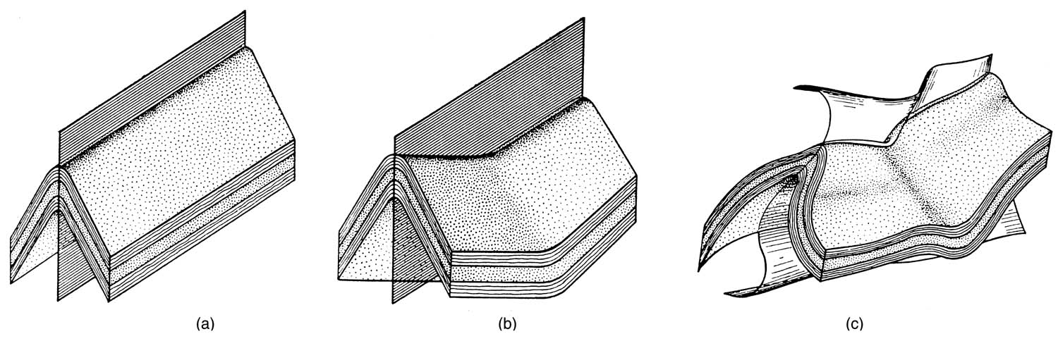
Fold Shape in 3D: Cylindrical and Non-cylindrical Folds
Cylindrical fold (straight hingeline)
Non-cylindrical fold (curved hingeline); planar axial surface
Non-cylindrical fold (curved hingeline); curved axial surface
Notes:
F I G U R E 1 0 . 3 A cylindrical fold (a) is characterized by a straight hinge line and a
noncylindrical fold (b) by a curved hinge line. The axial surface may be planar, as in (a) and (b), or
curved (c).

Slide 12
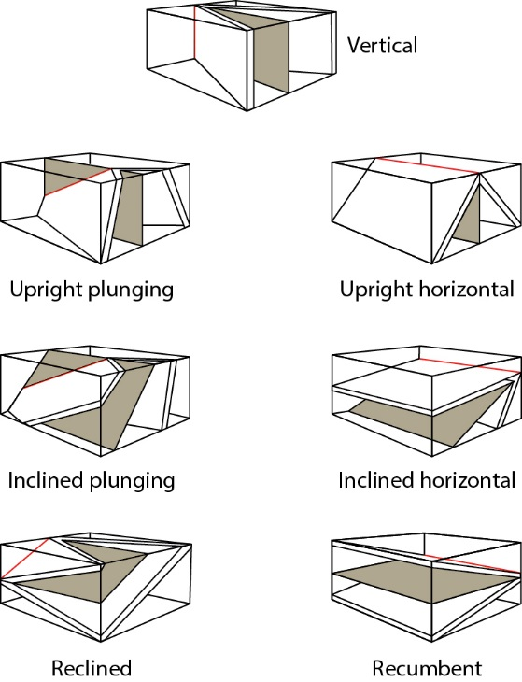
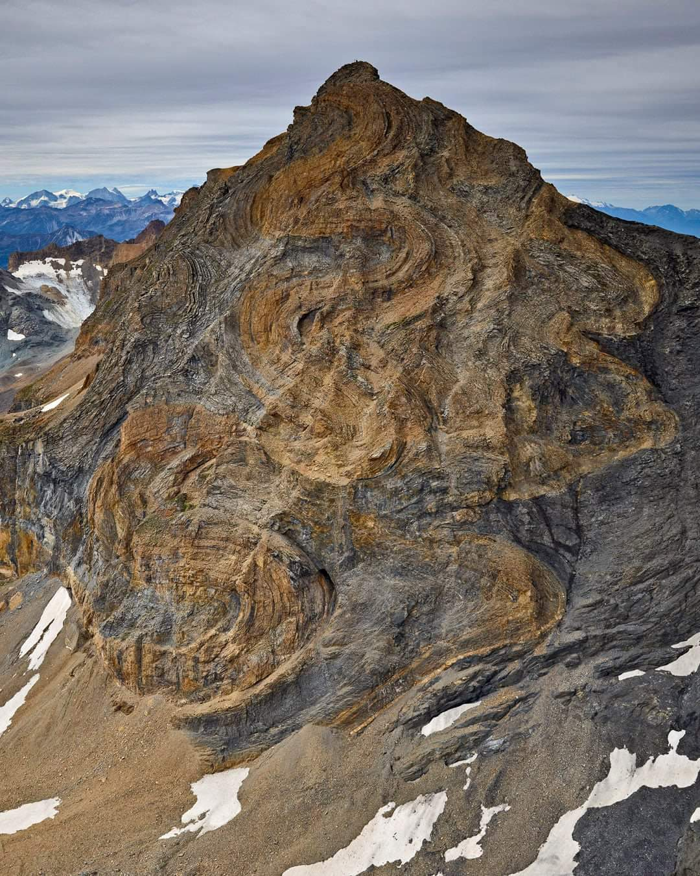
Fold Orientation
Fold classification based on plunge of hinge line (red) and dip of axial surface (shaded)
recumbent (nappe) folds of Ferdenrothorn in Bernese Alps, Switzerland.
Credit: Bernhard Edmaier
Notes:
F I G U R E 1 0 . 1 0 Fold classification based on the orientation of the hinge line and the axial surface (shaded).
F I G U R E 1 0 . 1 Large-scale recumbent fold in the Caledonides of northeast Greenland. The
height of the cliff is about 800 m and the view is to the Northwest.

Slide 13
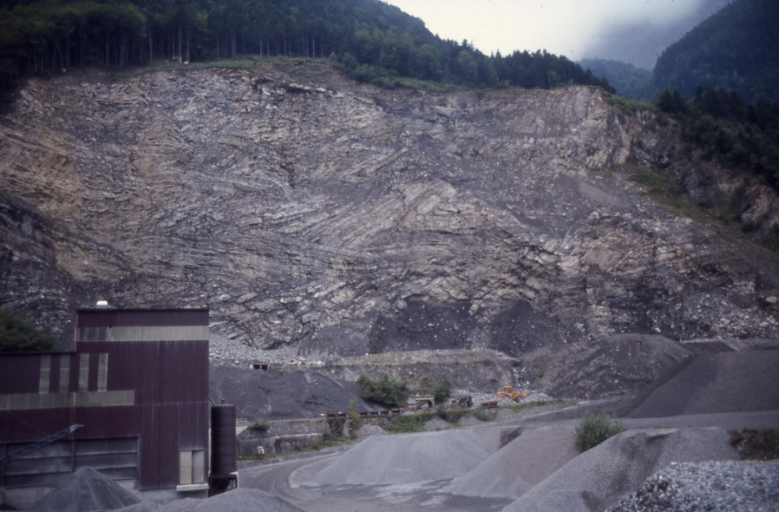
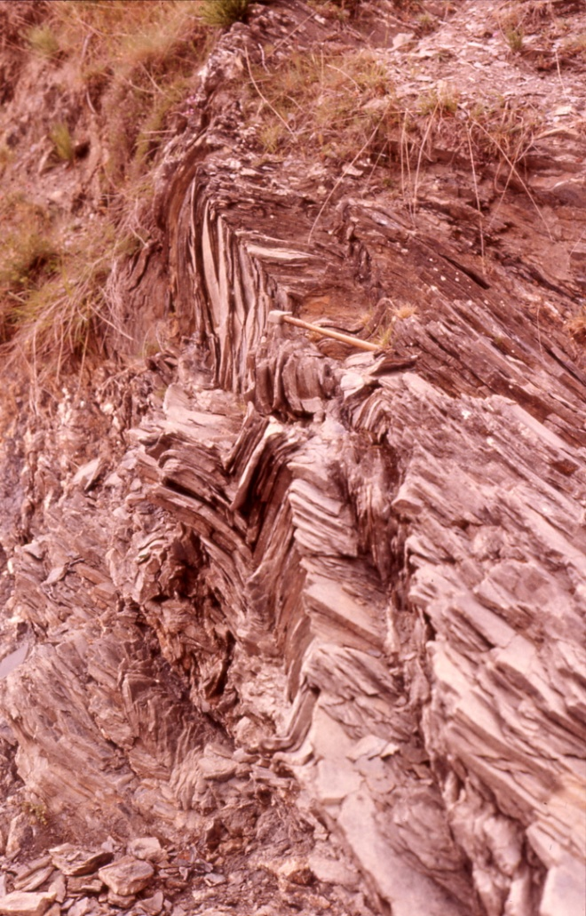
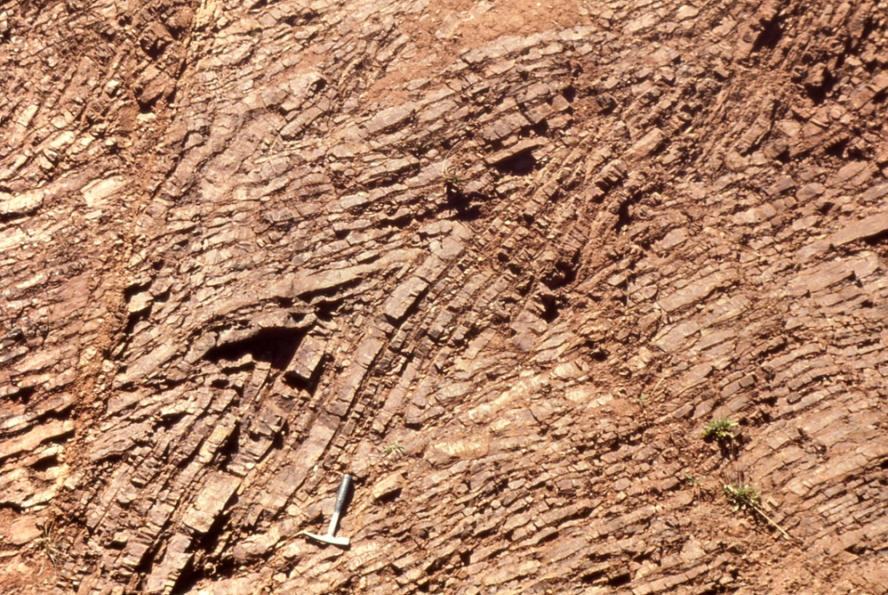
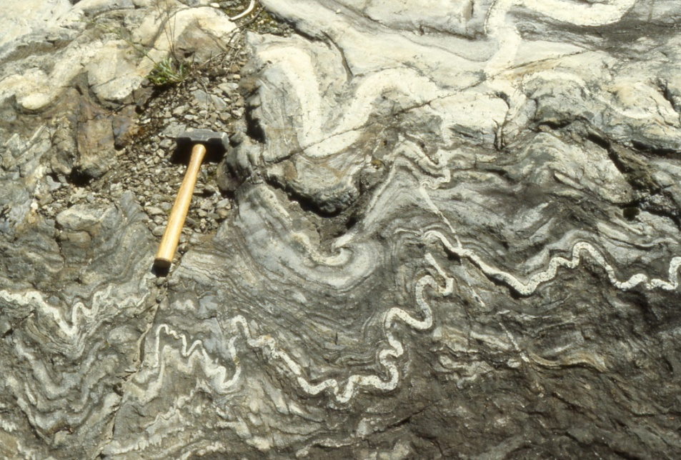
Other Fold Geometries
Recumbent chevron folds (Switzerland)
Chevron folds (CA)
Kink folds (Spain)
Ptygmatic (Grk: highly sinuous)
folds (Switzerland)

Slide 14
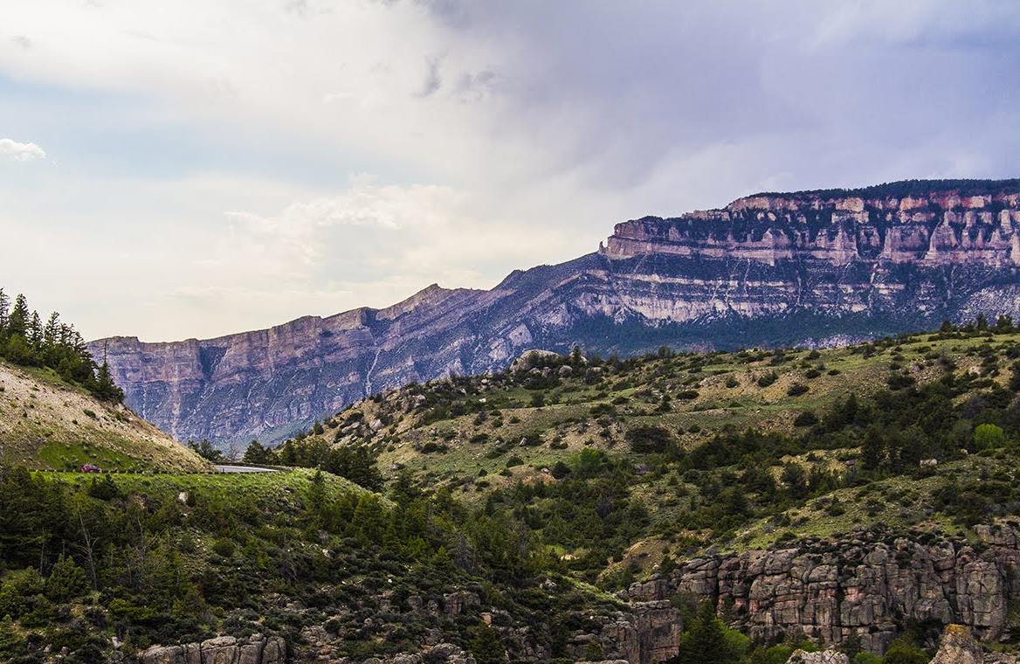
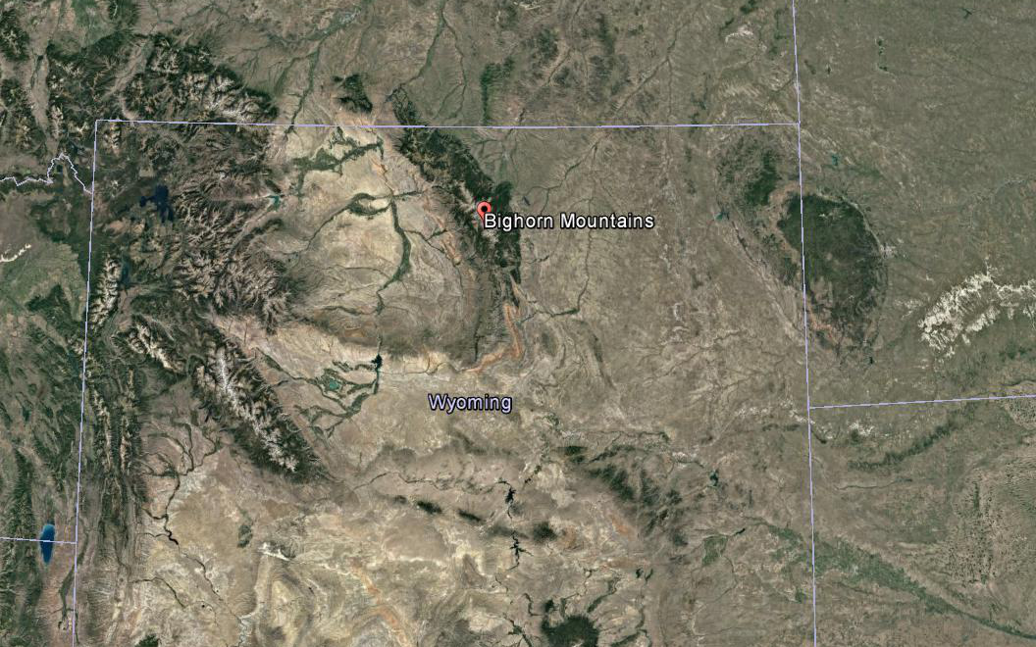
Other Fold Geometries: Monoclines
Monocline near Bighorn Mountains (WY) Formed as Bighorns pushed upward; monocline on western margin of range.
Uplift is part of Laramide deformation in western U.S., which includes Black Hills (SD), Wind Rivers (WY), and others.
Big Horns
Black Hills
Rocky Mountains
Wind Rivers
Credit: Charles Carrigan
Notes:
“Figure 10.18”

Slide 15
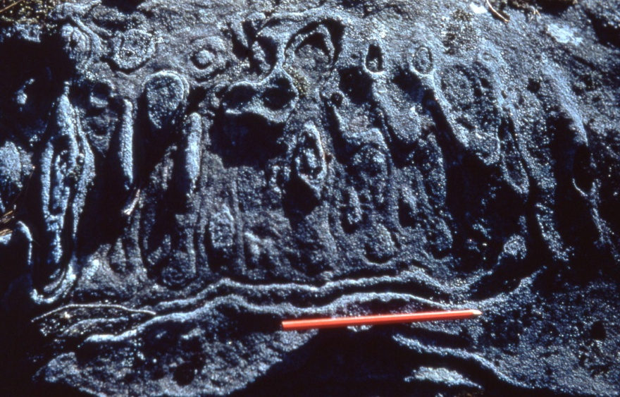
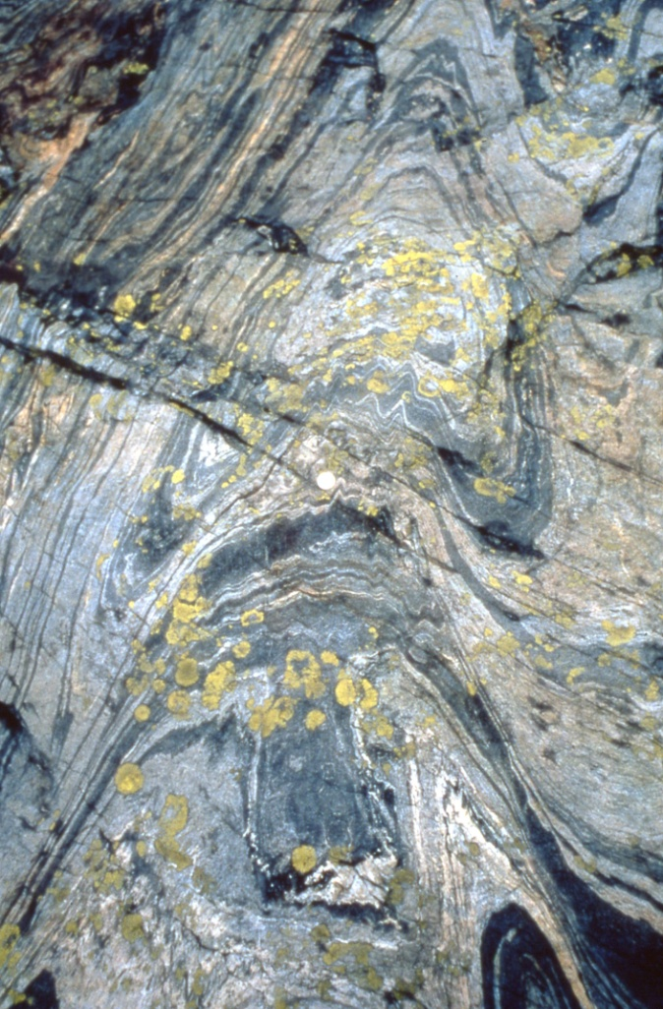
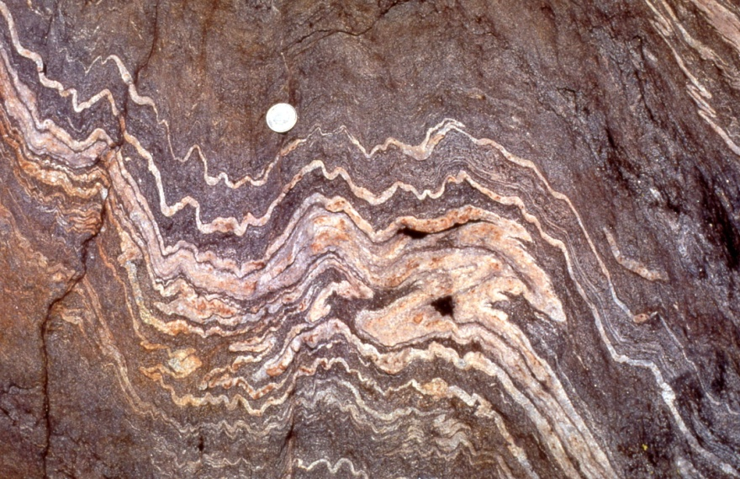
Super(im)posed Folding: Fold Interference Patterns
Type 1: “egg box”
Type 2:
“mushroom”
Type 3: “zig-zag”

Slide 16
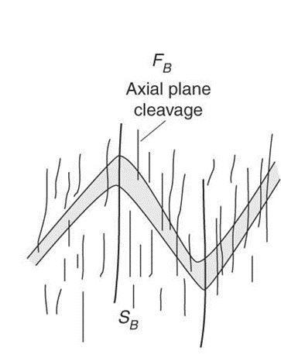
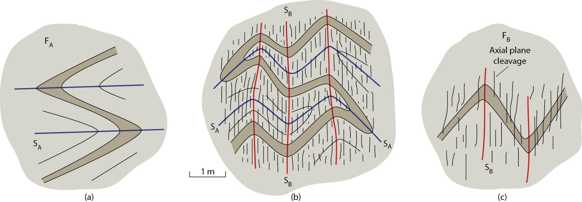
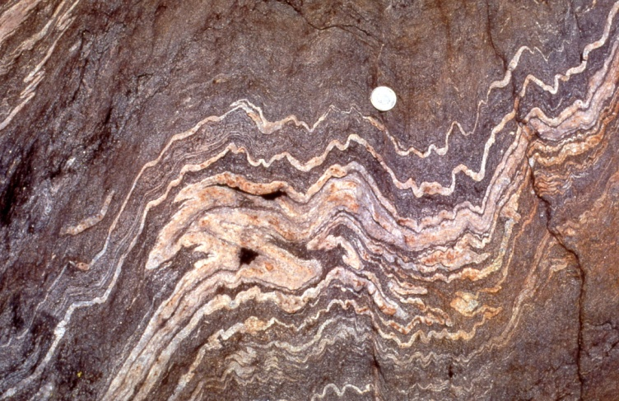
Fold Interference
F_{A} recumbent folds (a) are overprinted by F_{B} upright folds (b), producing the fold interference pattern in (c).
Notes:
F I G U R E 1 0 . 2 3 Dissecting a fold interference pattern. The cross sections show FA recumbent folds (a) that are overprinted by FB upright folds (b), producing the fold interference pattern in (c).

Slide 17
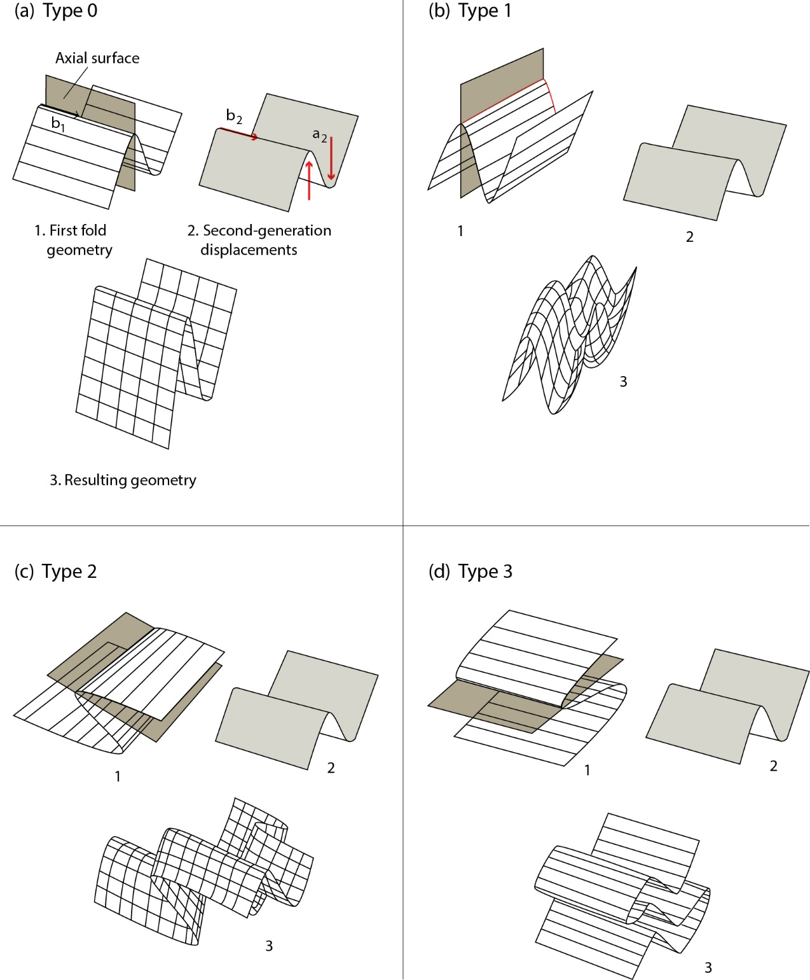
Basic Fold Interference Patterns
F2 folds (a₂ is relative shear direction and b₂ is hinge line) are superimposed on pre-existing F1 folds.
Notes:
F I G U R E 1 0 . 2 4 The four basic patterns arising from fold superposition. The analysis assumes
that F2 shear folds (a2 is the relative shear direction and b2 is the hinge line) are superimposed on
a preexisting F1 fold of variable orientation. Shear folds are modeled by moving a deck of cards. The
shaded surface is the S1 axial surface.

Slide 18
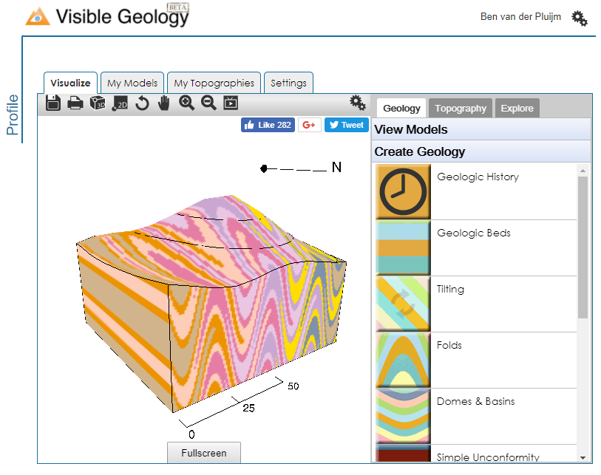
Homework: Fold Interference (Visible Geology)
This interactive webapp creates fold interference patterns. View, rotate and even add erosional surfaces and topography.
Create a layered block. Go to Geologic Beds and add beds until block is filled.
Go to Folds, Add Folding Event, and create outcrop pattern (click on ⊗)
Add second Folding Event to visualize interference outcrop pattern (click on ⊗).
Fold, Fold Again, Rotate, Erode,
and Learn …
Submit images of Type 1, 2, 3 end-members we discussed (upload 3 screenshots)
http://app.visiblegeology.com/
Notes:
The site http://app.visiblegeology.com/ allows you to create and examine fold interference patterns and look at them from different angles and introduce subsequent erosional surfaces and topography.
You need to create a layered block first. Go to Geologic Beds and add beds until the block is filled. Then go to Folds and create outcrop pattern, then add second fold and calculate outcrop pattern.
Rotate, erode, etc.
By Monday 3/12 8:30am, complete homework with upload of screenshot of your favorite pattern.

Slide 19
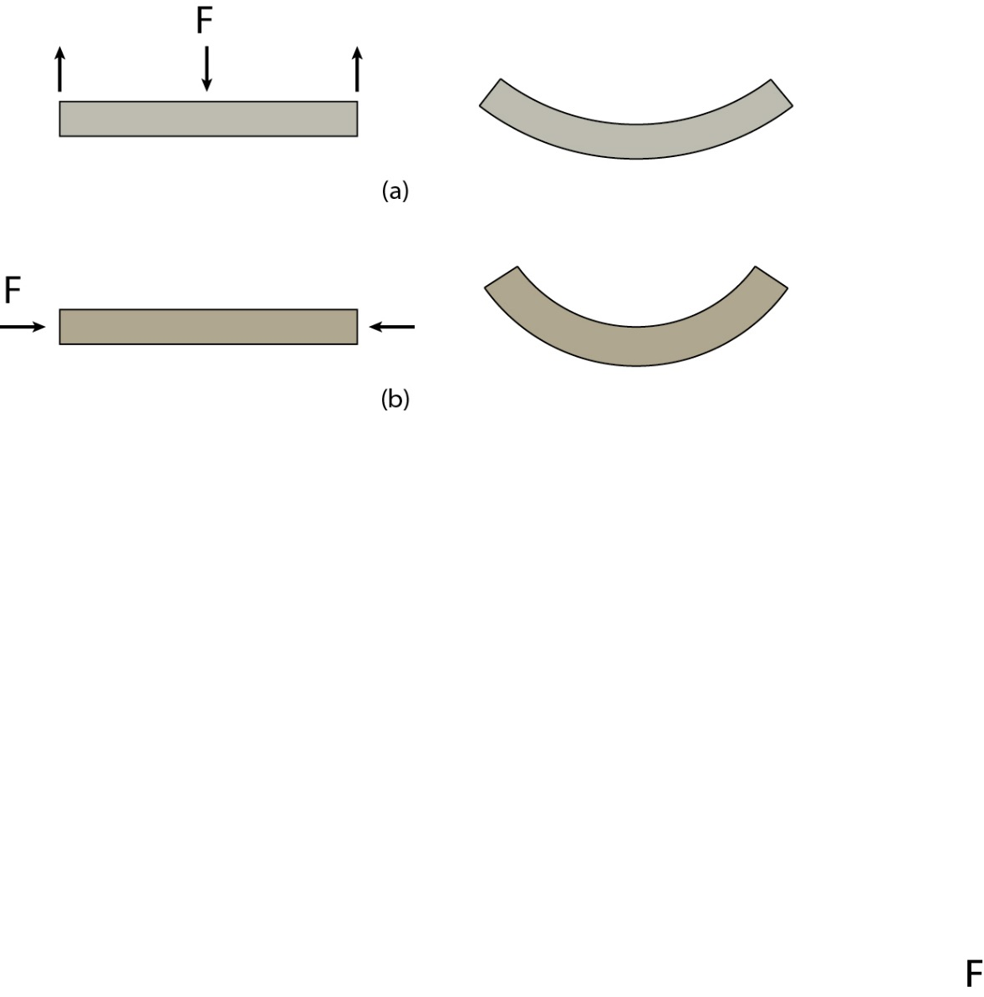
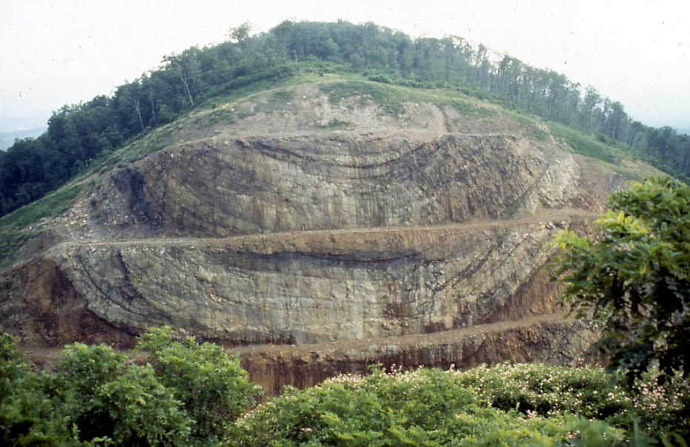
Folding: Bending vs Buckling
F/σ
Bending of a layer (e.g., Bighorn monocline)
F/σ
Buckling of a layer (e.g., Sideling Hill syncline)
Notes:
F I G U R E 1 0 . 2 7 Compression of a clay block of uniform
color (a), with irregularly shaped layers of different colors (b),
or with uniform colored layers separated by thin sheets of
rubber (c).
F I G U R E 1 0 . 2 8 Bending (a) and buckling (b) of a layer.

Slide 20
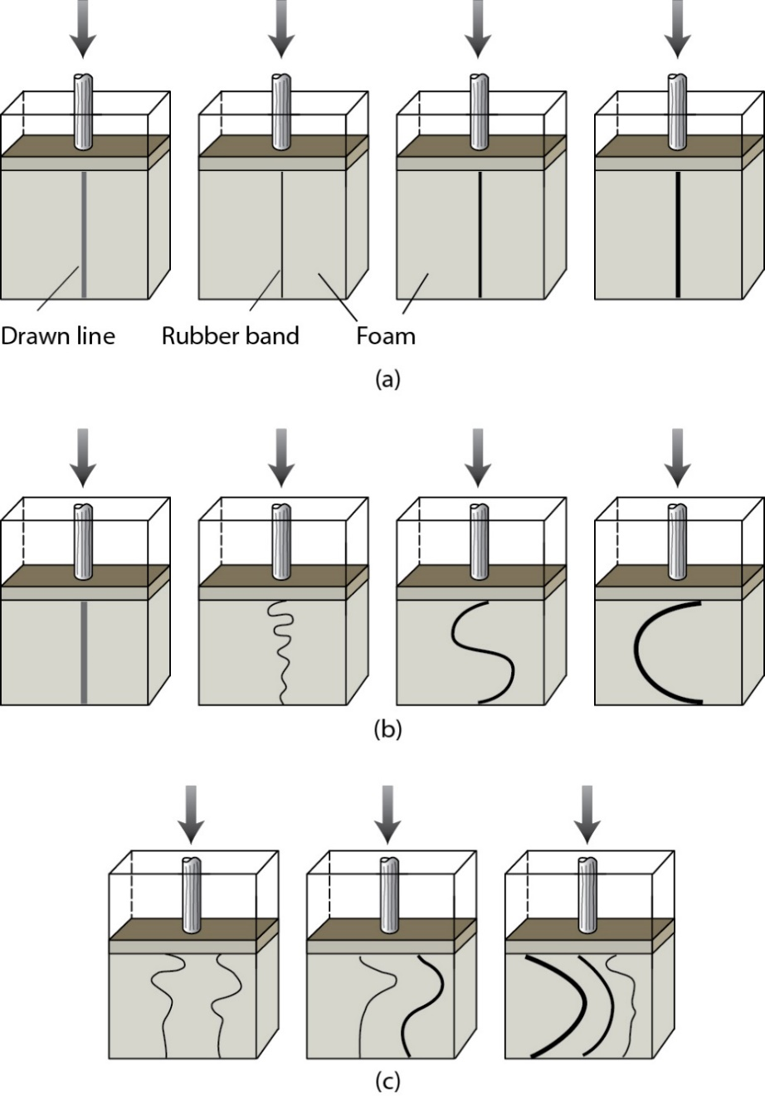
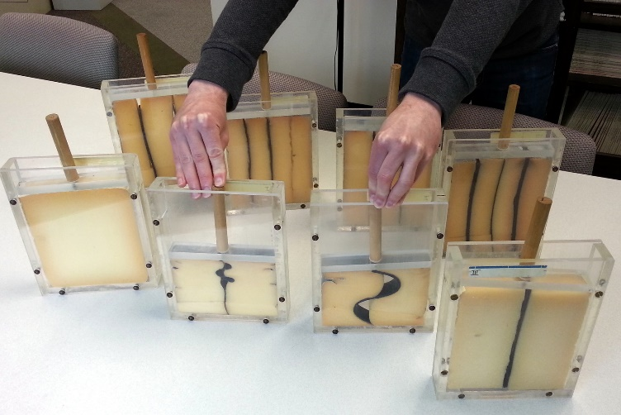
Trick in a Box: Experiments with Analogues
Foam-only box shows thickening of marker line, but no folding.
Boxes with rubber bands show folds with arc lengths varying as a function of thickness of each band.
With more than one rubber band, behavior depends on combination of bands and their thicknesses, with thicker bands dominant.
Notes:
Later: calculated viscosity ratio is ~1000
F I G U R E 1 0 . 2 9 Line drawings of deformation experiments with transparent boxes containing foam, and rubber bands. In
(a), four starting settings are shown that contain, from left to right, foam only (with marker line added), a thin, a medium, and
a thick rubber band. When applying the same displacement, shown in (b), the setups respond differently. The foam-only box
shows thickening of the marker line, but no folding. The boxes with rubber bands show folds with arc lengths varying as a
function of thickness of each band. When using more than one band (c), the behavior depends on the combination of bands
and their thicknesses, with the effect of the thicker bands being dominant.

Slide 21
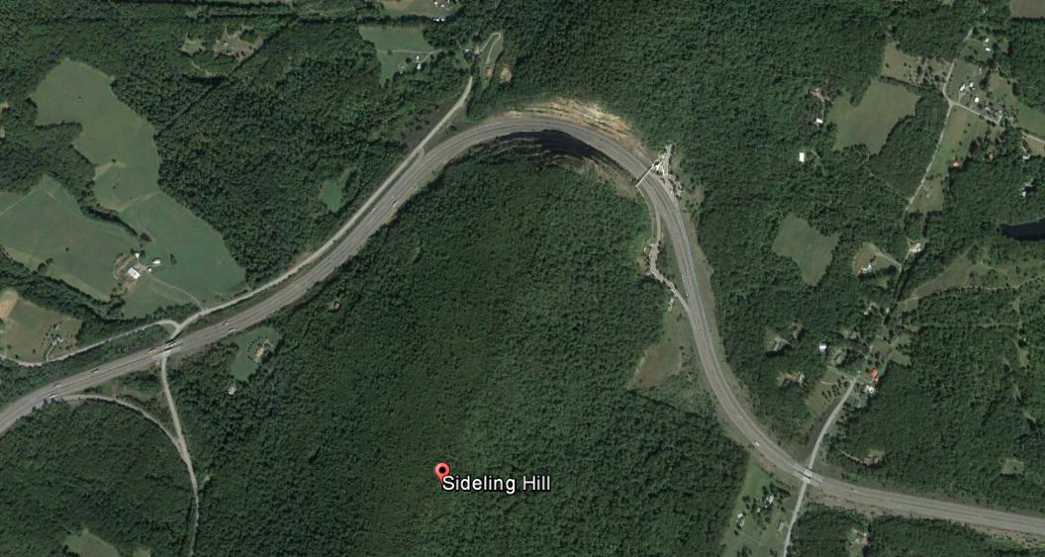
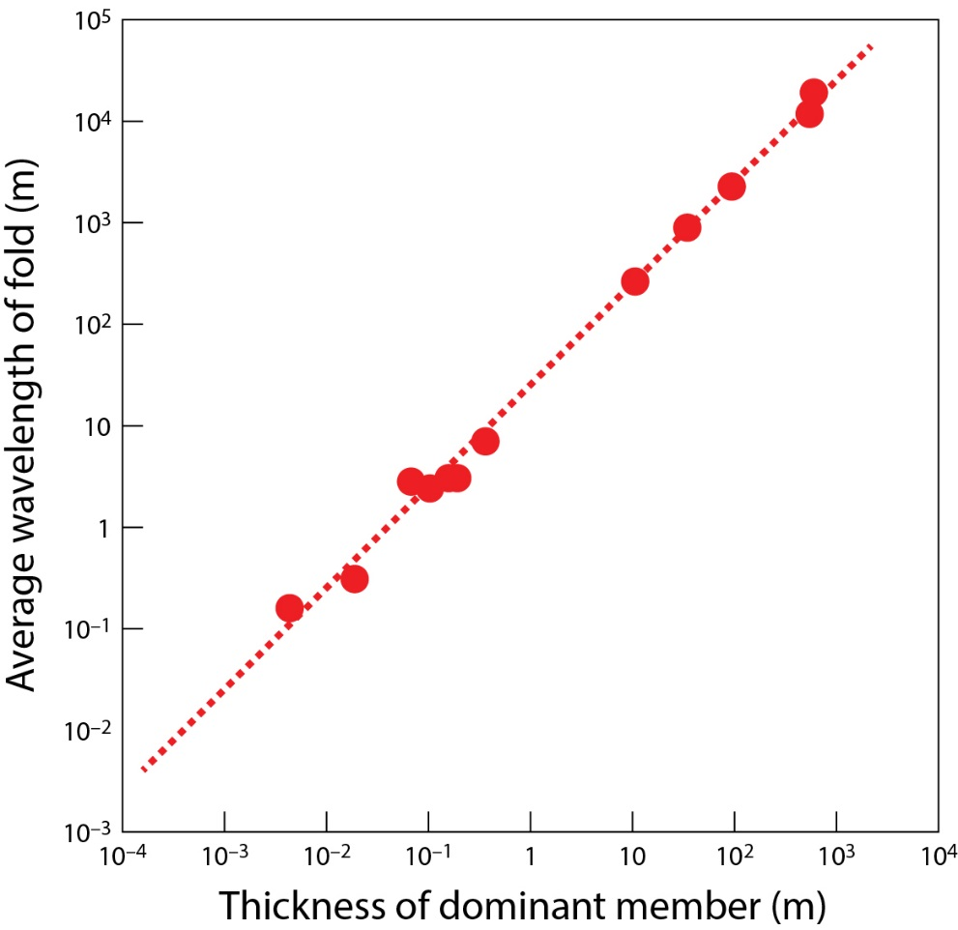
Wavelength-Thickness Relationship
39°42'52.80" N 78°17'07.94" W
Log–log plot of wavelength (W) versus layer thickness (t) in folded sandstone layers (US Appalachians).
Sideling Hill, MD
Notes:
F I G U R E 1 0 . 3 0 Log–log plot of wavelength versus layer thickness in folded sandstone layers.

Slide 22

Folding Math: Single Layer
Folding (Biot) equation
Linear (Newtonian) viscosity, wavelength-thickness (W-t) relationship for a single layer with viscosity η_{L} in matrix with viscosity η_{M}:
W = 2πt(η_{L}/6η_{M})^{1/3}
or, viscosity ratio is proportional to cube of W/t ratio:
η_{L}/η_{M} = 6/8π³(W/t)³

Slide 23


Thickness, Wavelength and Viscosity
Folding (Biot) Eqtn:
W_{s} = 2πt(η_{L}/6η_{M})^{1/3}
η_{L}/η_{M} = 6/8π³(W/t)³
Appalachian folds:
calculated viscosity ratio,
η_{sandstone}/η_{shale} (layer/matrix), is ~500.
Box Experiments:
calculated viscosity ratio, η_{rubber}/η_{foam} is ~1000.
Notes:
F I G U R E 1 0 . 3 0 Log–log plot of wavelength versus layer thickness in folded sandstone layers.

Slide 24
More Folding Math: Multi-Layer
Folding (Biot) equation
Linear (Newtonian) viscosity, wavelength-thickness (W-t) relationship for a single layer with viscosity η_{L} in matrix with viscosity η_{M}:
W = 2πt(η_{L}/6η_{M})^{1/3}
or, viscosity ratio is proportional to cube of W/t ratio:
η_{L}/η_{M} = 6/8π³(W/t)³
Interacting Multilayers
For N interacting multilayers:
W_{multi} = 2πt(Nη_{L}/6η_{M})^{1/3}
Note: W_{single}/W_{multi}=N^{2/3}
so N multilayers ≠ N.t single layer

Slide 25
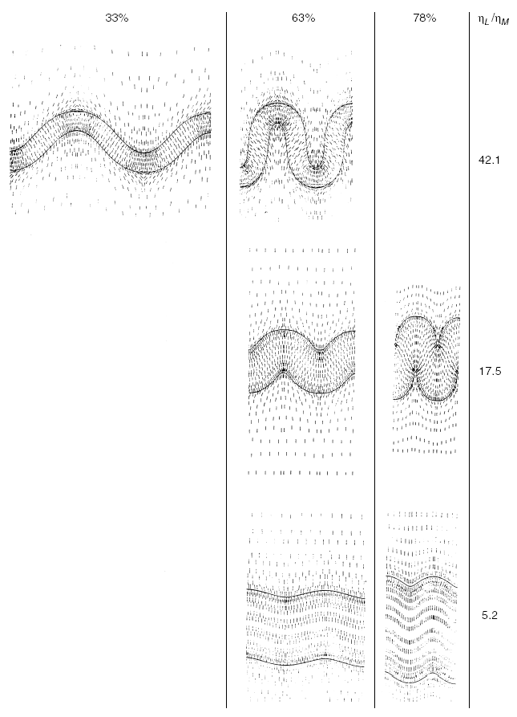
Effect of Viscosity Contrast
Shortening e: 33% 63% 78%
(η_{L})/(η_{M})
42.1
17.5
5.2
Finite-element modeling of single-layer buckling for various viscosity contrasts between layer (η_{L}) and matrix (η_{M}), and shortening strains (e, %).
Smaller contrast, greater layer thickening (t):
strain-modified fold (or Biot-Ramberg) equation.
Short tick marks are orientation of
long axis of strain ellipse in profile plane
viscosity contrast
Notes:
F I G U R E 1 0 . 3 1 Finite-element modeling of single-layer buckling for various viscosity
contrasts between layer (ηL) and matrix (ηM), and shortening strains (%). The short marks
represent the orientation of the long axis of the strain ellipse in profile plane.

Slide 26
Extra: Folding Math and Strain
Folding (Biot) equation
Linear (Newtonian) viscosity, wavelength-thickness (W-t) relationship for a single layer with viscosity η_{L} in matrix with viscosity η_{M}:
W_{s} = 2πt(η_{L}/6η_{M})^{1/3}
Strain-modified folding (Biot-Ramberg) equation
Incorporating strain ratio, with R=X/Z:
W_{s} = 2πt [(η_{L}(R-1))/(6η_{M}.2R²)]^{1/3}

Slide 27
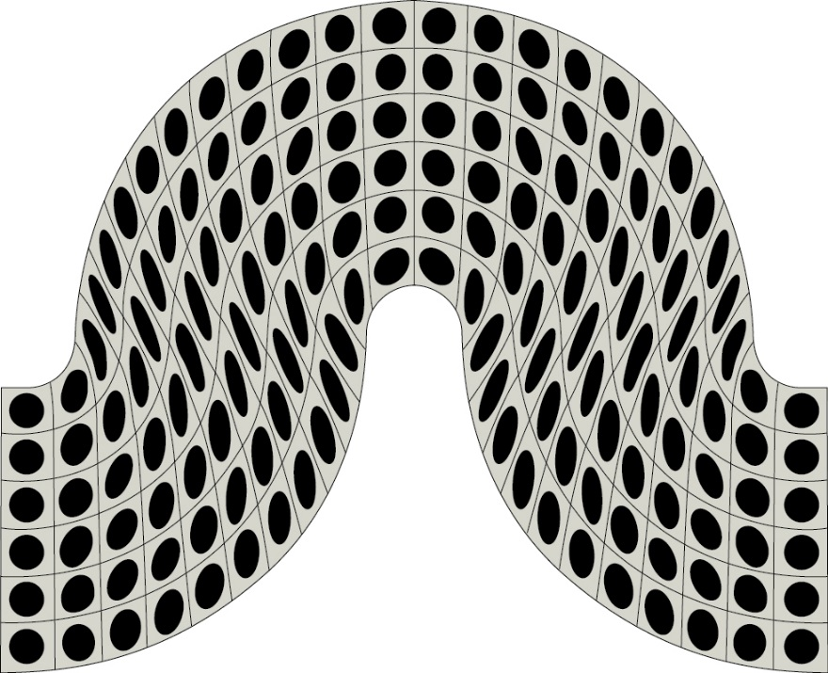
Folding and Strain: Flexural Folding
Strain pattern of flexural folding in fold profile plane (plane perpendicular to hinge line). <card deck>
Formation of parallel folds.
Notes:
F I G U R E 1 0 . 3 2 The characteristic strain pattern of flexural folding in the fold profile plane (the plane perpendicular
to the hinge line).

Slide 28
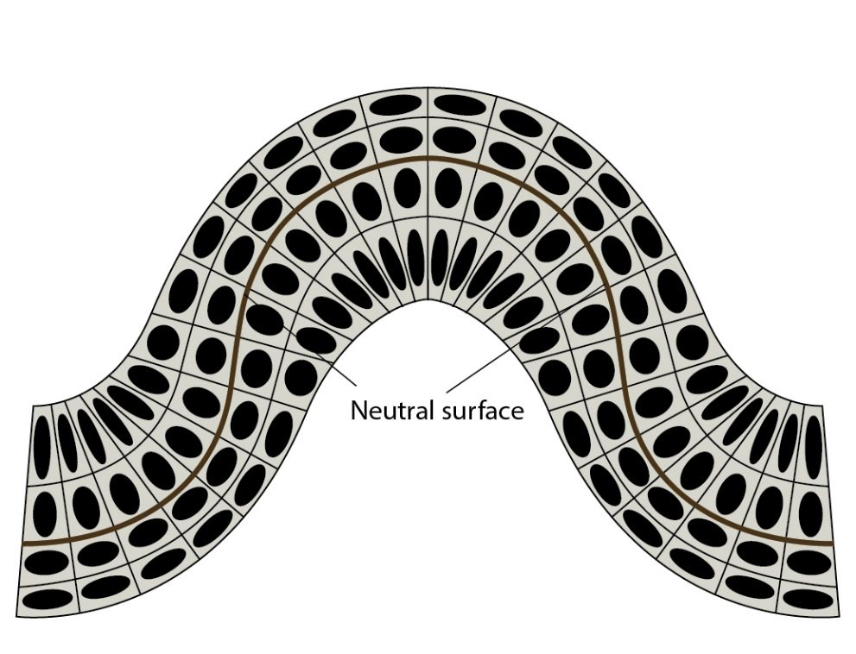
Folding and Strain: Neutral-surface Folding
Strain pattern of neutral-surface folding in fold profile plane. <rubber hose>
Formation of parallel folds.
… but what about similar folds?
Notes:
F I G U R E 1 0 . 3 3 The strain pattern of neutral-surface folding in the fold profile plane.

Slide 29
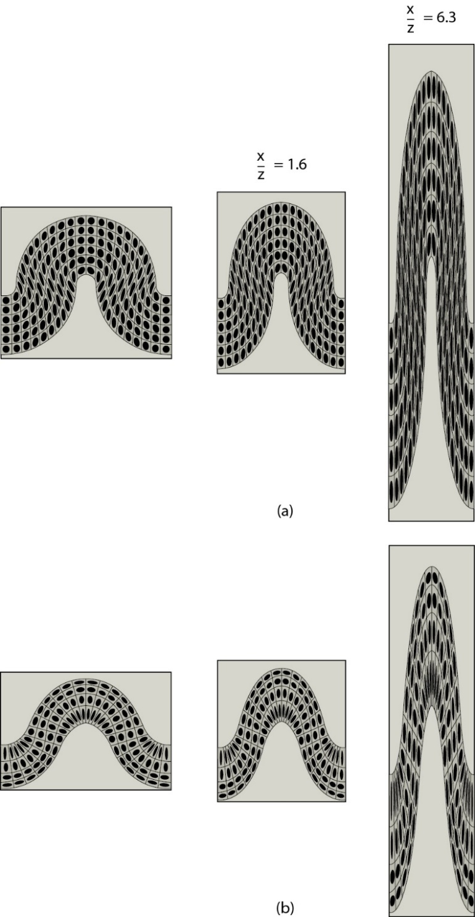
Similar Folds:
Superimposed Homogeneous Strain
Effect of superimposed homogeneous strain on:
flexural fold
neutral-surface fold
Constant volume, plane strain with
X/Z = 1.6 (20% shortening), and
X/Z = 6.3 (60% shortening).
In both cases parallel fold (same thickness layer) evolves into
similar fold (thickened hinge; thinned limbs)
Notes:
F I G U R E 1 0 . 3 5 The effect of superimposed homogeneous strain on (a) a flexural and (b) a neutral-surface fold. Constant volume, plane strain with X/Z = 1.6 (20% shortening), and X/Z = 6.3 (60% shortening) are shown.

Slide 30
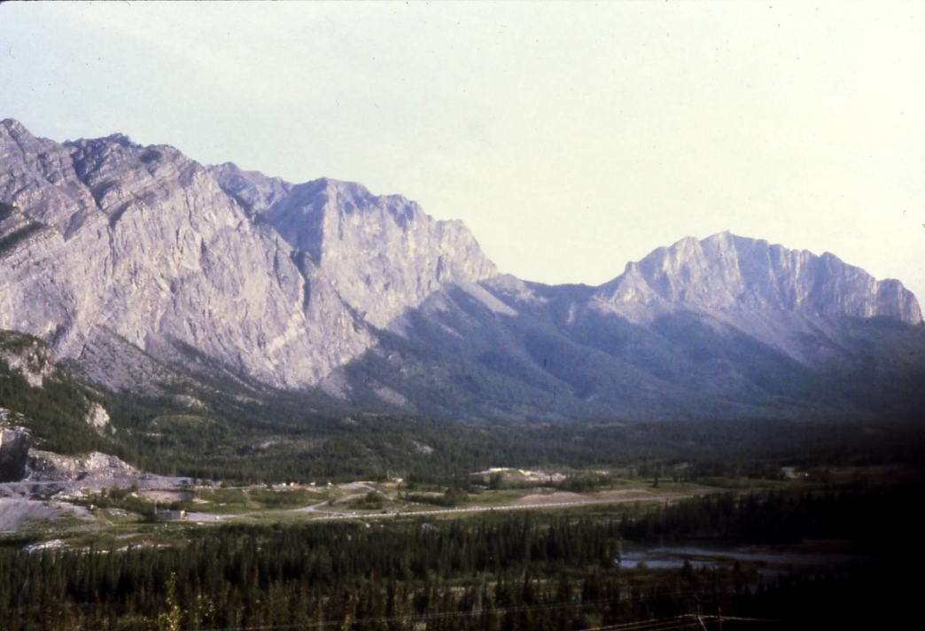
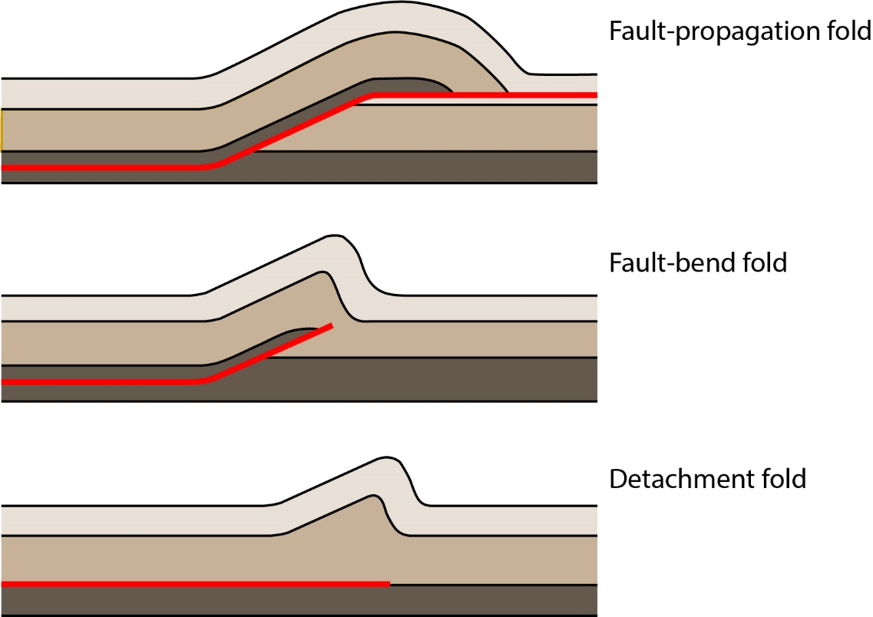
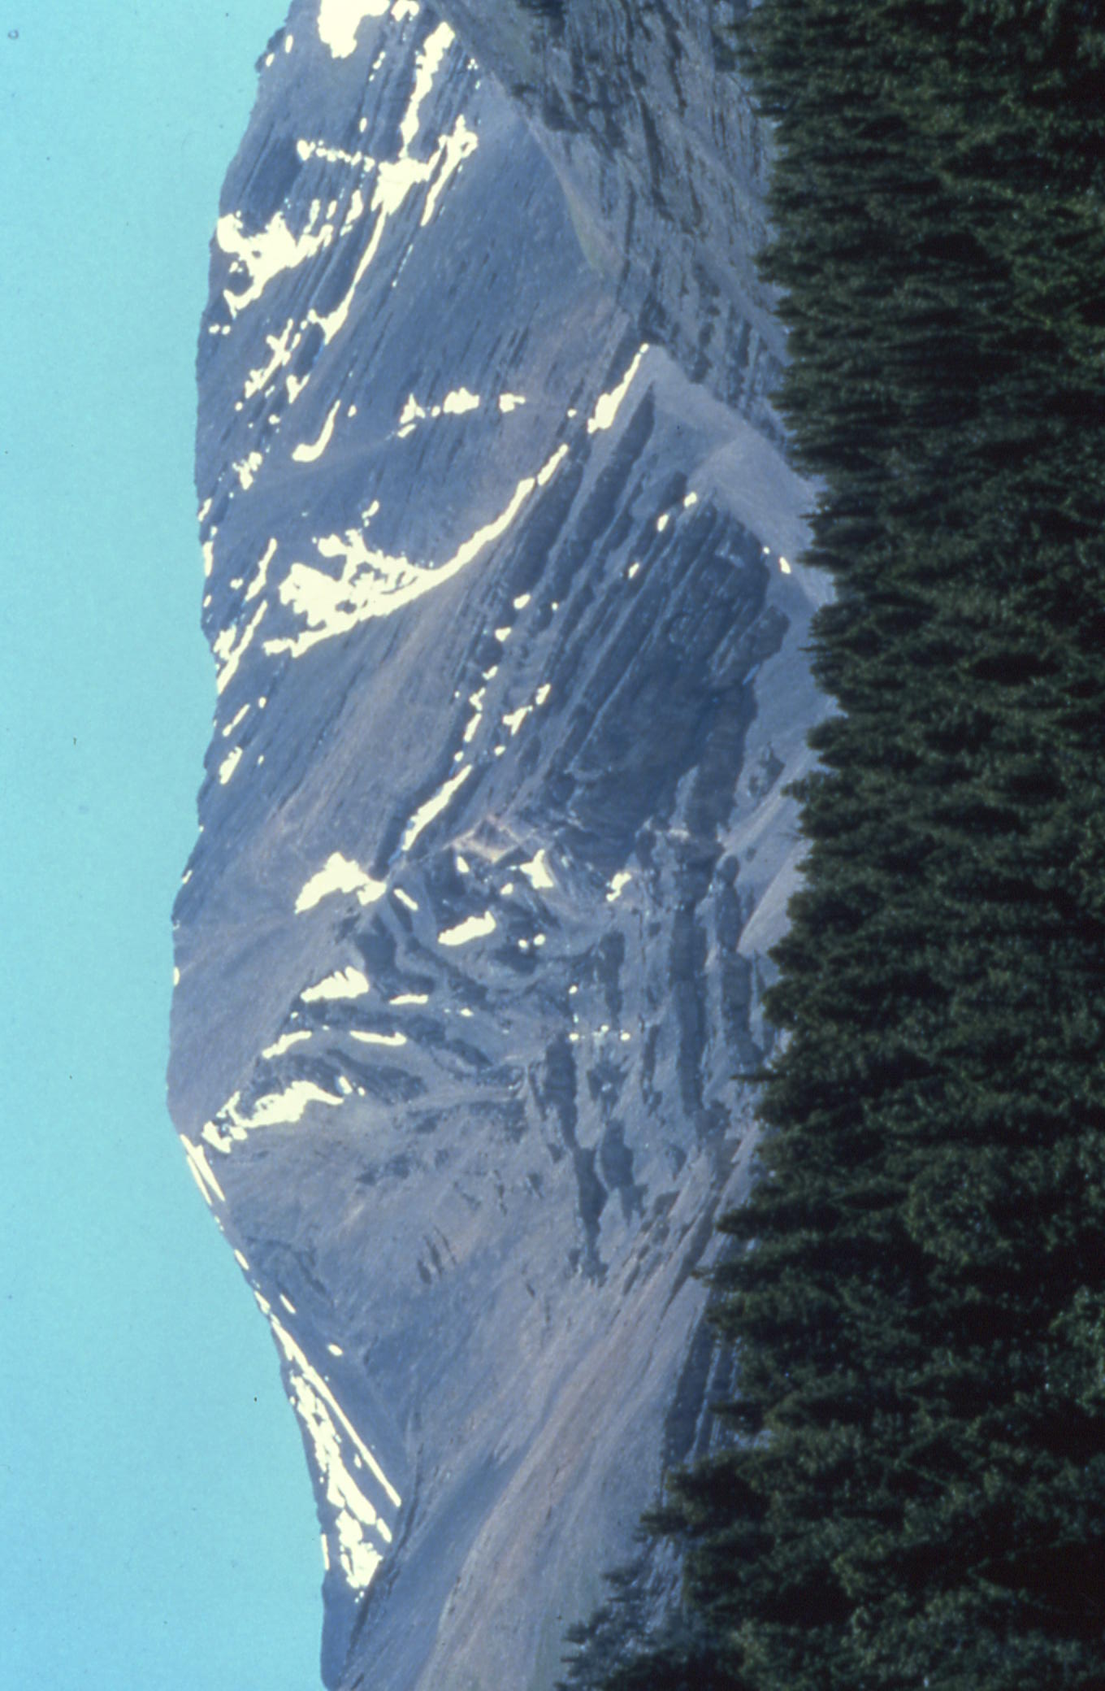
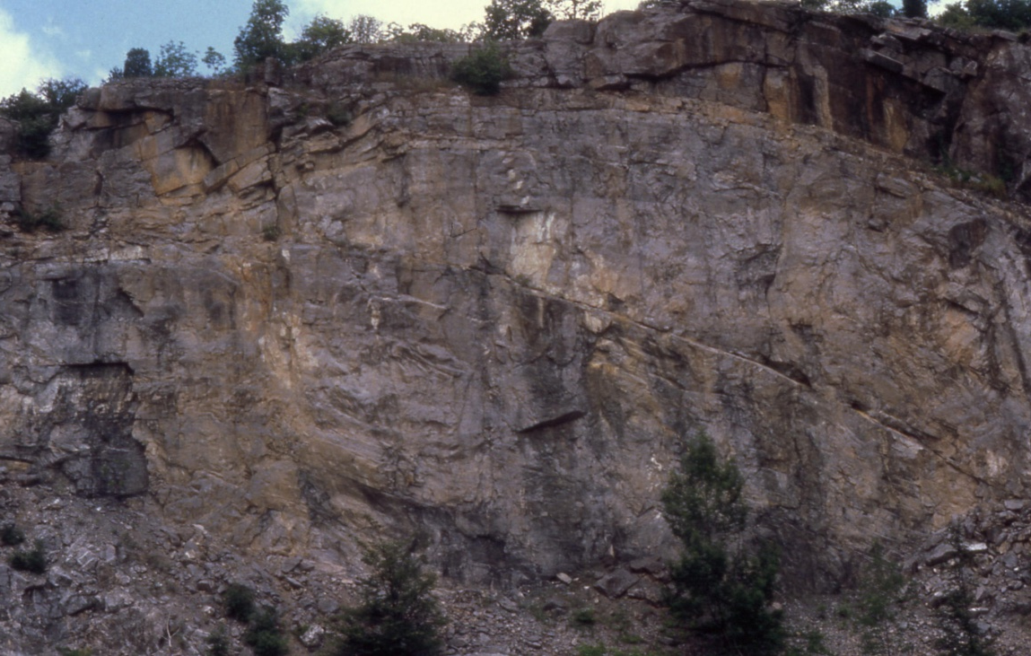
Fault-related Folding
Fault-bend folds
Fault-propagation folds
Detachment folds

Slide 31
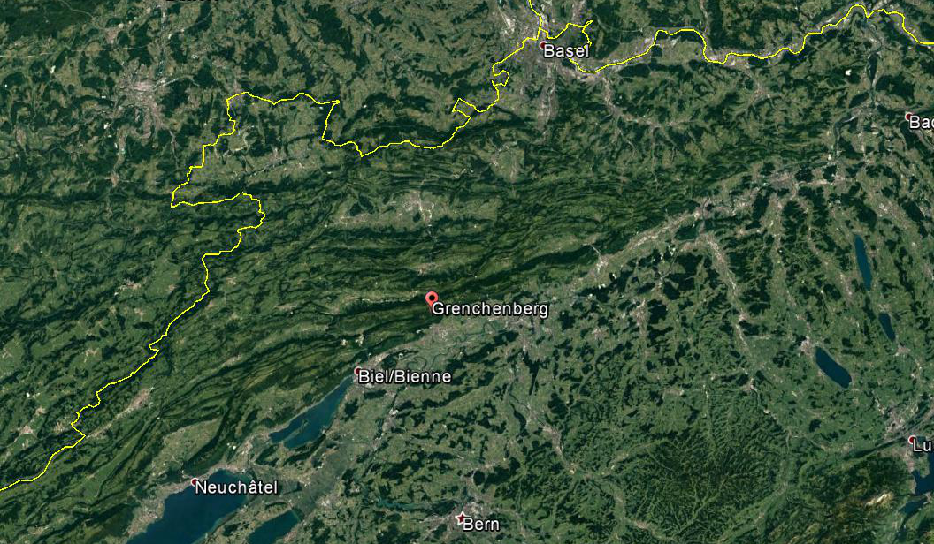

Fault-related Folding: Detachment Folds
47°12'50.95" N 7°27'11.18" E
Box-type detachment folds above pre-Triassic basement
(Jura Mnts, Switzerland)
Small-scale box folds in anhydrite (Delaware Basin, TX),
with detachments in organic-rich (dark) calcite layers
Notes:
F I G U R E 1 8 . 2 2 Cross section of detachment folds in the foreland of the Jura Mountains,
Switzerland. Note that the folds do not involve the basement. The fold cores filled with ductile rock
as the folds formed.
F I G U R E 1 0 . 5 Small-scale disharmonic folds in anhydrite of the Permian Castile Formation in
the Delaware Basin of Texas. White layers are anhydrite; dark layers consist of calcite that is rich in
organic material (hence the dark color). Note that detachments occur in the organic-rich calcite
layers and that the fold shapes (including box folds) in the anhydrite vary as a function of layer
thickness.

Slide 32


Fault-related Folding: Fault-propagation Folds
Fault-propagation fold in Lost River Range, Idaho, showing asymmetric fold dying out updip
Progressive development of
a fault-propagation fold
Notes:
F I G U R E 1 8 . 2 0 (a) Model for progressive development of a simple fault-propagation fold. (b) Exposure of a fold in the Lost
River Range, Idaho, showing an asymmetric fold dying out updip in the core of a fold.

Slide 33


Thrust Type: Imbricate Fan
Relative small displacements.
Break-forward (“piggy-back”) thrusting. Successively younger thrusts cut into footwall, and older faults and folds become deformed by younger structures.
Notes:
To understand the term “piggyback”, we go back to 16th century, when goods were transported in packs that people carried on theirs or animals backs. The term used to describe this was “pick pack” because you would pick up a pack in order to carry it on your back. >>pick-a-back>>piggy back
FIGURE 18.12 An idealized imbricate fan that develops by progressive break-forward thrusting. Note that successively
younger thrusts cut into the footwall, and older faults and folds become deformed by younger structures. The dashed lines are
the traces of fold axial surfaces. In the cross section showing “Time 3,” the sequence of thrusts is labeled. Fault 1 is the oldest and Fault 3 is the youngest. On this cross section, tip lines and branch lines are points; in three dimensions, they go into and out of the page.

Slide 34

Fault-related Folding: Fault-bend Folds
Fault-bend fold above McConnell Thrust, Alberta. Paleozoic strata moved 5 km vertically and 40 km horizontally, and lie above Cretaceous foreland basin deposits. (mirror image)
Progressive stages during development of fault-bend fold (dashed lines are traces of axial surfaces)
Notes:
F I G U R E 1 8 . 1 8 (a) Cross-sectional model showing the progressive stages during the development of a fault-bend fold.
The dashed lines are the traces of axial surfaces. (b) Photo of a fault-bend fold above the McConnell Thrust, near Seebe, Alberta
(Canada). These Paleozoic strata have been displaced over 5 km vertically and 40 km horizontally, and now lie above Cretaceous foreland basin deposits. The foreland basin deposits have preferentially eroded and are now forested.

Slide 35


Thrust Type: Duplex
Relatively large displacements.
Flat-roofed duplex by progressive break-forward faulting.
Roof thrust undergoes a sequence of folding and unfolding.
R. Allmendinger
Notes:
F I G U R E 1 8 . 1 3 (a) Idealized flat-roofed duplex that develops by progressive break-forward
faulting. Note that the roof thrust undergoes a sequence of folding and unfolding, and that
formation of the duplex results in significant shortening.
Duplex animation (Rick Allmendinger)

Slide 36


Multiple-ramp Structures
ramp anticline and ramp syncline
Block diagram with types of fault ramps (hanging wall removed). ‘Tear faults’ are vertically dipping lateral ramps.
Note that number of hanging-wall ramps must match number of footwall ramps.
Notes:
F I G U R E 1 8 . 8 When a thrust sheet moves up a stair-step fault, ramp anticlines develop. (a) The cross-sectional trace of the fault before slip. Points at the tops and bottoms of ramps are labeled. (b) The cross-sectional trace of the fault after slip. Note that the number of hanging-wall ramps exactly matches the number of footwall ramps.
F I G U R E 1 8 . 9 Three-dimensional block diagram illustrating different types of fault ramps (hanging wall removed). Tear faults are vertically dipping oblique ramps or lateral ramps.

Slide 37



Extreme Folding: Transposition
Asymmetric fold develops at perturbation (a–d), which then gets refolded (e–f).
Notes:
F I G U R E 1 2 . 2 4 Fold transposition in a layered rock that
undergoes non-coaxial, layer-parallel displacement. An
asymmetric fold develops at a perturbation (a–d), which in turn
gets refolded (e–f). The end result is a superimposed fold
structure that is essentially parallel to the dominant layering.
Note that if the second fold had formed at another location, the
two would have been indistinguishable, although formed at
different times.

Slide 38

Extreme Folding: Sheath Folds
Grenville Front, Ontario, Canada
… also called condom folds
Notes:
F I G U R E 1 2 . 2 8 A sheath fold in amphibolite gneiss showing the characteristic eye-shaped outcrop pattern (Grenville Orogen, Ontario, Canada); hammer for scale.
F I G U R E 1 2 . 2 9 Sheath folds are formed when weakly doubly-plunging folds are modified in a zone of high shear
strain. Several stages of fold modification occur, with the most evolved stage producing the characteristic conical geometry of
a sheath fold (fold 4). The progression in (a) has the lowest amount of shear at the left and the highest shear strain at the
right. Note the progressive curvature of the hinge line in folds 1 to 3, which typically is accompanied by a (stretching) lineation
in outcrop. In (b), the corresponding lower-hemisphere projections of hinge lines in folds 1, 2, and 3 are shown. The
great circle represents the shear plane and the open circle the shear direction; small dots are hinge-line measurements. When
fully exposed, sheath folds can be used as a shear-sense indicator with the nose pointing in the direction of transport;
otherwise, sheath folds indicate the direction of shear only.

Slide 39




Structure and Society: Resources and Geotourism
Oil and Gas Geotourism
Canadian
Rockies
Roeder, 2010

