Slide 1
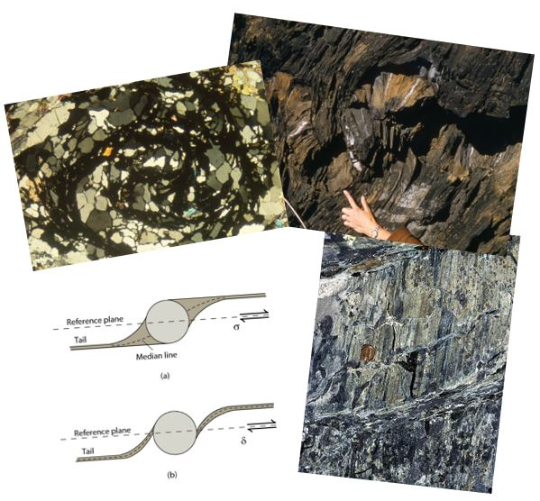
Deformation Fabrics and Fabric Elements
Earth Structure (Processes in Structural Geology &Tectonics)
© Ben van der Pluijm
9/15/2023 3:35 PM

Slide 2
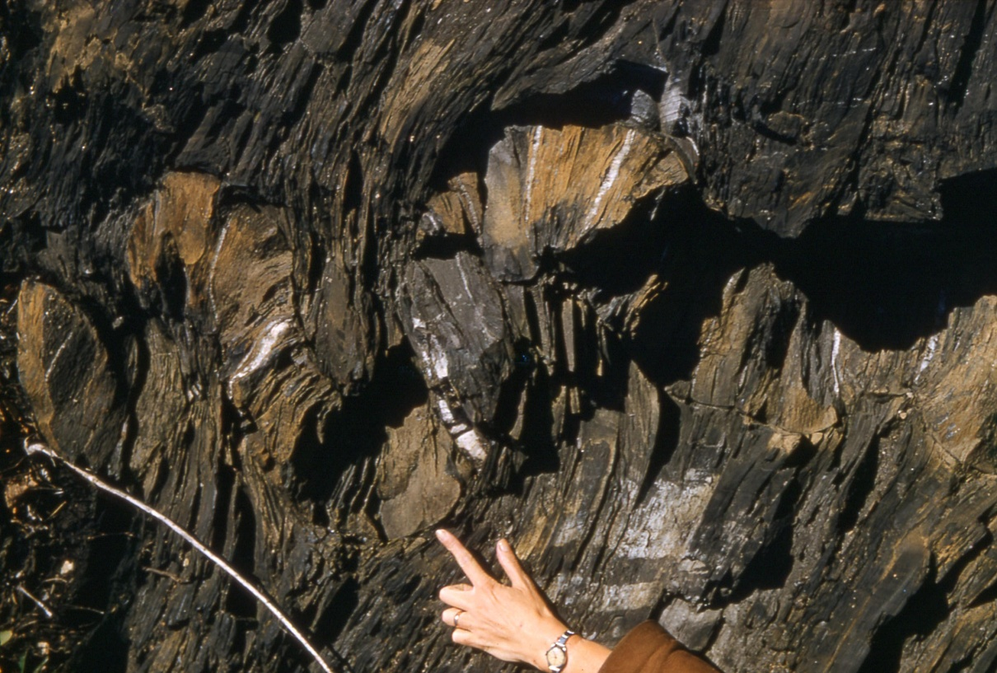
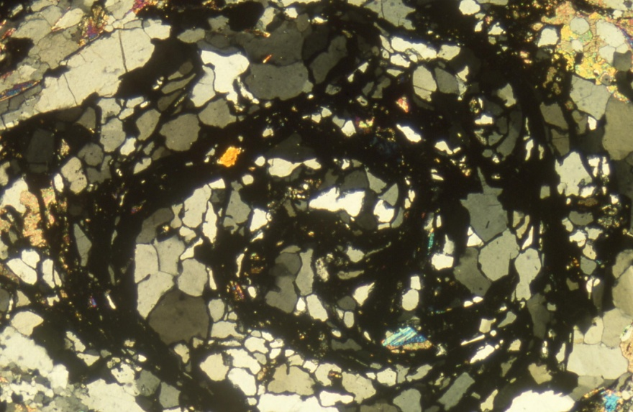
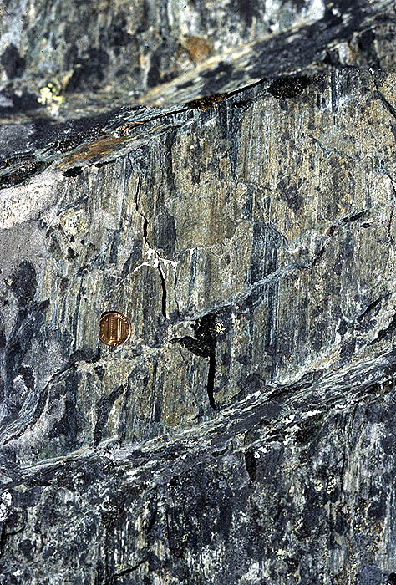
We Discuss …
Deformation Fabrics and Fabric Elements:
Foliations
By metamorphic grade, cleavage to gneissosity
Cleavage Morphology
(Porphyroblastesis)
Fabrics and Strain
Shear Zones
Shear sense indicators
Shear zones and Strain
Lineations
Boudinage

Slide 3
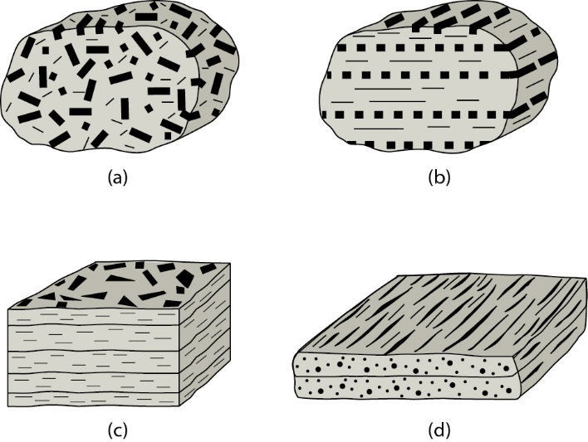
Rock Fabric Categories
Random fabric. Fabric elements are dark, elongate crystals.
(1-D) preferred fabric, in which long axes of elongate crystals are aligned with one another.
Foliation. Fabric elements are planar and essentially parallel to one another, creating a 2-dimensional fabric.
Lineation.
S L L/S Tectonites
Notes:
F I G U R E 1 1 . 1 The basic categories of fabrics. (a) A random fabric. The fabric elements are dark, elongate crystals. The long axes of these crystals are not parallel to one another. (b) A (1-dimensional) preferred fabric, in which the long axes of elongate crystals are aligned with one another. (c) A foliation. The fabric elements are planar and essentially parallel to one another, creating a 2-dimensional fabric. (d) A lineation. The fabric elements are linear; in this example, we show the alignment of fabric elements in a single plane.
F I G U R E 1 1 . 3 The nature of tectonites. (a) An S-tectonite. This fabric is dominantly a foliation,
and the rock may tend to split into sheets parallel to the foliation. Within the planes of foliation,
linear fabrics are not aligned, or are not present at all. (b) An L-tectonite. The alignment of linear
fabric elements creates the dominant fabric, so the rock may split into rod-like shapes. In
L-tectonites, there is not a strong foliation. (c) An L/S-tectonite. The rock possesses a strong
foliation and a strong lineation.

Slide 4
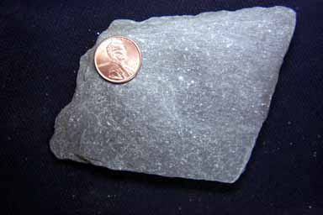
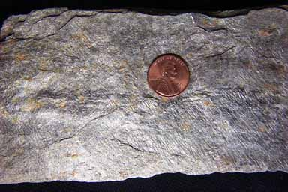
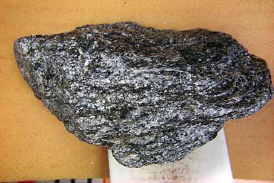
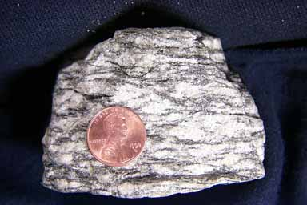
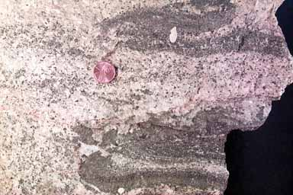
Foliations (with metamorphic grade)
Slate to Phyllite …
Cleavage
… to Schist
Schistosity
But
… to Gneiss
Gneissosity
… to Migmatite

Slide 5
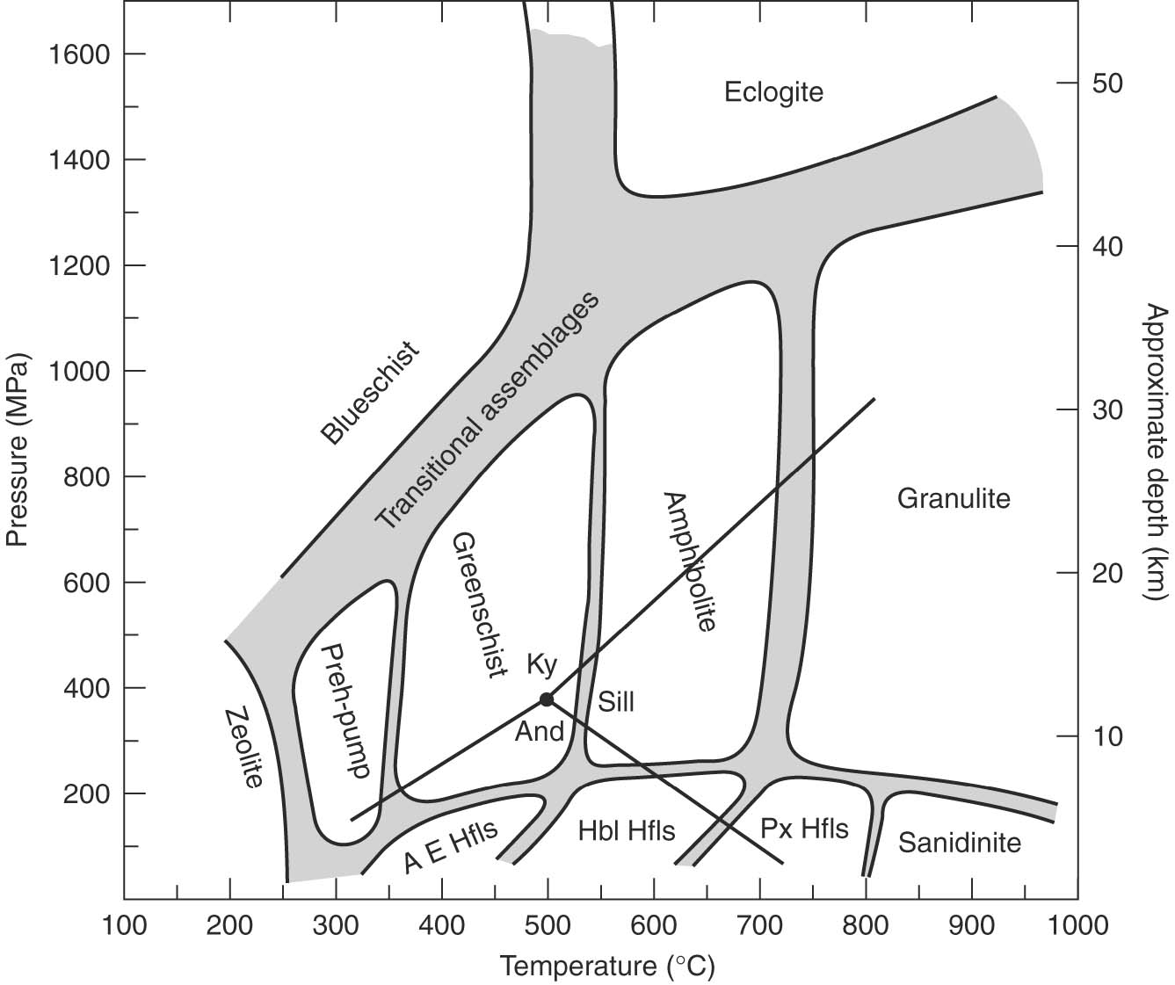
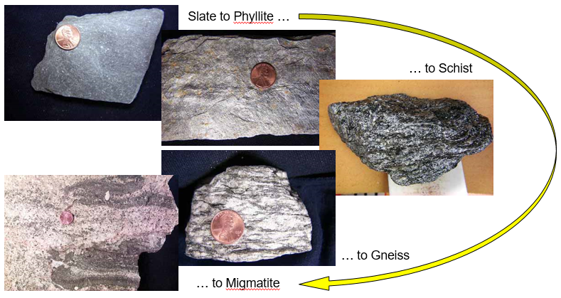
Foliations and Metamorphic Facies
Recall P_{l} - T change with depth.
For crustal rocks:
Lithostatic stress: ~27 MPa/km (or 270 bar/km)
Temperature: ~25C/km
Shale Slate Phyllite Schist Gneiss Migmatite
Notes:
Fig 13.2

Slide 6
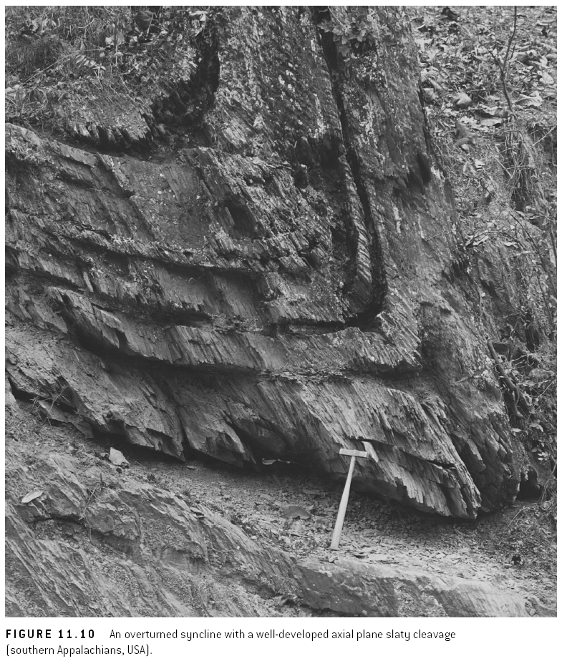
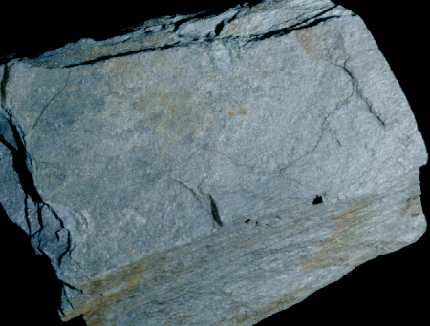
Slaty Cleavage (or Continuous Cleavage)
‘axial plane cleavage’
Notes:
F I G U R E 1 1 . 1 0 An overturned syncline with a well-developed axial plane slaty cleavage (southern Appalachians, USA).

Slide 7
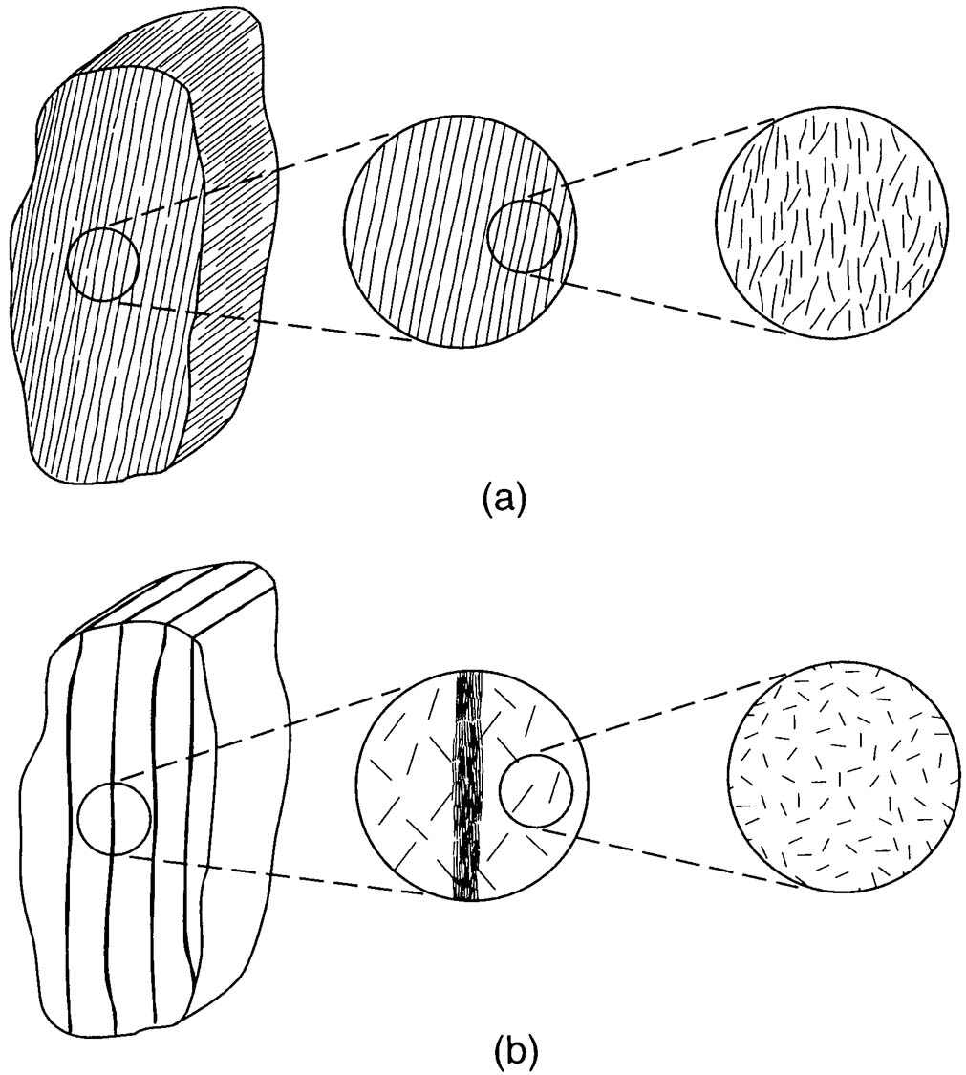
Foliation Classification
Cleavage
Continuous cleavage - Coarse cleavage (e.g., pencil cleavage) and fine cleavage (e.g., slaty cleavage)
Spaced cleavage - Disjunctive cleavage (e.g., stylolitic cleavage) and crenulation cleavage
Phyllitic cleavage - Continuous cleavage with a distinctive silky luster in very low-grade metamorphic rock (lower greenschist facies)
Stylolites – dissolution foliation in carbonates
Schistosity - Mica-rich foliation with a distinctive high sheen in low- to medium-grade metamorphic rock (greenschist facies)
Gneissosity - Coarse compositional banding or gneissosity in high-grade metamorphic rock (amphibolite and granulite facies)
Continuous Cleavage. Lines represent planar fabric elements that are visible no matter how small field of view (at least down to scale of individual grains)
Spaced Cleavage. Host rock is preserved between cleavage elements
Notes:
F I G U R E 1 1 . 2 The distinction between continuous and
spaced fabrics. (a) A continuous fabric. The lines represent a
planar fabric element that continues to be visible no matter
how small your field of view (at least down to the scale of
individual grains). (b) A spaced fabric. The rock between the
fabric elements does not contain the fabric. The circled areas
represent enlarged views.

Slide 8
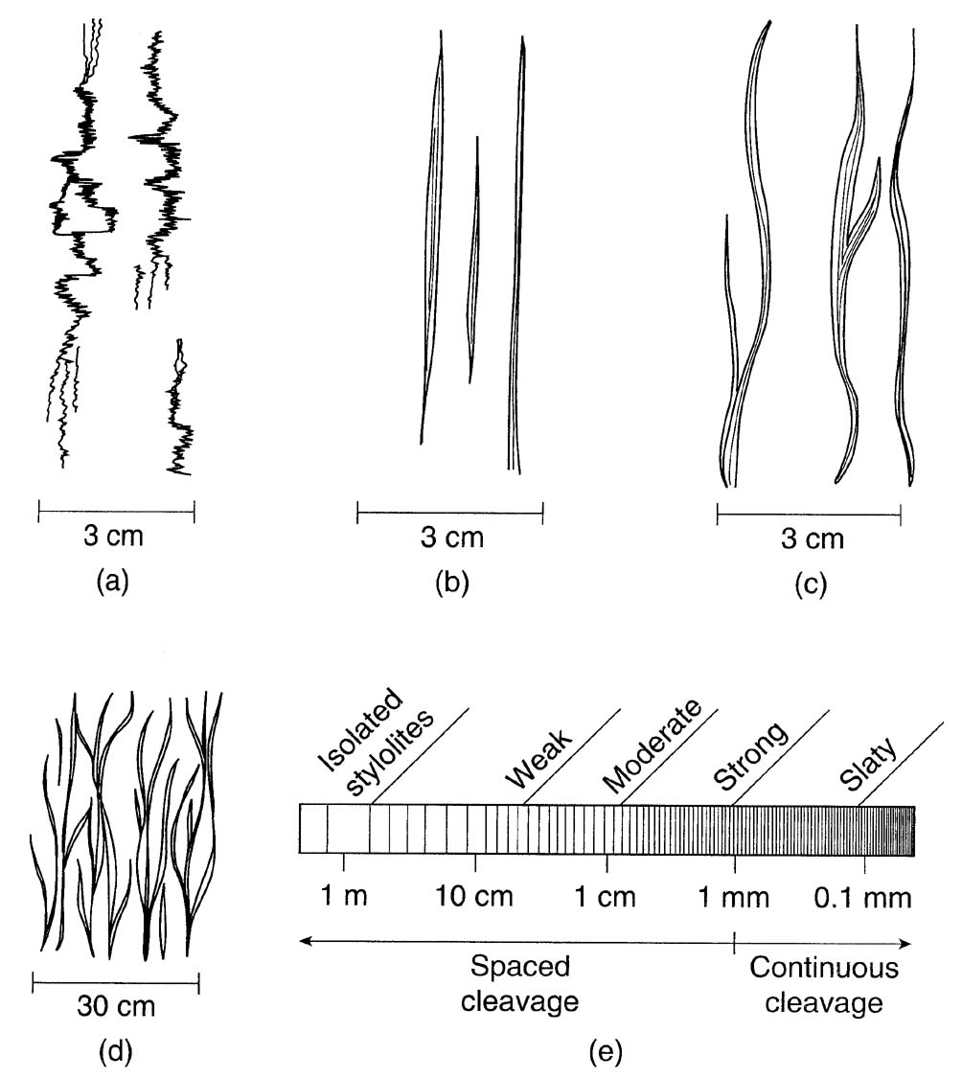
Cleavage Morphology
sutured domains (“stylolitic”)
planar domains
wavy domains
anastomosing domains
Spaced and continuous (or slaty) cleavage is based on domain spacing
Notes:
F I G U R E 1 1 . 7 Cross-sectional sketches of morphological
characteristics used for cleavage description and classification.
(a) Sutured domains; (b) planar domains; (c) wavy domains;
(d) an anastomosing array of wavy domains. In (e) the
description of spaced cleavage based on domain spacing
is shown.

Slide 9
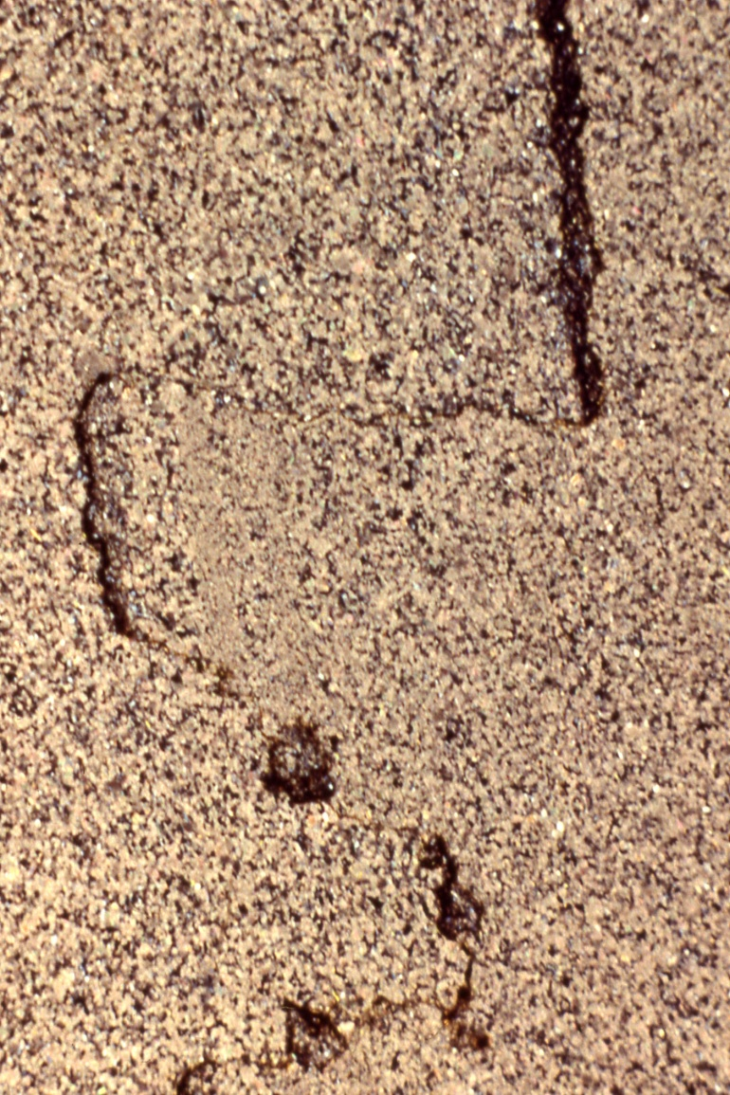
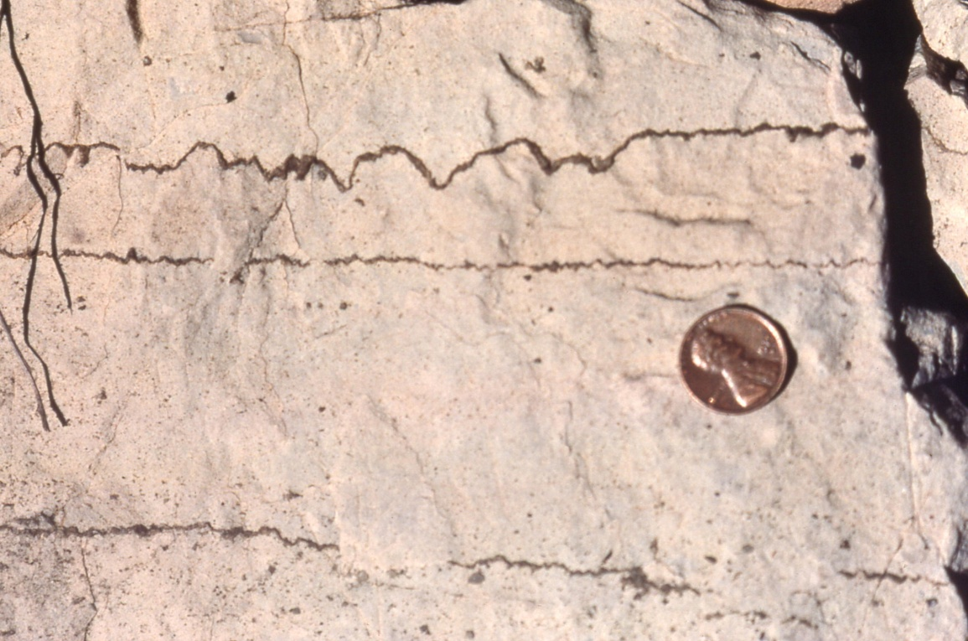
Foliation in Carbonates: Stylolites

Slide 10
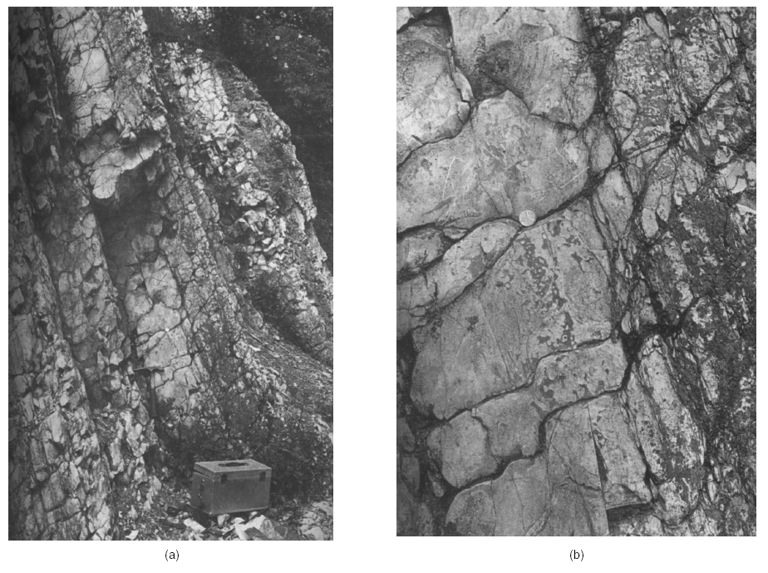
Spaced Cleavage
Harz Mountains, Germany
Notes:
F I G U R E 1 1 . 5 Spaced disjunctive cleavage (or solution cleavage) in limestone from the Harz Mountains of Germany. The cleavage is marked by the narrow dark bands which cut across the original, lighter-colored argillaceous limestone. (a) Outcrop view; (b) close-up view of central portion. In (c) the cleavage domain and microlithon of spaced cleavage are illustrated in gently left-dipping beds.

Slide 11
Microstructure of Cleavage
slaty (=continuous) cleavage (2mm width of view)
spaced cleavage (6mm width of view)

Slide 12
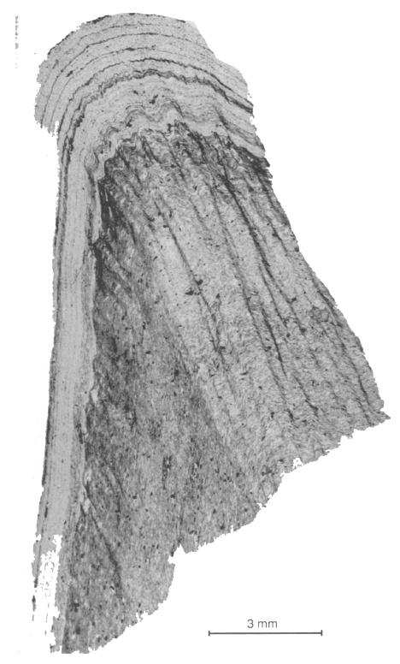
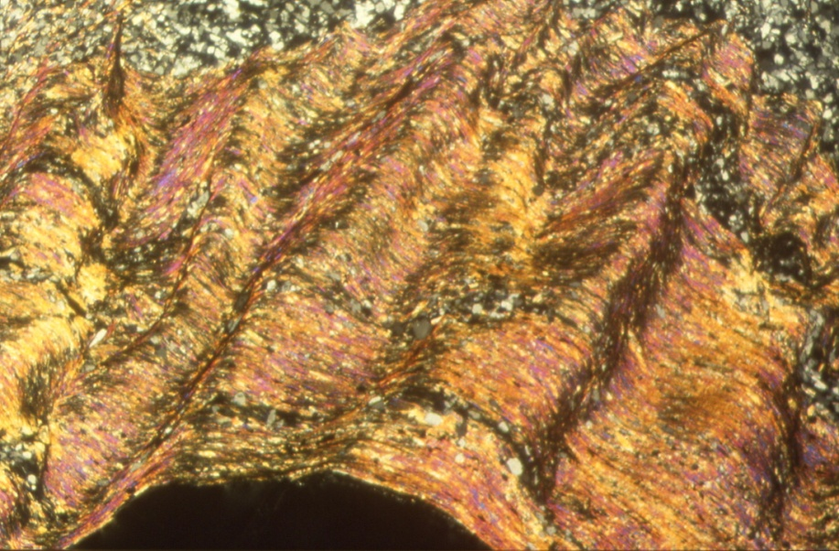
Crenulation cleavage (microfolds)
Categories of crenulation cleavage: (b) symmetric, and (c) asymmetric crenulation cleavage.
(3mm width of view)
Notes:
F I G U R E 1 1 . 1 3 The two basic categories of crenulation cleavage. (b) Symmetric crenulation
cleavage; (c) asymmetric (sigmoidal) crenulation cleavage. The arrows indicate a possible
component of shear associated with this crenulation geometry.
F I G U R E 1 1 . 1 2 Photomicrograph of crenulation cleavage in a phyllite (Vermont, USA). The spaced crenulation cleavage deforms an earlier continuous cleavage, with cleavage spacing and intensity that are less in the sandy layers (white).

Slide 13
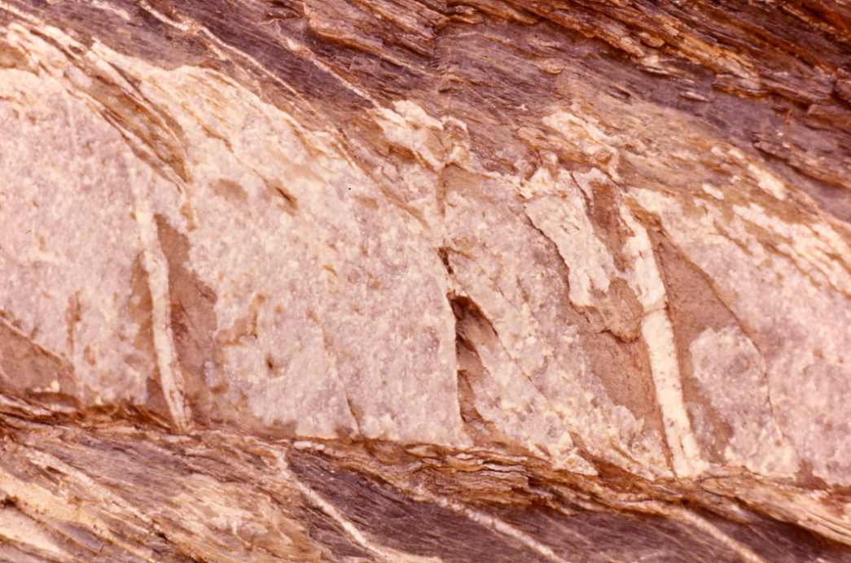
Axial Plane Cleavage and Cleavage Refraction
Younging
direction (“up”)
Axial plane, slaty cleavage (Cantabria, Spain)
Spaced Cleavage refraction (Eifel, Germ.); width of view is ~15 cm
Notes:
Fig 11.22

Slide 14
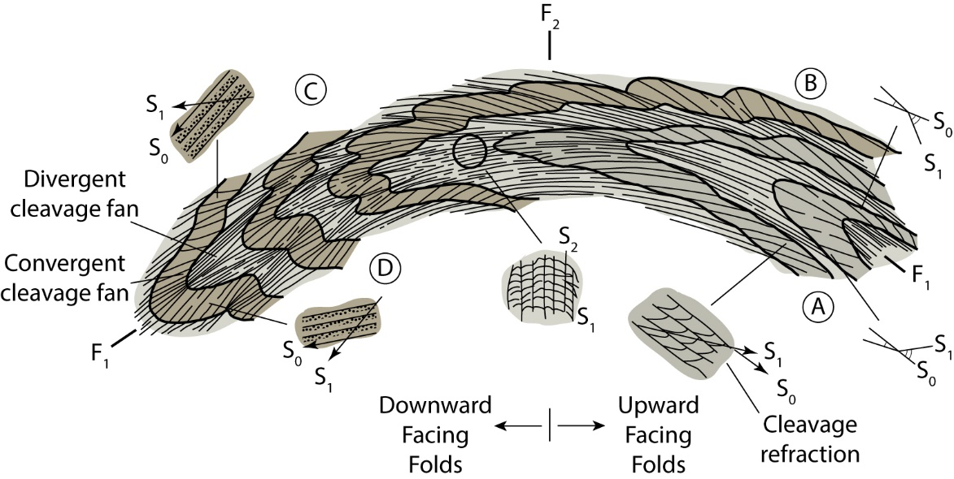
Synopsis: Fold-Cleavage Relationships
Fold generations (F₁, F₂), Fold Facing, Fold (a)symmetry, (axial plane) Cleavages (S₁, S₂), Cleavage refraction
Note cleavage-bedding relationships and cleavage refraction in upright and overturned limbs of upward-facing and downward-facing folds.
Notes:
F I G U R E 1 1 . 2 4 Cleavage-bedding relationships and cleavage refraction in upright and
overturned limbs of upward-facing and downward-facing folds.

Slide 15
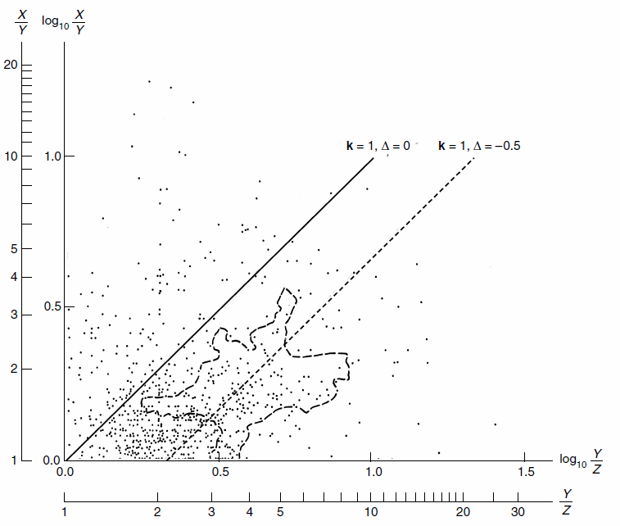
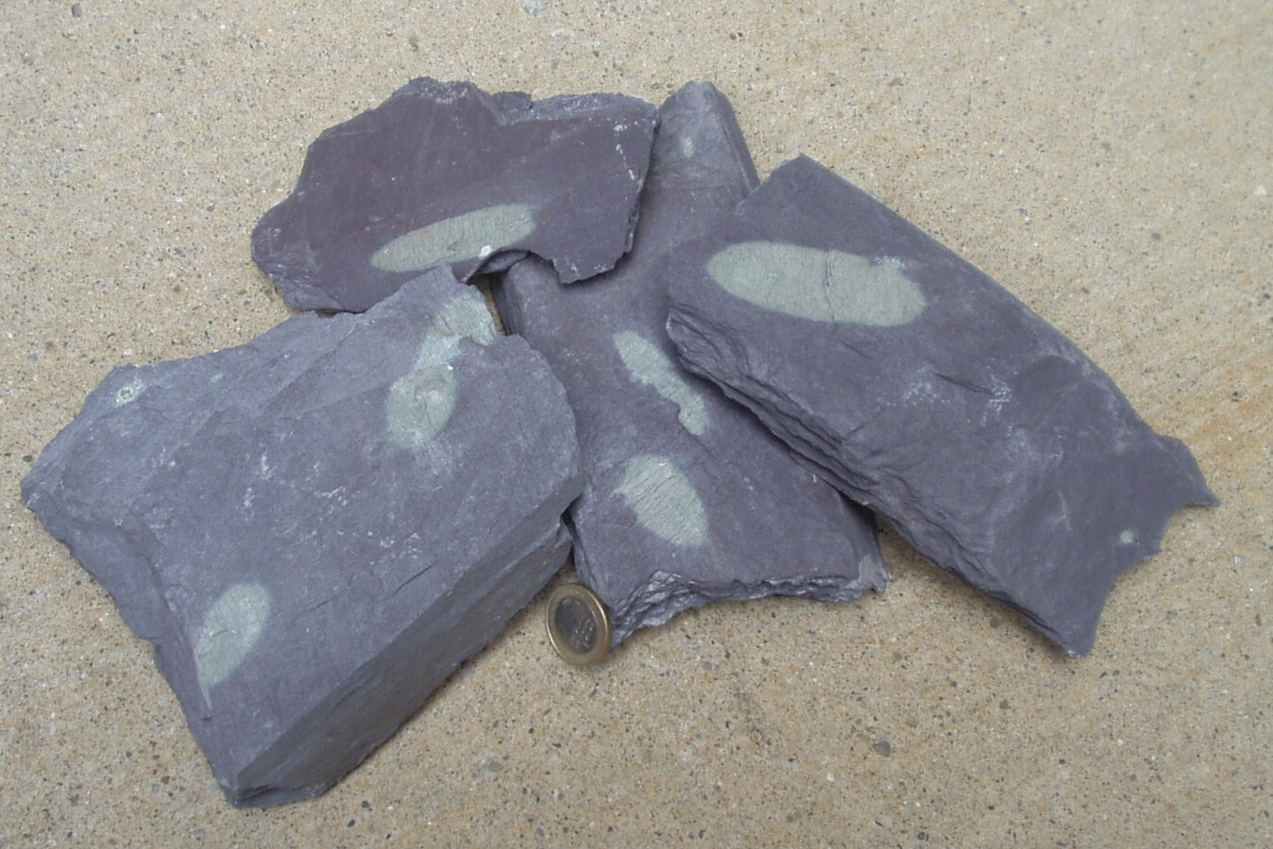
Cleavage and Strain
Plane strain k=1: X>Y=1>Z
k=1, Δ=0 k=1, Δ= -0.5 (50% vol loss)
Region representing hundreds of strain analyses in slates
Ellipsoidal reduction spots in slate (elliptical in x-section) after strain and volume change, Δ (Appalachians, USA).
Notes:
F I G U R E 1 1 . 1 8 Reduction spots in slate that are ellipsoidal in shape (elliptical in section); Appalachians, USA. They can be used as strain markers if they were formed as spherical regions around a reducing phase prior to deformation; coin for scale.

Slide 16
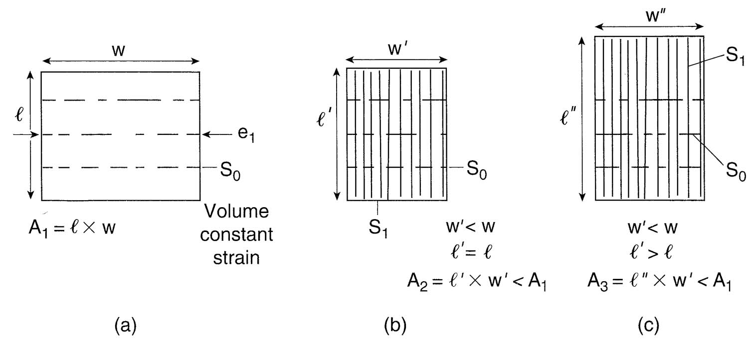
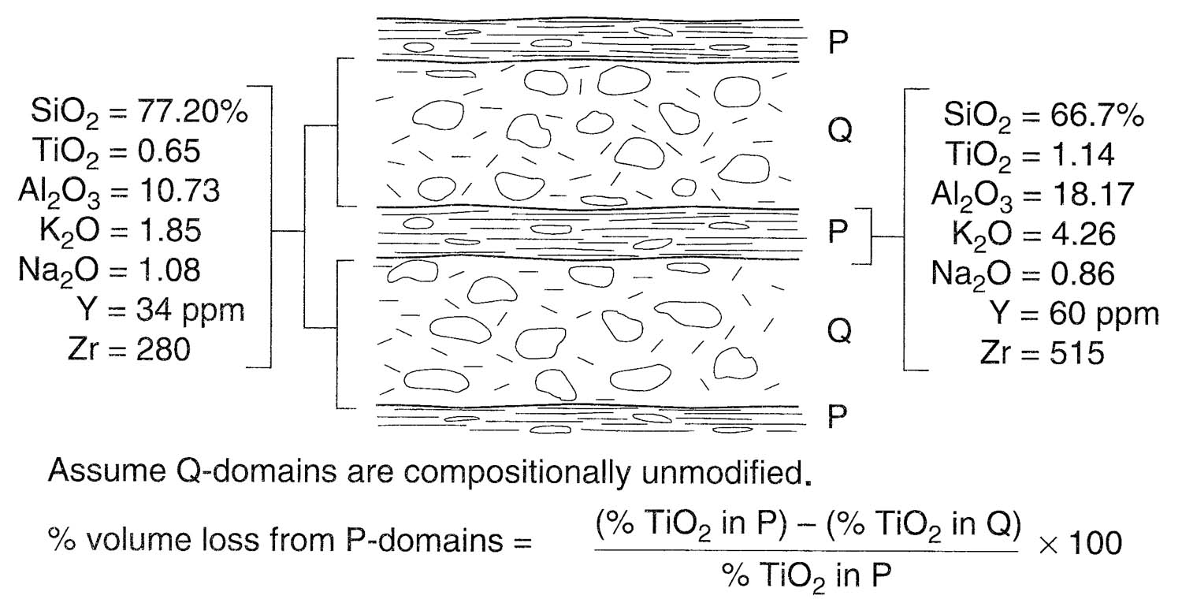
Foliations and Strain: Volume Change
w’’ = w’ < w
l’’ > l
A₃ = l’’ x w’’ = A₁
b. Volume loss
c. Constant volume
Volume change based on immoveable phases (TiO₂, Y, Zr):
~45% volume loss in slates
Notes:
F I G U R E 1 1 . 1 9 To lose or not to lose volume; that’s the question. (a) A block of height l and
width w is shortened and forms a cleavage. If there is volume loss strain, then w′ < w, but l′= l (we
are assuming no change in the third dimension; that is, the intermediate strain axis (Y) equals 1).
If there is volume constant strain, then l′′ > l, as in (c).
F I G U R E 1 1 . 2 0 Volume loss may occur by preferential removal of certain elements. If the
composition of the microlithons (Q-domains) is assumed to be constant, then the amount of volume
loss can be calculated (see equation); based on relatively immobile elements TiO2, Y, and Zr, the
volume loss is calculated as ∼45%.

Slide 17
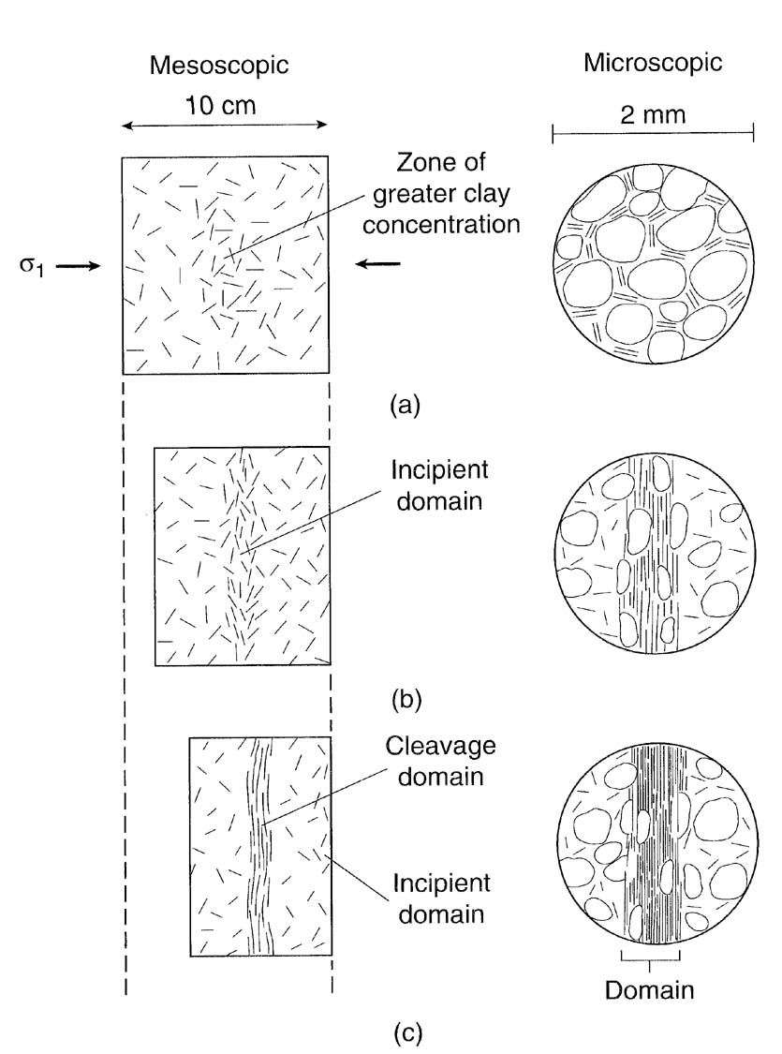
Cleavage Formation
Pre-cleavage. In some areas greater initial concentration of clay.
Incipient cleavage. As shortening and grain solution occur, zones with greater clay concentration evolve into incipient cleavage domains. Grains are preferentially dissolved on faces perpendicular to σ₁ and clay flakes rotate. (pencil cleavage; next)
(c) Cleavage. Clay flakes packed tightly together and only small relicts of soluble mineral grains visible. (continuous/slaty cleavage)
Notes:
F I G U R E 1 1 . 6 Evolution of spaced disjunctive cleavage. (a) Precleavage fabric of the rock. In the area indicated by the arrow in the mesoscopic image, there happens to be a greater initial concentration of clay. The microscopic image indicates that the clay flakes are randomly oriented. (b) As shortening and pressure solution occur, the zone in which there had initially been a greater clay concentration evolves into an incipient cleavage domain. At this stage, grains are being
preferentially dissolved on the faces perpendicular to S1, and the clay flakes are collapsing together. (c) Ultimately, a clearly defined cleavage domain is visible. In the domain, the clay flakes are packed tightly together and only small relicts of the soluble mineral grains are visible.

Slide 18
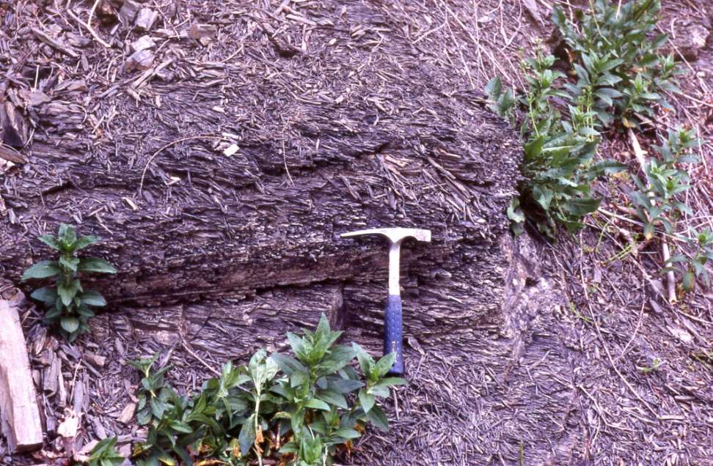
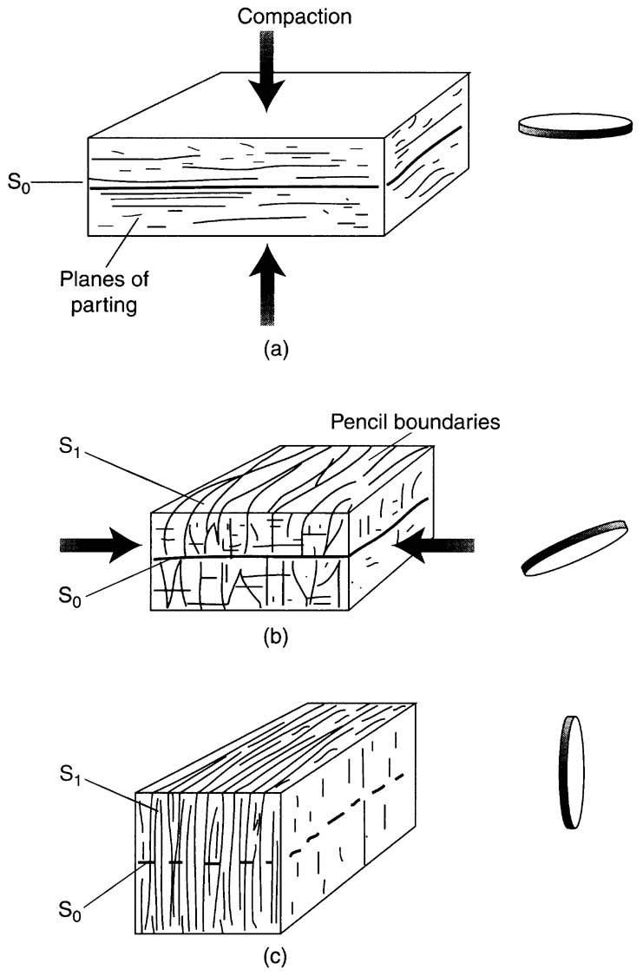
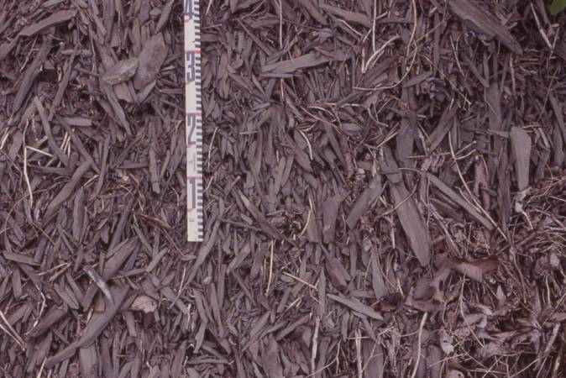
Pencil Cleavage (early cleavage development stage)
Notes:
F I G U R E 1 1 . 9 Sketches illustrating the progressive development of slaty cleavage via the formation of pencil structure. (a) Compaction during burial of a sedimentary rock produces a weak preferred orientation of clay parallel to bedding. A representative strain ellipsoid is like a pancake in the plane of bedding. (b) Shortening parallel to layering creates an incipient tectonic fabric. Superposition of this fabric on the primary compaction fabric leads to the formation of pencils. The
representative strain ellipsoid is elongate, with the long axis parallel to the pencils. (c) Continued tectonic shortening leads to formation of slaty cleavage at a high angle to bedding. The phyllosilicates are now dominantly aligned with the direction of cleavage, and a representative strain ellipsoid is oblate and parallel to cleavage.

Slide 19
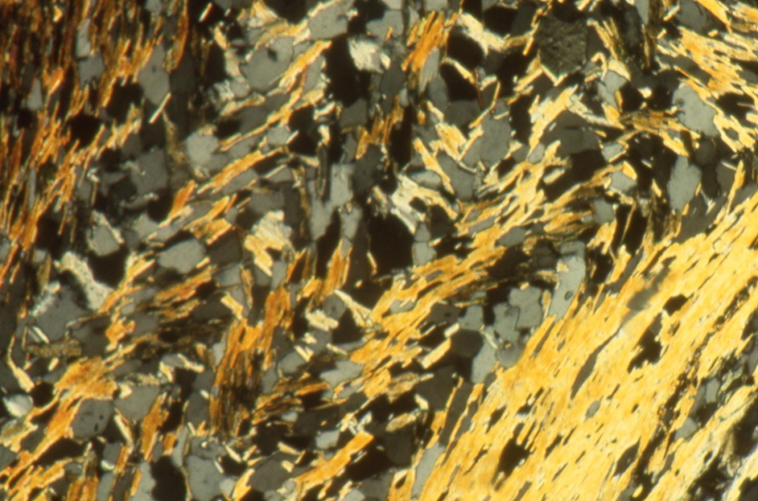
Cleavage Differentiation
Near homogeneous fabric, before migration of quartz.
Quartz accumulates in hinges of crenulations, and phyllosilicates concentrated in limbs, resulting in compositionally distinct bands.
Complete transposition of S₁ foliation into a new S₂ cleavage (or schistosity).
(0.5mm width of view)
Notes:
F I G U R E 1 1 . 1 5 Differentiation during the formation of crenulation cleavage. (a) Fairly homogeneous composition, before migration of the quartz. (b) Quartz accumulates in the hinges of the crenulations, and the phyllosilicates are concentrated in the limbs; the result is the formation of compositionally distinct bands in the rock. (c) Complete transposition of the S1 foliation into a new S2 cleavage or schistosity.

Slide 20
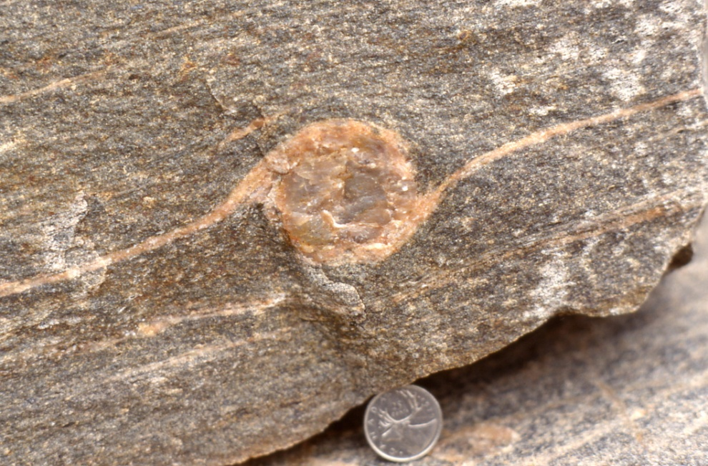
High-strain Zones or Shear Zones
Shear Zone is narrow region where deformation is highly concentrated (relative to adjacent host rock). Deformation rock is called mylonite.
Characteristics:
metamorphic conditions (300+ ºC)
fine-grained (relative to host rock)
foliated (parallel to shear zone boundary)
lineated (parallel to displacement direction)
fold transposition (high strain)
grain shape fabric from dynamic recrystallization
(grain crystallographic fabric from dislocation creep)
+/- shear-sense indicators

Slide 21
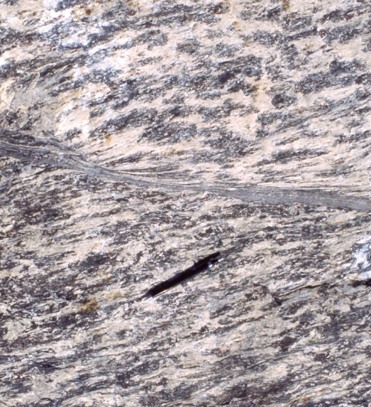
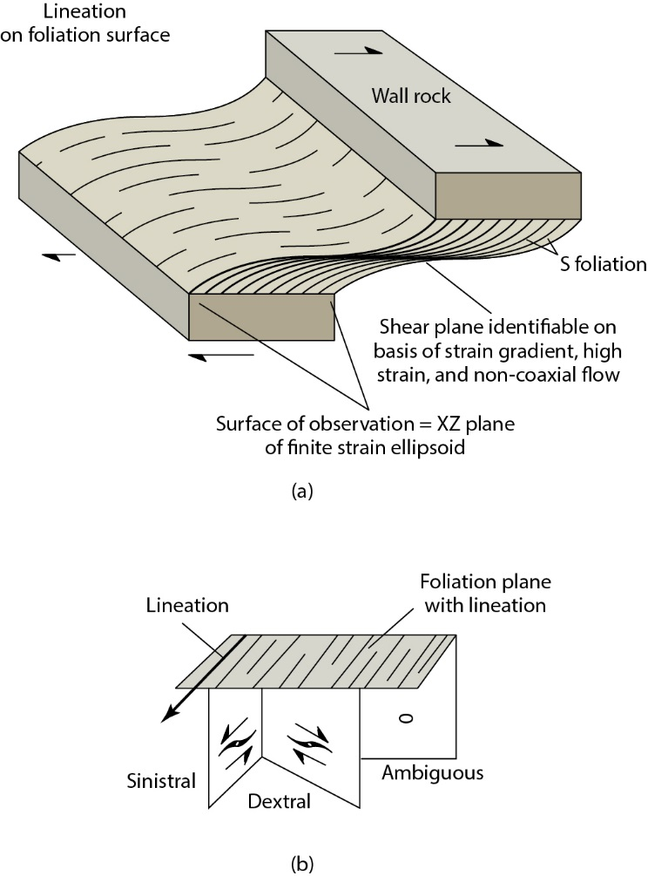
Shear Zone Geometry and Displacement
Notes:
F I G U R E 1 2 . 4 (a) Schematic, right-lateral ductile shear zone showing mylonitic foliation (S) and lineation. The optimal
surface for study is the XZ-plane of the finite strain ellipsoid.
(b) Apparent difference in shear sense, which results from observing the shear-sense indicator in different surfaces. Note
that the surface perpendicular to the lineation and the foliationgives no shear-sense information.

Slide 22
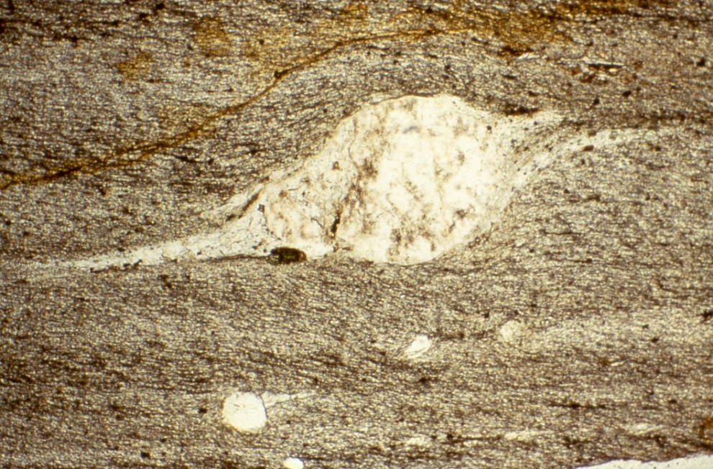
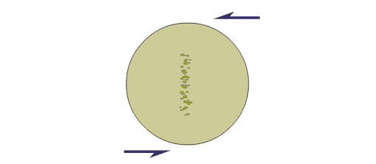
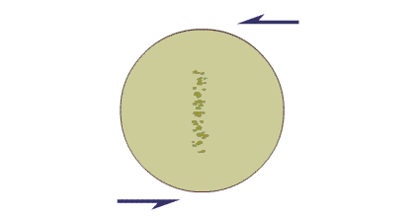
Shear-sense Indicators - Grain-Tail Complexes
From σ to δ
sigma clast
delta clast
Animations from Fossen, 2016
Notes:
F I G U R E 1 2 . 6 Grain-tail complexes as shear-sense indicators. (a) σ-type complex, (b) δ-type complex, and (c) the evolution of a σ-type complex into a δ-type grain-tail complex.

Slide 23
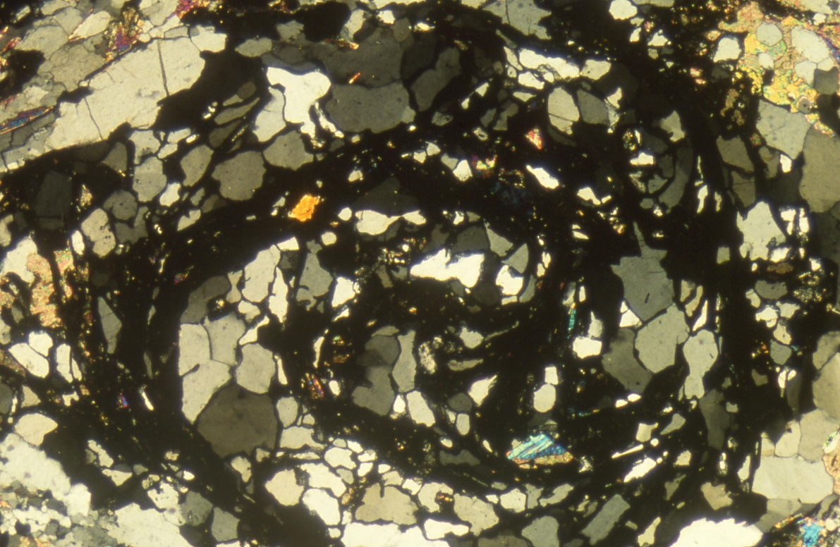
Foliations and Strain: Shear Zones
β = Ω tan ψ = Ω γ
β is rotation angle in radians (1 radian is 180°/π)
ψ is angular shear
γ is shear strain
Ω is mechanical coupling
“snowball garnet”
Notes:
F I G U R E 1 2 . 1 4 (a) A simple ball-bearing experiment (b) that illustrates the relationship between rotation [β] and shear (ψ, γ).

Slide 24
Shear-sense Indicators – Foliations (S, C, C’)
C’
C
S
C
S-C fabric
C-C’ fabric
Notes:
F I G U R E 1 2 . 1 1 Characteristic geometry of (a) C-S and (b) C-C′ structures in a dextral shear zone. The C-surface is
parallel to the shear zone boundary and is a surface of shear accumulation (i.e., not parallel to a plane of principal finite
strain). The S-foliation is oblique to the shear-zone boundary and may approximate the XY-plane of the finite strain ellipsoid.
The C′-foliation in (b) displaces an earlier foliation (C or composite C/S).

Slide 25
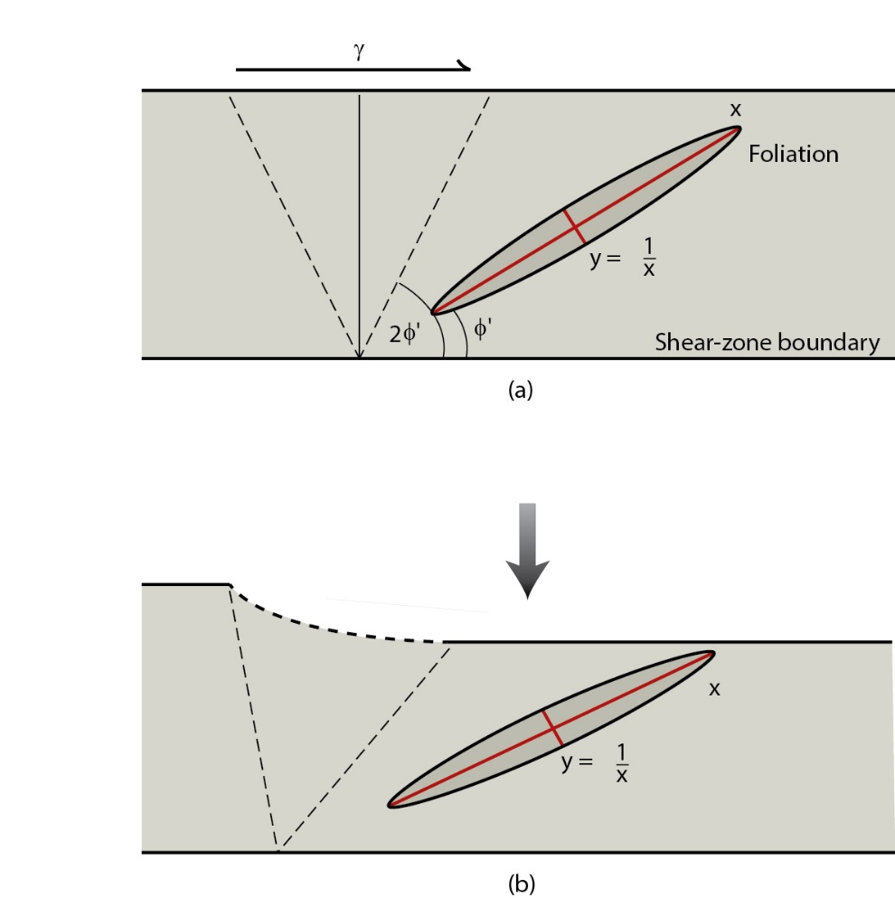
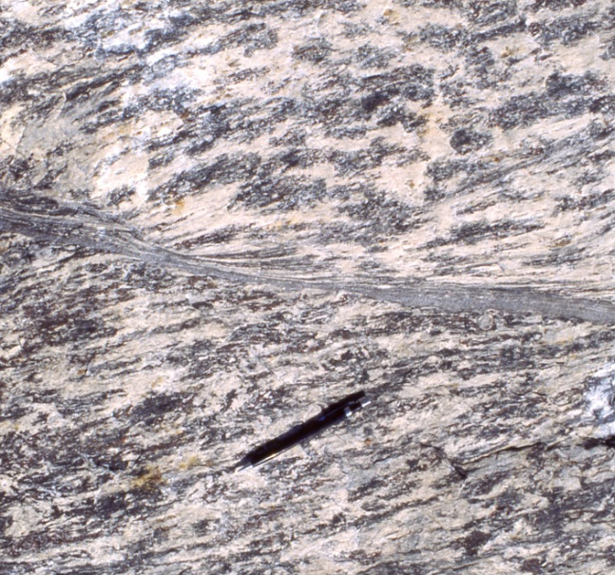
Foliations and Strain: Shear Zones
C
S
Strain State:
Z = shortening
X = extension
i = instantaneous
f = finite
Z_{i}
X_{i}
X_{f}
C
γ = 2/tan 2φ′
φ′ is angle between foliation (S) and shear-zone boundary (C)
X_{f}
X_{i}
Z_{i}
Notes:
F I G U R E 1 2 . 1 6 Small-scale, left-lateral shear zone in anorthosite, showing deflection of the mylonitic foliation (Grenville Orogen, Ontario, Canada). Width of view is ∼20cm.
F I G U R E 1 2 . 1 7 Angular relationship, φ′, between foliation and shear-zone boundary, and shear strain, γ, in (a) a perfect shear zone (kinematic vorticity number, Wk, is 1), and in (b) a zone with a component of shortening perpendicular to the shear-zone boundary (0 < Wk < 1). Dashed lines are traces of
circular sections of the strain ellipse.

Slide 26
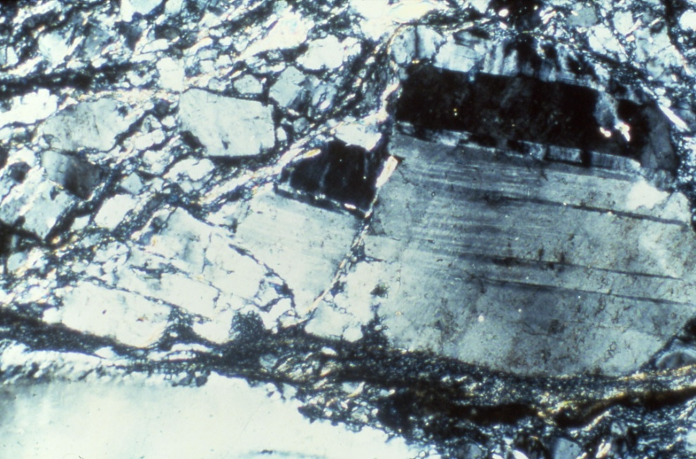
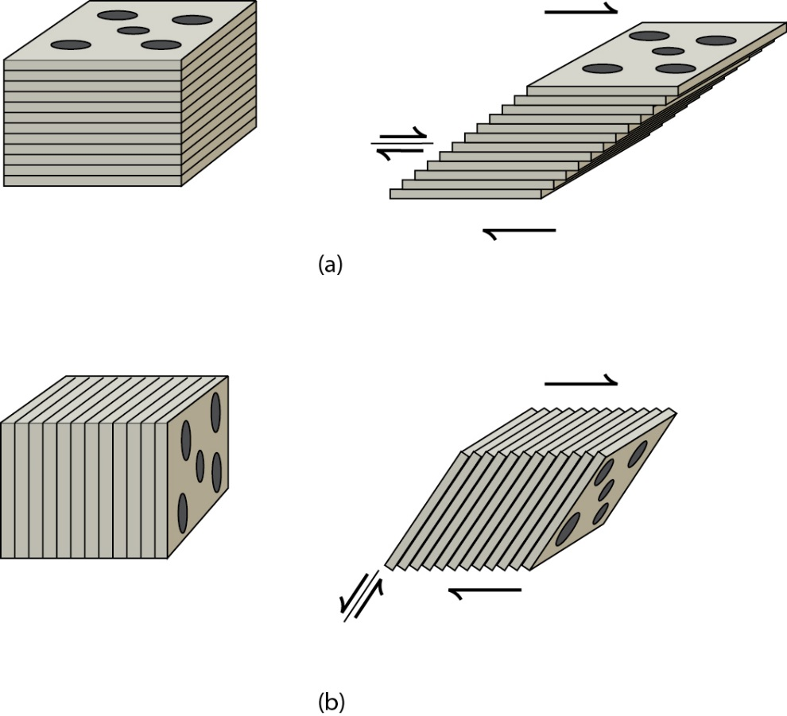
Shear-sense Indicators – Fractured Grains
Notes:
FIGURE 12.8 Placing dominos between a pair of hands to
demonstrate sense of shear from fractured grains, if the fractures
are at a low angle (a) or high angle (b) to the shear plane. Note that
rotation according to the “domino model” of individual segments of
fractured grains in (a) is the same as that for rotated grains.

Slide 27
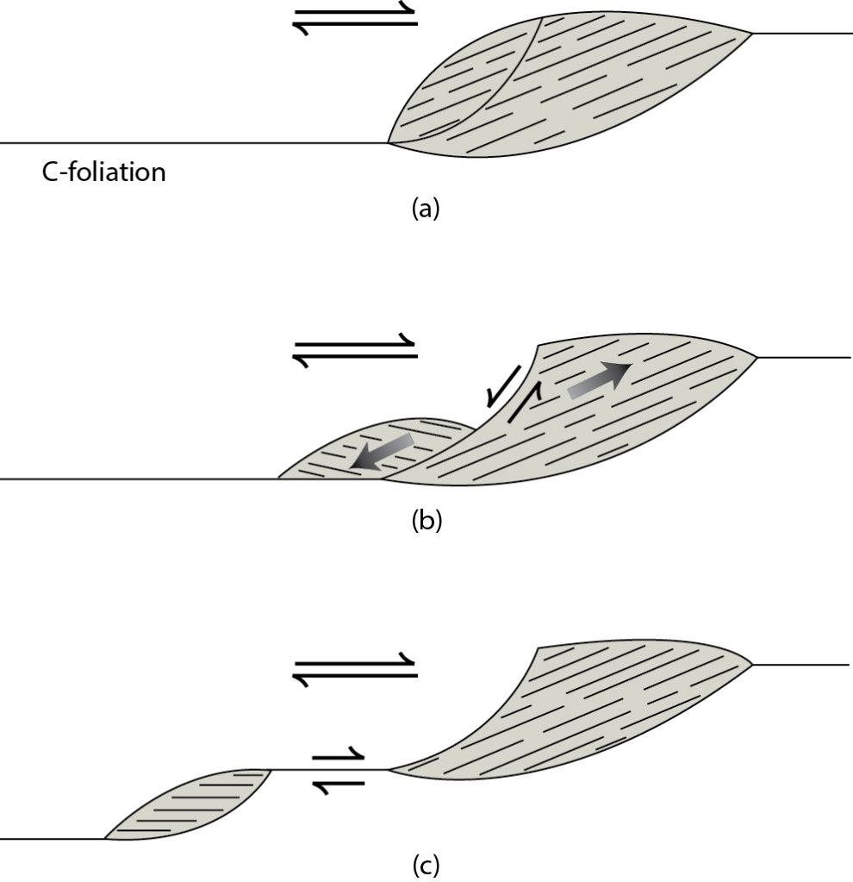
Shear-sense Indicators – Mica Fish
Notes:
F I G U R E 1 2 . 9 The formation of mica fish; (a) to (c) show successive stages in mica-fish development, with C-foliation marking the shear plane.

Slide 28
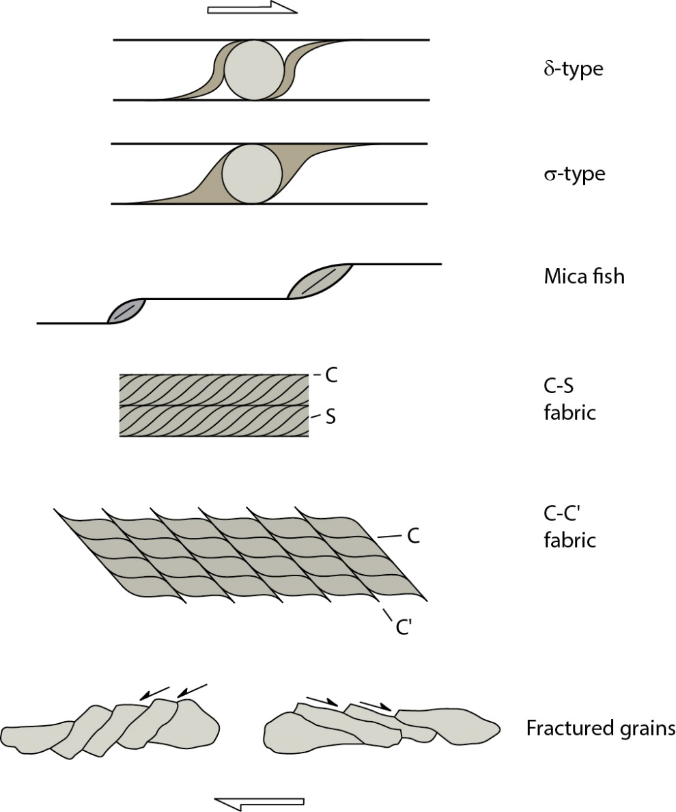
Shear-sense Indicators – Summary (right-lateral)
Dextral Shear
Notes:
F I G U R E 1 2 . 1 2 Summary diagram of shear-sense indicators in a dextral shear zone. A copy of this figure on a
transparency (for left- and right-lateral shear) makes a handy inclusion in your field notebook.

Slide 29
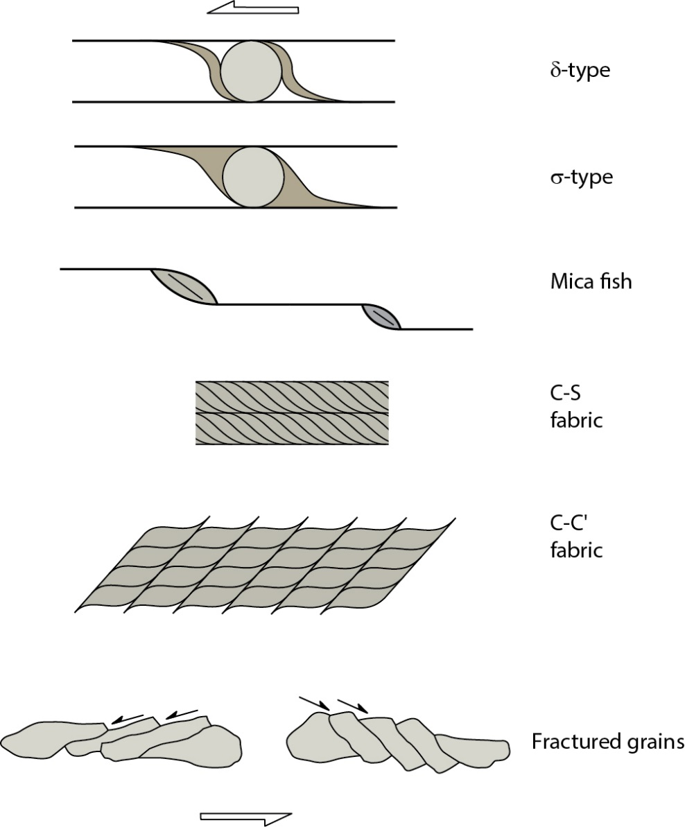
Shear-sense Indicators – Summary (left-lateral)
Dextral Shear Sinistral Shear
Notes:
F I G U R E 1 2 . 1 2 Summary diagram of shear-sense indicators in a dextral shear zone. A copy of this figure on a
transparency (for left- and right-lateral shear) makes a handy inclusion in your field notebook.

Slide 30
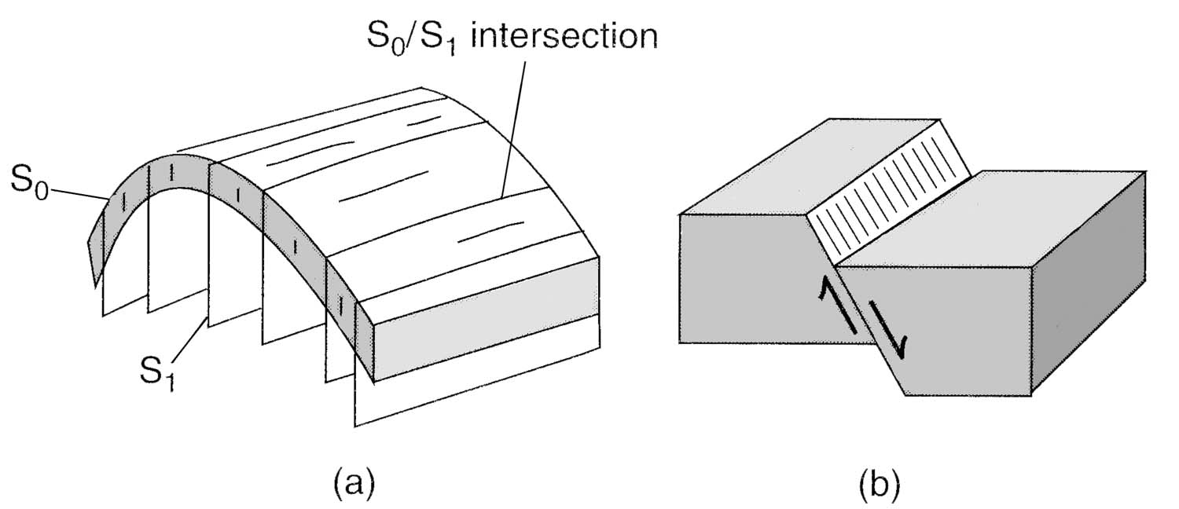
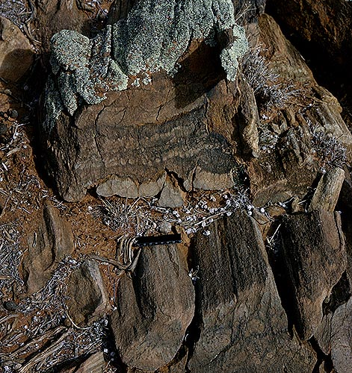
Surface and Mineral Lineations
Intersection lineation of bedding (S₀) and (axial plane) cleavage (S₁) in a fold
Slip lineation on a (normal) fault surface
Mineral lineation (hornblende)
(c)
Notes:
F I G U R E 1 1 . 2 7 Sketches of surface lineations. (a)
Intersection lineation of bedding (S0) and (axial plane) cleavage
(S1) in a fold, and (b) slip lineation on a (normal) fault surface.
64_241. Cleavage bedding lineation. Weekeroo, South Australia. [-32.058602,140.034027]; Jim Talbot
88_071. Lineation in hornblende schist. Holden Village, Lake Chelan, WA. [48.195919,-120.778384]; Jim Talbot

Slide 31
Surface and Mineral Lineations
Intersection lineation of bedding (S₀) and (axial plane) cleavage (S₁) in a fold
Friction: Slip lineation on a (normal) fault surface
Plasticity: Mineral lineation (hornblende)
(c)
Notes:
F I G U R E 1 1 . 2 7 Sketches of surface lineations. (a)
Intersection lineation of bedding (S0) and (axial plane) cleavage
(S1) in a fold, and (b) slip lineation on a (normal) fault surface.
64_241. Cleavage bedding lineation. Weekeroo, South Australia. [-32.058602,140.034027]; Jim Talbot
88_071. Lineation in hornblende schist. Holden Village, Lake Chelan, WA. [48.195919,-120.778384]; Jim Talbot

Slide 32
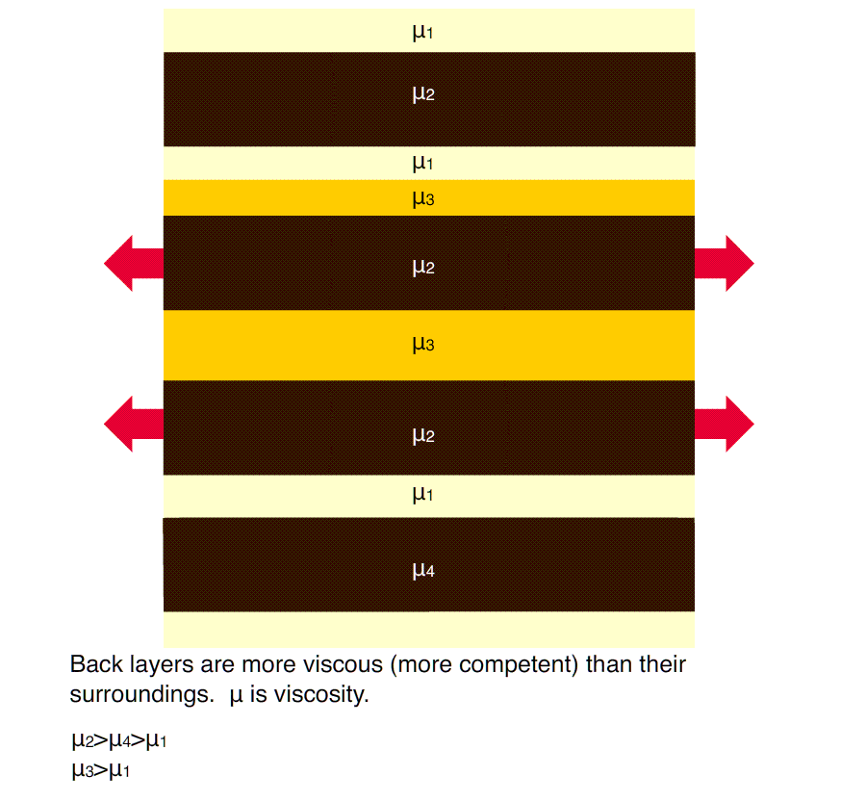
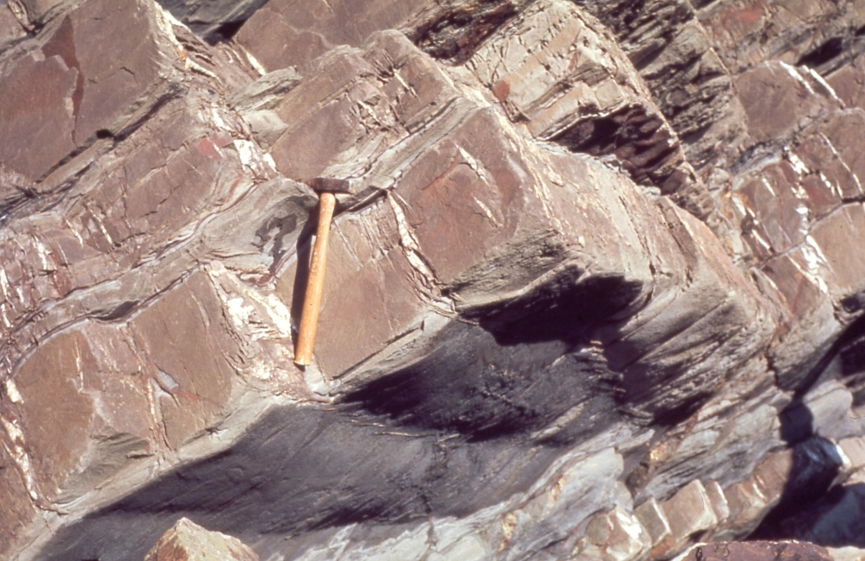
Extension: Boudinage
Boudinage and viscosity contrast:
μ₁ << μ₂
μ₁ ≤ μ₄
Viscosity:
μ = σ / ė (greater is ‘stickier’)
Foliation: veins
Lineation: ridges
Fossen, 2016

